Slide 1
Operating Systems
CMPSC 473
CPU Management
User-level Threads
September 24, 2015 – Lecture 10
Instructor: Diman Zad Tootaghaj
Adapted from slides by Dr. Bhuvan Urgaonkar
http://www.cse.psu.edu/~buu1/

Slide 2
Threads

Slide 3
Approach #1:
Multiple Cooperating Processes

Slide 4
E.g., MP Web browser
code
data
heap
code
data
heap
code
data
heap
code
data
heap
In virtual
memory
registers
stack
registers
stack
registers
stack
registers
stack
URL parsing process
Network sending process
Network reception process
Interprets response, composes media
together and displays on browser screen

Slide 5
E.g., MP Web browser
code
data
heap
code
data
heap
code
data
heap
code
data
heap
In virtual
memory
registers
stack
registers
stack
registers
stack
registers
stack
URL parsing process
Network sending process
Network reception process
Interprets response, composes media
together and displays on browser screen
Helps us understand “ease of design”
Processes employ IPC to share data and synchronization techniques to ensure correct sharing

Slide 6
Approach #1: Multiple Processes
code
data
heap
code
data
heap
code
data
heap
code
data
heap
In virtual
memory
registers
stack
registers
stack
registers
stack
registers
stack
URL parsing process
Network sending process
Network reception process
Interprets response, composes media
together and displays on browser screen
There’s something terribly wrong about this approach!

Slide 7
Approach #1: Multiple Processes
code
data
heap
code
data
heap
code
data
heap
code
data
heap
In virtual
memory
registers
stack
registers
stack
registers
stack
registers
stack
URL parsing process
Network sending process
Network reception process
Interprets response, composes media
together and displays on browser screen
Potentially, lot of redundancy in code, data, and heap segments!
  Virtual memory wastage => More contention for precious RAM => More waiting for slow swap device => Reduction in computer’s throughput
Also, TLB and cache contention between processes of same program
  TLB contention will become more clear when we study memory management

Slide 8
Approach #2: Share code, data, heap!
code
heap
data
registers
stack
registers
stack
registers
stack
registers
stack
threads
URL parsing process
Network sending process
Network reception process
Interprets response, composes media
together and displays on browser screen
Share code, data, heap via shared memory mechanisms
  Make them part of the same address space

Slide 9
(Old) Process Address Space
2^32-1
stack
SP
heap
data
code
PC
0

Slide 10
(New) Address Space with Threads
2^32-1
stack
SP for thread 1
SP for thread 2
SP for thread 3
heap
data
PC for thread 3
code
PC for thread 1
0
PC for thread 2
All threads in a process share the same address space

Slide 11
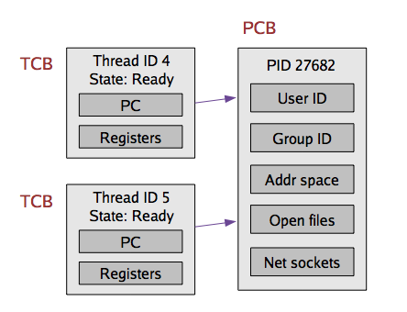
Implementing Threads
Given what we know about processes, implementing threads is “easy”
Idea: Break the PCB into two pieces:
  Thread-specific stuff: Processor state
  Process-specific state: Address space and OS resources (e.g., open files)

Slide 12
Thread Control Block (TCB)
TCB contains info on a single thread
  Thread id
  Scheduling state
  H/W context (registers)
  A pointer to corresponding PCB
PCB contains info on the containing process
  Address space and OS resources, but NO processor state!

Slide 13
Thread Control Block (TCB)
TCBs are smaller and cheaper than PCBs
  E.g., For some recent version of Linux:
    Linux TCB (thread_struct) has 24 fields
    Linux PCB (task_struct) has 106 fields

Slide 14
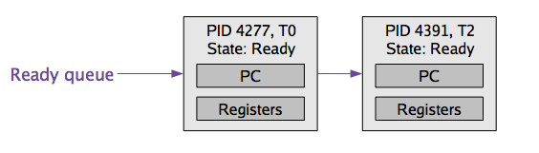
Context Switching
TCB is now the unit of a context switch
  Ready queue, wait queues, etc. now contain pointers to TCBs
  Context switch causes CPU state to be copied to/from the TCB
Context switch between two threads of the same process
  No need to change address space
    No TLB flush
Context switch between two threads of different processes
  Must change address space, possibly causing cache and TLB pollution

Slide 15
Implementing User-level Threads
It should be clear that we would need the following:
  UT.1: Scheduling and context switching code as part of process code
    E.g., a library that we link against our process
  UT.2: Room to store hardware context and stack for each thread in process’s own address space
  UT.3: Facility for this code to intervene execution of threads from time to time and run itself (analogous to timer interrupt handling by OS)
  UT.4: Ability to save/restore hw context (in user space)

Slide 16
Examples: #1, #2
2^32-1
Q: Where would the h/w context and stack for each thread be?
A: The process heap!
stack
Stack for P
Stack for T1
Stack for T2
heap
Stack for T3
TCBs for T1-T3
data
User-level threads library
Part of code segment
code
0

Slide 17
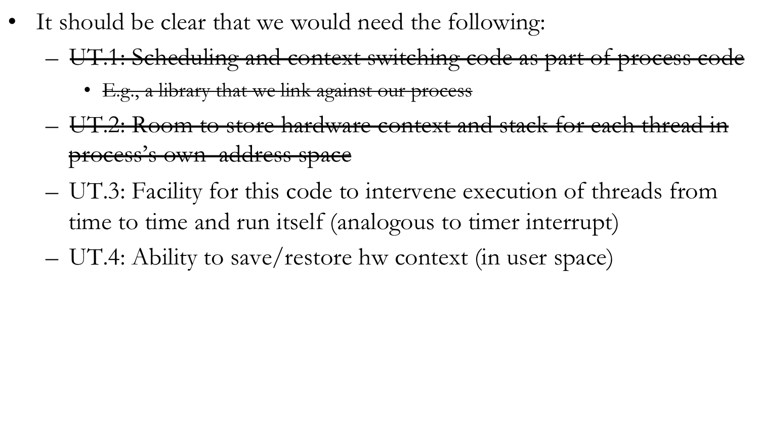
Implementing User-level Threads

Slide 18
UT.3: SIGALRM signal
UT.3: Facility for this code to intervene execution of threads from time to time and run itself (analogous to timer interrupt)
  Employ “virtual” interrupts a.k.a signals
    Request the OS to send periodic “alarm” signals to the process (SIGALRM)
  Implement a signal handler for SIGALRM (part of our code)
  Whenever the OS context switches this process in, if there is a signal pending, this handler would run before resuming execution
  This is our opportunity to run our scheduler/context switching code and pick a thread to run!

Slide 19
int main()
{
signal(SIGVTALRM, timer_handler);
struct itimerval tv;
tv.it_value.tv_sec = 2; //time of first timer
tv.it_value.tv_usec = 0; //time of first timer
tv.it_interval.tv_sec = 2; //time of all timers but the first
tv.it_interval.tv_usec = 0; //time of all timers but the first
setitimer(ITIMER_VIRTUAL, &tv, NULL);
for(; ;) {
if (gotit) {
printf("Got it!\n");
gotit = false;
}
}
return 0;
}
#include <setjmp.h>
#include <signal.h>
#include <string.h>
#include <unistd.h>
#include <sys/time.h>
bool gotit = false;
void timer_handler(int sig)
{
int ret_val;
gotit = true;
printf("Timer expired\n");
}

Slide 20
System calls related to signals
kill(signal_num, pid) - to send a signal
signal(signal_num, handler) - to handle it
  man pages recommend using sigaction(.), check this out for P1

Slide 21
Signal Handling (more)
When does a process handle a signal?
  Whenever it gets scheduled next after the generation of the signal
The OS marks some members of the PCB to indicate that a signal is due
  And we said the process will execute the signal handler when it gets scheduled
  But its PC had some other address!
    The address of the instruction the process was executing when it was scheduled last
  Complex task due to the need to juggle stacks carefully while switching between user and kernel mode

Slide 22
Signal Handling (more)
Remember that signal handlers are functions defined by processes and included in the user mode code segment
  Executed in user mode in the process’s context
The OS forces the handler’s starting address into the program counter
  The user mode stack is modified by the OS so that the process execution starts at the signal handler

Slide 23
User mode
Kernel mode
Normal flow
. . . (e.g., interrupt handling)
do_signal( )
handle_signal( )
setup_frame( )
Signal handler
Return code
on the stack
system_call( )
sys_sigreturn( )
restore_sigcontext( )
setup_frame: sets up the user-mode stack
  Forces Signal handler’s address into PC and some “return code”
  After the handler is done, this return code gets executed
    It makes a system call such as sigreturn (in Linux) that does the following:
      1. Restores signal pending info in the PCB for the process
      2. Restores the User mode stack to its original state
    When the system call terminates, the normal program execution can continue

Slide 24
Signal Masking
A process may request the OS that certain signals not be delivered to it
  Represented by a “signal mask” in the PCB
  Analog: the OS may interrupt certain interrupts
Interruptible vs non-interruptible interrupts and signals

Slide 25
Implementing User-level Threads
It should be clear that we would need the following:
  UT.1: Scheduling and context switching code as part of process code
    E.g., a library that we link against our process
  UT.2: Room to store hardware context and stack for each thread in process’s own address space
  UT.3: Facility for this code to intervene execution of threads from time to time and run itself (analogous to timer interrupt)
  UT.4: Ability to save/restore hw context and stack (in user space)

Slide 26
UT.4: User-level context switching
How to switch between user-level threads?
Need some way to swap CPU state
Fortunately, this does not require any privileged instructions
  So the threads library can use the same instructions as the OS to save or load the CPU state into the TCB
Typical C functions that offer this facility
  setjmp() and longjmp()
  sigsetjmp() and siglongjmp()
  setcontext(), getcontext(), makecontext(), swapcontext()

Slide 27
Interlude: setjmp() and longjmp()
In C, we can’t use the goto keyword to change execution to code outside the current funtion
setjmp() and longjmp() are C standard library routines that allow this
Useful for handling error conditions in deeply-nested function calls
Lets understand them first and then see how they can help realize user-level threads

Slide 28
setjmp() and longjmp()
int setjmp (jmp_buf env);
  Save current CPU state in the “jmp_buf” structure
void longjmp (jmp_buf env, int retval);
  Restore CPU state from “jmp_buf” structure, causing corresponding setjmp() call to return with return value “retval”
  Note: setjmp returns twice!
struct jmp_buf { … }
  Contains CPU specific fields for saving registers, PC.

Slide 29
Example 1: Basic Usage

Slide 30
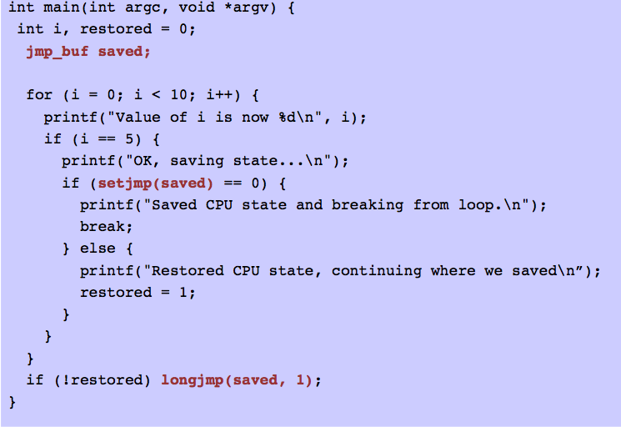

Slide 31
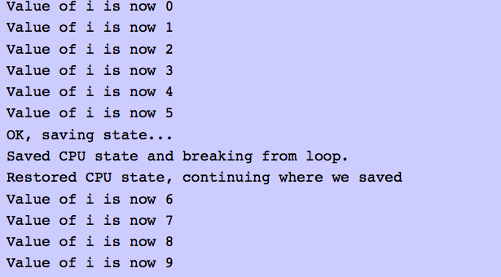
Example 1: Basic Usage

Slide 32
Quiz
Q1: Name two optimization goals (metrics) in designing a CPU scheduler and compare FCFS and SRTF with respect to these metrics.
Q2: Processes may be in one of 5 different states, can you name these states?
Q3: A process on an average runs for time T before blocking for I/O. A context switch takes time S which is effectively a waste (overhead). For round robin scheduling with quantum Q (S is not included in Q), give a formula for CPU efficiency for each of the following:
1) Q = S
2) Q >T
3) Q is nearly 0
Hint: CPU efficiency = (Useful CPU time)/(Total CPU time) =(Useful CPU time)/(Sum of CPU useful time and CPU overhead in switching processes).

