Slide 1
Operating Systems
CMPSC 473
Memory Virtualization
October 15, 2015 – Lecture 14
Instructor: Diman Zad Tootaghaj
Adapted from slides by Dr. Bhuvan Urgaonkar
http://www.cse.psu.edu/~buu1/

Slide 2
Exam format
Themes: Closed book closed note
  T1: Architecture basics, hardware support for OS
  T2: Processes, Threads, Scheduling
  T3: Memory management
Three kinds of questions
  True/False with one sentence explanation, multiple-choice: T1-T3
  Short answer questions: T1-T3
  Longer (design) questions: T2, T3

Slide 3
Sample Questions
True/False with one sentence explanation: T1-T3
  Que: A second trap can occur during the handling of an initial trap
  Answer: Yes, if an instruction belonging to the trap handler for the first trap causes a trap, e.g., a segmentation fault
  Que: If any scheduler within a hierarchy of schedulers is non-work conserving (NWC), the entire hierarchy is also NWC.
  Answer: False. Use a counter-example.
  Que: SJF offers better throughput than FCFS.
  Answer: False. Both offer the same throughput.
  Que: SRPT offers the same throughput as SJF. Assume that context switches take a finite, non-negligible amount of time.
  Answer: No. SRPT may cause more context switching than SJF, hence may lower throughput.

Slide 4
Sample Questions
True/False with one sentence explanation: T1-T3
  Que: The OS is made to reside in the address space of every process to allow improved usage of DRAM.
  Answer: False. This is done to reduce user/kernel switches from being as expensive as full context switches.

Slide 5
Sample Questions
Multiple-choice: T1-T3
  Que: Which of the following is essential to build a multi-programmed computer: (i) traps, (ii) interrupts, (iii) signals, (iv) TLB.
  Answer: (ii)
  Which of the following styles of writing a concurrent program causes the most use of kernel memory: (i) user-level threads, (ii) kernel-level threads, (iii) processes, (iv) all are the same

Slide 6
Sample Short and long-Answer Questions
Practice sets of angel
Quizes
Slides

Slide 7
Page Table Impl.
Page table is kept in main memory (usually)
Page-table base register (PTBR) points to the page table
Page-table length register (PRLR) indicates size of the page table
In this scheme every data/instruction access requires two memory accesses. One for the page table and one for the data/instruction.
The two memory access problem can be solved by the use of a special fast-lookup hardware cache called associative memory or translation look-aside buffers (TLBs)
Some TLBs store address-space identifiers (ASIDs) in each TLB entry – uniquely identifies each process to provide address-space protection for that process

Slide 8
TLB is Associative Memory
Associative memory – parallel search
Address translation (p, d)
  If p is in associative register, get frame # out
  Otherwise get frame # from page table in memory
Page #
Frame #

Slide 9

Paging Hardware With TLB

Slide 10
Effective Access Time
Associative Lookup =  time unit
Assume memory cycle time is 1 microsecond
Hit ratio – percentage of times that a page number is found in the associative registers; ratio related to number of associative registers
Hit ratio = 
Effective Access Time (EAT)
EAT = (1 + )  + (2 + )(1 – )
= 2 +  – 

Slide 11
Page Tables (contd.)
In addition to translations, page tables also store additional information about virtual pages
  Protection information
  Certain permissions
    E.g., read-only
  Address space identifiers (ASIDs) in some machines
The corresponding TLB is also designed to have room for these entries in the mappings it caches

Slide 12
TLB: A final note
Upon a context switch: to flush or not to flush?
  Flush: ASIDs not needed
  Not flush: ASIDs needed
Pros and cons of these options?

Slide 13
Memory Protection
Memory protection implemented by associating protection bit with each frame
Valid-invalid bit attached to each entry in the page table:
  “valid” indicates that the associated page is in the process’ logical address space, and is thus a legal page
  “invalid” indicates that the page is not in the process’ logical address space

Slide 14

Valid (v) or Invalid (i) Bit In A Page Table

Slide 15
Shared Pages
Shared code
  One copy of read-only (reentrant) code shared among processes (i.e., text editors, compilers, window systems).
  Shared code must appear in same location in the logical address space of all processes
Private code and data
  Each process keeps a separate copy of the code and data
  The pages for the private code and data can appear anywhere in the logical address space

Slide 16
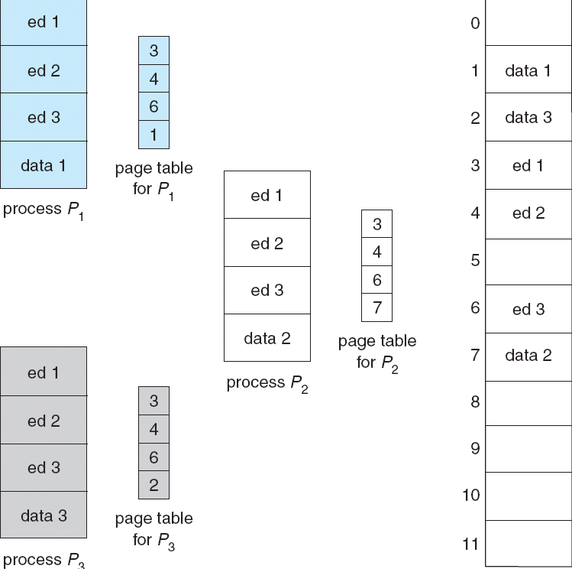
Shared Pages Example

Slide 17
Structure of the Page Table
Hierarchical Paging
Hashed Page Tables
Inverted Page Tables

Slide 18
Hierarchical Page Tables
Break up the logical address space into multiple page tables
Idea: Reduce the amount of memory needed to store the page table
A simple technique is a two-level page table

Slide 19

Two-Level Page-Table Scheme

Slide 20
Swapping
There may not be enough main memory to accommodate all pages needed by all processes
Idea: Virtualize main memory size
  i.e., Use a cheaper more abundant storage device to accommodate what does not fit in main memory
  Virtual memory size = Main memory size + Swap space
Typical swap device: disk (magnetic of flash)
  Slower than main memory!
Role of the OS: Transparently use the swap device to provide illusion of large memory

Slide 21
Page Fault
A page fault is a reference (via a load or a store) to a page currently not in DRAM
  The corresponding instruction is called a “faulting instruction”
When might a page fault occur?
  First reference to a page
    Exception: Pre-allocation of page; we will ignore this
    What must be done: new frame must be allocated and corresponding translation added to page table
  Page has been allocated but has been “swapped” out
    What must be done: page must be copied from swap device into a frame in DRAM and corresponding translation added to page table
  Some other situations like permissions – next lecture

Slide 22

Steps in Handling a Page Fault (Incomplete)
TTD: Introduce TLB and other data structures into this figure

Slide 23
Swapping and Page Faults
Some remarks and FFTs:
  Detection: who detects a page fault and how?
  The result of a page fault is a trap but one that is transparent to the process
    Why?
  The OS “page fault handler” executes upon the occurrence of a page fault
  Data structures of relevance
    The page table associated with the faulting process
    Free frames
    A data structure containing information about page layout on swap device
  Actions making up handling of a page fault must be “atomic”
    E.g., bringing in a page from swap device and updating page table and other data structures

Slide 24
Performance Impact of Page Faults
Page Fault Rate 0 <= p <= 1.0
  if p = 0 no page faults
  if p = 1, every reference is a fault
Effective Access Time (EAT)
EAT = (1 – p) x memory access
+ p (page fault overhead
+ swap page out
+ swap page in
+ restart overhead)

Slide 25
Example
Memory access time = 200 nanoseconds
Average page-fault service time = 8 milliseconds
EAT = (1 – p) x 200 + p (8 milliseconds)
= (1 – p x 200 + p x 8,000,000
= 200 + p x 7,999,800
If one access out of 1,000 causes a page fault, then
EAT = 8.2 microseconds.
This is a slowdown by a factor of 40!!

Slide 26
Techniques to overcome this slowdown
Increase DRAM size, increase DRAM and swap speed
Manage DRAM contents carefully to lower page fault rate
  Key difficulty: Uncertainty
    Recall CPU scheduling
  Key idea: Exploit principles of locality shown by process memory access patterns

Slide 27
Principles of Locality
Temporal: An item accessed now will be accessed with high probability in the near future
  Where does temporal locality come from?
  How might the OS exploit it?
Spatial: An access to a given virtual address implies nearby addresses will be accessed in the near future
  Where does spatial locality come from?
  How might the OS exploit it?
Value: Some values are very popular even across data items
  Where does value locality come from?
  How might the OS exploit it?

Slide 28
What should be held in DRAM?
How to decide what should be in DRAM?
  Reactive: demand paging
  Proactive: pre-fetching
We will be interested in demand paging
Correspondingly, we will be interested in exploiting temporal locality not spatial locality or value locality
  Will see some examples of exploiting spatial and value locality in later lectures

Slide 29
Demand Paging
Allocate a new page or fetch an existing page from swap on-demand
What happens if there is no empty frame in DRAM?
Must select a “victim” page to evict to swap device
The page replacement problem

Slide 30
Basic Page Replacement
1. Find the location of the desired page on swap
2. Find a free frame:
- If there is a free frame, use it
- If there is no free frame, use a page replacement algorithm to select a victim frame
3. Bring the desired page into the (newly) free frame; update the page table and free frame list
4. Restart the process

Slide 31

Page Replacement

Slide 32
Page Replacement Algorithms
Objective we will work with: Minimize page fault rate
Evaluate algorithm by running it on a particular string of memory references (reference string) and computing the number of page faults on that string
In all our examples, the reference string is
1, 2, 3, 4, 1, 2, 5, 1, 2, 3, 4, 5

Slide 33

Graph of Page Faults Versus The Number of Frames

Slide 34
First-In-First-Out (FIFO) Algorithm
Reference string: 1, 2, 3, 4, 1, 2, 5, 1, 2, 3, 4, 5
3 frames (3 pages can be in memory at a time per process)
1
1
4
5
2
2
1
3
9 page faults
3
3
2
4

Slide 35
First-In-First-Out (FIFO) Algorithm
Reference string: 1, 2, 3, 4, 1, 2, 5, 1, 2, 3, 4, 5
3 frames (3 pages can be in memory at a time per process)
4 frames
Belady’s Anomaly: more frames cause more page faults!!!
1
1
4
5
2
2
1
3
9 page faults
3
3
2
4
1
1
5
4
2
2
1
5
10 page faults
3
3
2
4
4
3

Slide 36

FIFO example: on your own

Slide 37

FIFO Illustrating Belady’s Anomaly

Slide 38
Optimal Algorithm
Replace page that will not be used for longest period of time
4 frames example
1, 2, 3, 4, 1, 2, 5, 1, 2, 3, 4, 5
What is the difficulty?
Used for measuring how well your algorithm performs
1
4
2
6 page faults
3
4
5

Slide 39

OPT example: on your own

Slide 40
How can we approximate optimal?
Recall temporal locality
Corollary: A page that has not been used for a long time will likely not be used for a long time
Heuristic called “Least Recently Used” (LRU)
  Evict the page that has not been accessed for the longest time

Slide 41
LRU Example
Reference string: 1, 2, 3, 4, 1, 2, 5, 1, 2, 3, 4, 5
1
1
1
1
5
2
2
2
2
2
3
5
5
4
4
4
4
3
3
3

Slide 42
Least Recently Used (LRU) Algorithm
Reference string: 1, 2, 3, 4, 1, 2, 5, 1, 2, 3, 4, 5
Counter implementation
  Every page entry has a counter; every time page is referenced through this entry, copy the clock into the counter
  When a page needs to be changed, look at the counters to determine which are to change
1
1
1
1
5
2
2
2
2
2
3
5
5
4
4
4
4
3
3
3

Slide 43

LRU Example: On your own

