Slide 1
Operating Systems
CMPSC 473
Process Synchronization
November 5, 2015 – Lecture 19
Instructor: Diman Zad Tootaghaj
Adapted from slides by Dr. Bhuvan Urgaonkar
http://www.cse.psu.edu/~buu1/

Slide 2
Process Synchronization

Slide 3
Recap
The mutual exclusion approach to addressing data races
Important to also ensure certain liveness conditions
“Mutex lock” or simply “lock”
  How to implement it?
  How to use it?

Slide 4
Mutual Exclusion Algorithms
A mutual exclusion algorithm specifies code for entry and exit sections to ensure:
  mutual exclusion: at most one process is in its critical section at any time, and
  some kind of "liveness" condition. There are three commonly considered ones…
Mutex = Mutual Exclusion + Liveness

Slide 5
E.g. #1: Shared Bank Account
lock mutex;
PROCESS 1 (wife’s transaction):
…
Withdraw (amt) {
Lock(mutex);
Bal -= amt;
Unlock(mutex);
return;
}_x001a_
PROCESS 2 (husband’s transaction):
…
Withdraw (amt) {
Lock(mutex);
Bal -= amt;
Unlock(mutex);
return;
}_x001a_

Slide 6
E.g. #2: Producer and Consumer
lock mutex;
while (true) {
while (count == 0); // do nothing
nextConsumed = buffer[out];
out = (out + 1) % BUFFER_SIZE;
lock(mutex);
count--;
unlock(mutex);
/* consume the item in nextConsumed
}
while (true) {
/* produce an item and put in nextProduced */
while (count == BUFFER_SIZE); // do nothing
buffer [in] = nextProduced;
in = (in + 1) % BUFFER_SIZE;
lock(mutex);
count++;
unlock(mutex);
}
Shared variables: buffer, count, and mutex
  New shared variable mutex used only by entry/exit sections after being initialized
Local variables: in, out, nextProduced, nextConsumed

Slide 7
Hardware Support for Mutex
Many systems provide hardware support for critical section code
Uniprocessors – could disable interrupts
  Currently running code would execute without preemption
  Generally too inefficient on multiprocessor systems
    Operating systems using this not broadly scalable
Modern machines provide special atomic hardware instructions
  Either test memory word and set value
  Or swap contents of two memory words

Slide 8
Mutex Via Disabling Interrupts
One way to achieve mutex is to disable interrupts when someone is in their critical section
  Why does this work? Extensively used inside the kernel
    Very efficient
  Downsides?
    What if a trap occurs with interrupts disabled?
    What if certain interrupts are non-maskable?
  How would you adopt this to design a mutex lock in your threads library
    Hint: Disable signals

Slide 9
TestAndndSet Instruction
Definition:
boolean TestAndSet (boolean *target)
{
boolean rv = *target;
*target = TRUE;
return rv:
}

Slide 10
Mutex lock using TestAndSet
Shared boolean variable lock, initialized to false
Solution:
while (true) {
while ( TestAndSet (&lock )); /* do nothing
// critical section
lock = FALSE;
// remainder section
}

Slide 11
Swap Instruction
Definition:
void Swap (boolean *a, boolean *b)
{
boolean temp = *a;
*a = *b;
*b = temp:
}

Slide 12
Mutex lock using Swap
Shared Boolean variable lock initialized to FALSE; Each process
has a local Boolean variable key.
Solution:
while (true) {
key = TRUE;
while ( key == TRUE)
Swap (&lock, &key );
// critical section
lock = FALSE;
// remainder section
}

Slide 13
E.g. #3: Signaling
PROCESS A:
A1 // one or more statements
a // single statement
A2 // one or more statements
PROCESS B:
B1 // one or more statements
b // single statement
B2 // one or more statements
Any interleaving is OK as long as “a” is executed before “b”
How to achieve this?

Slide 14
E.g. #3: Signaling (Lock using test&set)
BOOL m = FALSE;
PROCESS A:
A1 // one or more statements
a // single statement
m = false;
A2 // one or more statements
PROCESS B:
B1 // one or more statements
while(test&set(&m));
b // single statement
B2 // one or more statements
Lock(m);
Unlock(m);
Notice that how m is initialized of m is crucial

Slide 15
E.g. #3: Signaling (Lock using Peterson’s)
m = {turn, flag}
turn = A;
Flag[A] = TRUE;
Flag[B} = FALSE;
PROCESS A:
A1 // one or more statements
a // single statement
flag[A] = FALSE;
A2 // one or more statements
PROCESS B:
B1 // one or more statements
flag[B] = TRUE;
turn = A;
while (flag[A] && turn == A);
b // single statement
B2 // one or more statements
Lock(m);
Unlock(m);
Notice that how flag and turn are initialized is crucial

Slide 16
Problems with Locks
#1: For certain synchronization problems, using locks can be “clumsy”
#2: Can cause wastage (since they cause “busy wait” or “polling”)
#3: Can be harder to debug
We will focus mostly on #2, a bit on #1

Slide 17
Problems with Locks
#1: For certain synchronization problems, using locks can be “clumsy”
  E.g., how would you solve signaling using locks if you are not able to initialize it in ways shown in last two examples?

Slide 18
E.g. #3: Signaling (General Lock )
lock m;
PROCESS A:
A1 // one or more statements
a // single statement
Unlock(m);
A2 // one or more statements
PROCESS B:
B1 // one or more statements
Lock(m);
b // single statement
B2 // one or more statements
What happens here?? Depends. E.g., with pthreads:
  If the mutex type is PTHREAD_MUTEX_DEFAULT, attempting to recursively lock the mutex results in undefined behavior
  Attempting to unlock the mutex if it was not locked by the calling thread results in undefined behavior
  Attempting to unlock the mutex if it is not locked results in undefined behavior

Slide 19
Problems with Locks
#2: Mutex locks waste CPU cycles via busy wait
  If one thread has acquired the lock, others interested in acquiring keep “spinning” on the lock, i.e., polling its value
  Therefore, also called spin locks
Alternative to polling: event notification
  Related remarks:
    Polling vs. event notification is an important trade-off in other contexts as well (e.g., IO management)
    Interestingly, in uPs, polling may be preferable to event notification. Why? Hint: Compare context switch overhead with size of critical section; what is critical section is smaller?

Slide 20
Event Notification: Idea
Don’t make a thread (T1) poll the status of a lock if another (T2) is in its critical section
Instead,
  Allow T1 to indicate that it is interested in entering its critical section
  Allow T2 to indicate when it is done with its critical section
  Ensure that T2’s “signal” is conveyed to T1

Slide 21
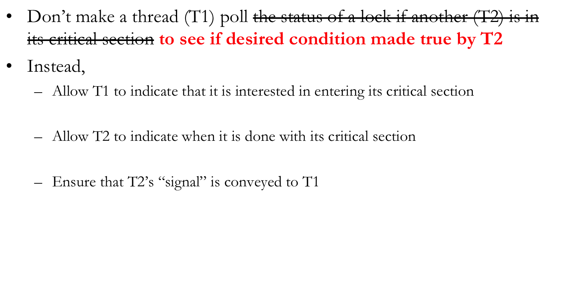
Event Notification: Idea

Slide 22
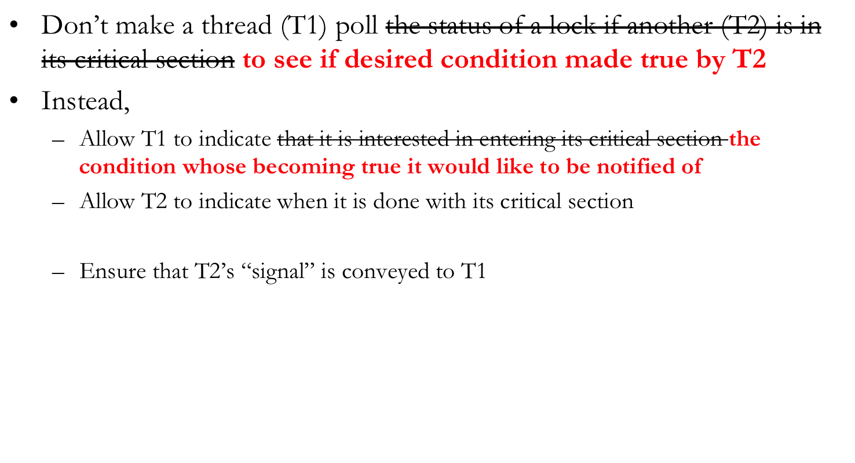
Event Notification: Idea

Slide 23
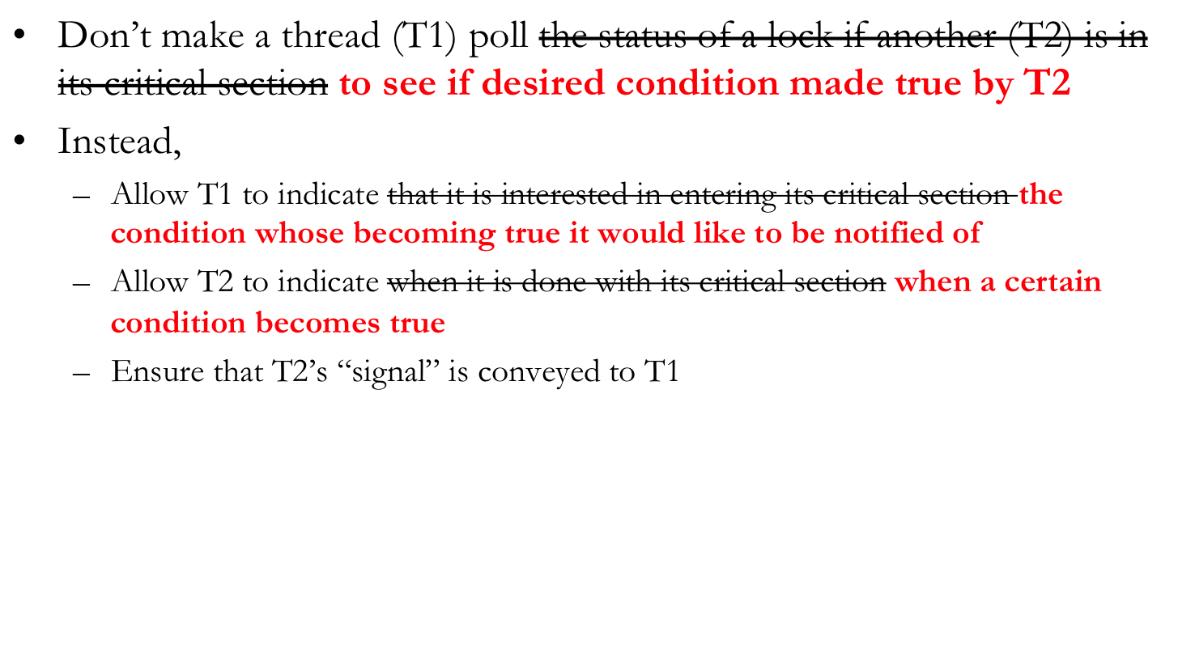
Event Notification: Idea

Slide 24
Condition Variables
Wait operation
  When a thread executes a wait call on a condition variable, it is immediately suspended
    It is now is waiting for the event that is represented by the condition variable to occur
Signal operation
  Eventually, a thread will cause the event to occur after which it will call the signal method on the corresponding condition variable
    If there are threads waiting on the signaled condition variable, the “monitor” will allow one of the waiting threads to resume its execution
    If there is no waiting thread on the signaled condition variable, this signal is lost as if it never occured

Slide 25
E.g. #3: Signaling (CVs )
cond_t a_done;
PROCESS A:
A1 // one or more statements
a // single statement
signal (a_done);
A2 // one or more statements
PROCESS B:
B1 // one or more statements
wait (a_done);
b // single statement
B2 // one or more statements

Slide 26
cond_t not_full, not_empty;
int count == 0;
Produce() {
if (count == N) wait (not_full);
… ADD TO BUFFER, count++ …
signal (not_empty);
}
Consume() {
if (count == 0) wait (not_empty);
… REMOVE FROM BUFFER, count-- …
signal (not_full);
}
What is wrong?
Notes:
The checking of a condition followed by a wait/signal should be done atomically. Note that signals can be lost. Q: Does this problem go away with semaphores?

Slide 27
cond_t not_full, not_empty;
mutex_lock m;
int count == 0;
Produce() {
mutex_lock (m);
if (count == N) wait (not_full,m);
… ADD TO BUFFER, count++ …
signal (not_empty);
mutex_unlock (m);
}
Consume() {
mutex_lock (m);
if (count == 0) wait (not_empty,m);
… REMOVE FROM BUFFER, count-- …
signal (not_full);
mutex_unlock (m);
}
NOTE: You can improve this code for more concurrency!

Slide 28
Busy Wait using Condition Variables
Have we completely eliminated the busy waiting that locks caused?

Slide 29
Busy waiting outside the critical section here, but could be inside a critical section also
Exercise: think of such a scenario on your own)
mutex_lock m;
int count == 0;
Produce() {
while (count == N);
… ADD TO BUFFER …
mutex_lock(m);
count++;
mutex_unlock (m);
}
Consume() {
while (count == 0);
… REMOVE FROM BUFFER …
mutex_lock(m);
count--;
mutex_unlock (m);
}
cond_t not_full, not_empty;
mutex_lock m;
int count == 0;
Produce() {
mutex_lock (m);
if (count == N) wait (not_full,m);
… ADD TO BUFFER, count++ …
signal (not_empty);
mutex_unlock (m);
}
Consume() {
mutex_lock (m);
if (count == 0) wait (not_empty,m);
… REMOVE FROM BUFFER, count-- …
signal (not_full);
mutex_unlock (m);
}

Slide 30
Condition Variables
pthreads functions/data struct
  pthread_cond_t condition = PTHREAD_COND_INITIALIZER; or
  pthread_cont_init (condition, attr)
  pthread_cond_wait (condition, mutex)
  pthread_cond_signal (condition)

Slide 31
When CVs are not adequate
Signal operations on CVs can be “lost”
  If there isn’t a thread doing a wait() when a thread calls signal(), the signal() is forgotten
Sometimes there is a need to remember all signal operations
Semaphores offer such “memory”
  Roughly: Semaphores = Integer + Signal/Wait, where the integer counts #signals - #waits

Slide 32
E.g. #3: Signaling (CVs )
cond_t a_done;
PROCESS A:
A1 // one or more statements
a // single statement
signal (a_done);
A2 // one or more statements
PROCESS B:
B1 // one or more statements
wait (a_done);
b // single statement
B2 // one or more statements
This solution actually isn’t correct. Can you spot a potential
problem due to a lost signal?
What happens if A executes signal (a_done) before B
executes wait (a_done)?

Slide 33
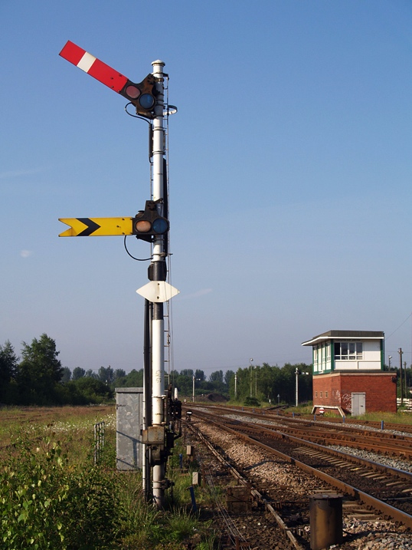
Semaphores (Dijkstra)
ACK: Lot of material borrowed from “The Little Book of Semaphores” by Allen B. Downey
  Available online (free) at:
  http://www.greenteapress.com/semaphores/

Slide 34
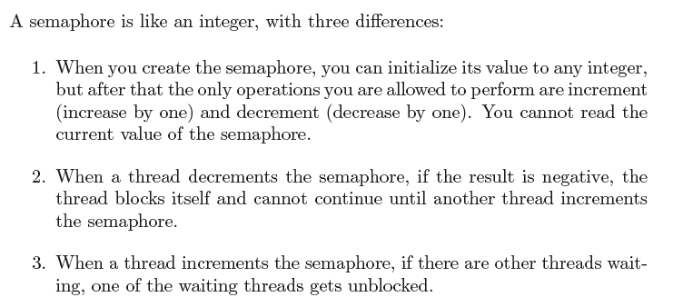
Semaphores Definition (Dijkstra)

