Slide 1
Operating Systems
CMPSC 473
Conclusion
December 8, 2015 – Lecture 26
Instructor: Diman Zad Tootaghaj
Adapted from slides by Dr. Bhuvan Urgaonkar
http://www.cse.psu.edu/~buu1/

Slide 2
Today’s Agenda
Finish remaining file system topics
  Some material for you to read on your own
What happens during bootup?
What happens during process creation and loading?
What we couldn’t cover (possible topics to explore on your own)
Tips for final exam
Finally, consider taking CSE 511 for more advanced material on synchronization, uP OS design, distributed system design, file systems, full machine virtualization, etc.

Slide 3
Remaining FS topics

Slide 4
Allocation Methods
An allocation method refers to how disk blocks are allocated for files:
Contiguous allocation
Linked allocation
Indexed allocation

Slide 5
Contiguous Allocation
Each file occupies a set of contiguous blocks on the disk
Simple – only starting location (block #) and length (number of blocks) are required
Wasteful of space (dynamic storage-allocation problem)
Files cannot grow

Slide 6

Contiguous Allocation of Disk Space

Slide 7
Linked Allocation
Each file is a linked list of disk blocks: blocks may be scattered anywhere on the disk.
block =
pointer

Slide 8
Linked Allocation (Cont.)
Simple – need only starting address
Free-space management system – no waste of space
Mapping
Q
LA/508
R
  Block to be accessed is the Qth block in the linked chain of blocks representing the file.
  Displacement into block = R + 4
File-allocation table (FAT) – disk-space allocation used by MS-DOS and OS/2.

Slide 9

Linked Allocation

Slide 10

File-Allocation Table

Slide 11
Indexed Allocation
Brings all pointers together into the index block.
Logical view:
index table

Slide 12

Example of Indexed Allocation

Slide 13
Indexed Allocation (Cont.)
Need index table
Random access
Dynamic access without external fragmentation, but have overhead of index block.
Mapping from logical to physical in a file of maximum size of 256K words and block size of 512 words. We need only 1 block for index table.
Q
LA/512
R
Q = displacement into index table
R = displacement into block

Slide 14
Indexed Allocation – Mapping (Cont.)
Mapping from logical to physical in a file of unbounded length (block size of 512 words).
Linked scheme – Link blocks of index table (no limit on size).
Q₁
LA / (512 x 508)
R₁
  Q₁ = block of index table
  R₁ is used as follows:
Q₂
R₁ / 512
R₂
  Q₂ = displacement into block of index table
  R₂ displacement into block of file:

Slide 15
Indexed Allocation – Mapping (Cont.)
Two-level index (maximum file size is 512³)
Q₁
LA / (512 x 512)
R₁
  Q₁ = displacement into outer-index
  R₁ is used as follows:
Q₂
R₁ / 512
R₂
  Q₂ = displacement into block of index table
  R₂ displacement into block of file

Slide 16
Indexed Allocation – Mapping (Cont.)

outer-index
index table
file

Slide 17

Combined Scheme: UNIX (4K bytes per block)

Slide 18
Free-Space Management
Bit vector (n blocks)
0
1
2
n-1
…
0 ⇒ block[i] free
1 ⇒ block[i] occupied
bit[i] =

Block number calculation
(number of bits per word) *
(number of 0-value words) +
offset of first 1 bit

Slide 19
Free-Space Management (Cont.)
Bit map requires extra space
  Example:
block size = 2¹² bytes
disk size = 2³⁰ bytes (1 gigabyte)
n = 2³⁰/2¹² = 2¹⁸ bits (or 32K bytes)
Easy to get contiguous files
Linked list (free list)
  Cannot get contiguous space easily
  No waste of space

Slide 20

Linked Free Space List on Disk

Slide 21
Bootup: A Very Simplified View
What happens between powering on a computer and when it is ready to run processes?
  Emphasis on aspects we have encountered in this course

Slide 22
Bootup: A Very Simplified View
Some code needs to be executed to load the OS itself and start its execution
  Need a persistent memory to store these instructions: often a ROM of some kind
  CPU to be designed to start executing certain instructions: often a special chip called the BIOS (Basic Input/Output Services)
BIOS runs code whose result is to load a special program called the Boot Loader into main memory which is what the CPU executes
  Boot Loader looks at certain devices in a pre-specified order

Slide 23
Bootup: A Very Simplified View
Meanwhile, other elements on the motherboard run their own firmware that initializes certain aspects
  E.g., DRAM becomes ready to communicate with CPU
Some things the OS does that we have encountered:
  Probes and detects how much DRAM, configures the MMU to set aside part of virtual address space and DRAM that would “belong” to the OS, provides it the address of OS page table
  Probes for IO devices (e.g., monitor, keyboard, disk, NIC), configures parameters relevant to interrupt handling for each
    E.g, which set of pins/values will be interpreted as the timer interrupt, how often should the timer interrupt the CPU?
  Initializes trap handling
    Which trap handler to execute upon the occurrence of each trap
Starts off the first process (Process 0)
  Special process that is always on, all other process created via fork()

Slide 24
Creating Processes
fork ()
Take 1: Used in older kernels
  Create a copy of the entire address space of the parent
  Create a new PCB for the new process
  Update parent, children, sibling pointers
  Place the new process in the ready queue
S . L . O . W .

Slide 25
RAM
Id=2000
State=ready
Id=2001
OS
State=ready
1. PCB with new
id created
PCB of parent
PCB of child
2. Memory allocated for child
Initialized by copying over
from the parent
Process
calls fork
3. If parent had called wait,
it is moved to a waiting queue
4. If child had called exec,
its memory overwritten
with new code & data
Processes
Parent’s memory
Child’s memory
5. Child added to ready queue,
all set to go now!

Slide 26
Creating Processes
fork ()
Problems with Take 1
  Child rarely needs to read/modify ALL the resources inherited from the parent
  Often, it immediately issues an execve() rendering all the effort that went into copying the address space useless!

Slide 27

Creating Processes: COW
fork ()
What modern kernels do to avoid this waste of precious CPU time
  Use Copy-On-Write
  Basic idea: Postpone work
  till the last minute
  Sounds familiar?
  Think assignments, quizzes, …

Slide 28
What we couldn’t cover
Synchronization
  Monitors: read from text
  Transactions: consider taking CSE 511
IO management
  Network IO: Consider taking a networking class
  File systems: Consistency and reliability issues, alternative file system designs especially log-structured file systems: read on your own from text and/or consider taking CSE 511

Slide 29
Final Exam Practice Questions
Short Answer
1- What is the difference between a user-level instruction and a privileged instruction?
Answer: privileged instruction can only be invoked when the hardware is running in privileged (a.k.a. kernel) mode. Examples of privileged instructions include those that move data in and out of protected device registers.
2- Define spatial locality and temporal locality.
Answer: Spatial locality means the access to a data item makes near-future accesses to spatially nearby data items more likely. Temporal locality means the access to a data item makes another access to the same data item in the near future more likely.

Slide 30
Final Exam Practice Questions
3- Consider a lottery scheduler. Consider two processes P1 and P2 with weights of 1 and 2, respectively. What is the probability of seeing P1 run in at most three quanta out of five successive quanta?
Answer: C(5,3)*(1/3)^3*(2/3)^2+C(5,2*)(1/3)^2*(2/3)^3+C(5,1)(1/3)*(2/3)^4 + (2/3)^5
4- Consider three concurrent processes consisting of a, b, and c instructions, respectively. Within each process’ execution, its instructions simply execute serially, i.e., in program order with no jumps. How many unique interleavings of these instructions are possible? Ignore the instructions associated with context switching or the scheduler itself.

Slide 31
Final Exam Practice Questions
Process Scheduling:
Answer: (a+b+c)!/((a!)*(b!)*(c!))

Slide 32
Final Exam Practice Questions
5- Which of the following components of program state are shared across threads in a multithreaded process?
Register values
Heap memory
Global Variables
Stack Memory

Slide 33
Final Exam Practice Questions
Multi-threaded process
  Heap memory and global variables are shared across threads
  Stack memory and register values are private to each thread – represents context of the thread

Slide 34
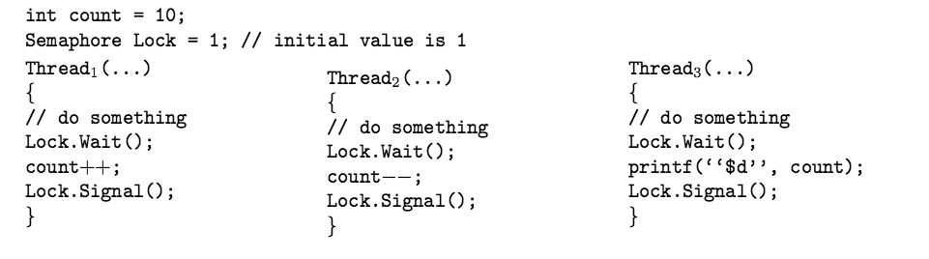
Final Exam Practice Questions
Synchronization
6- Suppose a program has three threads Thread1, Thread2, and Thread3, and a shared counter, count, as shown below:
A) What are the possible outputs of this program? Hint: there is more than one answer, and you must provide them all.
Answer: 9, 10, 11

Slide 35
Final Exam Practice Questions
Synchronization
7-Threads T1 and T2 are both concurrently executing the following code (given below for each), on a single CPU system, Each of x1 ... x9, and y1 ... y9 is a machine instruction. P() and V() are wait and signal operations on the same semaphore which has been initialized to 0, and ASSUME THAT THEY BOTH ARE SOMEHOW IMPLEMENTED AS A SINGLE MACHINE INSTRUCTION for answering this question. How many possible executions (interleavings of the completions of these instructions) could you potentially have if context switching could happen at any time?

Slide 36
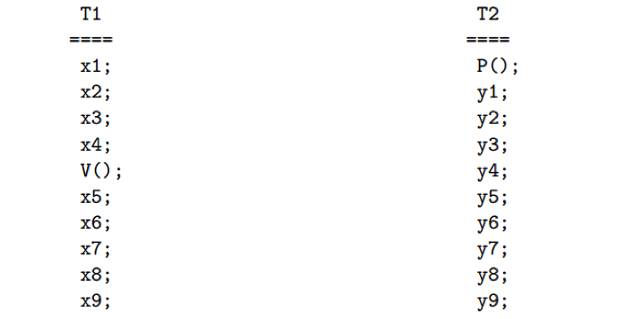
Final Exam Practice Questions
Synchronization

Slide 37
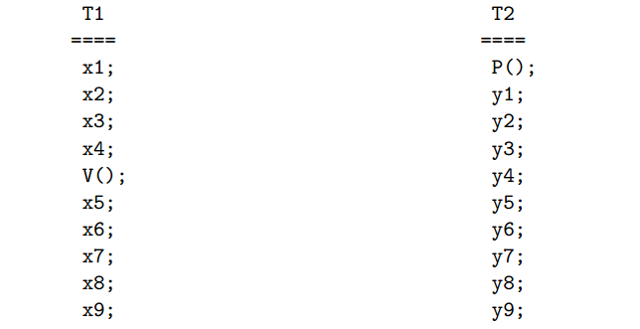
Final Exam Practice Questions
1
10
5
Note the x1...x4 and V() from T1 all have to complete before P() of T2.
Hence, all these 5 instructions will have to come first in all possible inter-leavings.
This leaves 5 instructions of T1 (x5 ... x9) to possibly interleave with all 10 instructions of T2.
Consequently, there could be (5 + 10)! / 5! * 10!, i.e. 15!/(5!*10!) total possible executions.

Slide 38
Final Exam Practice Questions
8- The program shown in the figure uses the Pthread API. What would be the output from the program for each printf?

Slide 39
Final Exam Practice Questions
int value = 0;
void *runner(void* param);
int main()
{
pthread_t tid;
pid = fork();
if(pid==0)
{
pthread_create(&tid, NULL, runner, NULL);
pthread_join(tid, NULL);
printf("CHILD: value =%d", value);
}
else if(pid>0)
wait(NULL); printf("PARENT: value =%d", value);
}
void *runner(void *param)
{
value=5;
pthread_exit(0);
}
value = 5
value = 0
Notes:
The fork() function does not return two values. What it does is return a single value, the way all functions do, but it returns twice.
Once within the parent process and once within the child. The parent process gets the child's process ID returned to it, the child gets 0 - an invalid process ID, so the code can tell it is the child.

Slide 40
Final Exam Practice Questions
Synchronization
9-mplement a version of the single producer, single consumer problem with the following idiosyncrasies:
(a) Let N>3 denote the size of the shared buffer.
(b) The producer always produces 2 items together whenever it is ready to do so.
(c) The consumer always consumes 3 items together whenever it is ready to do so.
Discuss any liveness related properties or problems that might arise.

Slide 41
Final Exam Practice Questions
Answer: Psuedocode solution using semaphores and a circular buffer of size N:
Semaphore isFull = N; Semaphore isEmpty = 0; Lock m;
Producer: while(true) {
...produce 2 items ...
wait(isFull);
wait(isFull);
Lock(m);
add 2 items to buffer
unlock(m);
signal(isEmpty);
signal(isEmpty); }

Slide 42
Final Exam Practice Questions
Answer:
Consumer: while(true) {
wait(isEmpty);
wait(isEmpty);
wait(isEmpty);
lock(m);
remove 3 items from buffer
unlock(m);
signal(isFull);
signal(isFull);
signal(isFull); }

Slide 43
Final Exam Practice Questions
Answer: Liveness: with a bounded buffer no one will starve.

Slide 44
Final Exam Practice Questions
Q1: Consider a demand-paging system with the following time-measured utilizations: CPU util = 20%, Paging disk (swap device) = 97.7%, Other I/O devices = 5%. For each of the following, say whether it will (or is likely to) improve CPU utilization. Explain your answer.
  Install a faster CPU
  Install a bigger swap device
  Increase the degree of multi-programming
  Decrease the degree of multi-programming
  Install more main memory
  Install a faster hard disk (on which the swapping device resides)
  Increase the page size

Slide 45
Final Exam Practice Questions
Q3: Consider a system with the following #memory refs vs. LRU queue position curve
If the following two computers cost the same, which would you buy
1. CPU = 1GHz, RAM = 600pages
2. CPU = 2GHz, RAM = 400pages
Assume 80% of instructions are CPU instructions and 20% of instructions are load/store instructions.
Assume memory access time of 100 cycles and swap access time of 100,000 cycles. Ignore memory needed to store page tables, ignore the TLB.
1000
0
1000

