Slide 1
Operating Systems
CMPSC 473
CPU Management
User-level Threads
September 22, 2015 – Lecture 9
Instructor: Diman Zad Tootaghaj
Adapted from slides by Dr. Bhuvan Urgaonkar
http://www.cse.psu.edu/~buu1/

Slide 2
Threads

Slide 3
An Interlude
Lets come back to our discussion on CPU scheduling after learning about the notion of threads in this lecture
  Understanding the notion of threads is important for working on project 1

Slide 4
Flow of Ideas in this Segment
We often want to write concurrent programs
  Consisting of multiple “flows of execution” each with its own register file and stack
Concurrent programming needs facilities for (i) data sharing and (ii) synchronization
One way to write concurrent programs is by employing multiple processes
However, processes can pose excessive overheads
Threads are a more efficient alternative to processes for concurrent programming and we will study how the OS provides this abstraction

Slide 5
Why Concurrent Programs?
Many programs need to do multiple activities simultaneously
Performance: Often speedup likely if we use multiple processes, one for each activity
  Exploiting multiple CPUs
  Better interleaving of CPU and IO
Ease of design: Often easier to write code for each “activity” as a separate process

Slide 6
Introduction to Concurrent Programming
Lets get a taste for concurrent programming by considering a simple parallel program
  Exercise: Write a concurrent program for mergesort
Our eventual goal: To understand the OS role in allowing/enabling concurrent programming

Slide 7
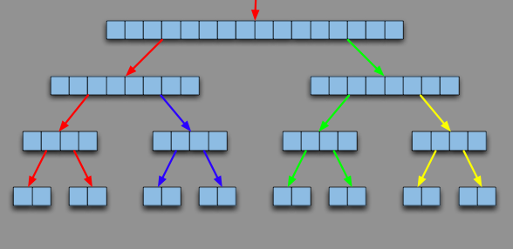
Parallel Mergesort
The four colors correspond to four different processes cooperating with each other

Slide 8
Parallel Mergesort: How?
What would the processes need from the OS?
  #1: Some way of sharing data across address spaces
  #2: Mechanisms to ensure that processes modify and use these shared data correctly

Slide 9
Parallel Mergesort: How? (2)
#1: Some way of sharing data across address spaces
  Two generic ways (revise on your own from 311)
    Shared Memory: OS ensures some portions of address spaces are shared
      e.g., pipes or shmget (UNIX)
    Message Passing: Sender process copies data to OS address space (via a system call), which then copies it to the recipient process address space
      e.g., signals, messages over sockets

Slide 10
Parallel Mergesort: How? (3)
#2: Mechanisms to ensure that processes modify and use these shared data correctly
  Similar to the register sharing problem (remember it?)
  We will study this in a few lectures: process synchronization

Slide 11
Parallel Mergesort: Why?
Why would you do such a thing?
  Is this faster than “serial” (single process) mergesort? When?
Clearly, likely to benefit from multiple CPUs
  E.g., each process could run on a separate CPU
Even if only single CPU (as in this course), might improve CPU utilization
  E.g., when process 1 is blocked on IO, process 2 might be able to run contributing to progress of the overall program

Slide 12
Concurrent Programs
Many programs need to do multiple activities simultaneously
Consider some activities a Web browser program needs to do
    Parse requested URL and find IP address from DNS server
    Use system calls to send request to some Web server
    Receive response
    Assemble response and display it
Performance: Often speedup likely if we use multiple processes, one for each activity
Ease of design: Often easier to write code for each “activity” as a separate process

Slide 13
Approach #1:
Multiple Cooperating Processes

Slide 14
E.g., MP Web browser
code
data
heap
code
data
heap
code
data
heap
code
data
heap
In virtual
memory
registers
stack
registers
stack
registers
stack
registers
stack
URL parsing process
Network sending process
Network reception process
Interprets response, composes media
together and displays on browser screen

Slide 15
E.g., MP Web browser
code
data
heap
code
data
heap
code
data
heap
code
data
heap
In virtual
memory
registers
stack
registers
stack
registers
stack
registers
stack
URL parsing process
Network sending process
Network reception process
Interprets response, composes media
together and displays on browser screen
Helps us understand “ease of design”
Processes employ IPC to share data and synchronization techniques to ensure correct sharing

Slide 16
Approach #1: Multiple Processes
code
data
heap
code
data
heap
code
data
heap
code
data
heap
In virtual
memory
registers
stack
registers
stack
registers
stack
registers
stack
URL parsing process
Network sending process
Network reception process
Interprets response, composes media
together and displays on browser screen
There’s something terribly wrong about this approach!

Slide 17
Approach #1: Multiple Processes
code
data
heap
code
data
heap
code
data
heap
code
data
heap
In virtual
memory
registers
stack
registers
stack
registers
stack
registers
stack
URL parsing process
Network sending process
Network reception process
Interprets response, composes media
together and displays on browser screen
Potentially, lot of redundancy in code, data, and heap segments!
  Virtual memory wastage => More contention for precious RAM => More waiting for slow swap device => Reduction in computer’s throughput
Also, TLB and cache contention between processes of same program
  TLB contention will become more clear when we study memory management

Slide 18
Approach #2: Share code, data, heap!
code
heap
data
registers
stack
registers
stack
registers
stack
registers
stack
threads
URL parsing process
Network sending process
Network reception process
Interprets response, composes media
together and displays on browser screen
Share code, data, heap via shared memory mechanisms
  Make them part of the same address space

Slide 19
(Old) Process Address Space
2^32-1
stack
SP
heap
data
code
PC
0

Slide 20
(New) Address Space with Threads
2^32-1
stack
SP for thread 1
SP for thread 2
SP for thread 3
heap
data
PC for thread 3
code
PC for thread 1
0
PC for thread 2
All threads in a process share the same address space

Slide 21
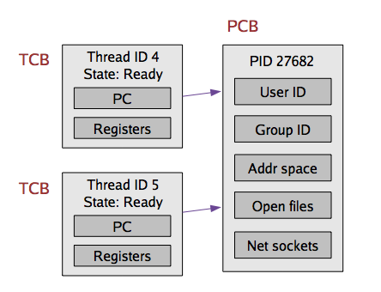
Implementing Threads
Given what we know about processes, implementing threads is “easy”
Idea: Break the PCB into two pieces:
  Thread-specific stuff: Processor state
  Process-specific state: Address space and OS resources (e.g., open files)

Slide 22
Thread Control Block (TCB)
TCB contains info on a single thread
  Thread id
  Scheduling state
  H/W context (registers)
  A pointer to corresponding PCB
PCB contains info on the containing process
  Address space and OS resources, but NO processor state!

Slide 23
Thread Control Block (TCB)
TCBs are smaller and cheaper than PCBs
  E.g., For some recent version of Linux:
    Linux TCB (thread_struct) has 24 fields
    Linux PCB (task_struct) has 106 fields

Slide 24
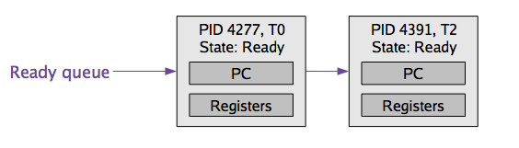
Context Switching
TCB is now the unit of a context switch
  Ready queue, wait queues, etc. now contain pointers to TCBs
  Context switch causes CPU state to be copied to/from the TCB
Context switch between two threads of the same process
  No need to change address space
    No TLB flush
Context switch between two threads of different processes
  Must change address space, possibly causing cache and TLB pollution

Slide 25
Implementing User-level Threads
It should be clear that we would need the following:
  UT.1: Scheduling and context switching code as part of process code
    E.g., a library that we link against our process
  UT.2: Room to store hardware context and stack for each thread in process’s own address space
  UT.3: Facility for this code to intervene execution of threads from time to time and run itself (analogous to timer interrupt handling by OS)
  UT.4: Ability to save/restore hw context (in user space)

Slide 26
Examples: #1, #2
2^32-1
Q: Where would the h/w context and stack for each thread be?
A: The process heap!
stack
Stack for P
Stack for T1
Stack for T2
heap
Stack for T3
TCBs for T1-T3
data
User-level threads library
Part of code segment
code
0

Slide 27
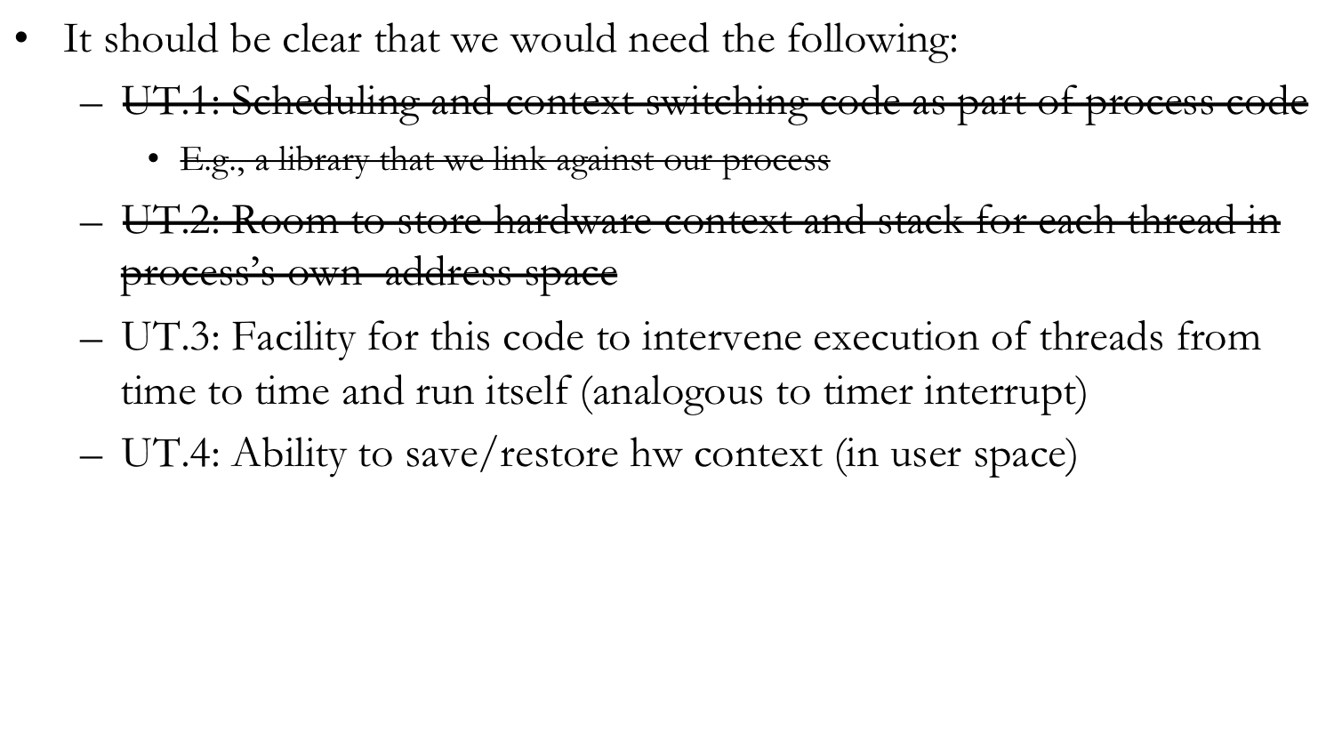
Implementing User-level Threads

Slide 28
UT.3: SIGALRM signal
UT.3: Facility for this code to intervene execution of threads from time to time and run itself (analogous to timer interrupt)
  Employ “virtual” interrupts a.k.a signals
    Request the OS to send periodic “alarm” signals to the process (SIGALRM)
  Implement a signal handler for SIGALRM (part of our code)
  Whenever the OS context switches this process in, if there is a signal pending, this handler would run before resuming execution
  This is our opportunity to run our scheduler/context switching code and pick a thread to run!

