Slide 1
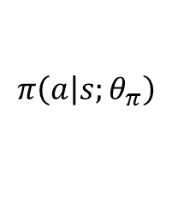
S
…
$$π\left(\left.a\right|s;θ_{π}\right)$$

Slide 2

S
$$V\left(s;θ_{V}\right)$$

Slide 3
Fully Connected
128 Units
Fully Connected
128 Units
Fully Connected
4 Units (action size)
BatchNorm
+ ReLu
Relu
Tanh activation
Action
vector

Slide 4
Fully Connected
128 Units
Fully Connected
128 Units
Fully Connected
1 Units (regression)
BatchNorm
+ LeakyReLu
LeakyRelu
No activation
Q-values

