Slide 1
How can I be a good geologist ? | What can I do to be a good geologist ? | TRUE
What’s one thing you would like to do better ? | What’s one thing you do despite knowing better ? | FALSE
What can make Physics easy to learn ? | How can you make Physics easy to learn ? | TRUE
What is the best way to make money online ? | What is the best way to ask money online ? | FALSE

Slide 2
Transform data into vectors dense in features
Compare two pieces of vectorized data using a distance metric (e.g. Manhattan)
Classify this distance as being of similar pieces of data or dissimilar
Use of Deep Learning
architecture
Use of any distance possible
Use of any linear classifier

Slide 3




Encoder
Decoder
Latent representation
$$x_{i}^{(t)}$$
$${\tilde{x}}_{i}^{(t)}$$
INPUT DATA
RECONSTRUCTED DATA
$$e(x_{i}^{\left(t\right)};W_{e})$$
$$d(e\left(x_{i}^{\left(t\right)};W_{e}\right); W_{d})$$
Vector representation used to compute distances

Slide 4
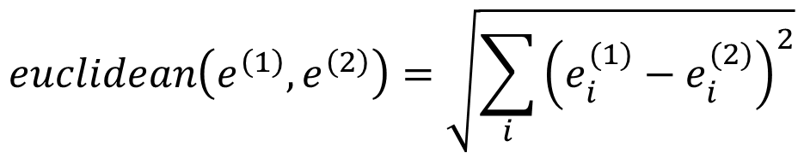
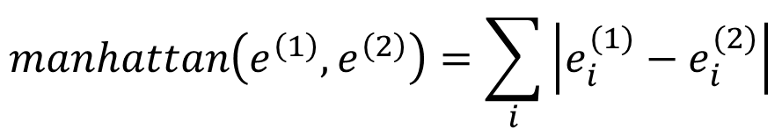
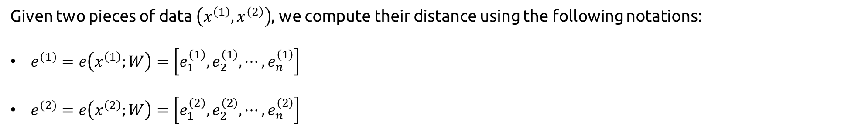
Given two pieces of data $\left(x^{\left(1\right)},x^{\left(2\right)}\right)$, we compute their distance using the following notations:
$e^{(1)}=e\left(x^{\left(1\right)};W\right)=\left[e_{1}^{\left(1\right)}, e_{2}^{\left(1\right)},⋯,e_{n}^{\left(1\right)}\right]$
$e^{(2)}=e\left(x^{\left(2\right)};W\right)=\left[e_{1}^{\left(2\right)},e_{2}^{\left(2\right)},⋯,e_{n}^{\left(2\right)}\right]$
Manhattan Distance
Euclidean Distance
$$manhattan\left(e^{\left(1\right)},e^{\left(2\right)}\right)=\sum_{i}{\left|e_{i}^{(1)}−e_{i}^{(2)}\right|}$$
$$euclidean\left(e^{\left(1\right)},e^{\left(2\right)}\right)=\sqrt{\sum_{i}{{\left(e_{i}^{(1)}−e_{i}^{(2)}\right)}^{2}}}$$

Slide 5
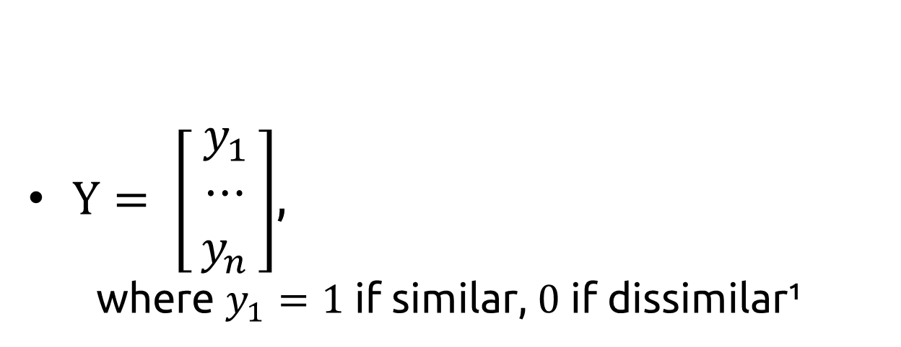
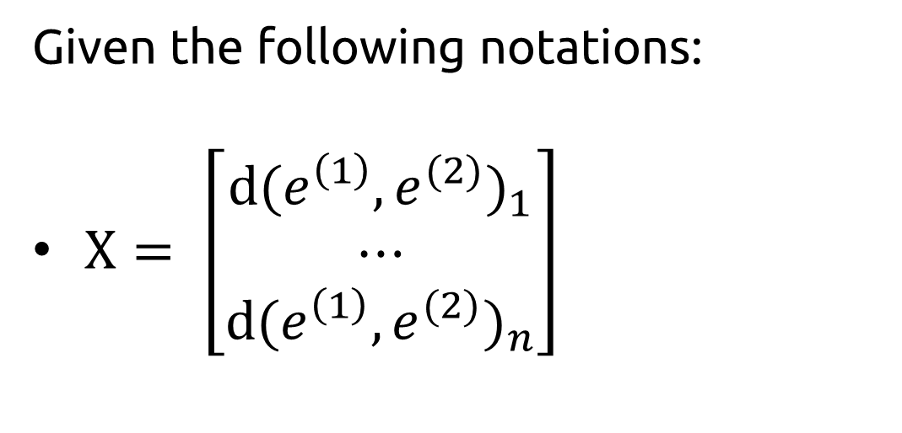
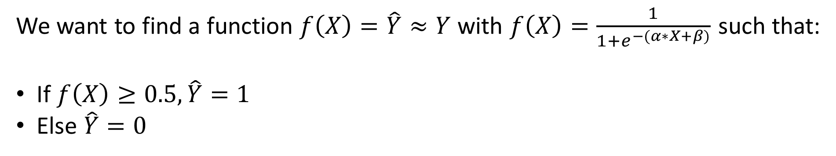
Given the following notations:
$X= \left[\begin{matrix}{d(e^{\left(1\right)}, e^{(2)})}_{1} \\ ⋯ \\ {d(e^{\left(1\right)}, e^{(2)})}_{n}\end{matrix}\right]$
$Y= \left[\begin{matrix}{ y}_{1 } \\ ⋯ \\ y_{n}\end{matrix}\right]$,
where $y_{1}=1$ if similar, $0$ if dissimilar¹
We want to find a function $f\left(X\right)=\hat{Y}≈Y$ with $f\left(X\right)=\frac{1}{1+e^{−(α∗X+β)}}$ such that:
If $f\left(X\right)≥0.5, \hat{Y}=1$
Else $\hat{Y}=0$
1: The opposite can also be used, it only will have an impact on the Loss formula used to train the encoder

Slide 6
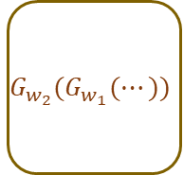

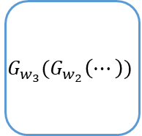


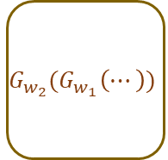

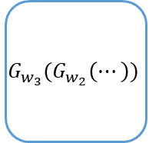


Encoder
Classification of distance measure
BiLSTM 1
BiLSTM 2
BiLSTM 3
$$G_{w_{1}}(x^{(1)})$$
$$G_{w_{2}}(G_{w_{1}}(⋯))$$
$$G_{w_{3}}(G_{w_{2}}\left(⋯\right))$$
$$x^{(1)}$$
Sequence 1
Outputs
Distance Measure $D$
…
$$\left\|G_{w}\left(x^{(1)}\right) − G_{w}(x^{(2)})\right\|$$
Classification of the distance
…
$D<δ$ ?
0: Dissimilar
1: Similar
Shared weights
BiLSTM 1
BiLSTM 2
BiLSTM 3
$$G_{w_{1}}(x^{(2)})$$
$$G_{w_{2}}(G_{w_{1}}\left(⋯\right))$$
$$G_{w_{3}}(G_{w_{2}}\left(⋯\right))$$
$$x^{(2)}$$
Sequence 2

Slide 7
How can I be a good geologist?
How can I be a good geologist?

Slide 8
What’s one thing you do
despite knowing better ?
DISSIMILAR
What’s one thing you
would like to do better ?
What would you like to
be better at ?
SIMILAR

Slide 9
























CONTRASTIVE LOSS
TRIPLET LOSS
QUADRUPLET LOSS
Encoder
Encoder
Encoder
$$Y$$
$${ m}_{1}$$
Positive
$$∗$$
$$∗$$
Positive
shared weights
$$\left\|.\right\|$$
+
Sequence 1
$$\frac{1}{2}$$
$$\left\|.\right\|$$
Anchor
$$−$$
shared weights
shared weights
$$\left\|.\right\|$$
$$.^{2}$$
+
Anchor
$$−$$
+
shared weights
$$\left\|.\right\|$$
+
Sequence 2
Negative 1
$$−$$
shared weights
$$\left\|.\right\|$$
$$\frac{1}{2}$$
Negative
shared weights
$$\left\|.\right\|$$
+
$$∗$$
$$∗$$
+
Negative 2
$$m$$
$$1−Y$$
$$m$$
$${ m}_{2}$$
$$loss\left(d, Y\right)=\frac{1}{2}∗Y∗d^{2}+\left(1−Y\right)∗\frac{1}{2}∗{max⁡(0, m−d)}^{2}$$
$$loss\left(d_{1},d_{2}\right)={{max⁡(d}_{1}}^{2}−{d_{2}}^{2}+m, 0)$$
$loss\left(d_{1},d_{2},d_{3}\right)={{max⁡(d}_{1}}^{2}−{d_{2}}^{2}+m_{1}, 0)+{{max⁡(d}_{1}}^{2}−{d_{3}}^{2}+m_{2}, 0)$
Disclaimer: here, we model $\max\left(x, 0\right)$ by a ReLu function that performs the exact same calculation

Slide 10
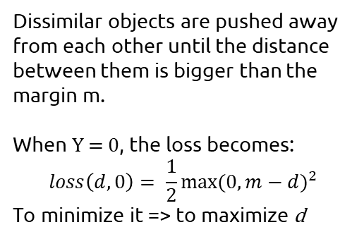


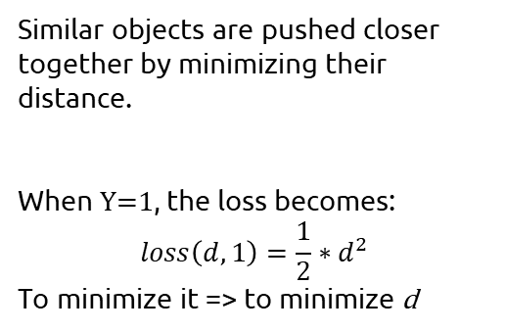
CONTRASTIVE LOSS
$$loss\left(d, Y\right)=\frac{1}{2}∗Y∗d^{2}+\left(1−Y\right)∗\frac{1}{2}∗{max⁡(0, m−d)}^{2}$$
Where:
d is the distance between the outputs of the encoder;
Y is the label of the model inputs (1 if similar, 0 if dissimilar);
m, the margin parameter
DISSIMILAR
SIMILAR
$$d$$
$$d$$
Dissimilar objects are pushed away from each other until the distance between them is bigger than the margin m.
When Y = 0, the loss becomes:
$$loss\left(d, 0\right)= \frac{1}{2}{max⁡(0,m−d)}^{2}$$
To minimize it => to maximize d
Similar objects are pushed closer together by minimizing their distance.
When Y=1, the loss becomes:
$$loss\left(d, 1\right)=\frac{1}{2}∗d^{2}$$
To minimize it => to minimize d

Slide 11
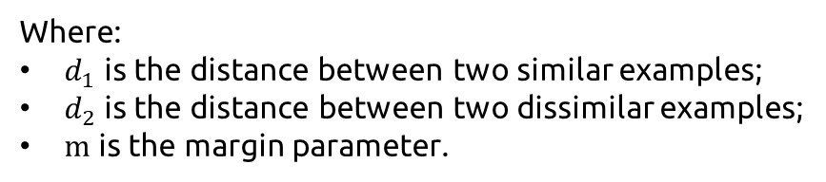



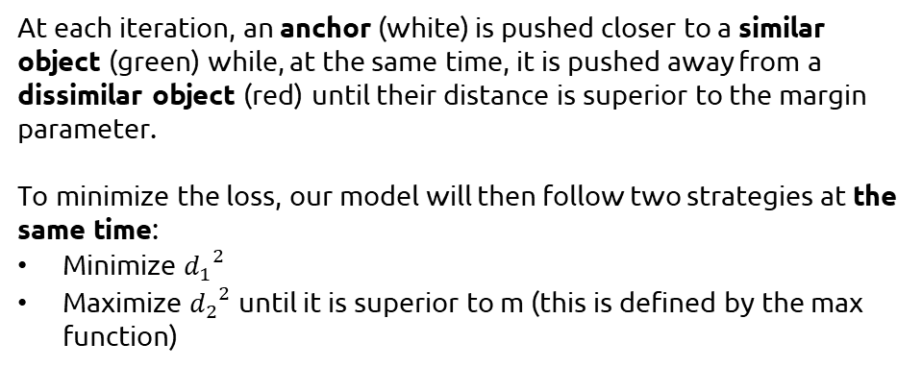
TRIPLET LOSS
$$loss\left(d_{1},d_{2}\right)={{max⁡(d}_{1}}^{2}−{d_{2}}^{2}+m, 0)$$
Where:
$d_{1}$ is the distance between two similar examples;
$d_{2}$ is the distance between two dissimilar examples;
m is the margin parameter.
$$d_{2}$$
$$d_{1}$$
At each iteration, an anchor (white) is pushed closer to a similar object (green) while, at the same time, it is pushed away from a dissimilar object (red) until their distance is superior to the margin parameter.
To minimize the loss, our model will then follow two strategies at the same time:
Minimize ${d_{1}}^{2}$
Maximize ${d_{2}}^{2}$ until it is superior to m (this is defined by the max function)

Slide 12
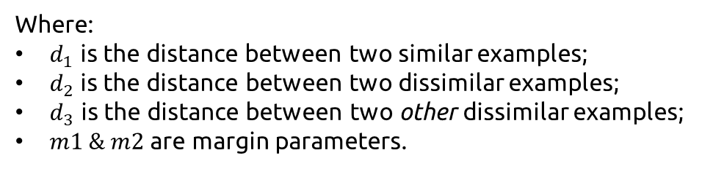




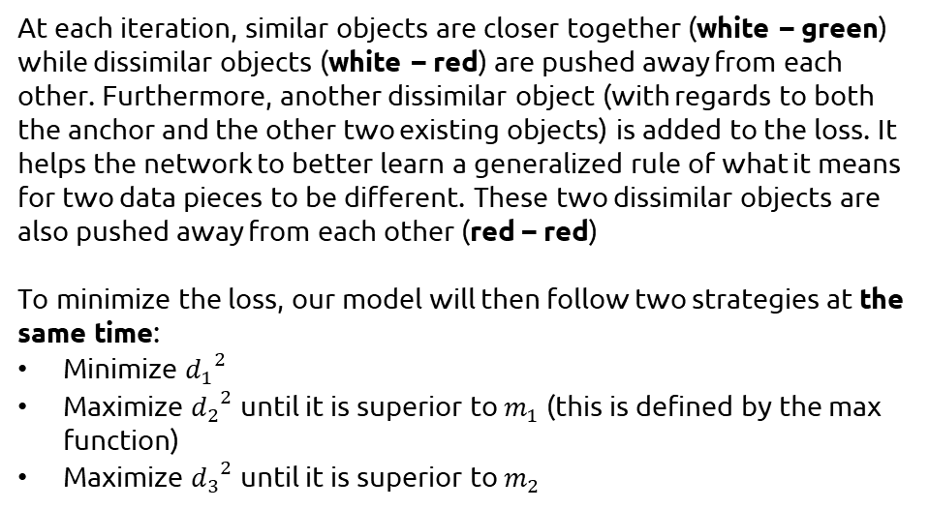
QUADRUPLET LOSS
$$loss\left(d_{1},d_{2},d_{3}\right)={{max⁡(d}_{1}}^{2}−{d_{2}}^{2}+m_{1}, 0)$$
$+{{max⁡(d}_{1}}^{2}−{d_{3}}^{2}+m_{2}, 0)$
Where:
$d_{1}$ is the distance between two similar examples;
$d_{2}$ is the distance between two dissimilar examples;
$d_{3}$ is the distance between two other dissimilar examples;
$m1$ & $m2$ are margin parameters.
$$d_{2}$$
$$d_{3}$$
$$d_{1}$$
At each iteration, similar objects are closer together (white – green) while dissimilar objects (white – red) are pushed away from each other. Furthermore, another dissimilar object (with regards to both the anchor and the other two existing objects) is added to the loss. It helps the network to better learn a generalized rule of what it means for two data pieces to be different. These two dissimilar objects are also pushed away from each other (red – red)
To minimize the loss, our model will then follow two strategies at the same time:
Minimize ${d_{1}}^{2}$
Maximize ${d_{2}}^{2}$ until it is superior to $m_{1}$ (this is defined by the max function)
Maximize ${d_{3}}^{2}$ until it is superior to $m_{2}$

Slide 13
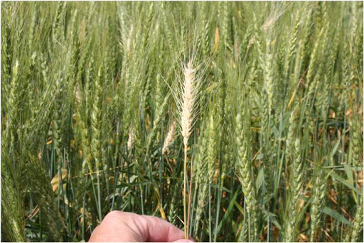
MULTIPLE PREDICTIONS
MULTIPLE MODELS
MODEL 1
SINGLE IMAGE
MODEL 2
WBF-MERGED PREDICTIONS
MODEL 3
MODEL 4

Slide 14
MULTIPLE IMAGE (TTA)
MULTIPLE PREDICTIONS
SINGLE MODEL
WBF-MERGED PREDICTIONS
MODEL 1

Slide 15





New Medium Article:
How to choose your loss when designing a Siamese Neural Network ? Contrastive, Triplet or Quadruplet ?
Di Martino Thomas
Website: https://dimartinot.com GitHub: https://github.com/dimartinot/

