Slide 1
How can I be a good geologist ? | What can I do to be a good geologist ? | TRUE
What’s one thing you would like to do better ? | What’s one thing you do despite knowing better ? | FALSE
What can make Physics easy to learn ? | How can you make Physics easy to learn ? | TRUE
What is the best way to make money online ? | What is the best way to ask money online ? | FALSE

Slide 2
Transform data into vectors dense in features
Compare two pieces of vectorized data using a distance metric (e.g. Manhattan)
Classify this distance as being of similar pieces of data or dissimilar
Use of Deep Learning
architecture
Use of any distance possible
Use of any linear classifier

Slide 3




Encoder
Decoder
Latent representation
$$x_{i}^{(t)}$$
$${\tilde{x}}_{i}^{(t)}$$
INPUT DATA
RECONSTRUCTED DATA
$$e(x_{i}^{\left(t\right)};W_{e})$$
$$d(e\left(x_{i}^{\left(t\right)};W_{e}\right); W_{d})$$
Vector representation used to compute distances

Slide 4
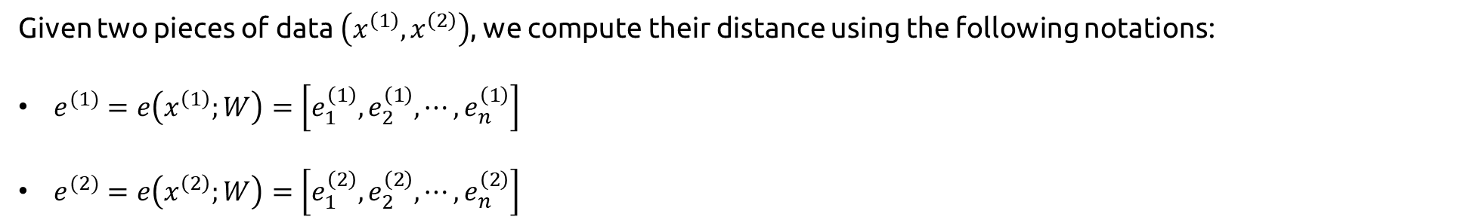
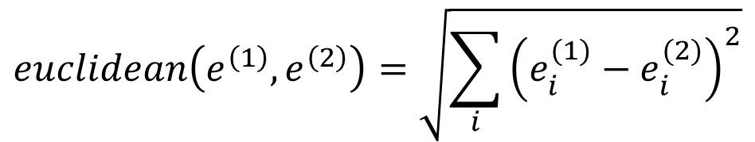
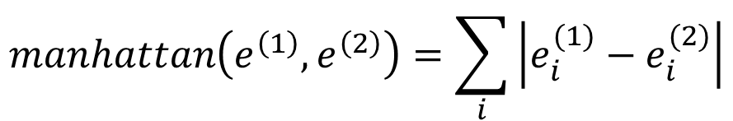
Given two pieces of data $\left(x^{\left(1\right)},x^{\left(2\right)}\right)$, we compute their distance using the following notations:
$e^{(1)}=e\left(x^{\left(1\right)};W\right)=\left[e_{1}^{\left(1\right)}, e_{2}^{\left(1\right)},⋯,e_{n}^{\left(1\right)}\right]$
$e^{(2)}=e\left(x^{\left(2\right)};W\right)=\left[e_{1}^{\left(2\right)},e_{2}^{\left(2\right)},⋯,e_{n}^{\left(2\right)}\right]$
Manhattan Distance
Euclidean Distance
$$manhattan\left(e^{\left(1\right)},e^{\left(2\right)}\right)=\sum_{i}{\left|e_{i}^{(1)}−e_{i}^{(2)}\right|}$$
$$euclidean\left(e^{\left(1\right)},e^{\left(2\right)}\right)=\sqrt{\sum_{i}{{\left(e_{i}^{(1)}−e_{i}^{(2)}\right)}^{2}}}$$

Slide 5
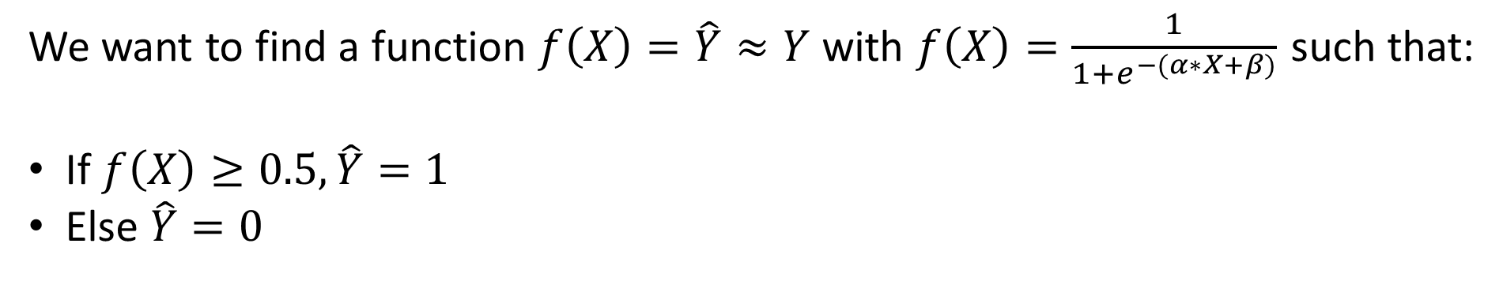
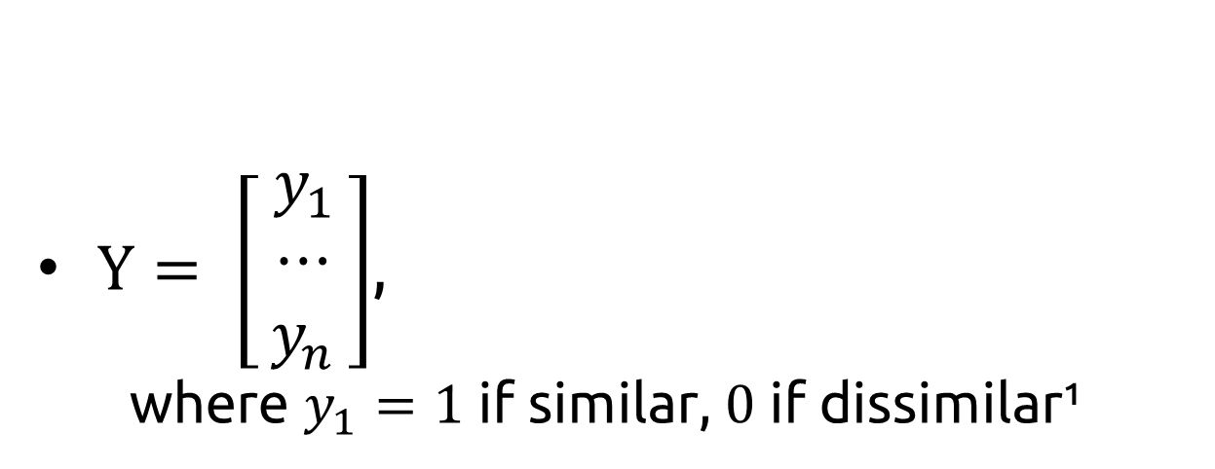
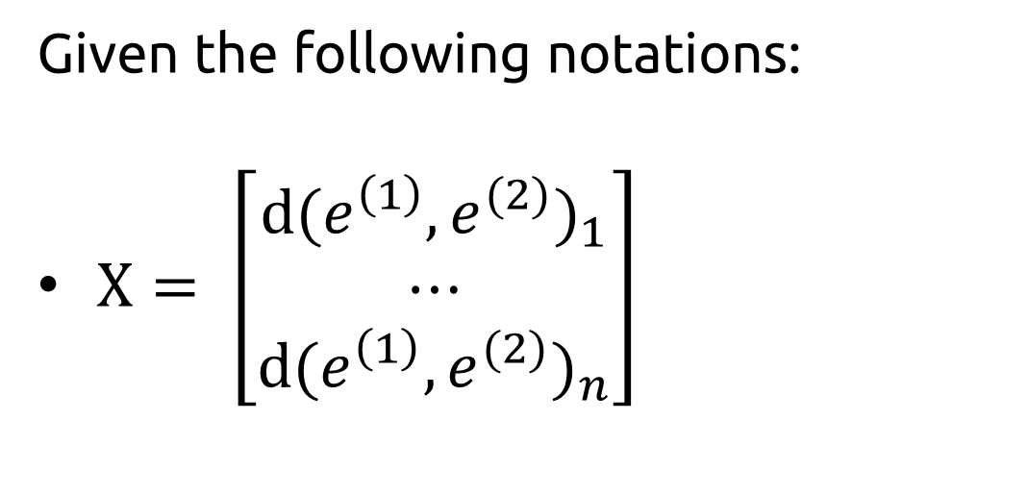
Given the following notations:
$X= \left[\begin{matrix}{d(e^{\left(1\right)}, e^{(2)})}_{1} \\ ⋯ \\ {d(e^{\left(1\right)}, e^{(2)})}_{n}\end{matrix}\right]$
$Y= \left[\begin{matrix}{ y}_{1 } \\ ⋯ \\ y_{n}\end{matrix}\right]$,
where $y_{1}=1$ if similar, $0$ if dissimilar¹
We want to find a function $f\left(X\right)=\hat{Y}≈Y$ with $f\left(X\right)=\frac{1}{1+e^{−(α∗X+β)}}$ such that:
If $f\left(X\right)≥0.5, \hat{Y}=1$
Else $\hat{Y}=0$
1: The opposite can also be used, it only will have an impact on the Loss formula used to train the encoder

Slide 6

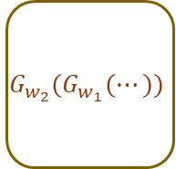


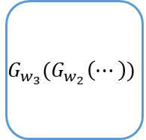
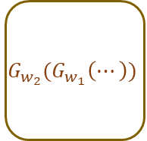




Encoder
Classification of distance measure
BLSTM 1
BLSTM 2
BLSTM 3
$$G_{w_{1}}(x^{(1)})$$
$$G_{w_{2}}(G_{w_{1}}(⋯))$$
$$G_{w_{3}}(G_{w_{2}}\left(⋯\right))$$
$$x^{(1)}$$
Sequence 1
Outputs
Distance Measure
…
$$\left\|G_{w}\left(x^{(1)}\right) − G_{w}(x^{(2)})\right\|$$
Classification of the distance
…
$D_{1}<δ$ ?
0: Dissimilar
1: Similar
Shared weights
BLSTM 1
BLSTM 2
BLSTM 3
$$G_{w_{1}}(x^{(2)})$$
$$G_{w_{2}}(G_{w_{1}}\left(⋯\right))$$
$$G_{w_{3}}(G_{w_{2}}\left(⋯\right))$$
$$x^{(2)}$$
Sequence 2

Slide 7
How can I be a good geologist?
How can I be a good geologist?

