Slide 1
Data Analytics pada Aplikasi Mata Garuda menggunakan Multi-Bro IDS Sensor
Final Project Progress
Abid Famasya Abdillah (2110131016)
Supervised by:
Ferry Astika S, ST, M.Sc.
Iwan Syarif, S.Kom., M.Sc., Ph.D.

Slide 2
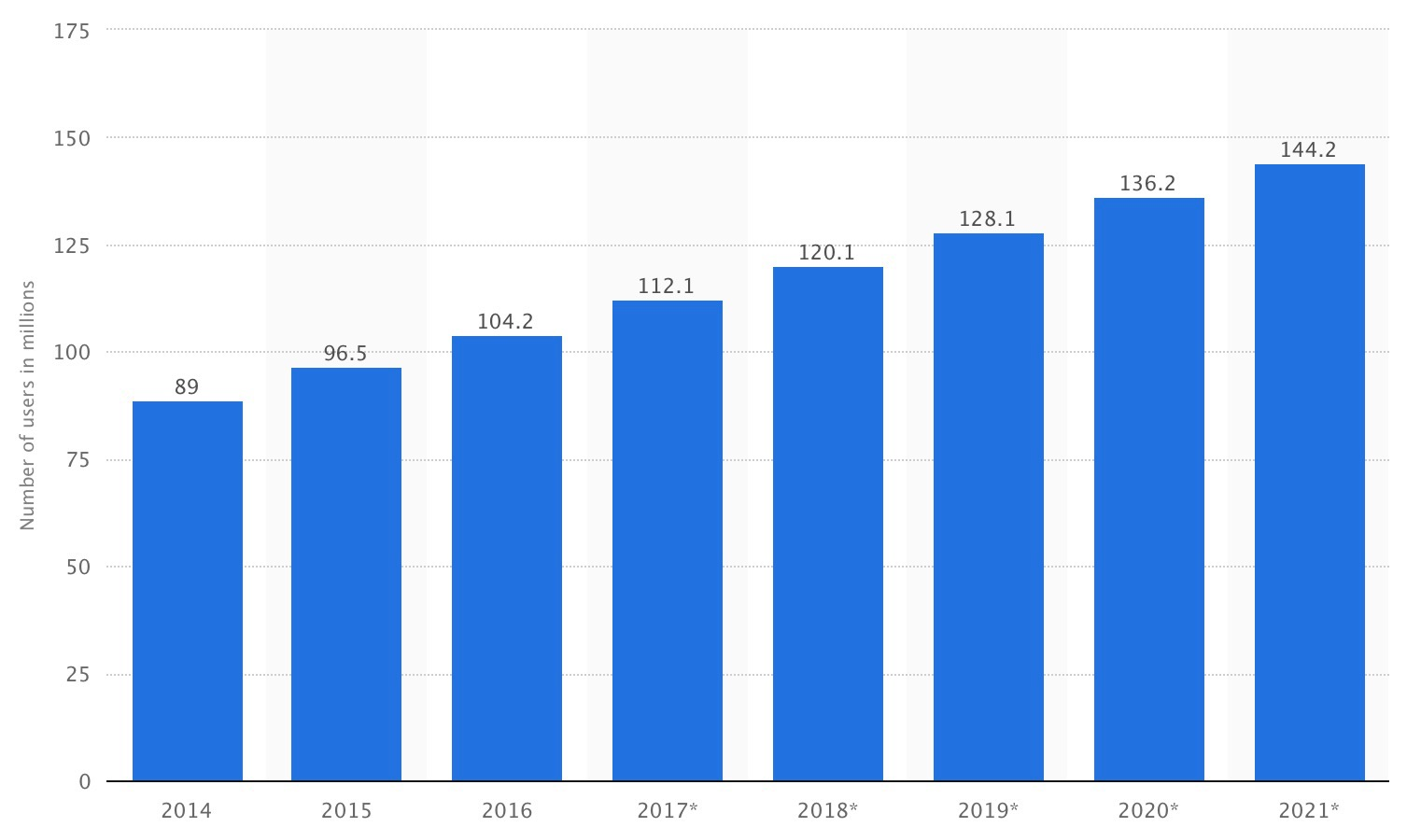
Introduction
Internet is a massive communication platform where 3,5 billion people use it everyday.
Indonesia internet users
Source : Statistica, 2016
Notes:
3,5 billion is about 49% of all people in earth

Slide 3
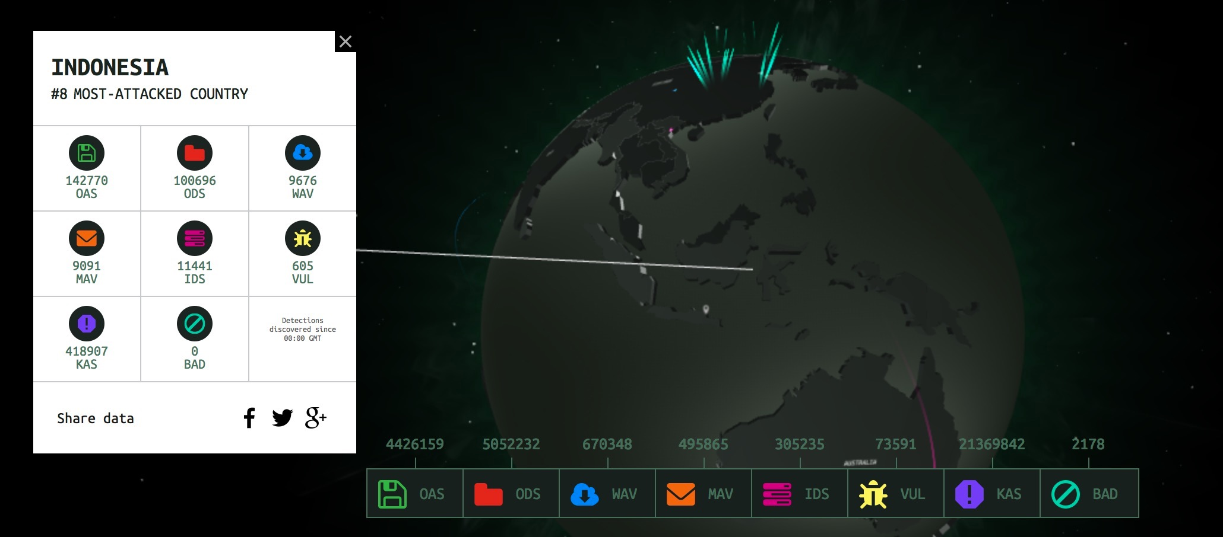
Indonesia internet threat
Source : cybermap.kaspersky.com
The attack isn’t just targeting government’s site. They’ve been attacking us in various ways
- ID-SIRTII 2012

Slide 4

ID-SIRTII (Indonesia Security Incident Response Team) have been developing Mata Garuda for years. It’s Snort-based advanced network monitoring system to monitor Indonesian traffic flow.
Capabilities :
Deep seeing
Having intelligence engine to gain insight
Able to adapt (modularity)
Providing better decision platform by reducing false alarm

Slide 5
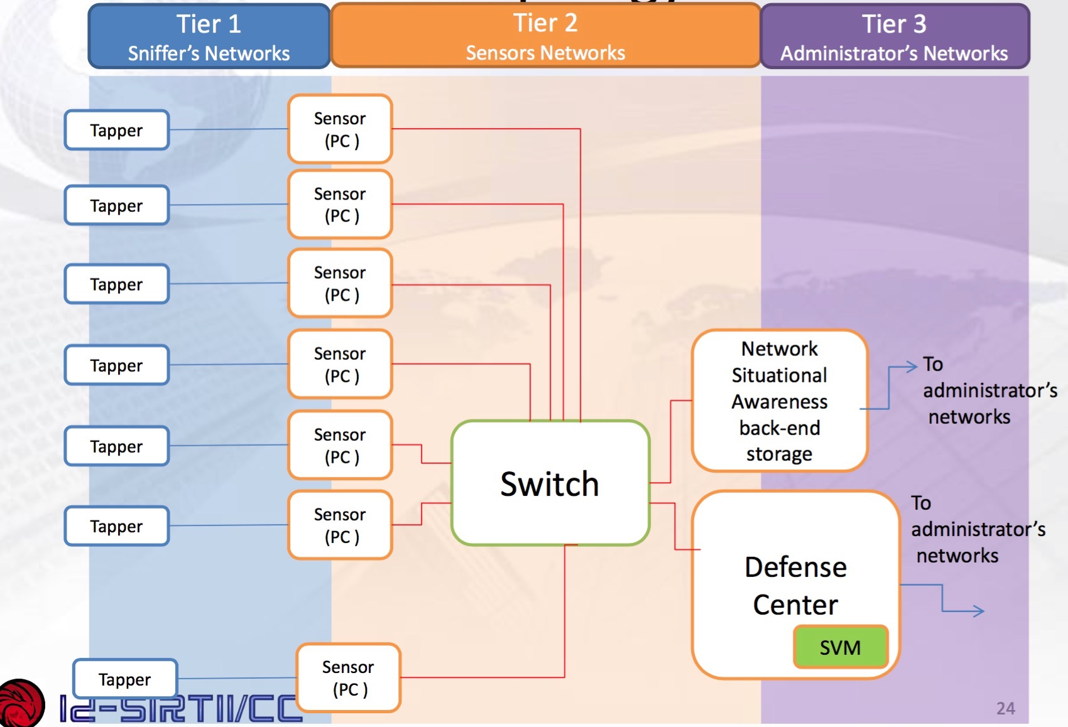
Old topology
Sensors placed on a NAP network

Slide 6
How to make Mata Garuda as resource pool of agents and develop data analytics module of it
Main Challange

Slide 7
Problems
Internet providers always increasing and cloud-based service become common
Previous topology require high computational power and bandwidth
Each providers has its own policies

Slide 8
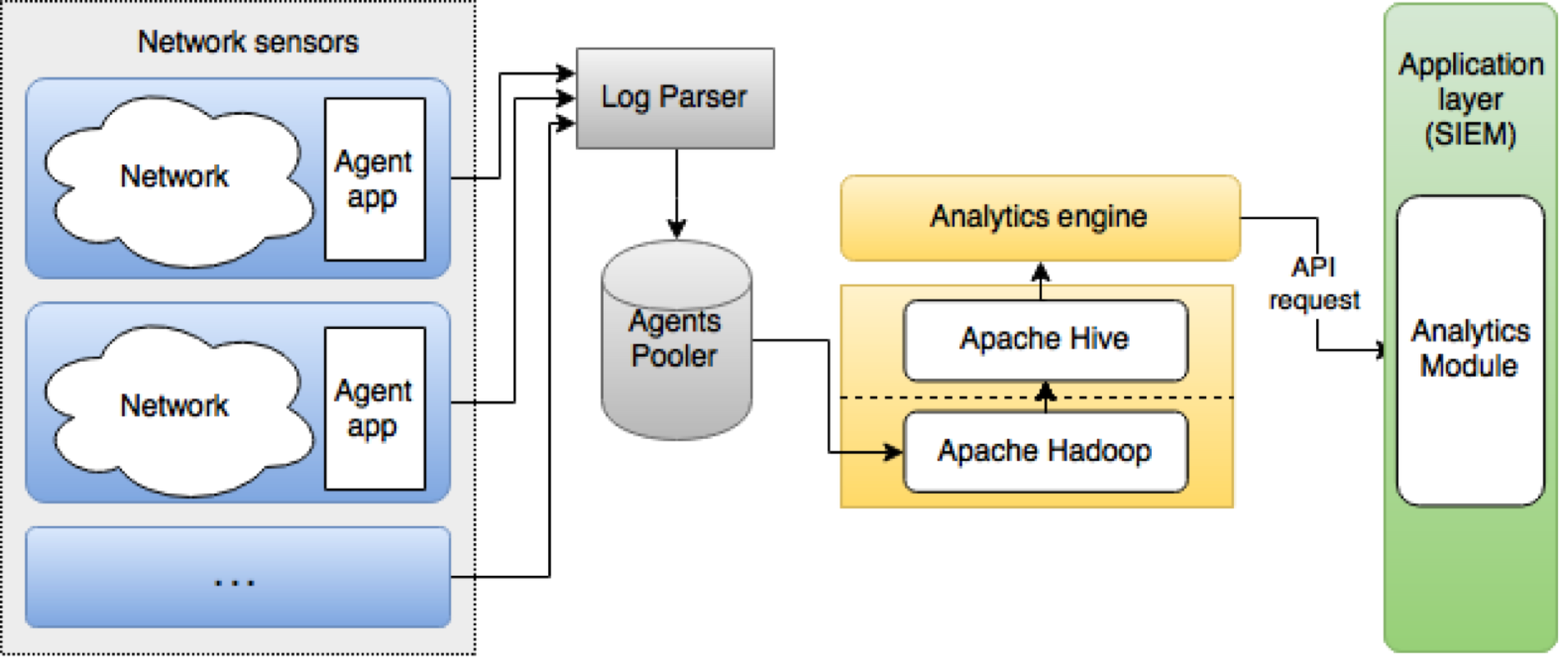
System architecture

Slide 9
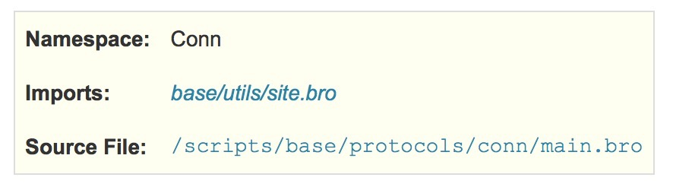
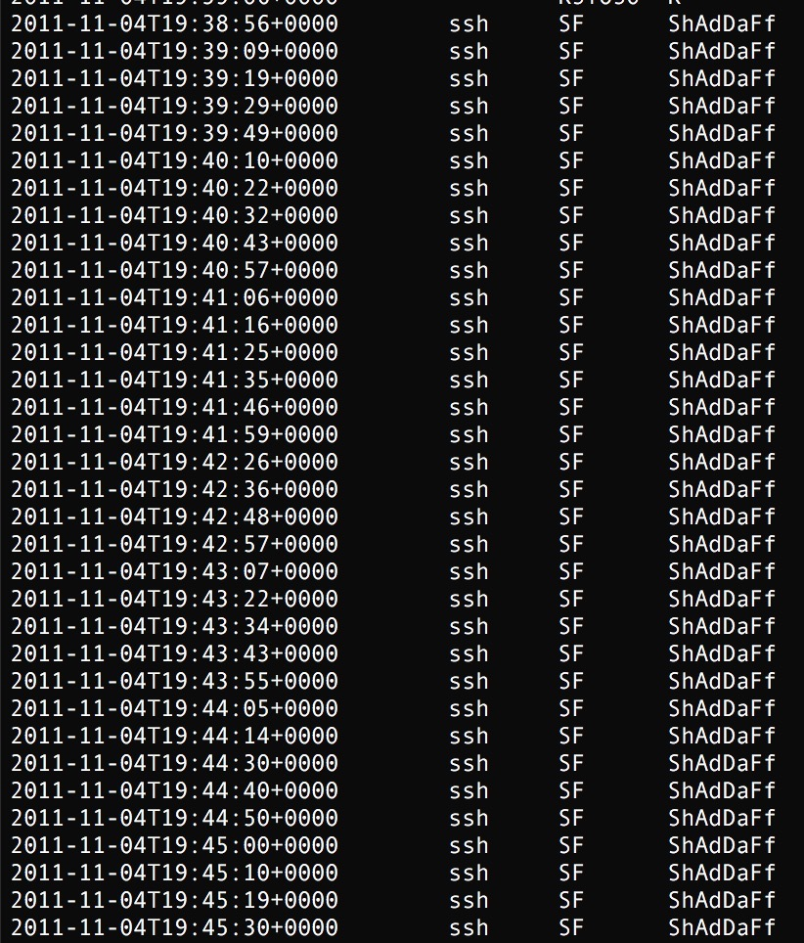
Network sensors
This script manages the tracking/logging of general information regarding TCP, UDP, and ICMP traffic. For UDP and ICMP, “connections” are to be interpreted using flow semantics.
Network sensor will generate raw packet logs of all retrieved packets (saved in conn.log)

Slide 10
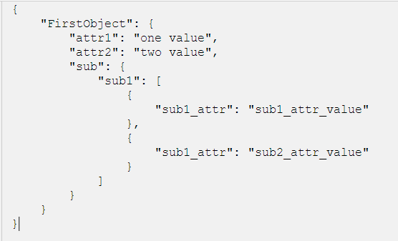
Log parser
Raw packet logs
Log parser retrieved it and parse it into more readable format

Slide 11


Retrieve and save
Log Parser
Raw packet logs
Raw packet logs
Multiple network sensors collected
Saved into distributed servers to gain MapReduce processing capability

Slide 12
Data processing
Log Parser
Raw packet logs
Raw packet logs
Multiple network sensors collected
Process data to classify intrusion attempts
Data processing
Saved into distributed servers

Slide 13

Integration
Log Parser
Raw packet logs
Raw packet logs
Multiple network sensors collected
Data processing
Classify intrusion
attempts
Integrating module
Saved into distributed servers

Slide 14
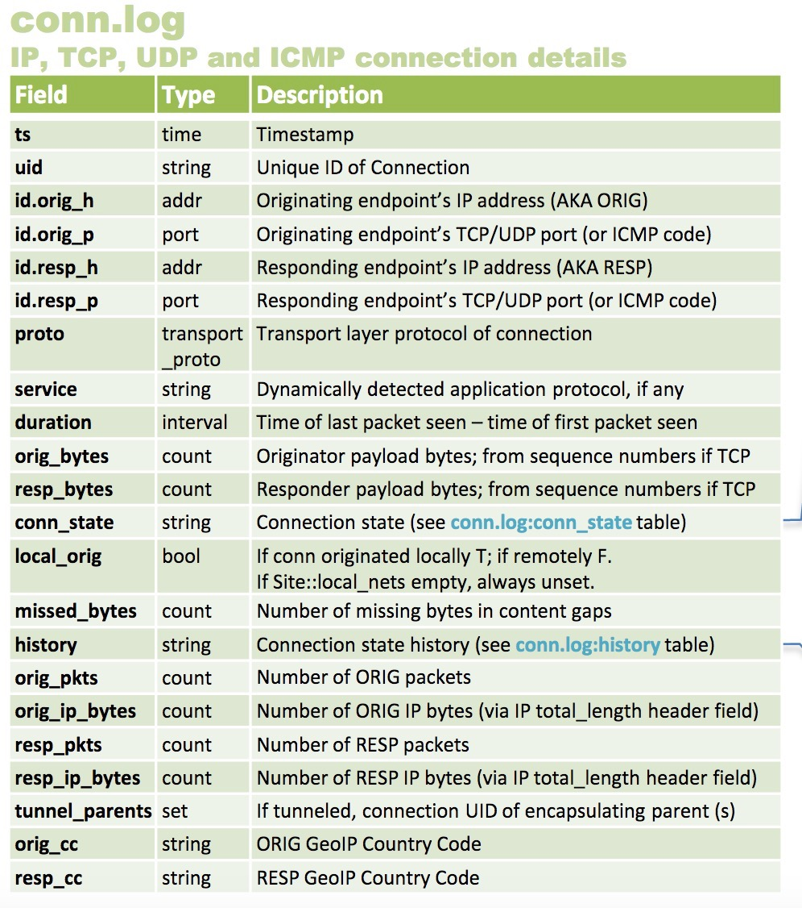
Detection method
First, sort collected data by timestamp
SSH Bruteforce
FTP attack
DOS

Slide 15
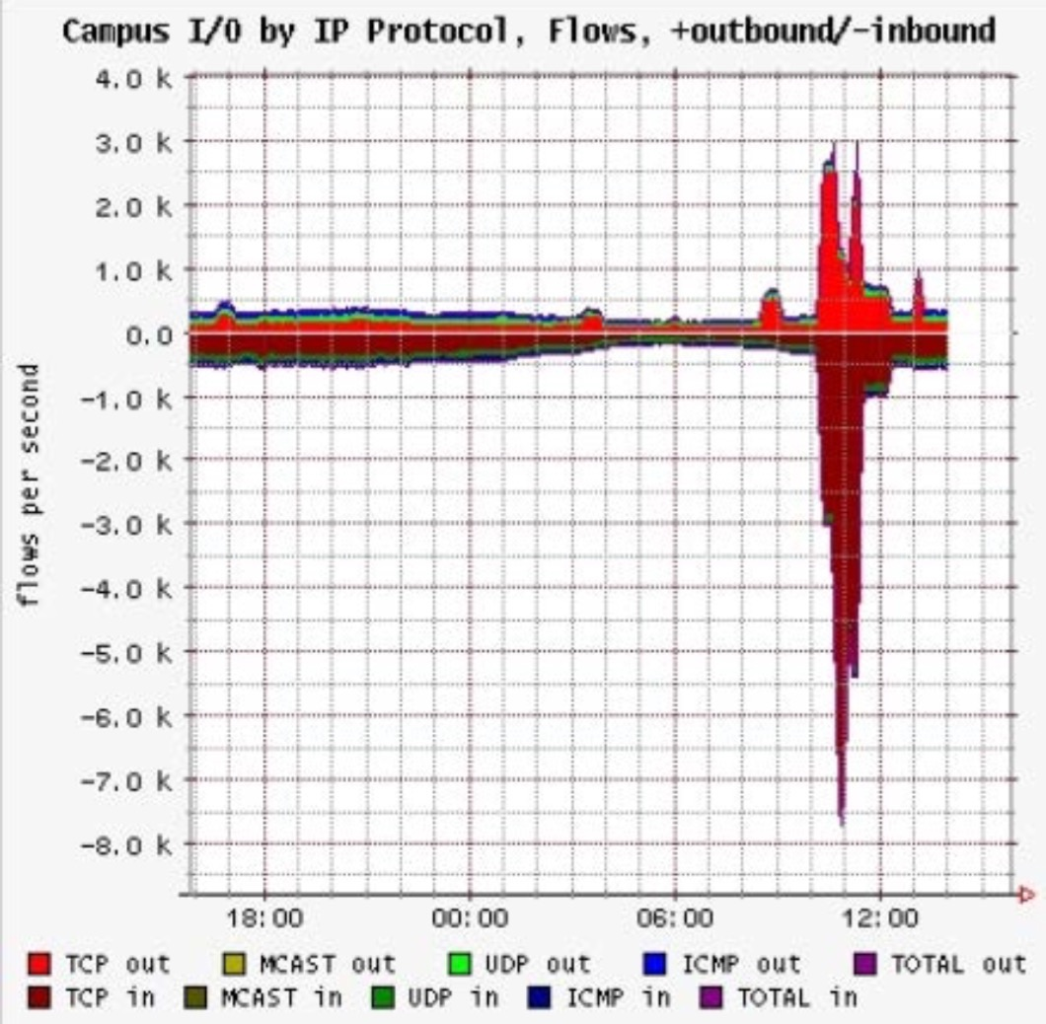
Detection method
If failed attempts > threshold then classify to attack
If TCP 3-ways handshake violating normal behaviour
OR
There are anomalies in TCP flag (i.e. flooding)

Slide 16
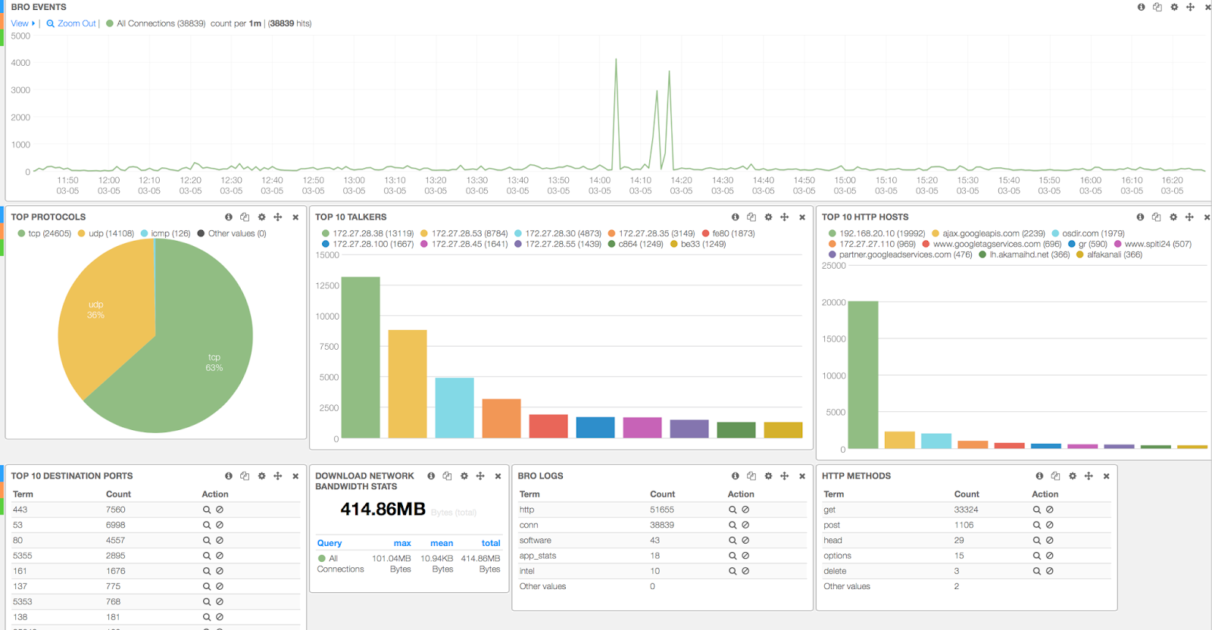
Intrusion Analytics
Present it into analytics module

Slide 17
Bibliography
V. Paxson, "Bro: A System for Detecting Network Intruders in Real-Time," Seventh USENIX Security Symp., 1998.
M. Hisyam, F. A. Saputra and J. Akhmad, "IDS Log Analisis Menggunakan Hadoop dan Mahout untuk Data Mining pada Mata Garuda," Jurnal Teknik Informatika dan Komputer PENS, 2015.
L. Aniello, G. Lodi and R. Baldoni, "Inter-Domain Stealthy Port Scan Detection through Complex Event Processing," in 13th European Workshop on Dependable Computing, Pisa, 2011.
D. K. Denatious and A. John, "Survey on Data Mining Techniques to Enhance Intrusion Detection," International Conference on Computer Communication and Informatics (ICCCI -2012), 2012.
Mahbub, F. A. Saputra and A. Alimudin, "Mendapatkan Dataset Rule Network dan Melakukan Ekstraksi Data Menggunakan Bro IDS," in Jurnal Teknik Informatika dan Komputer PENS, Surabaya, 2015.

Slide 18
Thank you
Abid Famasya Abdillah
famasya@it.student.pens.ac.id
2110131016

