Slide 1

MetaVox
MetaVox
https://github.com/dimastatz/metavox
AI Dubbing Python Library for Multi-Language Support
Notes:
Hi everyone, and thank you for being here today.
Imagine a world where creating impactful presentations is as simple as typing a prompt. No more hours spent designing slides or rehearsing narration—just an idea, and the technology does the rest. That’s the power of MetaVox.
MetaVox is a groundbreaking AI-driven solution that transforms the way professionals and educators develop and deliver presentations. Using cutting-edge AI, it generates high-quality slides from simple text inputs and synchronizes them with live voice narration—creating a seamless, dynamic, and engaging experience for audiences worldwide.
Whether you're a business leader, a teacher, or a content creator, MetaVox empowers you to focus on what truly matters—delivering your message with clarity and impact. Today, I’m excited to show you how MetaVox is revolutionizing presentations and making communication effortless. Let’s dive in!

Slide 2

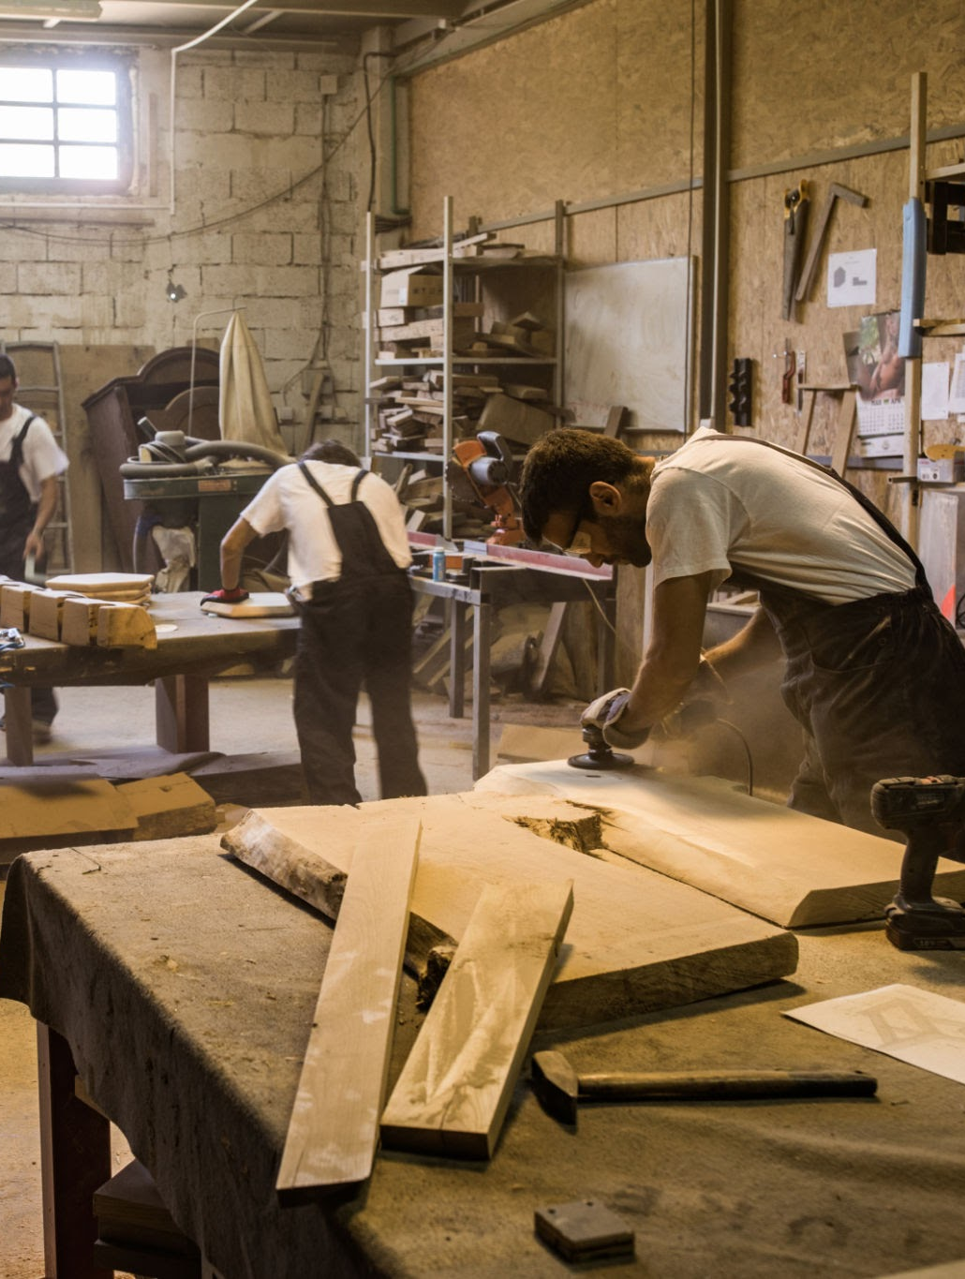


MetaVox
MetaVox
https://github.com/dimastatz/metavox
Agenda
DESIGN TEAM
FACTORY TEAM
OUR PRODUCTS
OUR
CUSTOMERS
Notes:
Before we dive into the details, let’s take a quick look at today’s agenda.
Who We Are – I’ll start by introducing MetaVox, our mission, and what drives us to innovate in the presentation space.
Our Customers – Next, we’ll discuss who benefits from MetaVox and how our solution is transforming their workflows.
Our Products – We’ll then explore MetaVox’s key offerings, showcasing how our AI-powered technology simplifies and enhances presentations.
Contact Information – Finally, we’ll wrap up with ways you can reach out to us for further discussions, partnerships, or product inquiries.
By the end of this session, you’ll have a clear understanding of how MetaVox is redefining the future of presentations. Let’s get started!

Slide 3

“”
At MetaVox, we believe ideas should take center stage—not the effort to present them. Our vision is to transform every thought into a compelling story, effortlessly brought to life through AI-powered automation and voice narration
Full name CEO & Founder
Notes:
At MetaVox, our vision is simple yet powerful: to redefine the way people create and deliver presentations through AI-driven automation and seamless voice narration.
We believe that presentations should be about ideas, not effort. Too often, professionals and educators spend hours crafting slides, fine-tuning visuals, and rehearsing narration—time that could be better spent refining their message and engaging with their audience.
MetaVox eliminates these barriers by using advanced AI to generate compelling presentations from simple prompts and enhance them with natural, synchronized voice narration. Our goal is to make every presentation effortless, engaging, and impactful, whether it’s for business, education, or content creation.
As we continue to push the boundaries of AI and automation, our vision remains clear: empowering anyone, anywhere, to communicate their ideas with confidence and clarity.
With that in mind, let’s take a closer look at who we are and what drives us

Slide 4
THANK YOU
MetaVox
https://github.com/dimastatz/metavox
Notes:
That brings us to the end of our presentation.
Thank you all for your time and attention today. We’re excited about the future of MetaVox and how it’s transforming the way professionals and educators create and deliver presentations.
If you have any questions, I’d love to answer them now. And if you’d like to connect later, feel free to reach out—we’d be happy to continue the conversation.
Once again, thank you, and I look forward to seeing how MetaVox can help you elevate your presentations!

