Slide 1

A BRIEFING FOR TRANSFORMATION LEADERS
The Diagnose Conversation
Most transformations don't fail on strategy. They stall in adoption. Here is how to see it early.
pandatron.ai
Notes:
Leave-behind version. Self-explanatory, no presenter needed. Sources are listed in the notes of each slide.

Slide 2

THE PATTERN
Strategy gets approved. Adoption is where transformations stall.
12%
#1
22%
of business transformations achieve their original ambitions. 88% fall short.
implementation barrier is resistance to change, ahead of budget, timelines and technology.
of employees say they got enough training, coaching or tools to adapt after a reorganization.
BAIN & COMPANY · 2024 · 400+ EXECUTIVES
KEARNEY TRANSFORMATION STUDY · 2026 · 102 LEADERS
BAIN & COMPANY · 2026 · ~1,000 EXECUTIVES AND EMPLOYEES
Three studies, one pattern: the plan survives approval, then stalls where people meet it.
The Diagnose Conversation
02 / 14
Notes:
Sources: Bain & Company, 15 Apr 2024 (400+ executives). Kearney Transformation Study 2026, "The adoption gap" (102 transformation leaders). Bain & Company, 29 Jan 2026 (~1,000 executives and employees).

Slide 3




THE BLIND SPOT
Dashboards report adoption. They cannot see the workarounds.
WHAT THE DASHBOARD SHOWS
ILLUSTRATIVE
WHAT IS ACTUALLY HAPPENING
Workarounds keep the old process alive
80%
94%
+32%
New tool for reporting, old habits for the work
Adoption
Trained
Logins
Compliance on record, not in practice
STATUS: ON TRACK
SAME REORGANIZATION, TWO VIEWS: SHARE WHO BELIEVE IT WILL DELIVER
Leaders
88%
52 pts
Employees
36%
perception gap
BAIN & COMPANY · JAN 2026 · ~1,000 EXECUTIVES AND EMPLOYEES WHO WENT THROUGH A REORGANIZATION
The Diagnose Conversation
03 / 14
Notes:
Dashboard figures are illustrative. Perception gap: Bain & Company, Jan 2026, ~1,000 executives and employees who went through a reorganization.

Slide 4


CURRENT VISIBILITY
Snapshot tools show that friction exists. They rarely show its kind, location or fix.
TODAY'S SNAPSHOT TOOLS
Surveys
Focus groups
Manager feedback
Readiness assessments
WHAT THEY SHOW
WHAT THEY MISS
What kind of friction it is
Knowledge, bandwidth, identity or loss
That friction exists
Where it concentrates
By unit, function, geography and role
Which intervention it needs
Training, provisioning, role design or acknowledgement
The gap is rarely commitment. It is resolution.
The Diagnose Conversation
04 / 14
Notes:
Snapshot tools are useful for detecting friction. They rarely resolve its type, location or the intervention it needs.

Slide 5




THE FOUR COSTS OF CHANGE
Most friction gets filed as a skills gap. The expensive costs are the other three.
USUALLY FILED HERE
THE EXPENSIVE THREE
Knowledge
Bandwidth
Identity
Loss
“I don't know it yet, or nobody has decided.”
“I can't reach it or fit it.”
“Who am I here now?”
“Nothing replaces it.”
Something new, unknown or undecided.
No time, tools or access. The environment blocks it.
The change reads as a threat to standing, not a training gap.
Something valued is ending. Arguing only confirms the loss.
WHAT WORKS
WHAT WORKS
WHAT WORKS
WHAT WORKS
Supply the answer: a decision, specific information, or training.
Provision and simplify: devices, access, time, fewer demands.
A concrete, respected role in the new model, built with peers.
Acknowledge the loss and restore what it carried. Never argue with it.
Training fixes knowledge. The other three need changes to the environment, the role or the story.
The Diagnose Conversation
05 / 14
Notes:
Supporting data: WEF Future of Jobs Report 2025, 1,000+ employers. Skills gaps are the most cited barrier (63%), culture and resistance to change second (46%).

Slide 6





FROM DIAGNOSIS TO DECISIONS
Seeing where friction concentrates changes five decisions.
DECISIONS THIS COULD INFORM
Communication strategy
Manager support
Rollout scope
Intervention timing
Change resources
Which message lands where
Which managers need help first
What to simplify or sequence
Where to step in early
Where to put people and budget
The value is not another survey. It is seeing execution risk early enough to avoid the delay, the productivity loss and the failed adoption.
The Diagnose Conversation
06 / 14
Notes:
Seeing friction by unit, function, geography and role informs where to communicate, support, simplify, intervene and invest.

Slide 7

THE SYSTEM
Diagnosis is one layer of three. The same conversations run the whole loop.
Diagnose
01
Diagnose
MAPPING AND DIAGNOSING
Maps readiness and friction by cohort, so every intervention is targeted, not broadcast.
02
Activate
1:1 AI
conversations
CHANGE ACTIVATION
Measure
Activate
Weekly 1:1 AI conversations move each person from confusion to committed action.
03
Measure
EXECUTION INTELLIGENCE
A weekly signal on adoption, friction and emerging risk, while there is still time to act.
The Diagnose Conversation
07 / 14
Notes:
Diagnose, Activate and Measure run on the same 1:1 AI conversations, so the signal and the intervention come from one source.

Slide 8
LAYER 01 · DIAGNOSE
Diagnose gives leaders four views of where execution will stall.
ILLUSTRATIVE
Readiness Map
Risk and Reward Profiles
Stakeholder Alignment
Change Readiness Profile
Readiness by cohort and component, so interventions land in the right place.
Friction and flow factors, ranked by likely impact on timelines.
Where leadership narratives diverge before the front line feels it.
The share of each cohort ready today, and the constraint holding the rest.
SHOWN NEXT
One map for leadership: where we will lose execution velocity, why, and what to change.
The Diagnose Conversation
08 / 14
Notes:
Thumbnails are illustrative. A real Change Readiness Profile follows.

Slide 9

LAYER 01 · CHANGE READINESS PROFILE
In three cohorts, readiness is already there. Incentives are holding it back.
COHORT · RESPONDENTS
BINDING CONSTRAINT
Champion
Ready
Hesitant
Resistant
Technology & Data n = 88
None
Marketing n = 62
None
Sales & Distribution n = 110
Support (mild)
Readiness is there.
48 to 57% of Claims, Underwriting and Legal already score Ready or Champion. Fix the incentive before adding training.
Claims n = 141
Incentive
Underwriting n = 96
Incentive
Legal & Compliance n = 61
Incentive
Customer Service n = 127
Value (credibility)
Shares, never names. Groups under 50 people are never reported, so Senior Leaders is not shown.
Real client readout, anonymized. Enterprise AI adoption program. n = 685 across the 7 cohorts shown. Champion = CCI score of 4 or higher. Bands use the five confidence components. Value and Incentive are scored separately. No cohort mean is reported: an average describes none of them.
The Diagnose Conversation
09 / 14
Notes:
Real client readout, anonymized. Groups under 50 people are never reported. n = 685 across the 7 cohorts shown.

Slide 10

LAYER 01 · HOW READINESS IS MEASURED
Confidence sets readiness. Value amplifies it. Incentive decides whether anyone moves.
CHANGE CONFIDENCE INDEX · FIVE COMPONENTS
Support
Does my world give me what I need?
Openness
Am I looking ahead?
Proactive
Am I initiating?
×
Adaptability
Can I handle what is changing now?
Readiness
Set by the five confidence components
Value amplifies
Is this worth it, for me?
Incentive gates
Does it pay, and is it safe?
People move
Behavior changes at work
Learning
Am I building the skills?
Gating rule: if the change is not worth it or does not pay, readiness is capped, whatever confidence says.
The Diagnose Conversation
10 / 14
Notes:
CCI+2: five confidence components (Support, Openness, Proactive, Adaptability, Learning) plus Value and Incentive, scored separately.

Slide 11




LAYER 02 · ACTIVATE
A short weekly conversation moves each person from ambiguity to agency.
WHAT MAKES IT STICK
01
02
10 to 15 minutes a week
Clarify priorities
Surface blockers
What the change means for me, specifically.
Name what is in the way, in my own words.
Private and 1:1
Remembers context
Every week
One private 1:1 session
A tone each person picks
12 TO 24 WEEKS OF REINFORCEMENT
04
03
CORE · 12 WEEKS
EXTENDED · TO 24
Connect back to work
Reframe resistance
Tie the strategy to this week's tasks.
Build readiness before it is required.
WK 1
WK 12
WK 24
Small shifts, reinforced weekly, compound into new habits.
The Diagnose Conversation
11 / 14
Notes:
Sessions are 10 to 15 minutes a week, private and 1:1, over 12 to 24 weeks.

Slide 12



LAYER 03 · MEASURE
Leaders get a weekly execution signal, not a quarterly snapshot.
Execution signal Week 12 · all units
ILLUSTRATIVE DATA
Unit
Function
Region
Role
CHAMPION SHARE
CCI+2 LEVEL BY COHORT
SIGNALS THIS WEEK
41%
Tech & Data
Customer Service
▲ 6 pts since week 1
Down six weeks running. Value credibility is the binding constraint.
Sales
HOTSPOTS
Claims
1
Customer Service
Incentive fixed, wk 6
Claims
PARTICIPATION
Recovering since the incentive fix in week 6.
78%
Customer Svc
of invited employees
The Diagnose Conversation
12 / 14
Notes:
Dashboard is illustrative. Trend values are simulated.

Slide 13

WHERE THIS HAS WORKED
Clients used it to surface hidden risk, compress a program and launch AI products.
Asahi Kasei Pharma
Skanska
Coach A
CLINICAL DEVELOPMENT CENTER
LEADERSHIP DEVELOPMENT
TSE: 9339
M&A INTEGRATION
LEADERSHIP TRANSFORMATION
AI TRANSFORMATION
2.7 / 5
3× faster
3
Perceived support, surfaced as a hidden risk in a multi-continent merger.
A 6-month leadership journey delivered in 2 months, scaled to thousands.
AI-powered products launched after embedding AI across its offer.
During integration. Milestones met.
2 months, versus 6 before
Partner since Aug 2023. Also resells Pandatron in Japan.
Sources: Pandatron client case studies. Coach A is a Pandatron partner. Its share price is not attributed to Pandatron.
The Diagnose Conversation
13 / 14
Notes:
Case details come from Pandatron case studies. Coach A is a Pandatron reseller in Japan since Aug 2023.

Slide 14
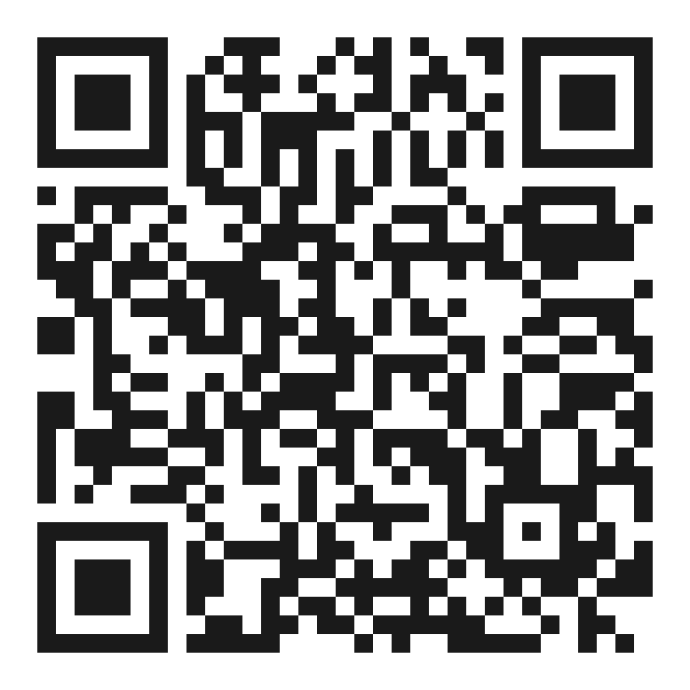
NEXT STEP
Start with one live transformation. Decide once you see the data.
HOW A DIAGNOSTIC WORKS
1
Pick one live transformation where slow adoption clearly costs the business.
Robert Newland
HEAD OF GROWTH
robert.newland@pandatron.ai
www.pandatron.ai
2
We diagnose a meaningful population of employees, in their own words.
Scan to email Robert
Subject line pre-filled: Diagnose pilot
3
You see friction patterns, readiness by cohort and the decisions the data supports. Then you decide.
What you get: the Readiness Map, Risk and Reward Profiles, Stakeholder Alignment and the Change Readiness Profile.
The Diagnose Conversation
14 / 14
Notes:
Contact Robert Newland, Head of Growth, robert.newland@pandatron.ai.

