Slide 1

Span<T>
Memory Management

Slide 2
Memory Intro
Stack memory - allocated on the Stack with the stackalloc keyword
Unmanaged memory - allocated on the unmanaged heap (invisible to GC) by calling Marshal.AllocHGlobal or Marshal.AllocCoTaskMem methods
Managed memory – managed by GC, allocated with the new operator

Slide 3
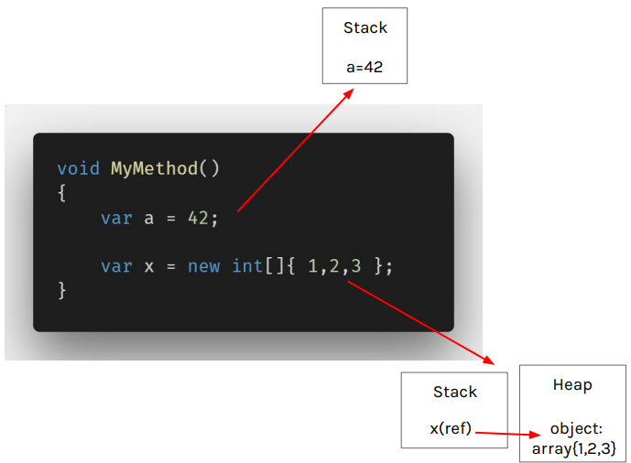
Code Analysis

Slide 4
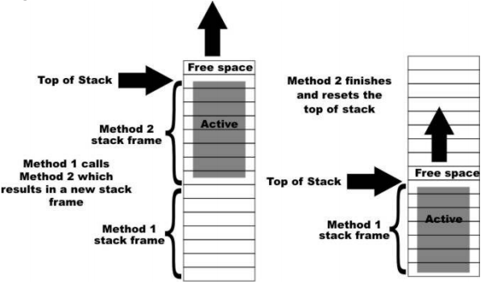
Stack

Slide 5
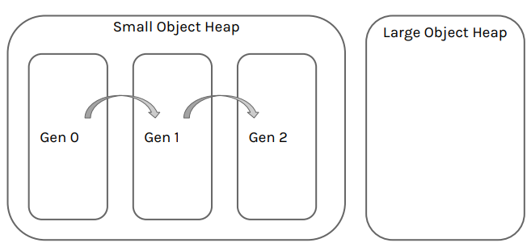
Heap

Slide 6
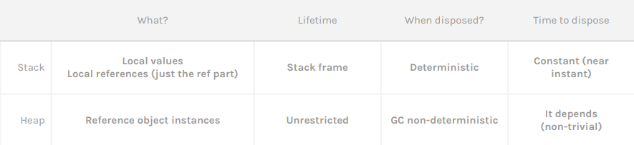
Stack vs Heap

Slide 7
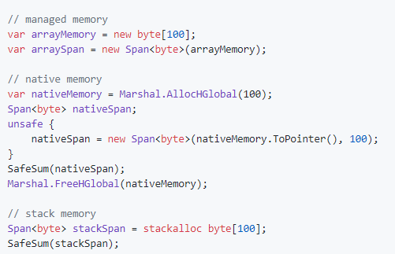
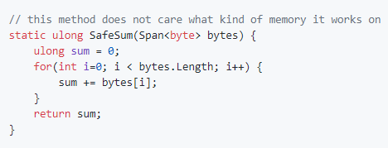
Span<T>
Is an value type abstraction over all types of memory available to .NET
Ensures memory and type safety and has almost no overhead

Slide 8
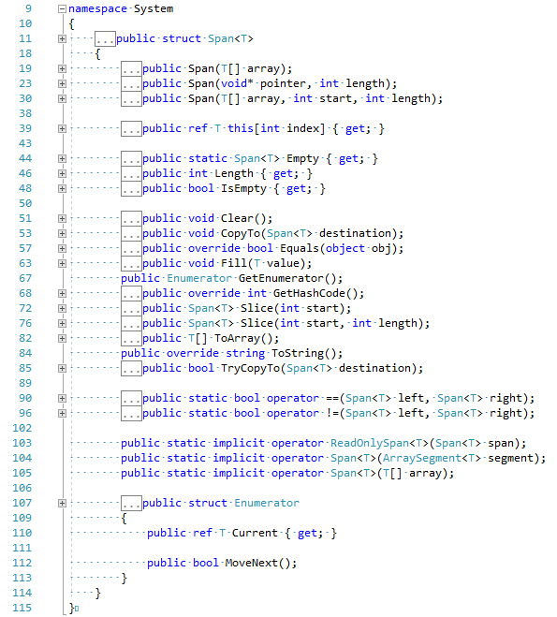
Api

Slide 9
Use case scenarios
Alternative to unsafe code
Parsing text
Sharing partial parts of memory

Slide 10
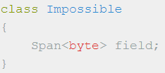
Limitations
Stack-only
Span must not be a field in non-stack-only type
Span must not implement any existing interface
Span must not be a parameter for async method
Span must not be a generic type argument

Slide 11
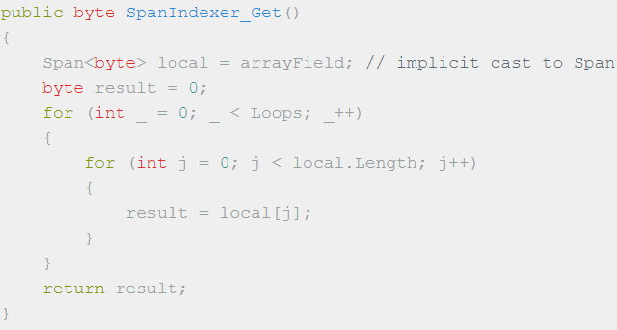
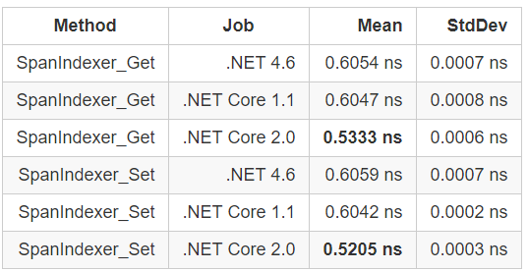
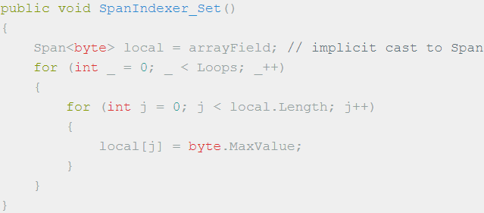
Version Hell
Only the .NET Core 2.0 runtime enforces some of the safety rules
C# 7.2 to have safety guaranteed by the compiler

Slide 12
Summary
Work with any type of memory
Work with native memory much easier
Avoid allocating and copying of memory with Slicing
Supports .NET Standard 1.0+
It’s performance is on par with Array for new runtimes.
It’s limited due to stack only requirements.
It’s not finished yet, we need C# 7.2 to have safety guaranteed by the compiler

Slide 13
References
https://github.com/dotnet/corefxlab/blob/master/docs/specs/span.md
http://adamsitnik.com/the-new-Memory-Diagnoser/
https://github.com/dimdeli/span_lab

