Slide 1
Pycharm
Download Pycharm (https://www.jetbrains.com/fr-fr/pycharm/download/#section=windows)
Select the version that corresponds to your OS (Windows, Mac or Linux)
Once downloaded, double click on the installation file (*.exe)

Slide 2
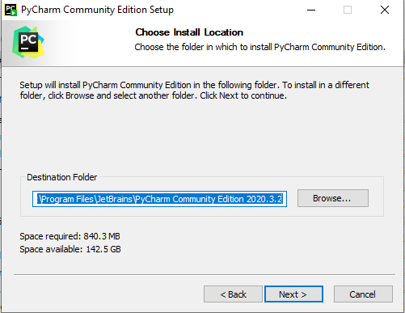
You can change the Destination Folder if you want

Slide 3
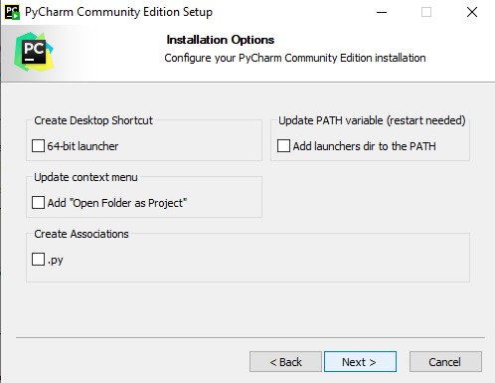
Let all the boxes unselected

Slide 4
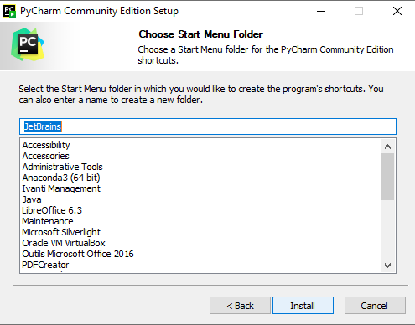
Let the default value

Slide 5
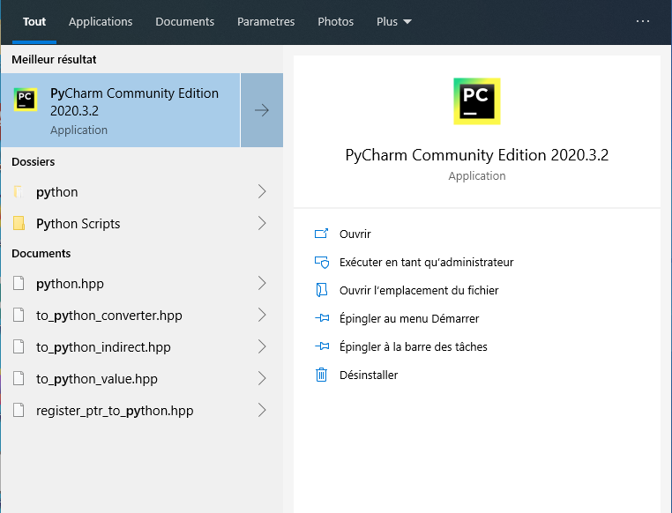
Once Pycharm is installed launch it

Slide 6
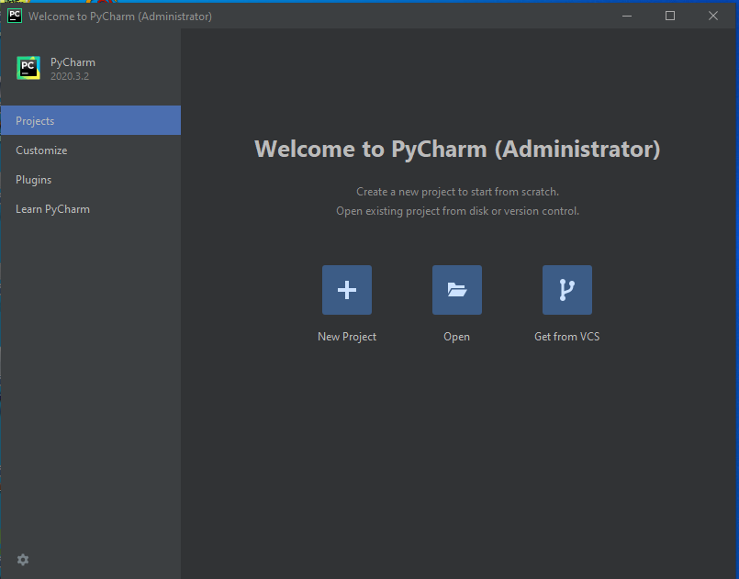
Click on New Project (+)

Slide 7
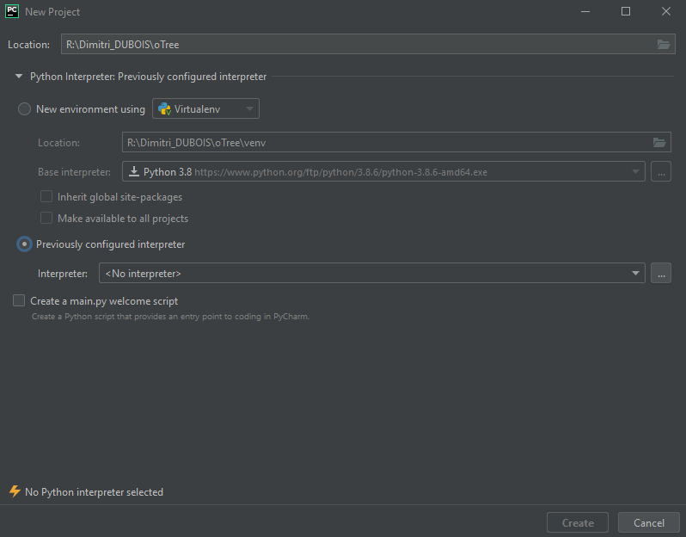
Change the location and select the directory you created with the command otree startproject
Also, select “Previously configured Interpreter” and click on the three dots on the right (...)

Slide 8
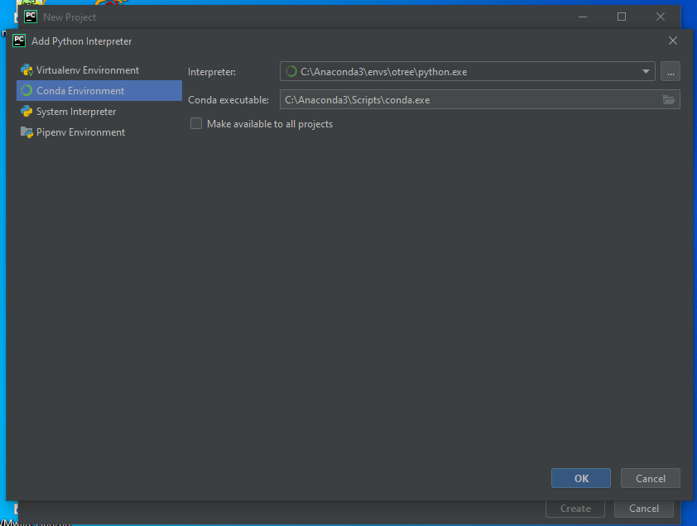
Select Conda Environment and in the interpreter you should have the right path to the Anaconda Environment you created.

Slide 9
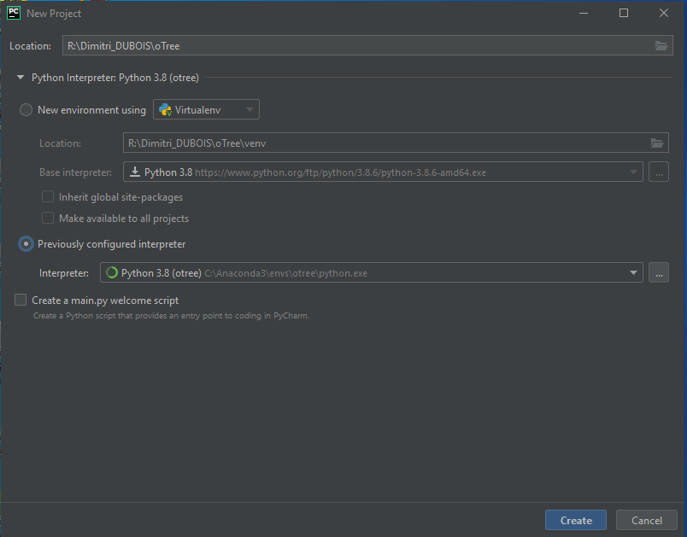
After clicking on Ok on the previous screen the interpreter area is filled in

Slide 10
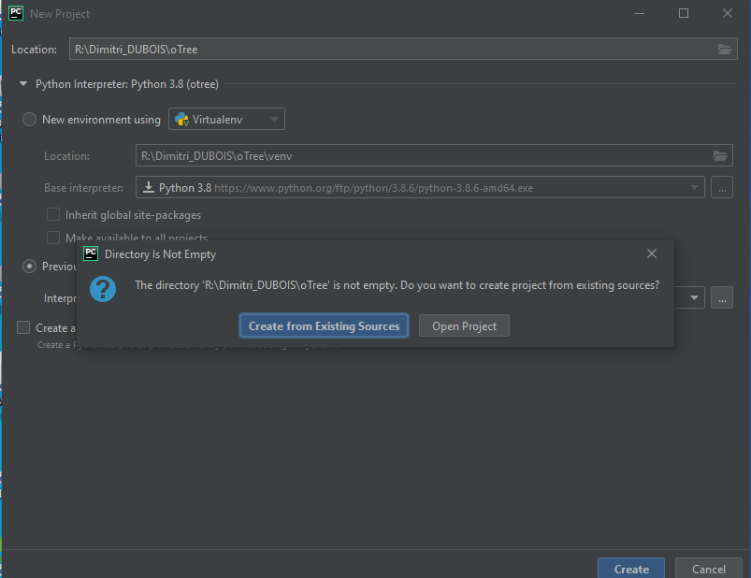
Click on “Create”, and in the popup click on “Create from Existing Source”

Slide 11
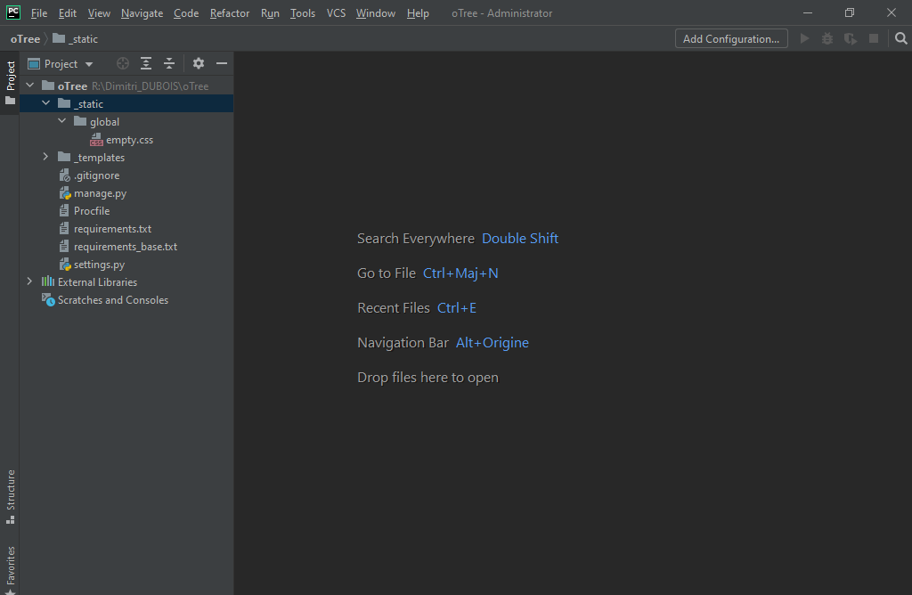
The screen you should have in front of you

Slide 12
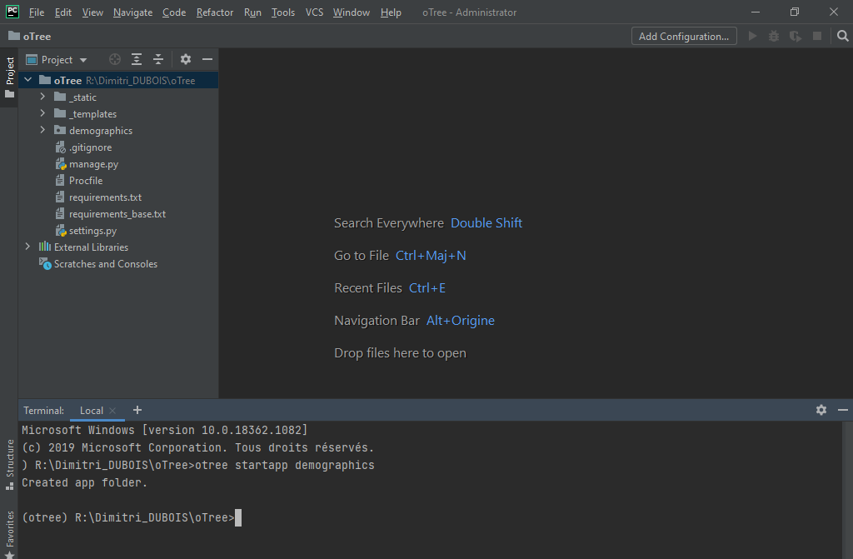
At the bottom of the screen click on “Terminal” and write otree startapp demographics
It creates the application demographics, you should see a new directory (demographics)

Slide 13
Great! You’re ready to start coding with otree

