Slide 1
Anaconda
Download anaconda (https://www.anaconda.com/products/individual)
Execute the installation file (*.exe)

Slide 2
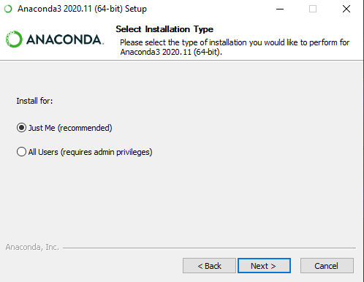
Select “Just Me”

Slide 3
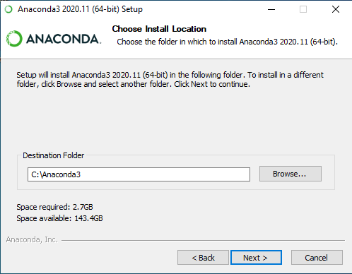
Change the destination folder, it will be easier to find the directory thereafter

Slide 4
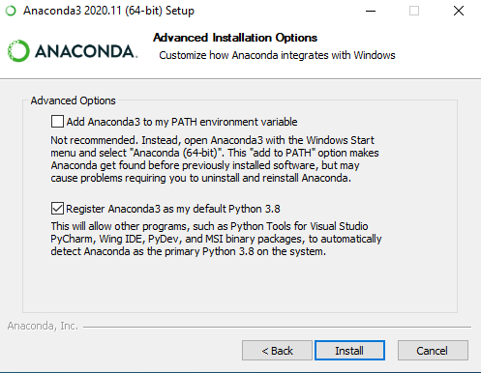
Click on “Register Anaconda as my default Python”

Slide 5
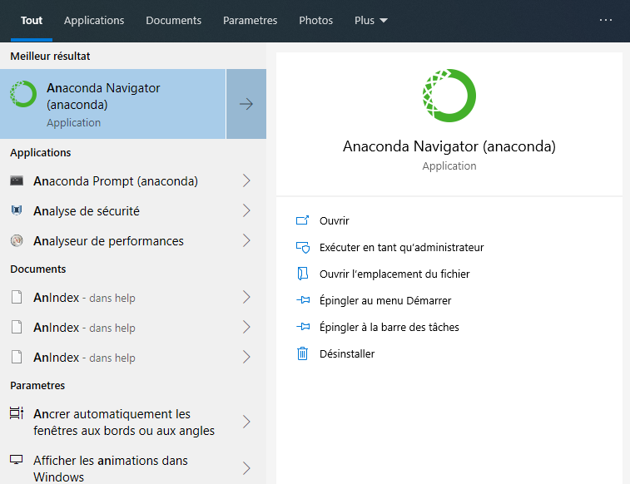
Once the installation is finished, launch Anaconda Navigator

Slide 6
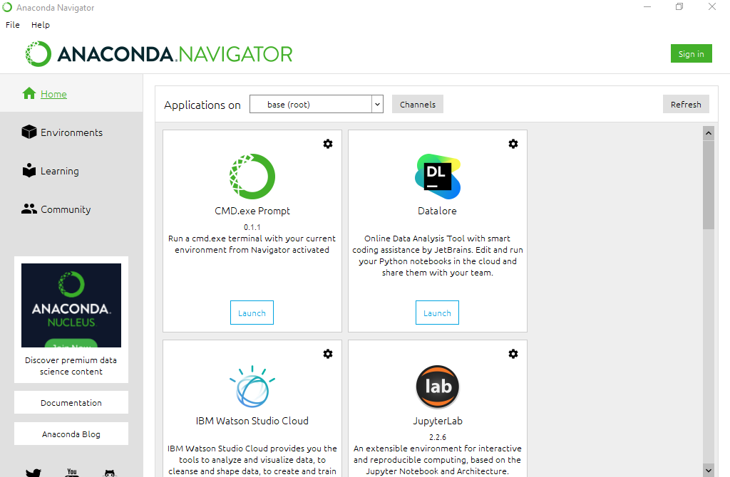
Anaconda Navigator

Slide 7
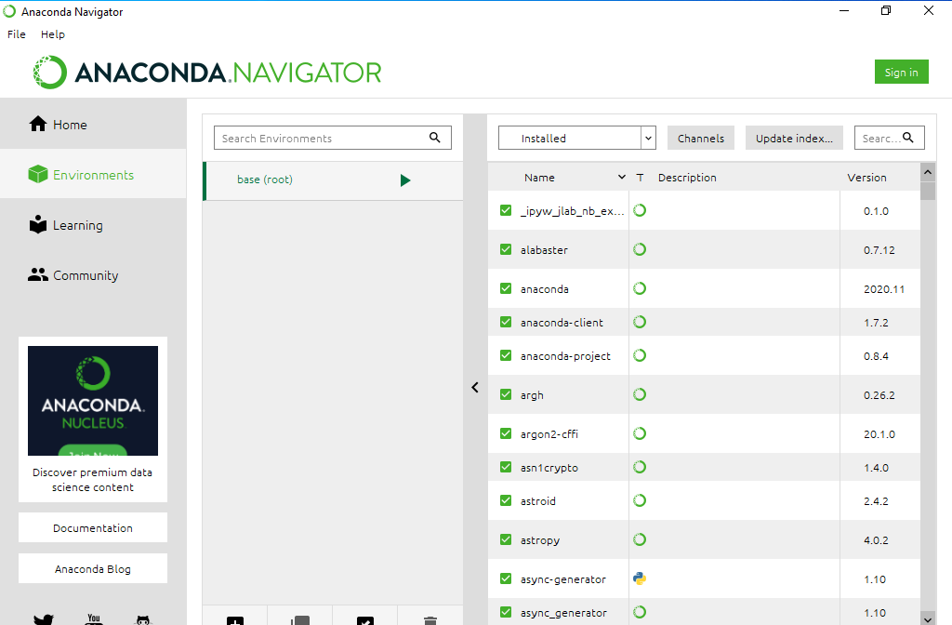
Click on “Environments”

Slide 8
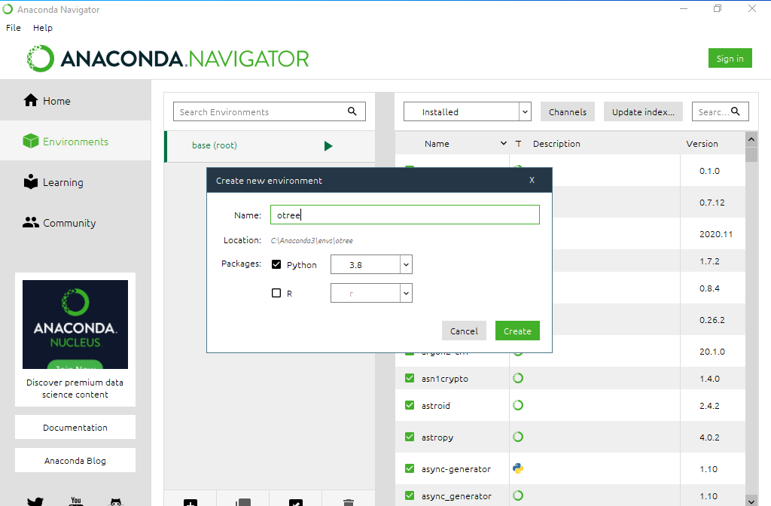
Click on the + (create) at the bottom and then in the popup that appears enter otree as Name and select Python

Slide 9
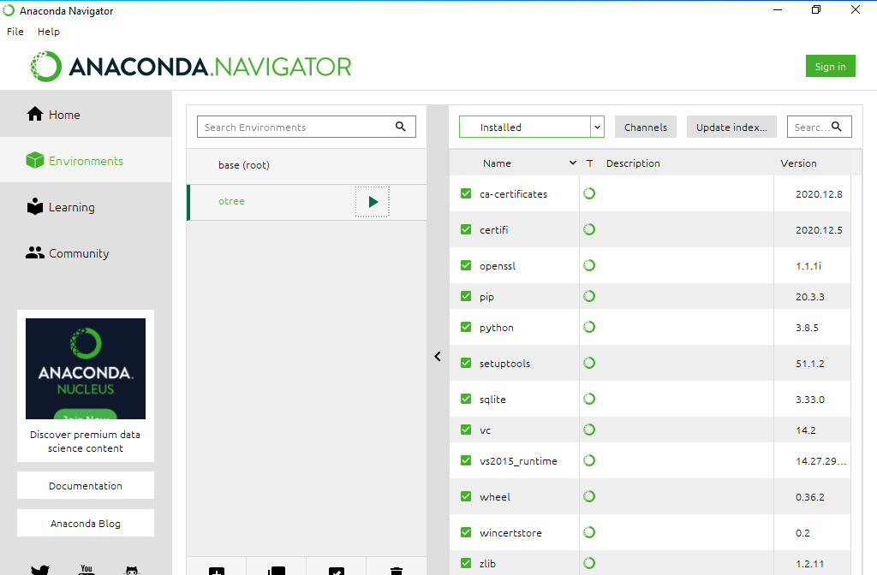
Once created, select the new environment and click on the green arrow

Slide 10
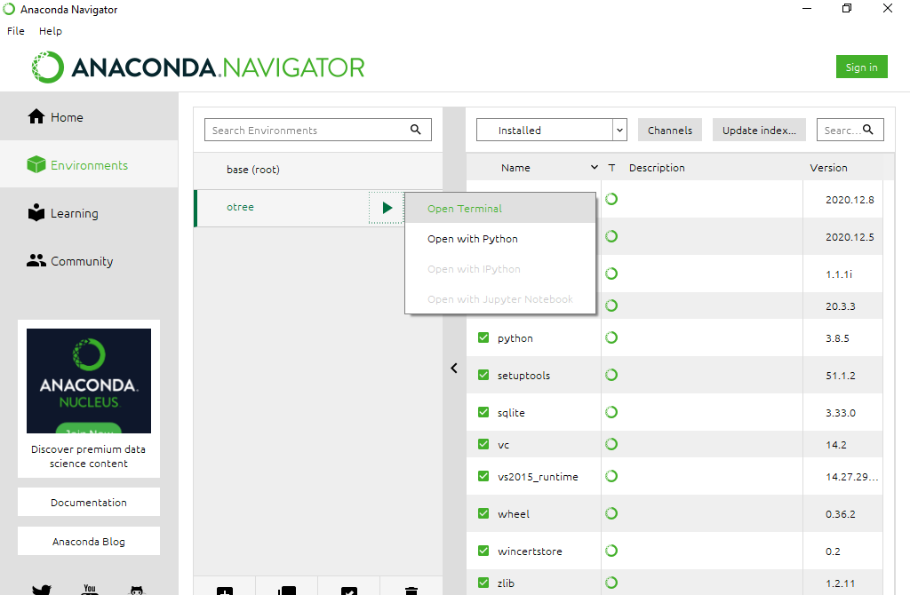
Select Open Terminal

Slide 11
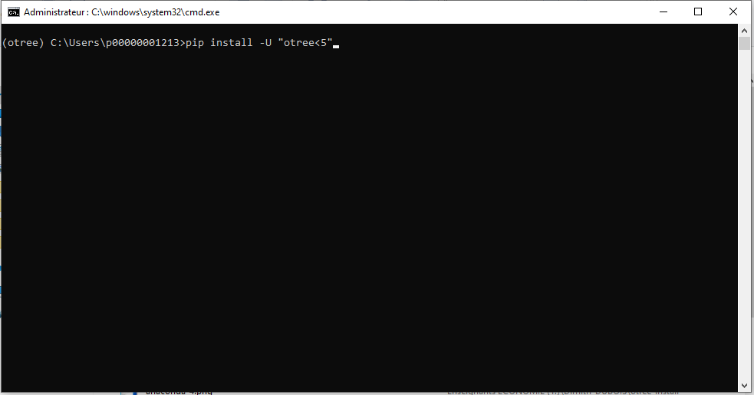
In the console write pip install -U otree

Slide 12
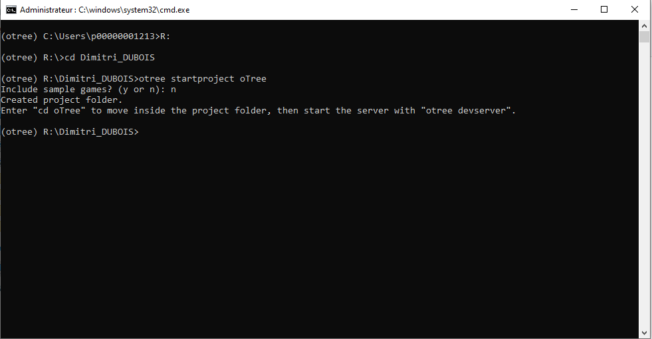
Once otree is installed move to the directory in which you want to create the otree project (cd for change directory).
Once in the directory, write otree startproject otree

Slide 13
Once the project is created you can close the console and anaconda navigator, and start the installation of Pycharm

