Slide 1
Project One : Intelligent OCR Invoice Processing Requirements
Vendors Send invoices to :sampleinvoice@zingerpay.com
Template 1: Standard ZingerPay Invoice Document Type Template
Template 2: Semi Structured Invoice Document Type Template
Template 3: Standard Treasury Payment Voucher Document Type Template
Function Module One
BOT Monitors sampleinvoice@zingerpay.com email address every Thirty Minutes
Moves all incoming emails into “1_pending_processing” folder
For Each Email in “pending_processing” folder, run Intelligent OCR Workflow
Function Module Two : Create Two Versions (Version A : For Unattended Standard ZingerPay Invoice Document Type Template and Version B : Attended : Semi Structured Invoice Document Type Template)
Intelligent OCR Workflow reads each attachment in the email using the PO Invoice Document Type Template
Intelligent OCR Workflow and saves the scanned information into Microsoft excel file as file name : C://users/username/1_OCR_Invoices/Date/invoice#_date.xlxs.
We will eventually configure a dropbox or google drive or onedrive directory for this.
Function Module Three
BOT logs into https://zingerpay.com/zingerapps/portal_electronic_payments/login.asp
Selects Vendor Management
Check if Vendor Exists
Action
If Vendor exists, select “Enter Payment Request”
If Vendor does not exist, select “Plus Sign” to add Vendor.
Enter Payment Request
Function Module Four
Once Payment Request is entered, email is moved from pending_processing to “3_processed_invoices” folder.
If processing fails, email is moved from “pending_processing” folder to “2_invoices_for_review” folder.

Slide 2
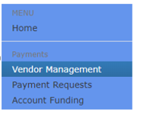
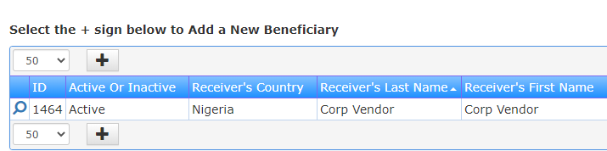
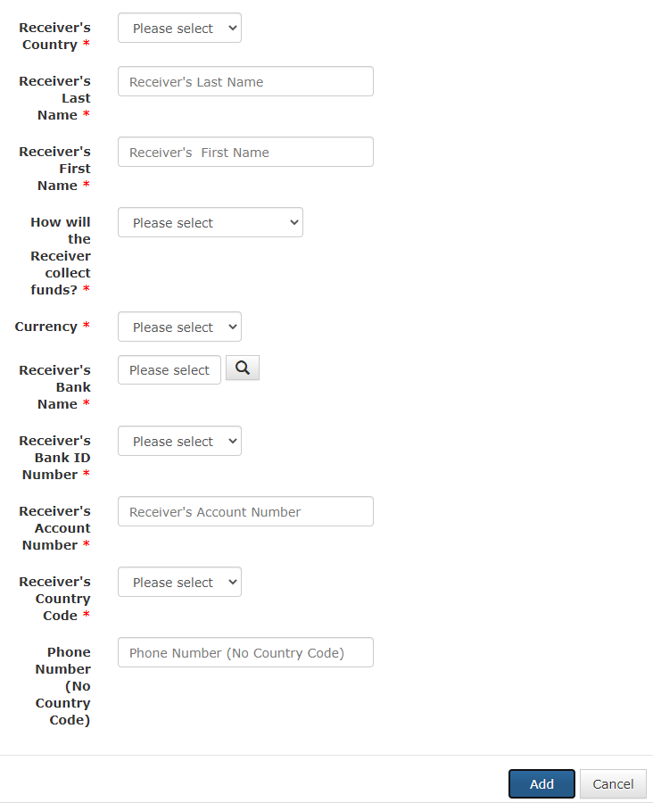


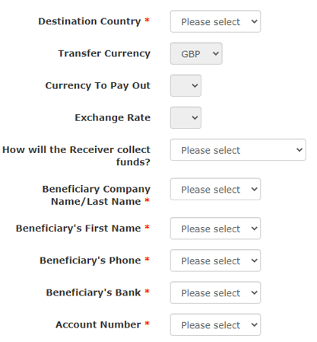
Project One : Intelligent OCR Invoice Processing Requirements
3b
1
2
3a
4

Slide 3
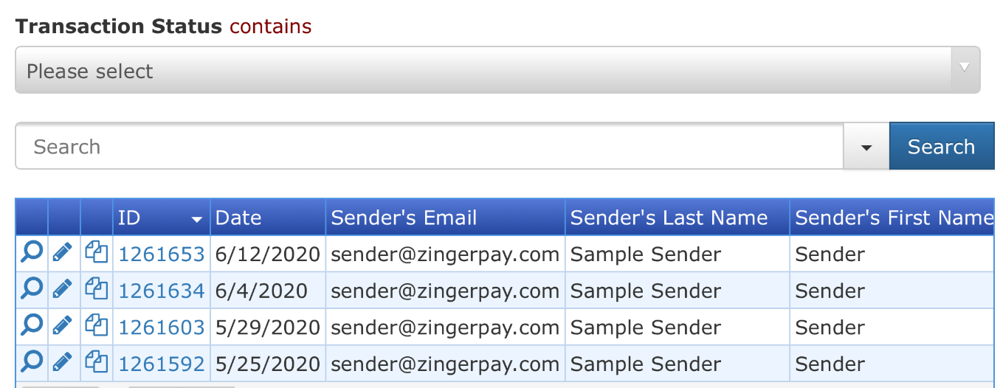
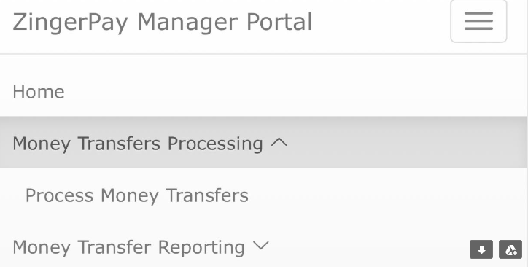
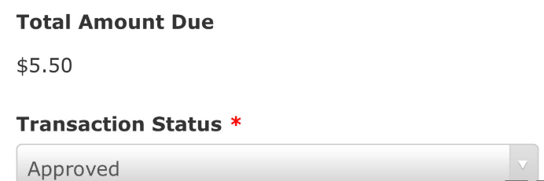
Project Two : Payment Processing Requirements
Function Module One
BOT logs into https://zingerpay.com/zingerapps/***/login.asp
Selects Approve Payments
Select all Payments with status “Submitted_For_Approval”
Change them from status “Submitted_For_Approval” to “Approved”
If the API returns Value “Processed” then initiate SMS Sending API
If the API returns Value “Failed”, send email to customerservice@zingerpay.com with following data:
2
Search for Transaction Status Contains “Submitted_For_Approval”
1
Select Process Payment Request
3

