Slide 1
Non-negative Matrix Factorization
Higher understanding with lower dimensions – GLBIO 2019
Da-Inn Erika Lee

Slide 2
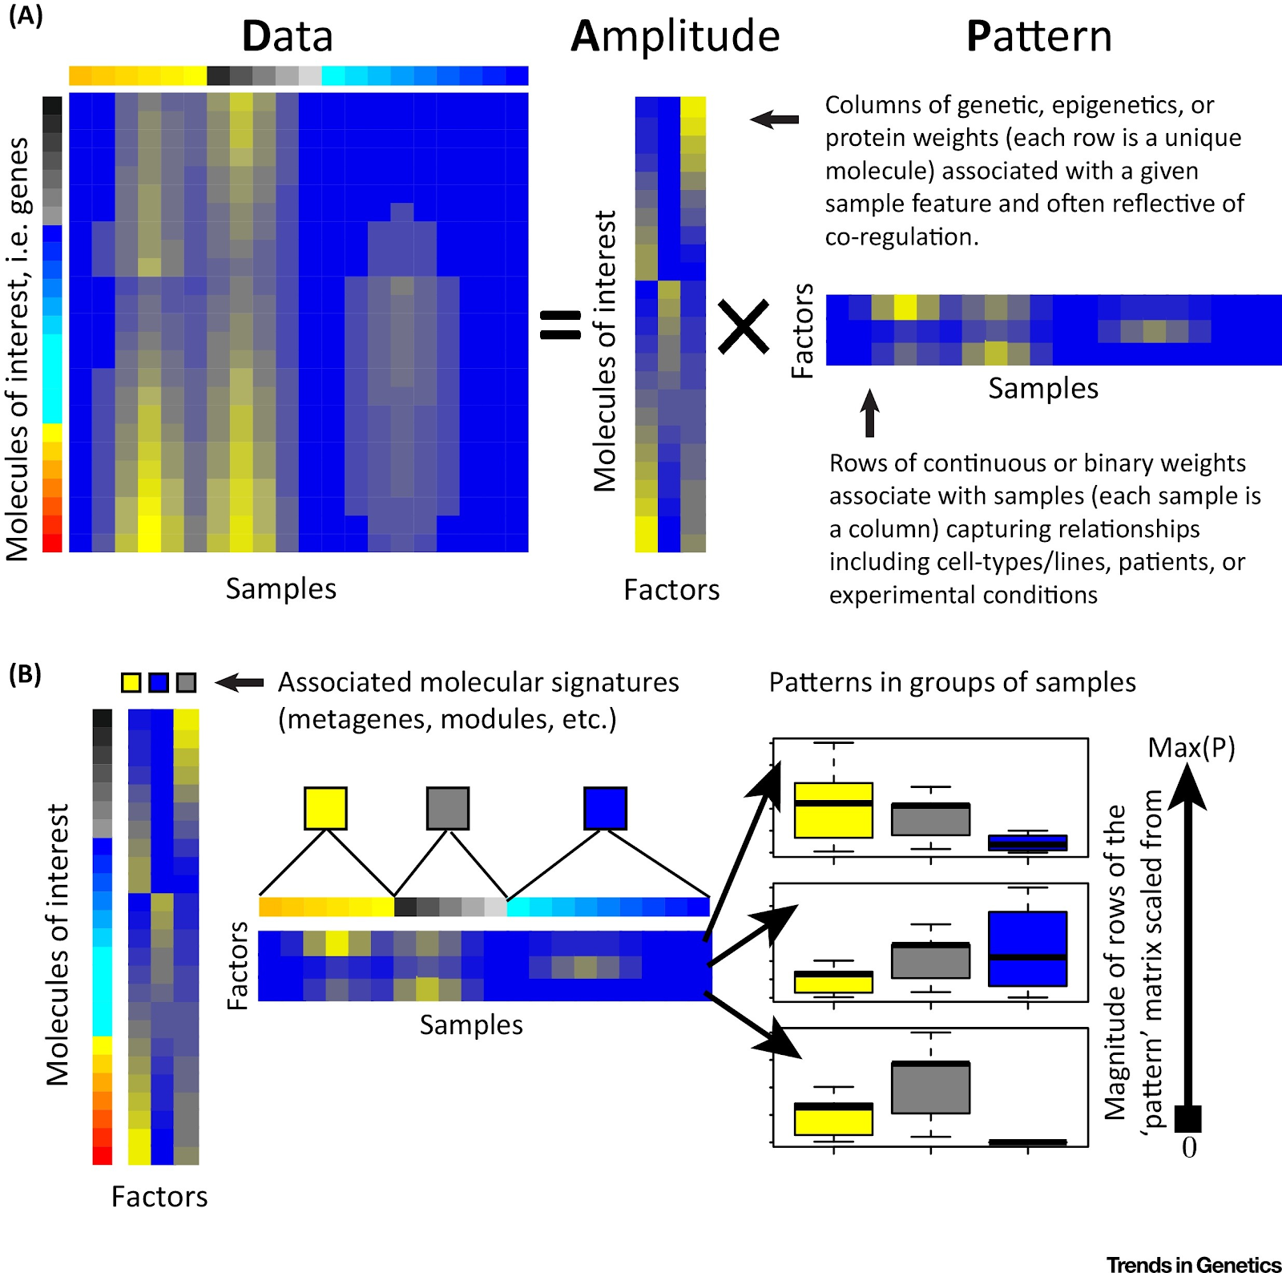

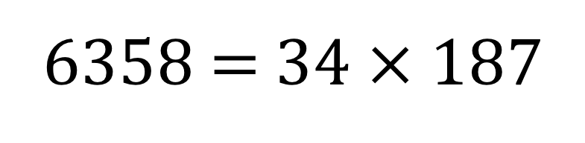

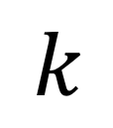
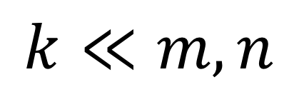


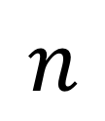

Intuition
You can factor a number to two smaller numbers:
You can also factorize a large matrix into two smaller ones:
6358 = 34 $×$ 187
$$n$$
$$≈$$
$$n$$
•
$$k$$
$$m$$
$$m$$
$$k$$
$$k≪m,n$$

Slide 3
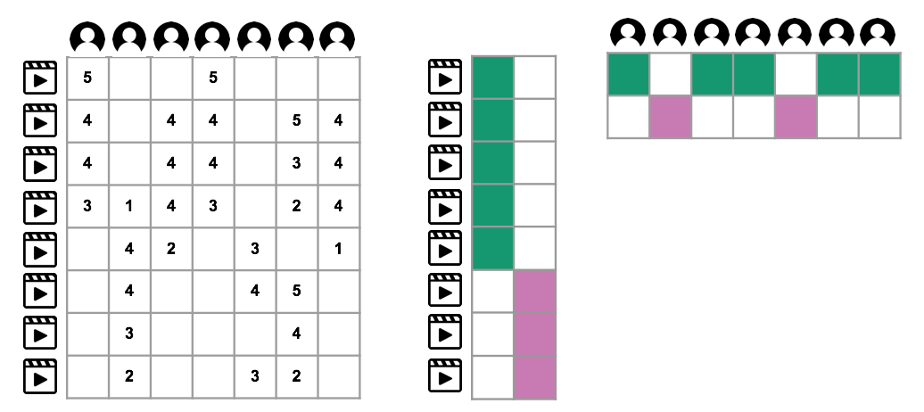



Why is that useful?
Take the Netflix challenge data for example:
The factors enable co-clustering groups of users that prefer groups of similar movies.
$${\text{H}}^{T}∈ℝ^{k×m}$$
$$\text{X}∈ℝ^{n×m}$$
$$\text{W}∈ℝ^{n×k}$$

Slide 4
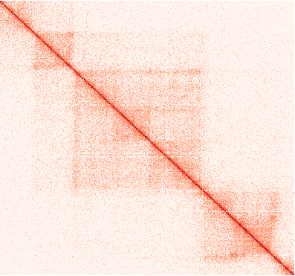
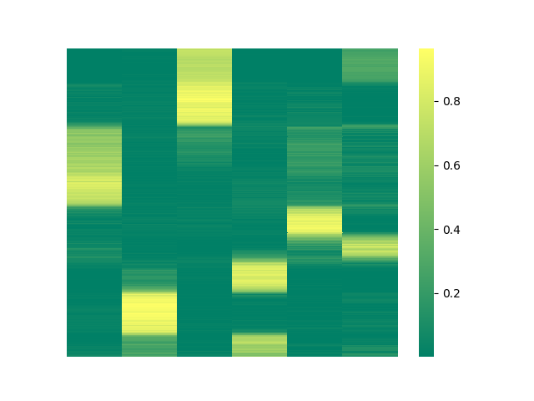
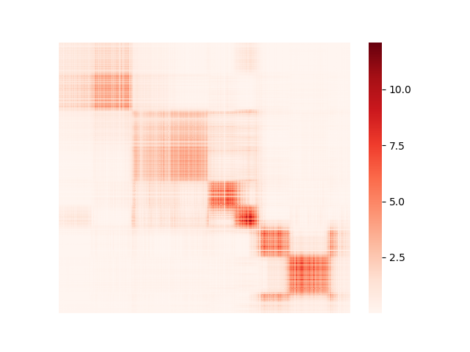








Objective
Minimize
i.e., find factors such that when multiplied back,
you get as close as you can to the original matrix.
$$≈$$
$$•$$
$$=$$
$${\text{H}}^{T}∈ℝ^{k×m}$$
$$\text{X}∈ℝ^{n×m}$$
$$\text{W}∈ℝ^{n×k}$$
$$\text{X}’∈ℝ^{n×m}$$

Slide 5
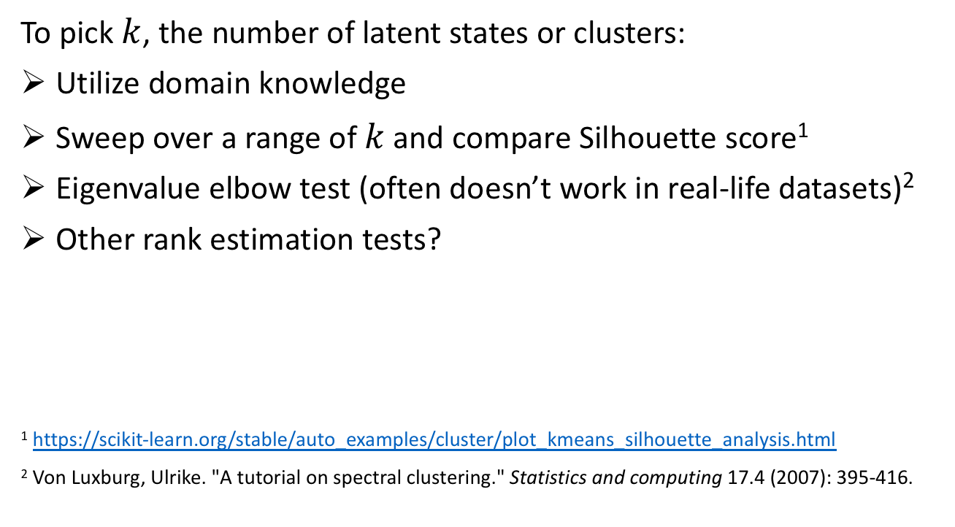
Parameter selection
To pick $k$, the number of latent states or clusters:
Utilize domain knowledge
Sweep over a range of $k$ and compare Silhouette score¹
Eigenvalue elbow test (often doesn’t work in real-life datasets)²
Other rank estimation tests?
¹ https://scikit-learn.org/stable/auto_examples/cluster/plot_kmeans_silhouette_analysis.html
² Von Luxburg, Ulrike. "A tutorial on spectral clustering." Statistics and computing 17.4 (2007): 395-416.

Slide 6
Clustering
To assign each row or column to a ‘hard’ cluster:
Assign each row to the most dominant latent state, i.e. column with the largest value for the given row (used in demo code)
k-means clustering
Agglomerative clustering
Or whatever else you want to try!

Slide 7
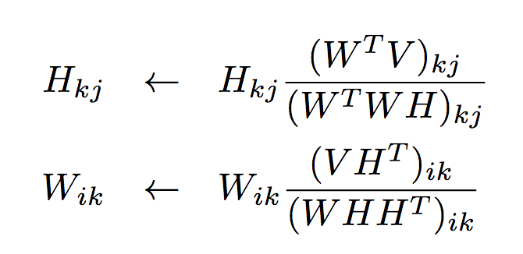
Algorithms
Multiplicative update
Guaranteed convergence to local minimum
Can get slow due to large matrix-matrix multiplications
Gradient descent (e.g. alternating least square)
Sometimes does not converge
Faster

Slide 8
Takeaways
NMF enables co-clustering of row entities and column entities.
R: https://cran.r-project.org/web/packages/NMF/index.html
Python: https://scikit-learn.org/stable/modules/generated/sklearn.decomposition.NMF.html
Recommendation for exploring all the different NMF flavors:
Start with the API default objective, algorithm, and initialization, visualize the results to see if you get something reasonable, and go from there. Or,
Find an implementation for an application similar to your dataset and end goal.

Slide 9

Initialization methods
$$p.s.$$
Random initialization
Randomly fill in the factors initially
Run multiple times, pick one that achieved best objective value
NNDSVD initialization
Utilize singular vectors and values of the matrix to capture basic structure
Shown to converge faster to better objective value

Slide 10

An alternate objective for NMF
$$p.s.$$
“Find factors such that when multiplied back,
you get as close as you can to the original matrix.”
This objective can alternately be expressed as
minimizing the KL divergence between
the distribution in the original matrix
and the approximated one:
“When applying the method to a medulloblastoma dataset, where we knew the underlying substructure, we observed that the divergence-based update equations were able to capture a subclass that the norm-based update equations did not.”
Brunet et al. PNAS 2004

Slide 11
Probabilistic cousins
$$p.s.$$
You can factor probabilities:
which gives us the probabilistic interpretations and implementations of NMF.
Probabilistic Latent Semantic Analysis (PLSA)
Mathematically equivalent to NMF minimizing KL divergence
EM algorithm
Bayesian NMF
MCMC
Variational inference

