Slide 1
Autoencoders
Higher Understanding with Lower Dimensions
Henry Ward - GLBIO (5/20/2019)

Slide 2
Core idea
Map input data to low-dimensional space with neural nets

Slide 3
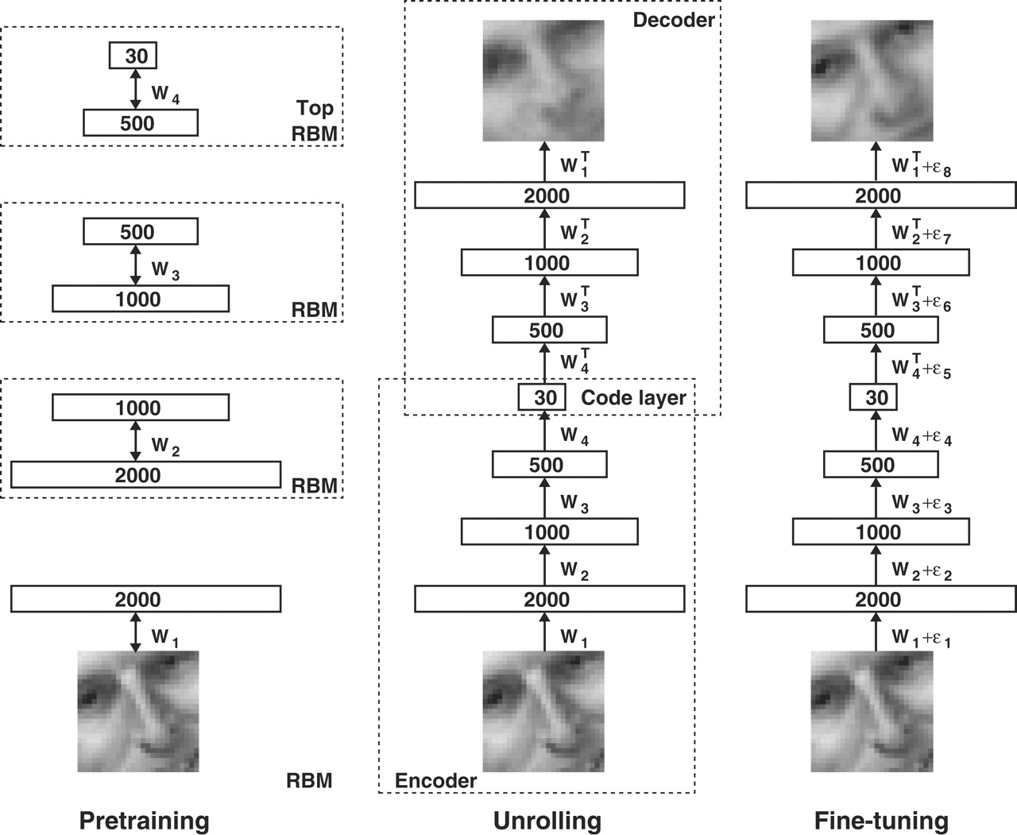
Modern formulation (Hinton & Salakhutdinov 2006)
Notes:
Shouldn’t say “original” formulation, because apparently the idea was percolating in various forms since the 1980’s, but was generally too computationally difficult to implement.

Slide 4
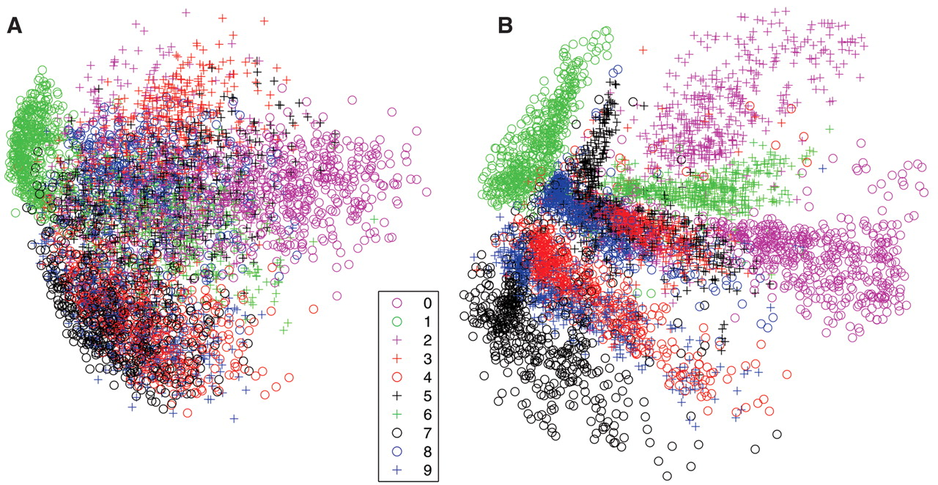
Visualizing encoded data
Notes:
Left: first two PCs of MNIST. Right: two-dimensional autoencoder.

Slide 5
Relationship to PCA
Linear activation function onto a single hidden layer of p < n nodes approximates the first p principal components
Fully-connected
Squared-error loss function
Weights are NOT equivalent to principal components
Get principal components from weights by getting left singular values of weights (from SVD)
Plaut, E. (2018). From principal subspaces to principal components with linear autoencoders
Notes:
Next we’ll go through some extensions to the idea of an autoencoder.

Slide 6
Sparse autoencoders
We want to have more nodes in the encoded layer
Enabled by setting sparsity constraint on the nodes
Penalize nodes for having average activation values that deviate from a preset sparsity parameter
Notes:
Resource: https://web.stanford.edu/class/cs294a/sparseAutoencoder.pdf

Slide 7
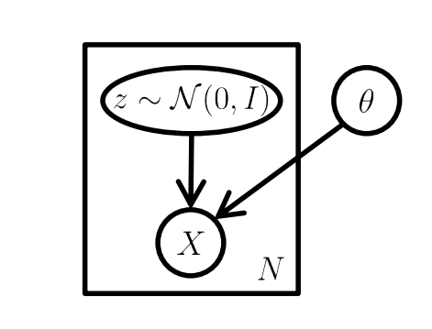
Variational autoencoder (VAE)
Carl Doersch (2016). Tutorial on variational autoencoders.
Notes:
General process is to map from a latent variable (typically a Gaussian distribution) to input data, X, using the parameters of a model, theta (e.g. a neural network).
Reference: https://arxiv.org/pdf/1606.05908.pdf

Slide 8
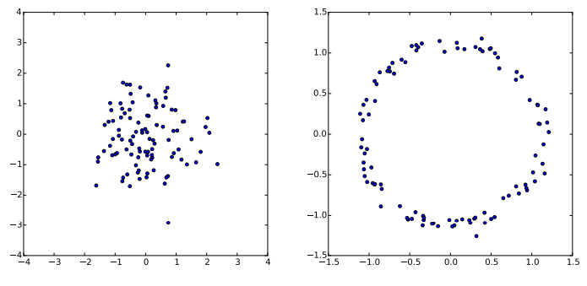
VAE formulation
G(z)
Carl Doersch (2016). Tutorial on variational autoencoders.
Notes:
Gaussian noise mapped through g(z) = z/10 + z/||z||. Same strategy employed by autoencoders

Slide 9
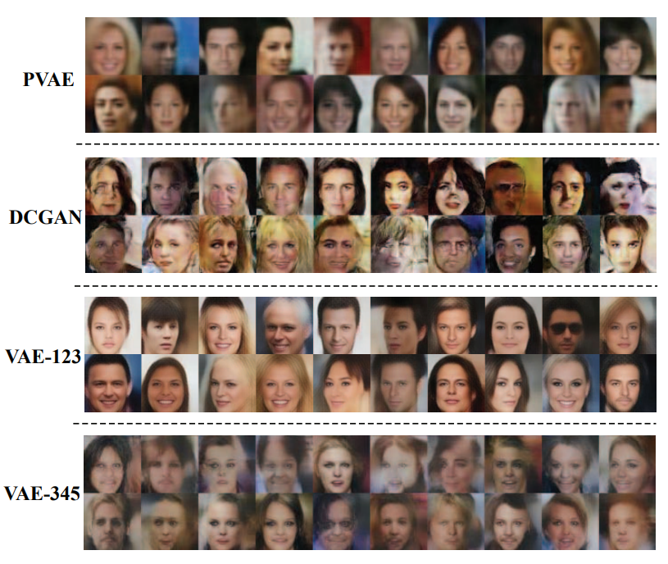
VAEs for image generation
Hou, X. et al. (2017). Deep feature consistent variational autoencoder.
Notes:
Gaussian noise mapped through g(z) = z/10 + z/||z||. Same strategy employed by autoencoders

Slide 10
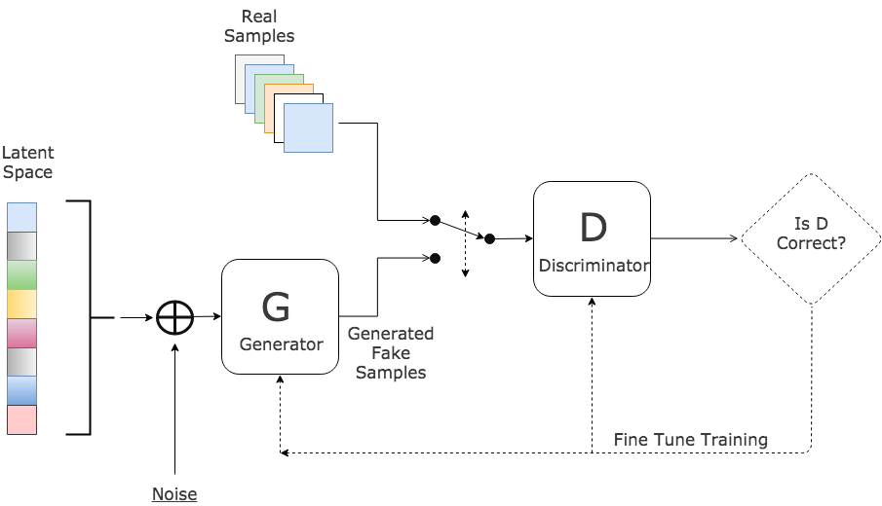
Generative adversarial network (GAN)
Source: https://stats.stackexchange.com/questions/277756/some-general-questions-on-generative-adversarial-networks/278045

Slide 11
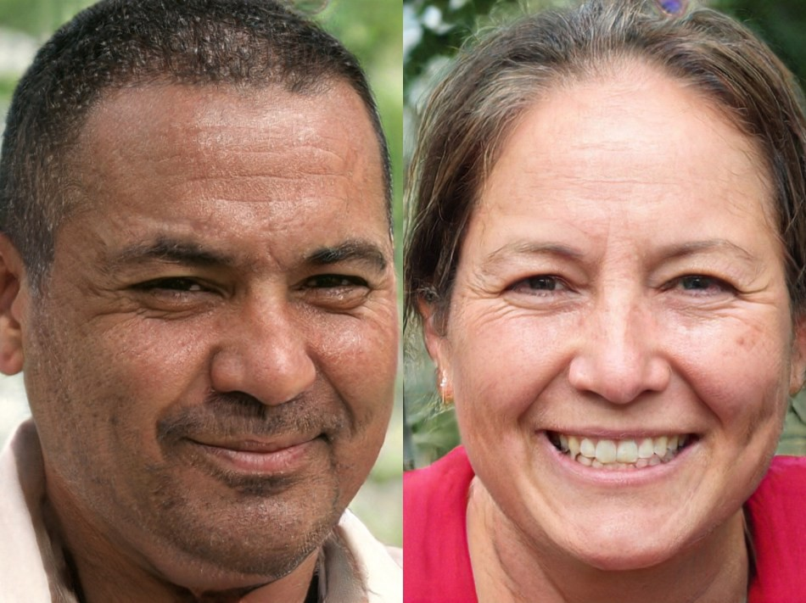
GANs for image generation
Learn latent space like VAEs
Map data back to learned latent space to get encodings
Source: https://medium.com/syncedreview/gan-2-0-nvidias-hyperrealistic-face-generator-e3439d33ebaf

