Slide 1
Patient Safety, Clinical Governance & Enterprise Risk Oversight
Healthcare organizations operate in complex, high-stakes environments where risk management directly affects patient outcomes, legal exposure, regulatory compliance, and institutional reputation.
Prepared by: Phumi Mhlongo & Nozipho Mememla

Slide 2

Agenda
Healthcare Risk Landscape
Core Risk Categories
Patient Safety & Clinical Risk
Data & Cybersecurity Risks
Regulatory & Liability Exposure
Incident Management & Quality Integration
Implementation & Governance
This presentation integrates patient safety science with enterprise risk governance.

Slide 3

Healthcare Risk Landscape
Healthcare risk management is shaped by:
Patient Acuity
Regulatory Scrutiny
Increasing patient acuity and complexity
Regulatory scrutiny and accreditation standards
Data Privacy
Staffing Challenges
Data privacy requirements
Staffing shortages and burnout
Litigation
Reputation
Litigation exposure
Public transparency and reputation sensitivity
Definition: Healthcare risk is exposure to patient harm, regulatory violation, financial loss, or reputational damage arising from clinical or operational activities.
In healthcare, risk failures directly impact human life.

Slide 4
Risk Categories in Healthcare
Healthcare risks typically fall into:
1. Clinical Risk
2. Operational Risk
3. Financial Risk
Patient harm during care delivery
Staffing, process, or system failures
Revenue cycle, reimbursement, fraud
4. Compliance Risk
5. Strategic Risk
6. Reputational Risk
Regulatory breaches
Market competition, service expansion
Public trust and transparency
Effective ERM must integrate clinical governance with enterprise oversight.

Slide 5

Patient Safety Framework
Patient safety is the foundation of healthcare risk management.
Core elements:
Just Culture
Safety Culture
Encouraging reporting without blame
Leadership prioritizing patient welfare
Standardized Protocols
Continuous Monitoring
Consistent procedures across care settings
Ongoing surveillance and improvement
Definition: A "just culture" balances accountability with system learning.
Example: Encouraging nurses to report near-misses without fear of punishment.
Patient safety is a system property, not an individual attribute.

Slide 6
Clinical Risk Management
Clinical risk refers to potential harm during patient diagnosis, treatment, or care delivery.
Examples
Controls
Diagnostic delay
Miscommunication during handover
Failure to monitor deteriorating patient
Inadequate informed consent
Clinical pathways
Escalation protocols (e.g., rapid response teams)
Standardized documentation
Peer review committees
Clinical risk management requires multidisciplinary oversight.

Slide 7

Medication Safety
Medication errors are among the most common adverse events.
Risks include:
Controls:
Incorrect dosage
Wrong medication
Drug interactions
Look-alike/sound-alike drugs
Electronic prescribing systems
Barcode medication administration
Double-check protocols
Pharmacy reconciliation processes
Definition: Medication reconciliation ensures medication lists are accurate during transitions of care.
Medication safety failures can lead to severe harm or death.

Slide 8
Infection Prevention
Healthcare-Associated Infections (HAIs) are preventable patient harms.
Common HAIs include:
Central line-associated bloodstream infections
Surgical site infections
Catheter-associated urinary tract infections
Controls:
Sterile technique protocols
Hand hygiene compliance
Environmental cleaning audits
Isolation procedures
Infection control failures carry patient, regulatory, and financial consequences.

Slide 9
Surgical & Procedural Risks
Operating rooms are high-risk environments.
Risks include:
Controls:
Wrong-site surgery
Anesthesia complications
Retained surgical items
Equipment malfunction
Surgical safety checklists
Time-out procedures
Instrument counts
Anesthesia monitoring standards
Example: WHO surgical safety checklist reduces procedural mortality.
Procedural safety must be protocol-driven.

Slide 10

Data Privacy
Healthcare organizations manage sensitive personal health information (PHI).
Risks include:
1
2
Unauthorized access
Data breaches
3
4
Identity theft
Regulatory penalties
Definition: Protected Health Information (PHI) includes any identifiable patient data related to health status or treatment.
Controls:
Access control policies
Encryption
Audit logs
Privacy officer oversight
Data breaches carry significant legal and reputational risk.

Slide 11
Cybersecurity in Healthcare
Healthcare systems are increasingly targeted by cybercriminals.
Risks include:
Ransomware attacks disrupting hospital systems
EHR system compromise
Medical device vulnerabilities
Definition: Electronic Health Records (EHR) are digital patient records requiring strict security controls.
Controls:
Network segmentation
Multi-factor authentication
Incident response plans
Regular penetration testing
Cyber incidents can disrupt patient care delivery.

Slide 12
Risk Assessment Matrix
Healthcare risk scoring considers:
Likelihood × Severity
Severity dimensions may include:
Patient harm
Legal exposure
Financial impact
Reputational damage
Example: A medication labeling error may have moderate likelihood but high severity.
High-severity events require board-level visibility.
Consistent scoring improves prioritization and mitigation tracking.

Slide 13



Incident Reporting System
Incident reporting systems capture:
Adverse events
Near-misses
Unsafe conditions
Definition: An adverse event is unintended harm caused by medical care rather than the underlying condition.
Effective systems require:
Anonymous reporting options
Timely review
Feedback loops
Learning depends on transparent reporting.

Slide 14
Root Cause Analysis
Root Cause Analysis (RCA) investigates systemic contributors to harm.
Steps include:
1
Define event
2
Map sequence of events
3
Identify contributing factors
4
Determine root causes
5
Develop corrective actions
Example: Wrong medication administered due to labeling confusion and shift fatigue.
RCA must focus on system improvement, not blame.

Slide 15
Regulatory Compliance
Healthcare organizations must comply with:
Licensing regulations
Accreditation standards
Health information privacy laws
Infection control regulations
Non-compliance consequences include:
Financial penalties
Loss of accreditation
Operational restrictions
Compliance governance must be embedded in ERM.

Slide 16
Medical Malpractice Risk
Medical malpractice risk arises from:
Risk Sources
Controls
Negligence claims
Failure to diagnose
Surgical errors
Lack of informed consent
Documentation accuracy
Evidence-based practice
Communication training
Malpractice insurance
Strong clinical governance reduces liability exposure.

Slide 17
Credentialing & Privileging
Credentialing ensures provider qualifications meet standards.
Controls:
Privileging defines scope of clinical practice.
Regular credential audits
Centralized provider database
Peer review oversight
Risks include:
Unverified qualifications
Expired licenses
Practicing beyond scope
Competency assurance protects patient safety.

Slide 18
Emergency Preparedness
Healthcare facilities must prepare for:
Pandemics
Mass casualty events
Natural disasters
Infrastructure failure
Definition: Emergency preparedness includes surge capacity planning and continuity of care strategies.
Controls:
Emergency operations plans
Drill simulations
Backup power systems
Stockpile management
Preparedness determines resilience.

Slide 19
Risk Register Template
Healthcare risk registers should document:
Field
Description
Risk description
Cause–Event–Impact
Inherent risk score
Risk level before controls
Controls in place
Current mitigation measures
Residual risk score
Risk level after controls
Responsible owner
Accountable individual or team
Review frequency
Scheduled reassessment cadence
Standardized documentation supports board oversight.

Slide 20
Quality Improvement Integration
Risk management and quality improvement are interdependent.
Examples:
Incident Trends → Protocol Changes
Clinical Audits → Mitigation Plans
Using incident trends to drive protocol changes
Linking clinical audit results to mitigation plans
Definition: Continuous Quality Improvement (CQI) systematically improves patient outcomes through iterative evaluation.
Integrated governance reduces duplication and silos.

Slide 21
Staff Training & Competency
Human error contributes significantly to adverse events.
Controls:
1
2
Simulation-based training
Competency assessments
Hands-on practice in controlled environments
Regular evaluation of clinical skills
3
4
Annual certification updates
Fatigue management
Keeping credentials current
Addressing burnout and shift scheduling
Ongoing education strengthens clinical reliability.

Slide 22
Vendor & Third-Party Risks
Healthcare depends on:
Medical device suppliers
IT vendors
Pharmaceutical providers
Outsourced service providers
Risks include:
Supply disruption
Defective devices
Data breaches
Vendor oversight requires contractual, technical, and operational monitoring.

Slide 23
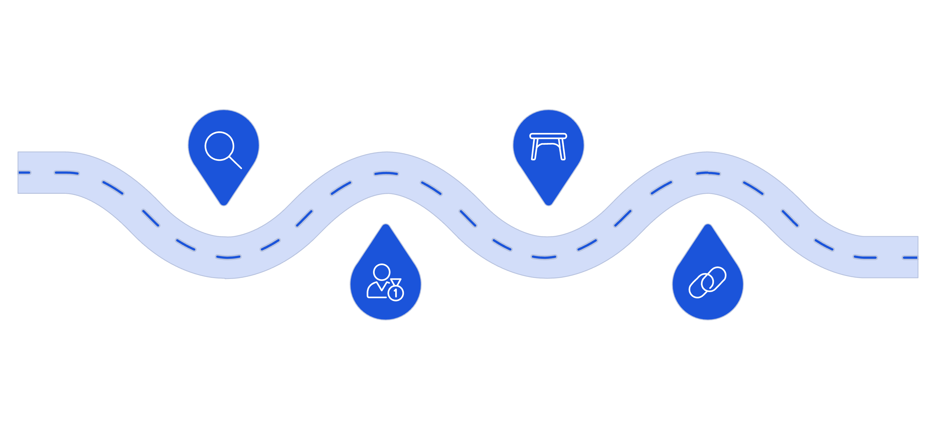
Implementation Roadmap
Gap Assessment
Risk Matrix
Evaluate current risk and compliance gaps
Standardize scoring and prioritization
Patient Safety
Integration
Strengthen incident reporting and response
Align quality and risk processes
Executive sponsorship and medical leadership alignment are critical.

Slide 24
Summary & Next Steps
Healthcare risk management must:
Protect patient safety
Strengthen clinical governance
Ensure regulatory compliance
Secure health data
Reduce malpractice exposure
Integrate quality and risk systems
Immediate Actions:
Review top clinical adverse events
Assess cybersecurity resilience
Audit credentialing processes
Strengthen board-level risk reporting
Patient safety is the ultimate measure of healthcare governance effectiveness.

Slide 25
LEGAL
Property Notice
This presentation is the intellectual property of Phumi Mhlongo and Nozipho Mememla. All rights reserved. Unauthorized reproduction, redistribution, or commercial use is strictly prohibited without prior written consent.

Slide 26
IMPORTANT
Disclaimer
This material is provided for educational and professional purposes only. Healthcare organizations must apply independent professional judgment and comply with applicable regulatory and accreditation requirements when implementing risk management frameworks.

