Slide 1
Operational, Environmental & Safety Risk Governance in Mining
Mining operations involve high-risk physical environments, heavy equipment, geological uncertainty, and significant environmental and social exposure.
Prepared by: Phumi Mhlongo & Nozipho Memela

Slide 2
Agenda
01
02
03
Mining Industry Risk Landscape
Operational Risk Categories
Underground & Surface Hazards
04
05
06
Equipment & Worker Safety
Environmental & Regulatory Compliance
Risk Assessment & Controls
07
08
09
Incident & Emergency Management
Community & Strategic Risks
Implementation Roadmap
This presentation integrates operational safety, environmental stewardship, and enterprise governance.

Slide 3






Mining Industry Risk Landscape
Mining is characterized by:
High fatality potential environments
Geotechnical instability
Commodity price volatility
ESG and environmental scrutiny
Community and labor sensitivity
Definition: Mining risk is the exposure to injury, environmental harm, production interruption, or financial loss arising from extraction and processing activities.
Example: A tailings dam failure can result in catastrophic environmental and reputational damage.
Risk management in mining protects life, license, and long-term viability.

Slide 4






Operational Risk Categories
Mining operational risks typically fall into:
Geotechnical risk
Rockfall, slope failure
Equipment failure
Mechanical breakdown
Explosives risk
Blasting hazards
Ventilation failure
Air quality compromise
Water ingress or flooding
Underground inundation
Processing plant hazards
Chemical & mechanical risks
Each category requires specialized controls and monitoring.
Enterprise risk governance must consolidate site-level exposure.

Slide 5

Underground Mining Hazards
Underground mining presents elevated safety risks due to confined and unstable environments.
Key hazards include:
Controls include:
Rockbursts and ground collapse
Methane or gas explosion
Ventilation system failure
Equipment collision in narrow tunnels
Water inflow or flooding
Ground support systems
Continuous gas monitoring
Emergency refuge chambers
Ventilation redundancy
Underground operations demand strict geotechnical monitoring.
Example: Insufficient roof support can lead to ground fall and fatalities.

Slide 6
Surface Mining Risks
Open-pit mining introduces different but equally significant hazards.
Key risks:
Controls include:
Slope instability and pit wall collapse
Heavy vehicle collisions
Blasting incidents
Dust exposure
Highwall failure
Slope monitoring radar
Traffic management plans
Blast exclusion zones
Example: Improper blast timing can trigger uncontrolled fly rock.
Dust suppression systems
Surface mining risk often escalates with scale.

Slide 7
Equipment & Machinery Risks
Mining relies heavily on high-capacity machinery.
Risks include:
Controls:
Haul truck rollover
Conveyor entanglement
Crushing injuries
Maintenance-related incidents
Preventive maintenance programs
Lockout/Tagout (LOTO)
Operator certification
Telematics monitoring systems
Definition: Mechanical integrity refers to maintaining equipment to prevent unexpected failure.
Equipment risk is one of the largest contributors to serious injuries.

Slide 8





Environmental Compliance
Mining significantly impacts land, water, and ecosystems.
Environmental risks include:
Acid mine drainage
Tailings dam failure
Dust pollution
Water contamination
Biodiversity loss
Example: Poor tailings management can cause downstream contamination and regulatory shutdown.
Controls:
Environmental monitoring systems
Water treatment plants
Rehabilitation planning
Tailings dam integrity inspections
Environmental governance protects social license to operate.

Slide 9

Worker Health & Safety
Occupational health risks in mining include:
Silica dust (silicosis)
Noise exposure
Diesel particulate matter
Heat stress
Definition: Occupational health focuses on long-term exposure risks, not just immediate injury.
Controls include:
Respiratory protection
Noise mitigation programs
Health surveillance
Fatigue management systems
Safety culture must be embedded at all operational levels.

Slide 10
Risk Assessment Matrix
Mining risk assessment evaluates:
Likelihood × Consequence
Consequence dimensions include:
Fatality potential
Environmental damage
Production downtime
Financial loss
Regulatory impact
Example: A tailings breach may have low likelihood but extreme consequence.
High-consequence low-frequency (HCLF) events must receive board visibility.

Slide 11
Hazard Identification Process
Hazard identification should be systematic and documented.
Methods include:
1
2
3
4
Pre-task risk assessments
Job Safety Analysis (JSA)
Geotechnical inspections
Safety walk-throughs
5
Incident trend analysis
Example: Identifying unstable rock formations before drilling begins.
Proactive hazard identification prevents escalation.

Slide 12





Control Hierarchy
The hierarchy of controls ranks safety measures by effectiveness:
1
Elimination
2
Substitution
3
Engineering
4
Administrative
5
PPE
Elimination – Remove hazard
Substitution – Replace hazard
Engineering controls – Physical barriers
Administrative controls – Policies & procedures
PPE – Personal protective equipment
Example: Installing physical guards (engineering control) is more effective than relying solely on PPE.
Mining safety governance should prioritize elimination and engineering solutions.

Slide 13
Emergency Response Planning
Mining emergency preparedness must address:
Underground entrapment
Explosion
Fire
Tailings failure
Chemical spill
Key elements:
Emergency response teams
Mine rescue capability
Regular simulation drills
Communication protocols
Response time directly impacts survival outcomes.

Slide 14
Regulatory Framework
Mining operations are regulated by:
Key Regulations:
Non-compliance can result in:
Occupational health & safety legislation
Environmental permits
Explosives regulations
Water usage licenses
Mine closure requirements
Fines
Shutdown
Criminal liability
License suspension
Regulatory governance must be embedded in risk registers.

Slide 15




Incident Investigation
Incident investigations must focus on root cause, not blame.
Tools include:
5 Whys
Fishbone diagrams
Barrier analysis
Human factors assessment
Example: Equipment collision may trace back to fatigue scheduling practices.
Lessons learned must be shared across sites.

Slide 16
Leading vs Lagging Indicators
Lagging indicators measure past events:
Leading indicators predict risk exposure:
Fatalities
Lost Time Injury Frequency Rate (LTIFR)
Near-miss reporting
Safety observation rate
Critical control verification
Leading metrics drive proactive safety management.

Slide 17
Risk Register Template
Mining risk documentation should include:
Field
Description
Risk description
Cause–Event–Impact
Inherent risk rating
Risk level before controls
Controls in place
Current mitigation measures
Residual risk rating
Risk level after controls
Risk owner
Accountable individual
Review frequency
Scheduled reassessment cycle
Standardized registers improve governance reporting.

Slide 18
Contractor Management
Contractors often represent a large portion of mining workforce exposure.
Risks include:
Controls:
Contractor prequalification
Inconsistent safety culture
Performance monitoring
Lower training standards
Safety audits
Interface risk
Contractor risk must be integrated into enterprise reporting.

Slide 19
Technology & Automation Risks
Modern mining increasingly relies on:
Autonomous trucks
Remote drilling systems
Digital monitoring
Risks include:
System failure
Cybersecurity breach
Skills gaps
Automation reduces exposure but introduces digital risk.

Slide 20




Community & Stakeholder Risks
Mining operations affect surrounding communities.
Risks include:
Land disputes
Water access conflicts
Social unrest
Labor strikes
Definition: Social license to operate refers to ongoing community acceptance of mining activities.
Strong stakeholder engagement reduces operational disruption.

Slide 21
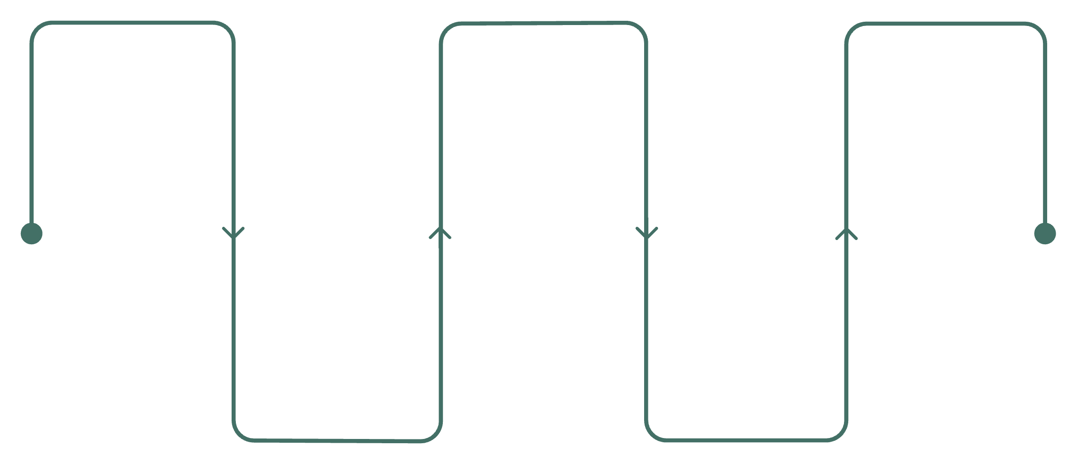
Implementation Roadmap
Gap Assessment
Integrate Register
Continuous Assurance
Assess risk and compliance gaps
Consolidate risks into register
Ongoing improvement and oversight
Standardize Controls
Enhance Reporting
Define hazards and control standards
Improve dashboards and reports
Phase 1
1
Risk & Compliance Gap Assessment
2
Phase 2
Hazard & Control Standardization
Phase 3
3
Risk Register Integration
4
Phase 4
Dashboard & Reporting Enhancement
Phase 5
5
Continuous Improvement & Assurance
Board oversight strengthens accountability.

Slide 22





Summary & Next Steps
Mining risk management must:
Prioritize life protection
Strengthen geotechnical monitoring
Improve equipment reliability
Enhance environmental governance
Maintain strong community relationships
Immediate Actions:
1
Conduct tailings integrity review
2
Review underground ventilation systems
3
Strengthen contractor oversight
4
Align risk reporting with board governance
Mining risk governance protects people, assets, and license to operate.

Slide 23
LEGAL NOTICE
Property Notice
This presentation is the intellectual property of Phumi Mhlongo and Nozipho Memela. All rights reserved. Unauthorized reproduction, redistribution, or commercial use is strictly prohibited without prior written consent.

Slide 24
IMPORTANT
Disclaimer
This material is provided for educational and professional purposes only. Organizations must apply independent professional judgment when implementing mining risk management frameworks within their specific regulatory and operational context.

