Slide 1
Securing Microservices with Hashicorp stack
Richard Heath
DevOps Lead
@HumanLongevity

Slide 2


Introduction
Background
Lead DevOps Engineer
Human Longevity Inc
Health intelligence company using advanced genomics and imaging information to provide proactive, personalized, and preventative health recommendations.
We are hiring!
https://www.humanlongevity.com/careers/
Demo Outline
Live demo on how to use HashiCorp stack to help solve security requirements.
Not an in-depth discussion on individual stack.
Notes:
Not an in-depth but more exploratory on how to use/integrate these tools to solve security problems.

Slide 3
Microservices
Agility
Innovation
Quality
Scalability
Availability
Notes:
https://docs.aws.amazon.com/aws-technical-content/latest/microservices-on-aws/benefits-of-microservices.html

Slide 4

Increased Complexity
Deployment
Testing
Monitoring
Network Communication
Management
Security

Slide 5

Security requirements
Encryption at rest
Encryption in transit
Authentication
Authorization
DB Credentials
Secrets
Password Rotation

Slide 6
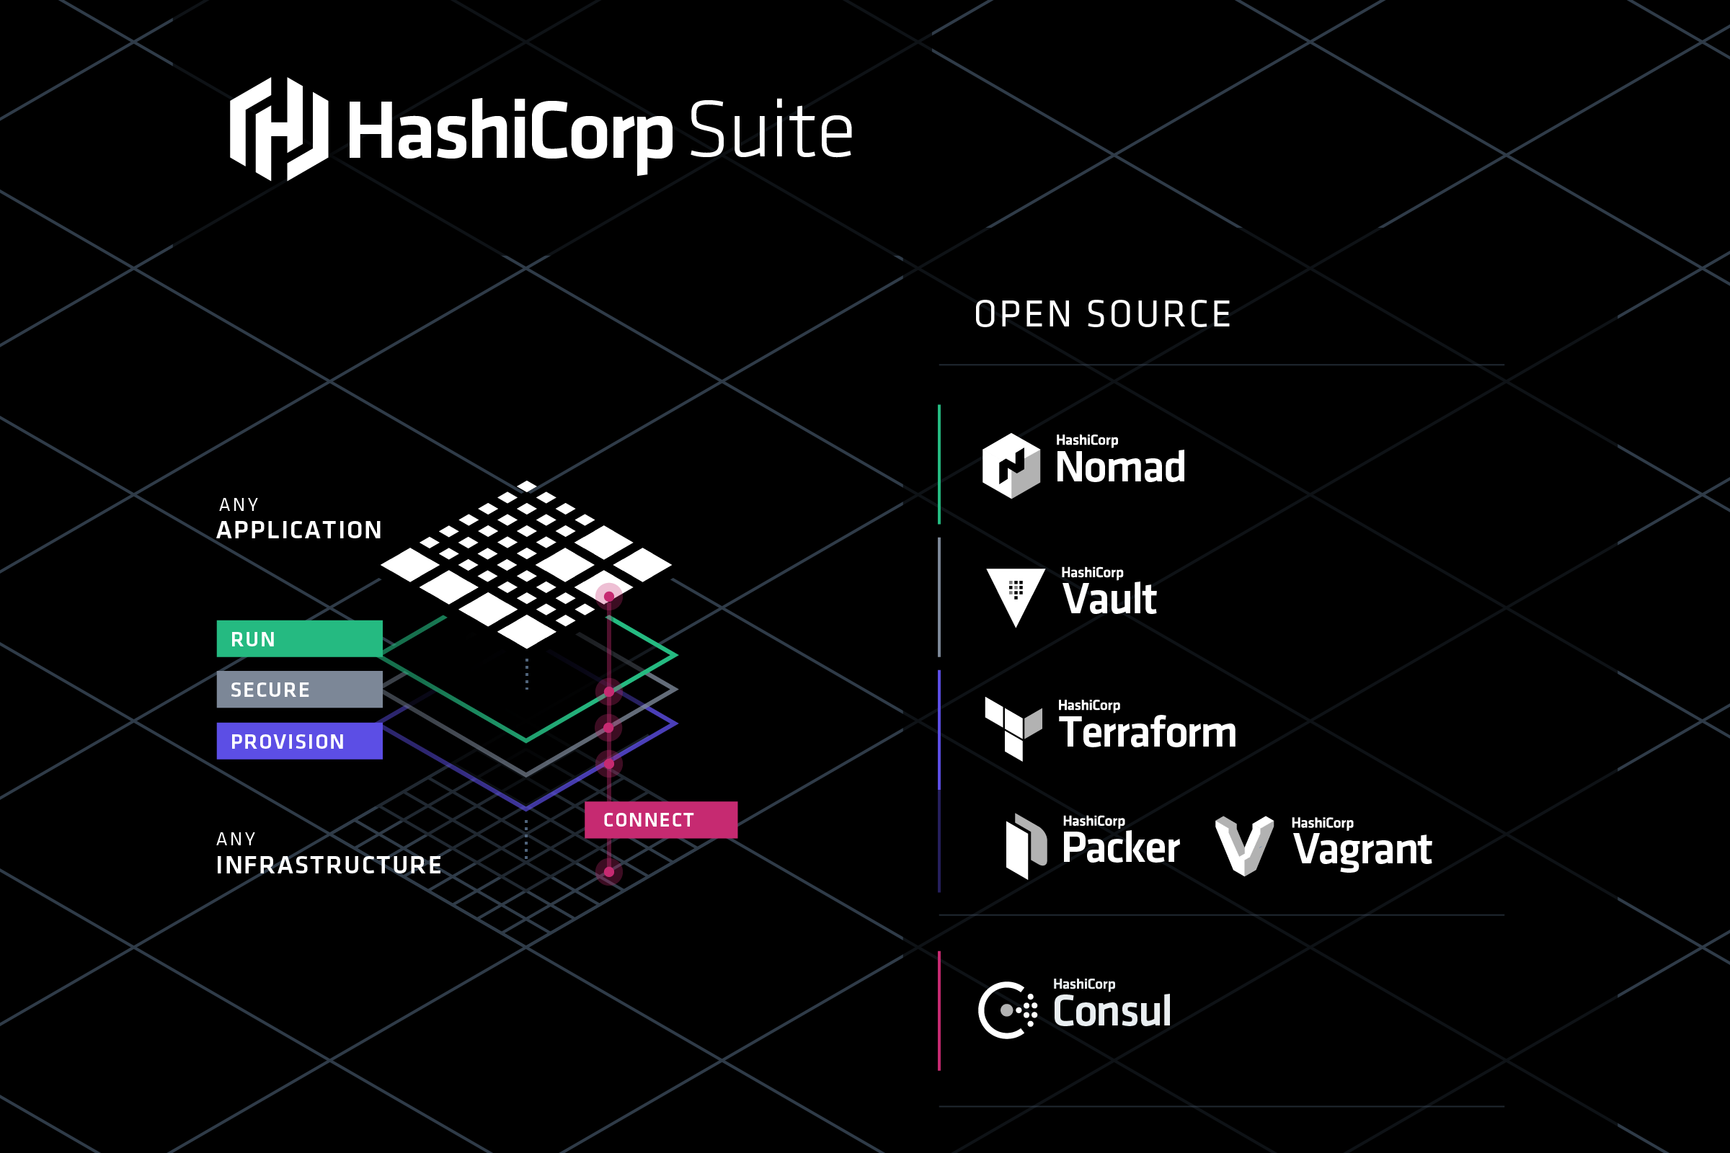
Notes:
Simplify
Abstract
Secure
I need to do this without bombarding the team with SUPPORT!

Slide 7
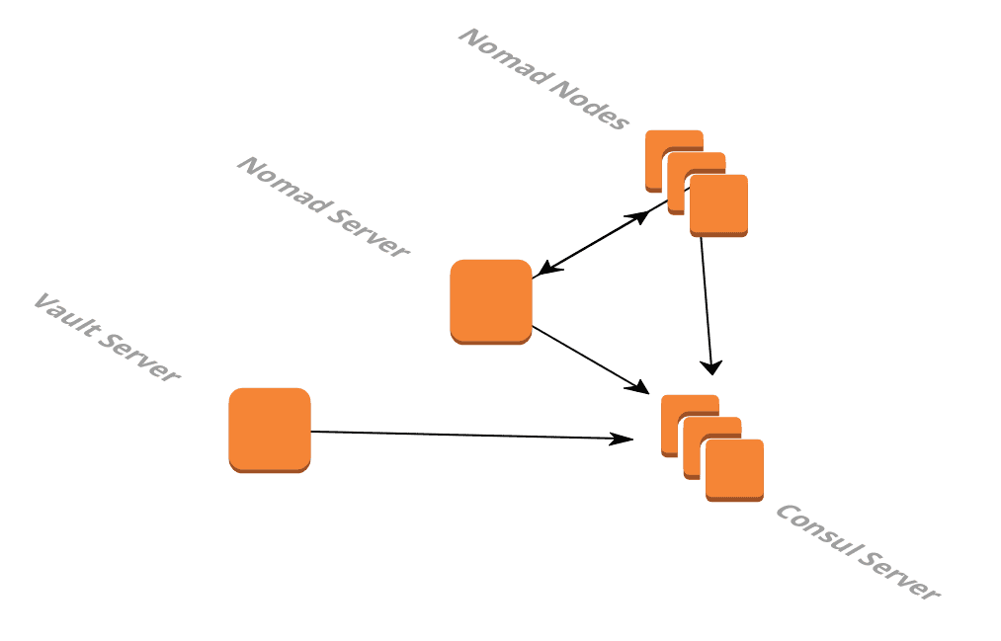

Infrastructure
All services are running on AWS EC2 instances
Notes:
Show terraform code used to create infrastructure

Slide 8
task: deploy autoascii service
Someone created an awesome website called AutoAscii. This site converts any image URL to an ascii art!
Requirements:
Deploy Web UI for AutoAscii
Deploy Backend Service Asciifier that AutoAscii depends on

Slide 9
plan
Use nomad to deploy backend docker container.
Use Consul service discovery so web ui knows what backend service to use.
Use nomad to deploy web ui docker container.

Slide 10
Solved
Encryption at Rest
We are using nomad to run the services.
In Terraform worker node drives are encrypted by default.
Jobs running on nomad worker nodes are always encrypted at rest.

Slide 11
Demo: Consul connect
We need to secure communication between web and backend services due to compliance reasons.
Requirements:
Anyone can hit backend service. We need to restrict access only to web service.
We need to encrypt network traffic to backend service.
We need to do this without changing code!

Slide 12
Plan
Services are already registered in Consul.
We can use Consul Connect proxy to encrypt service to service communication.
Also using Consul Connect intentions we can control what services can access the backend service.

Slide 13
Solved
Encryption in transit
All traffic going through Consul Connect proxy is automatically encrypted using TLS.
Authentication
Services authenticates and registered to consul.
Authorization
Communication is authorized using Consul Connect Intentions.
With intentions you can easily allow/deny service to service communication.
Notes:
use allow or deny

Slide 14
Demo: temporary credentials
We have a new requirement to keep track of submitted image urls and resulting ascii version to a database.
Requirements:
Need to provide application DB credentials to store image URL and resulting ascii.
Ohh by the way InfoSec wants DB credentials to be rotated monthly.
Notes:
to a database.

Slide 15
plan
Create RDS database using Terraform.
Give DB control to Vault so it can dynamically create temp credentials.
Create Vault database backend roles for admin and backend service.
Update nomad job to use updated docker container and use database credentials created by Vault.

Slide 16
solved
DB Credentials
We give Vault credentials so it can dynamically generate temporary credentials for the application.
Password Rotation
Since credentials are temporary it automatically creates new credentials when it expires.
Secrets
You can also use Vault to encrypt secrets like API keys.
Using ACL you can control which services have access to these secrets.

Slide 17
Conclusion
Nomad
Orchestration
Vault
DB Credentials
Secrets
Password Rotation
Consul
Encryption at rest
Encryption in transit
Authentication
Authorization
Terraform
Provision Infrastructure
Encryption at rest
Run Services
Integration with Vault and Consul
Service Discovery

