Slide 1
Big mountain case study Problem Statement
How can Big Mountain resort get a better value for their ticket price and reduce cost by $1,540,000
within a year by increasing the base elevation and decreasing the miles of the target run without
undermining the ticket price.

Slide 2
Exploratory data analysis and data preprocessing
The exploratory data analysis showed the relationship between states and different features. We were able to know the state with the highest population, states with the highest number of resorts, total skiiable area,etc. The analysis also showed that states with high mountaneous region such as vermont have the highest resorts per 100k capita. All features were numerical except 'region' and 'state' which are categorical features. The two key features to be weary of is 'reorts_per_100kcapita' and 'resort_night_skiing_state_ratio' It was observed that states with high skiible area had low prices.
Cross-validation was used to partition the training set into k folds, train the model on k-1 of those folds, and calculate performance on the fold not used in training. This procedure then cycled through k times with a different fold held back each time. This ended up building k models on k sets of data with k estimates of how the model performs on unseen data but without having to touch the test set. Mean absolute error is arguably the most intuitive of all the metrics, because it tells the expected avaerage to be off by around $19 if ticket price is guessed based on an average of known values. It can be concluded that the random forest model has a lower cross-validation mean absolute error by almost $1. It also exhibited less variability. Verifying performance on the test set produces performance consistent with the cross-validation results.

Slide 3
Recommendation and key findings
The model says closing one run makes no difference. Closing 2 and 3 successively reduces support for ticket price and so revenue. If Big Mountain closes down 3 runs, it seems they may as well close down 4 or 5 as there's no further loss in ticket price. Increasing the closures down to 6 or more leads to a large drop.

Slide 4
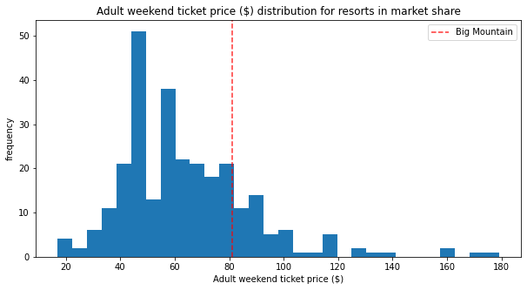
aDULT Weekend ticket price

Slide 5
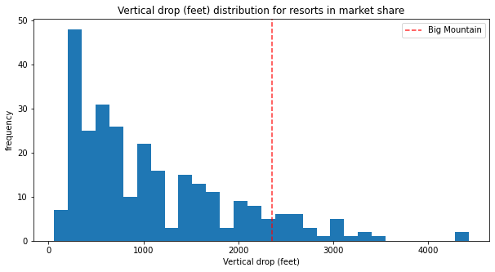
Vertical drop

Slide 6
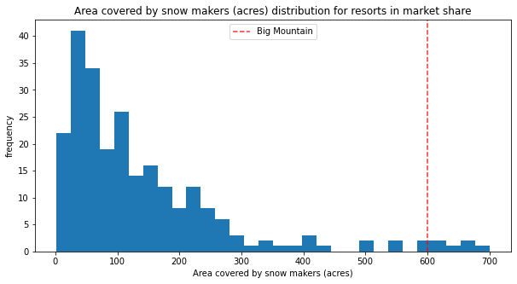
Snow making area

Slide 7
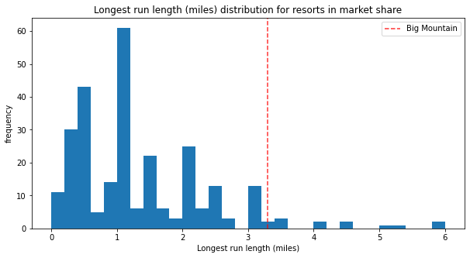
Longest runs

Slide 8
Summary and conclusion
Big Mountain Resort modelled price is $93.82, actual price is $81.00. Even with the expected mean absolute error of $10.34, this suggests there is room for an increase. This result should be looked at optimistically and doubtfully! The validity of the model lies in the assumption that other resorts accurately set their prices according to what the market (the ticket-buying public) supports. The fact that the resort seems to be charging that much less that what's predicted suggests the resort might be undercharging. It's reasonable to expect that some resorts will be "overpriced" and some "underpriced."

