Slide 1
Customer Segmentation Infographics
Team: Dimitris Farantos, Andreas Katsaros
Notes:
For our project we chose to do a customer segmentation analysis/clustering. We are in the Data Science team in a big Retail store and we are conducting a customer clustering in order for the marketing team to use and create better and more personalized campaigns.
This analysis facilitates a deeper understanding of customers, enabling businesses to tailor products to meet the distinct needs, behaviors, and concerns of various customer types
By conducting a Customer Personality Analysis, businesses can refine their products based on the preferences of specific customer segments. Rather than allocating resources to market a new product to the entire customer database, companies can identify the segments most likely to be interested in the product. Subsequently, targeted marketing efforts can be directed toward those particular segments, optimizing resource utilization and increasing the likelihood of successful product adoption.

Slide 2
The Dataset

Slide 3
The Dataset
Columns
29

Slide 4
The Dataset
Columns
Observations
29
2240

Slide 5
The Dataset
Columns
Observations
Observation Window
29
2240
8/1/2012 - 6/12/2014

Slide 6
The Dataset
Year of birth, Marital status, Number of children
Date became a customer, Days since last purchase
Spent in: Meat, Fish, Sweets, Fruits, Wines, Jewelry
Deals-Web-Catalogue purchases, Campaigns accepted, complains
Columns
Observations
Observation Window
29
2240
8/1/2012 - 6/12/2014

Slide 7
Exploratory Data Analysis

Slide 8
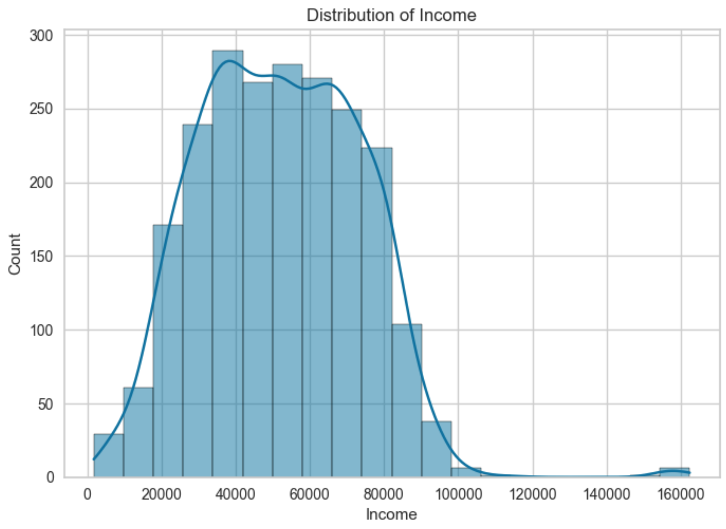
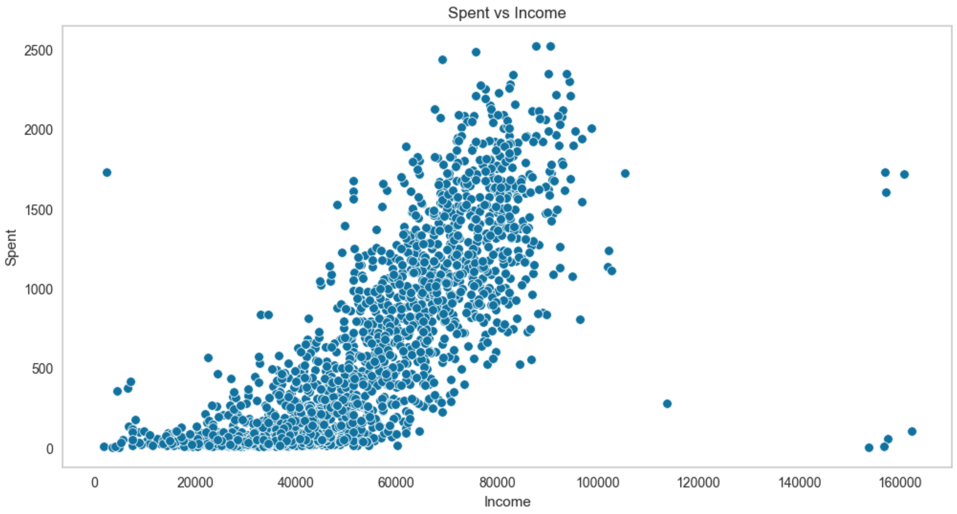
Exploratory Data Analysis

Slide 9
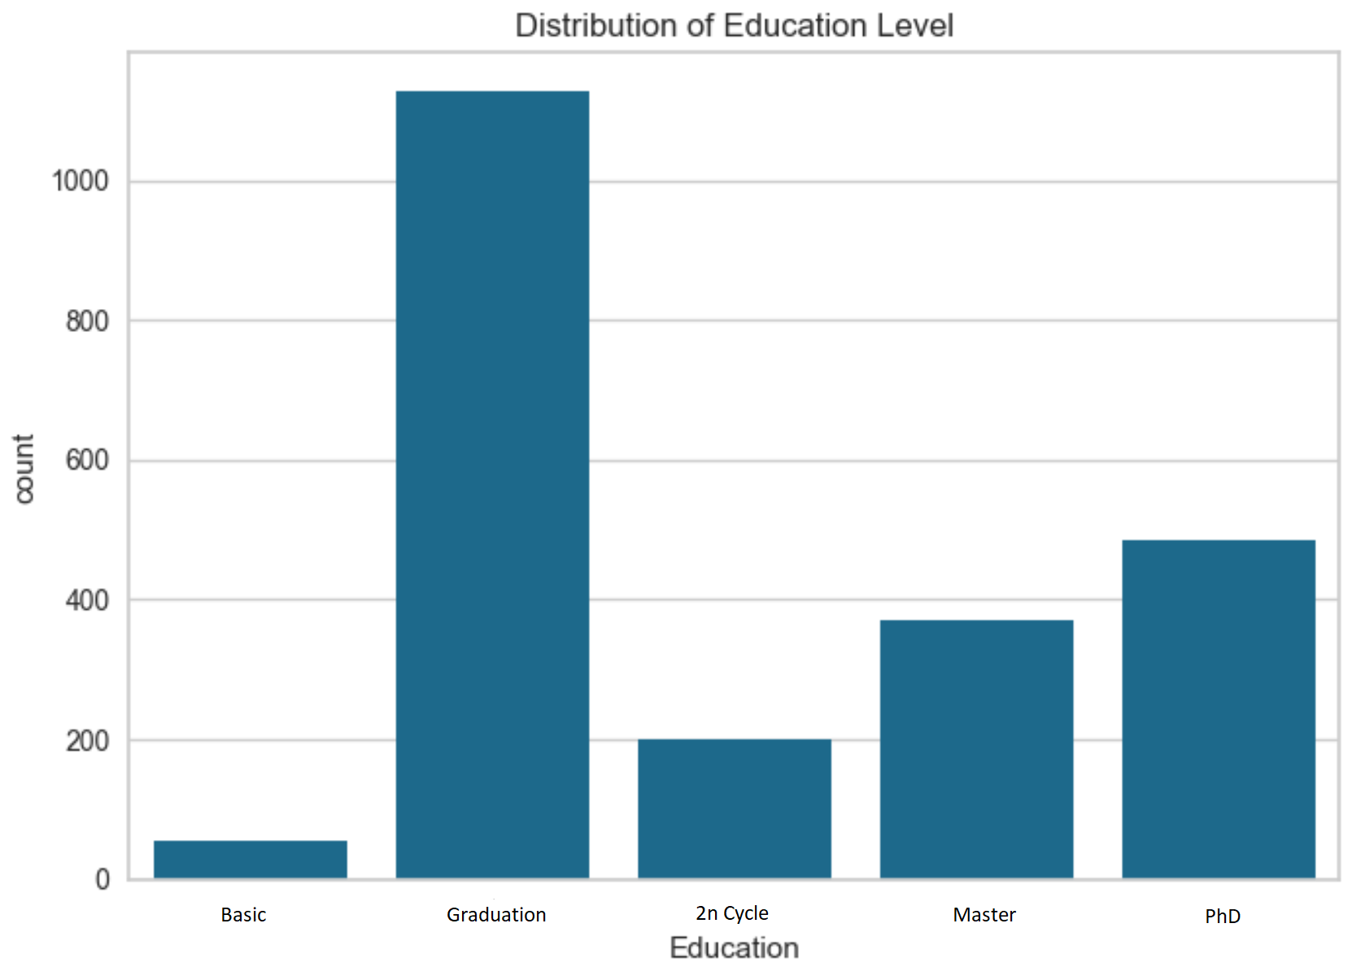
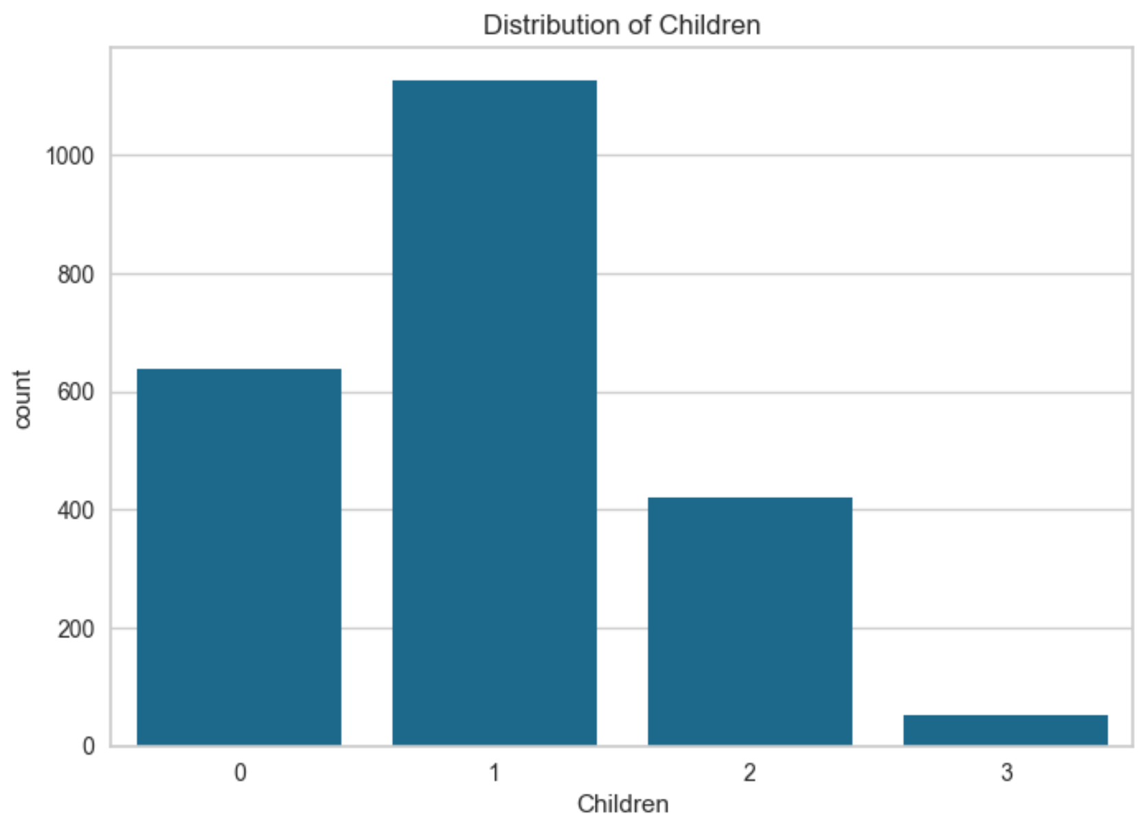
Exploratory Data Analysis

Slide 10
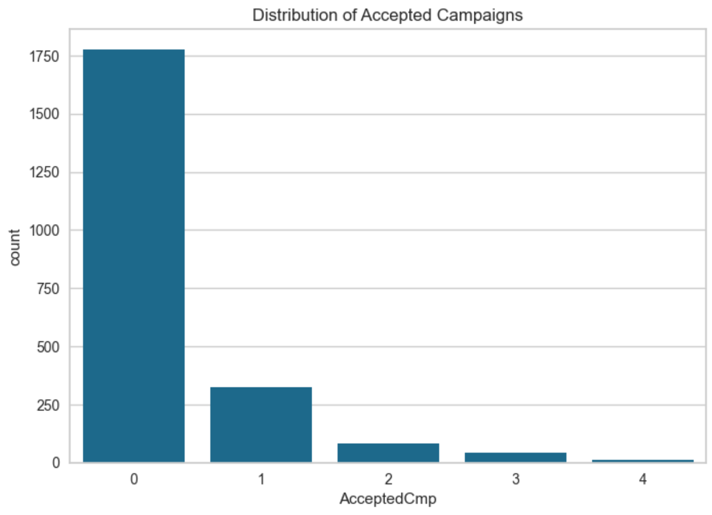
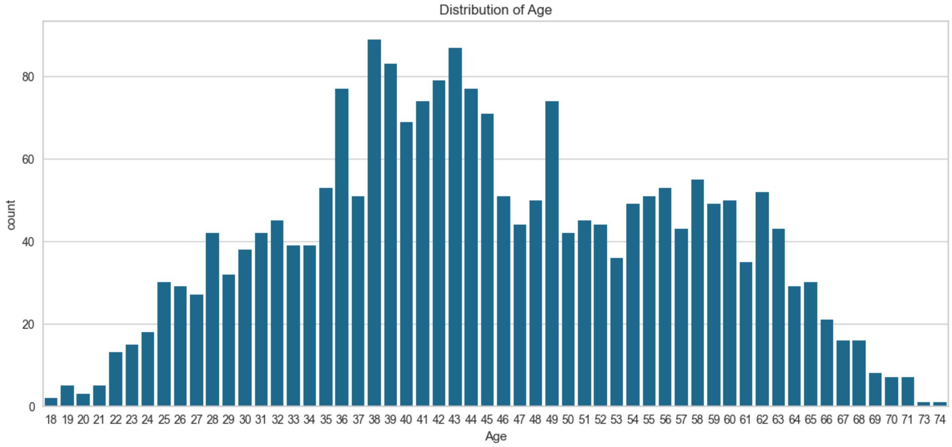
Exploratory Data Analysis

Slide 11
Customer Segmentation Infographics

Slide 12
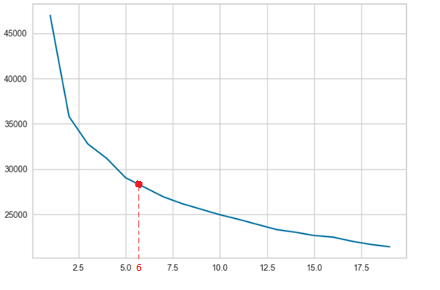
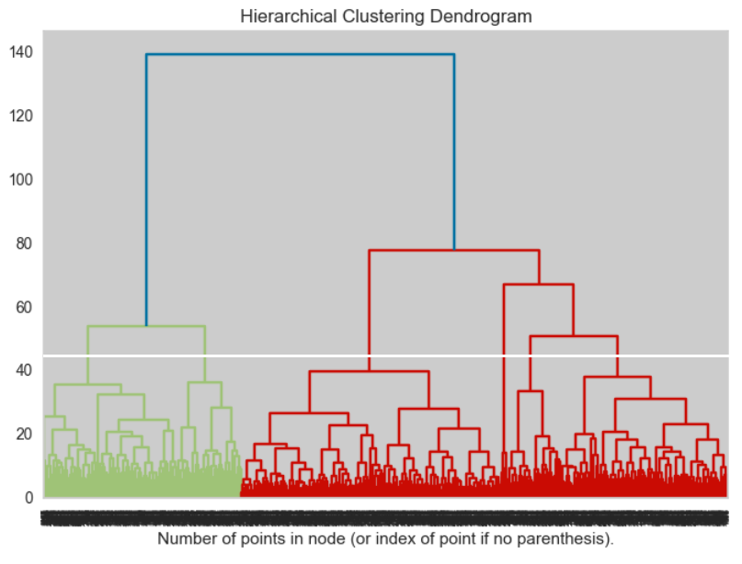
Customer Segmentation Infographics

Slide 13
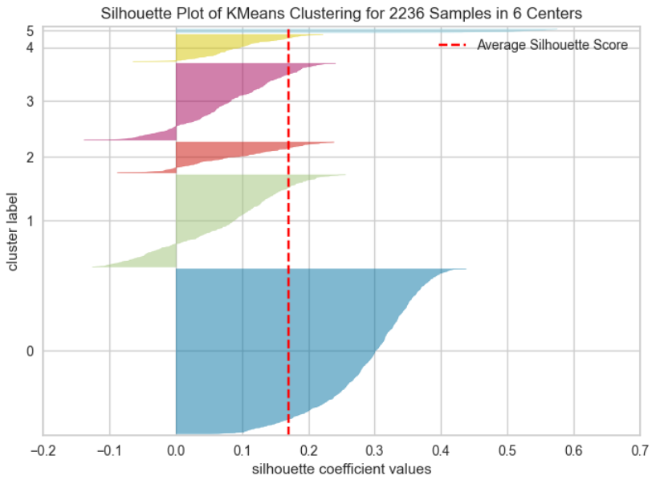
Customer Segmentation Infographics

Slide 14
Customer Segmentation Infographics
6 Clusters

Slide 15
Graphs on our clusters

Slide 16
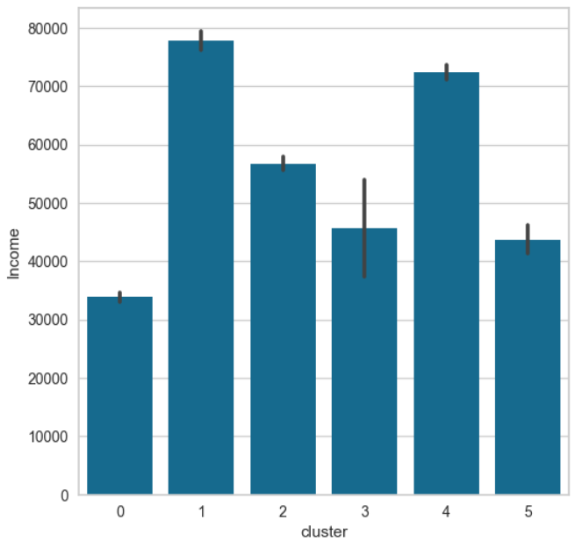
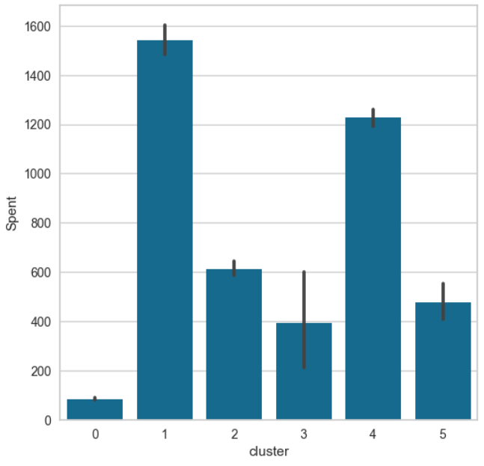
Graphs on our clusters
Income
$ Spent

Slide 17
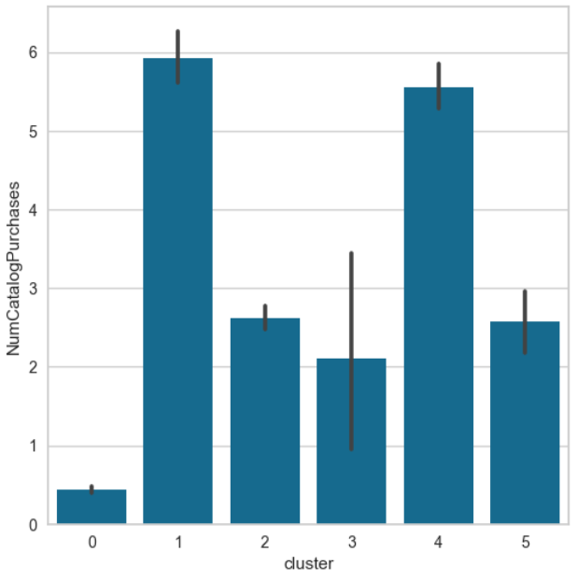
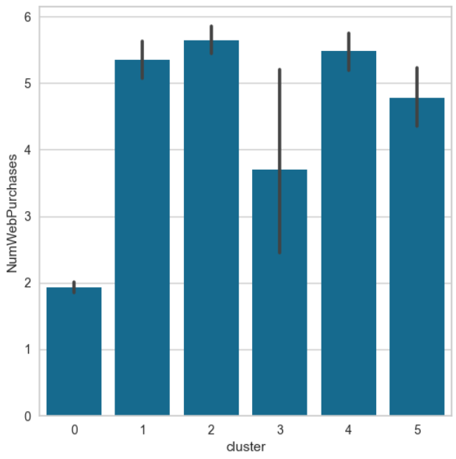
Graphs on our clusters
Campaign Response
Online Shopping

Slide 18
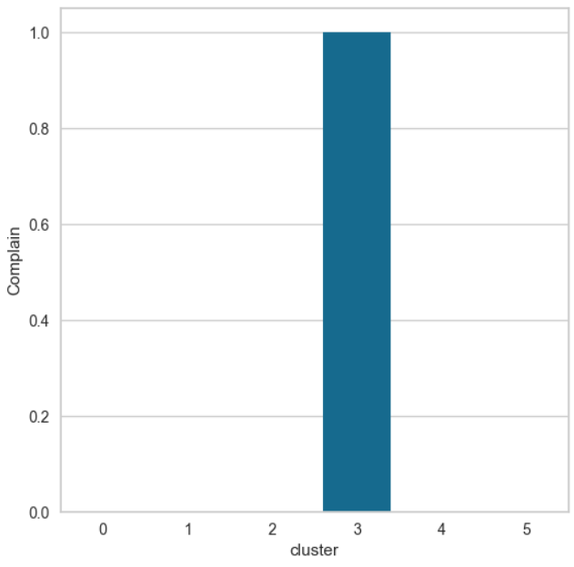
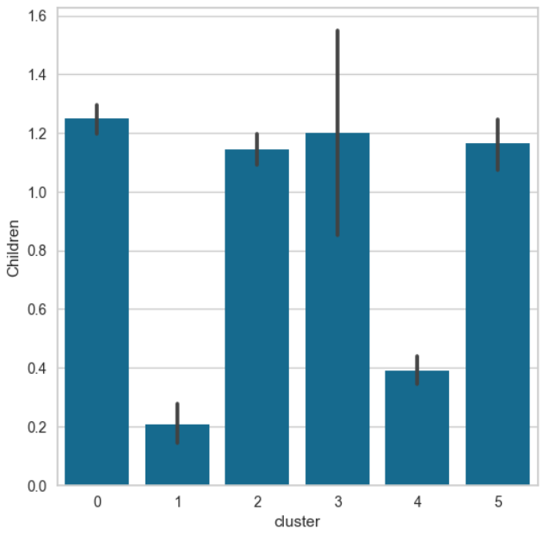
Graphs on our clusters
Complains
Number of Children

Slide 19
Factors Considered in Clustering Analysis

Slide 20
Factors Considered in Clustering Analysis
Income & Spending
Education
Number of children
Response to campaigns
Types of shopping

Slide 21
Customer Segmentation Results
Family Savers
01
Low income families with moderate education levels who prioritize saving money for their children.

Slide 22
Customer Segmentation Results
Family Savers
01
Low income families with moderate education levels who prioritize saving money for their children.
Elite Shoppers
02
High-income individuals with high levels of education who respond to campaigns and make large purchases & shopping both online and from catalogs.

Slide 23
Customer Segmentation Results
Family Savers
01
Low income families with moderate education levels who prioritize saving money for their children.
Elite Shoppers
02
High-income individuals with high levels of education who respond to campaigns and make large purchases & shopping both online and from catalogs.
Bargain Hunters
03
Moderate-income individuals with high education levels who are actively looking for deals & shopping online.

Slide 24
Customer Segmentation Results
Family Savers
Struggling Families
01
04
Low income families with moderate education levels who prioritize saving money for their children.
Low-income families with low education levels who have complaints, possibly related to financial difficulties.
Elite Shoppers
02
High-income individuals with high levels of education who respond to campaigns and make large purchases & shopping both online and from catalogs.
Bargain Hunters
03
Moderate-income individuals with high education levels who are actively looking for deals & shopping online.

Slide 25
Customer Segmentation Results
Family Savers
Struggling Families
01
04
Low income families with moderate education levels who prioritize saving money for their children.
Low-income families with low education levels who have complaints, possibly related to financial difficulties.
Elite Shoppers
Affluent Shoppers
02
05
High-income individuals with high levels of education who respond to campaigns and make large purchases & shopping both online and from catalogs.
High-income individuals with moderate education levels who make significant purchases & shopping both online and from catalogs.
Bargain Hunters
03
Moderate-income individuals with high education levels who are actively looking for deals & shopping online.

Slide 26
Customer Segmentation Results
Family Savers
Struggling Families
01
04
Low income families with moderate education levels who prioritize saving money for their children.
Low-income families with low education levels who have complaints, possibly related to financial difficulties.
Elite Shoppers
Affluent Shoppers
02
05
High-income individuals with high levels of education who respond to campaigns and make large purchases & shopping both online and from catalogs.
High-income individuals with moderate education levels who make significant purchases & shopping both online and from catalogs.
Bargain Hunters
Educated Shoppers
03
06
Moderate-income individuals with high education levels who are actively looking for deals & shopping online.
Low-income families with high education levels who respond to campaigns and are interested in deals & shopping online.

Slide 27
Proposals
Family Savers
Struggling Families
01
04
Offer a savings plan that includes discounts on children's products or educational materials.
Discounts on groceries and household essentials.
Elite Shoppers
Affluent Shoppers
02
05
Launch a loyalty program offering exclusive deals on high-end products and early access to sales events.
Personalized shopping experiences, including home delivery services and personal shopper consultations.
Bargain Hunters
Educated Shoppers
03
06
Daily or weekly emails featuring the best deals on popular products.
Provide access to educational content about smart shopping and exclusive discounts on a variety of products.

Slide 28
Thank you ☺
Feel free to ask any questions or offer suggestions for improvements!

