Slide 1
Electric Vehicles in Washington
Team DSFT 1:
Andreas Katsaros, Dimitris Farantos

Slide 2
Topics of Analysis:
How is the distribution of electric vehicles (EVs) across different counties and cities?
What are the most popular makes and models of EVs?
Which electric vehicle types (BEV or PHEV) are most popular?
What is the distribution of EVs through the years?
What is the distribution of electric range of vehicles preferred?
What is the market share between EV models?

Slide 3
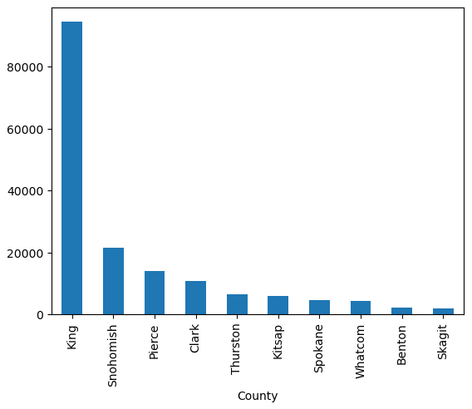
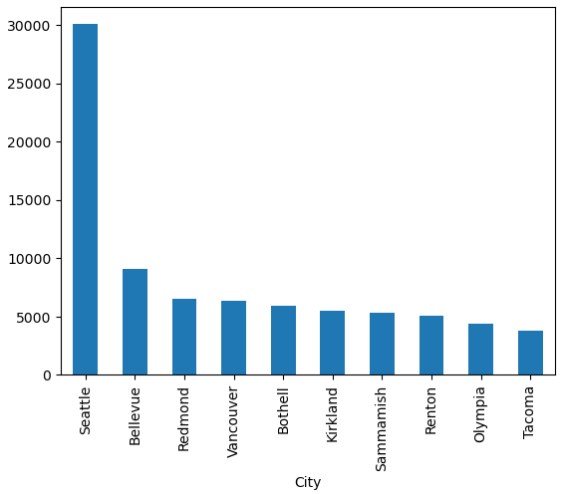
How is the distribution of electric vehicles (EVs) across different counties and cities?
As you can see in the graphs, there is a clear trend in the distribution of electric vehicles (EVs) across Washington State, with a notable concentration in larger cities and urban centers.
This insight underscores the importance of targeted infrastructure development and awareness campaigns to further promote EV adoption in diverse geographic areas.

Slide 4
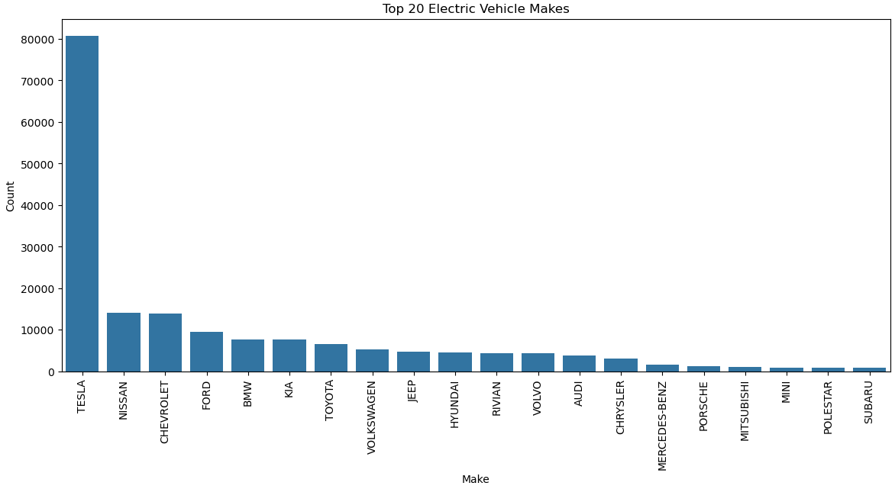
What are the most popular makes and models of EVs?

Slide 5
What are the most popular makes and models of EVs?
Here we see that Tesla is the leading manufacturer in electric vehicles within Washington State, with an impressive 80k registered cars.
Following Tesla, Nissan and Chevrolet hold the next positions with approximately 15k registrations each, showcasing a clear dominance of Tesla in the market.

Slide 6
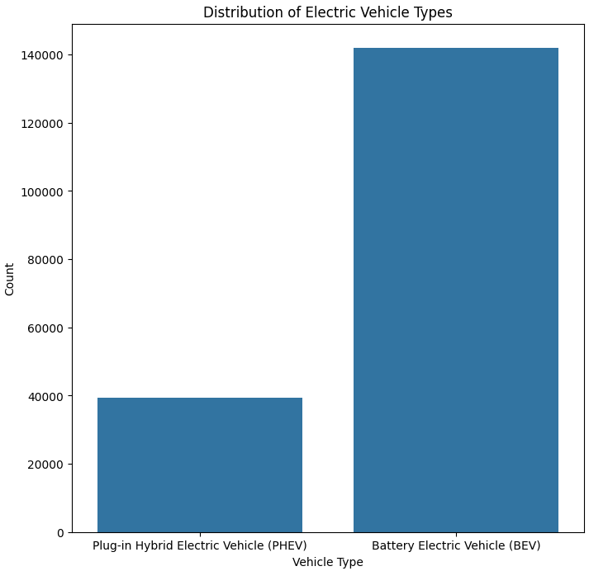
Which electric vehicle types (BEV or PHEV) are most popular?
Among electric vehicle types, Battery Electric Vehicles (BEVs) significantly outpace Plug-in Hybrid Electric Vehicles (PHEVs) in popularity, with approximately 140,000 registrations in Washington State compared to nearly 40,000 PHEVs. This data reflects a clear preference for BEVs over PHEVs in the region.

Slide 7
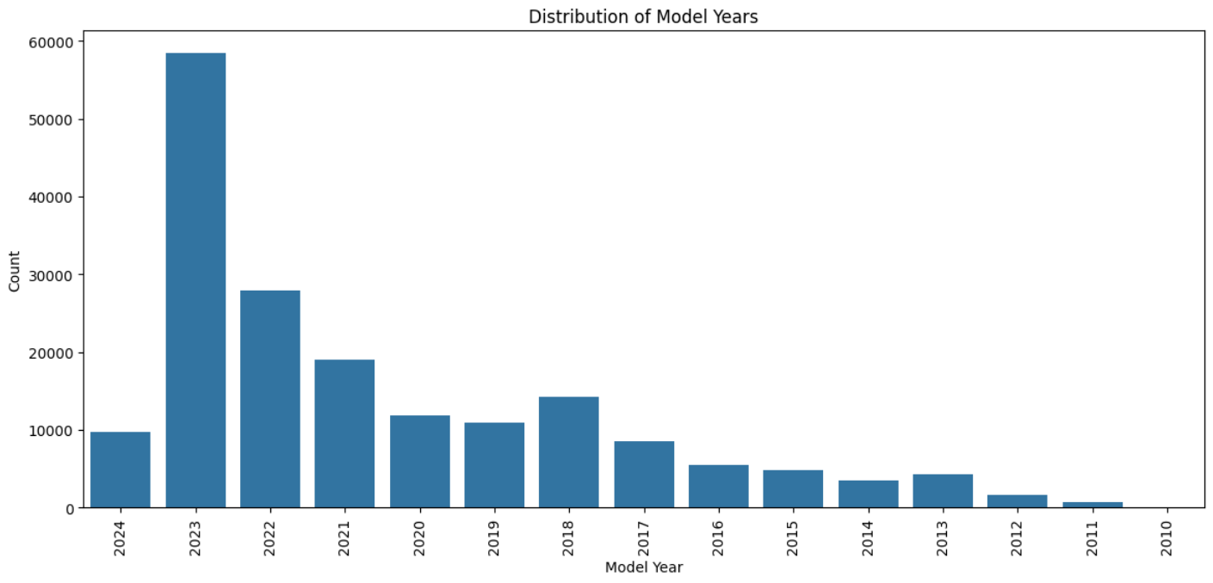
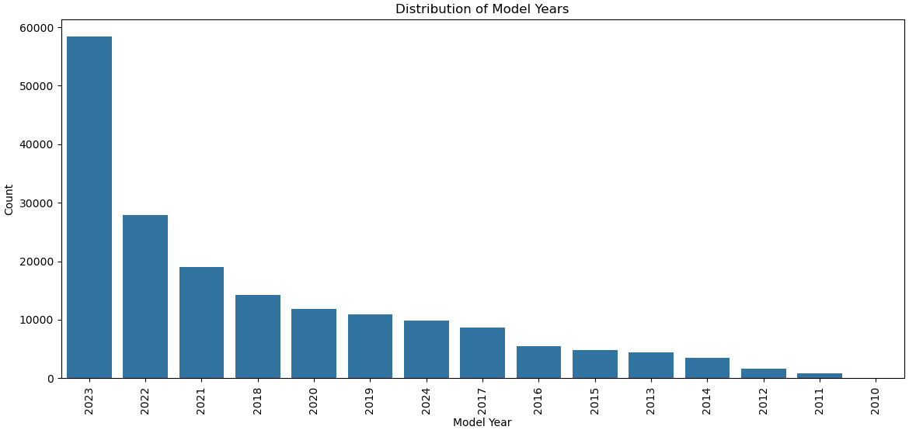
What is the distribution of EVs through the years?

Slide 8
What is the distribution of EVs through the years?
The distribution of EVs through the years shows a remarkable trend of exponential growth in registrations YoY. This signifies a significant and ongoing shift towards electric vehicle adoption, reflecting increasing interest and investment in sustainable transportation options.

Slide 9
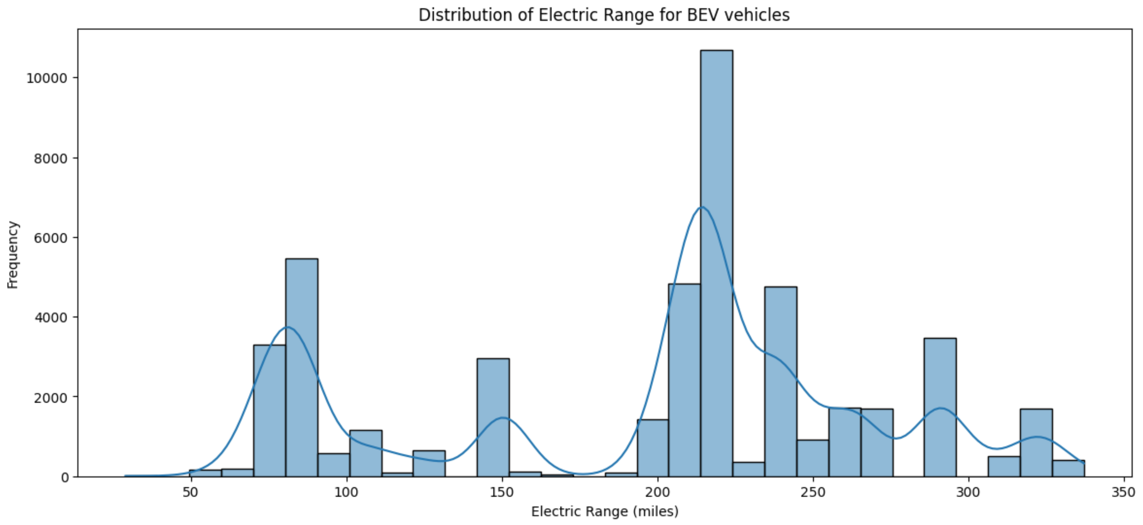
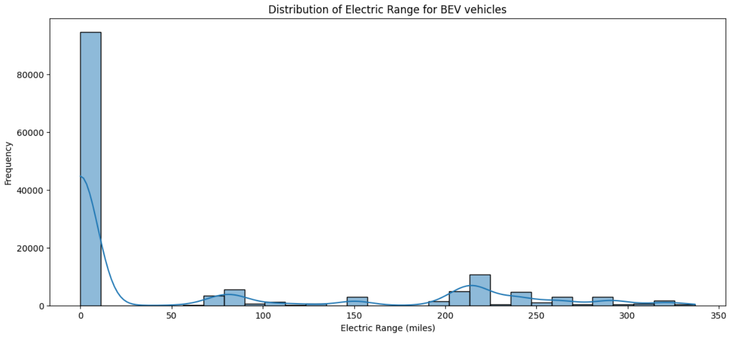
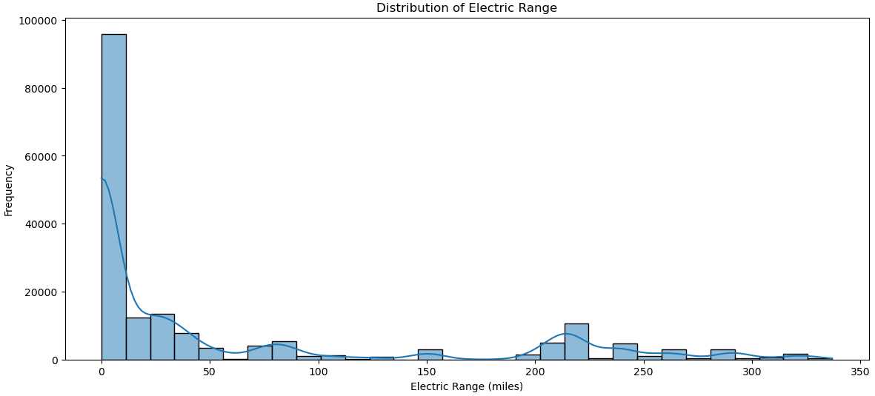
What is the distribution of electric range of vehicles preferred?

Slide 10
What is the distribution of electric range of vehicles preferred?
Our analysis of the electric ranges for Battery Electric Vehicles (BEVs) reveals a significant concentration around 240 miles, indicating a common target range for many manufacturers. Additionally, there are noticeable peaks at 75, 150, and 300 miles, suggesting distinct market segments or design strategies for different driving needs.

Slide 11
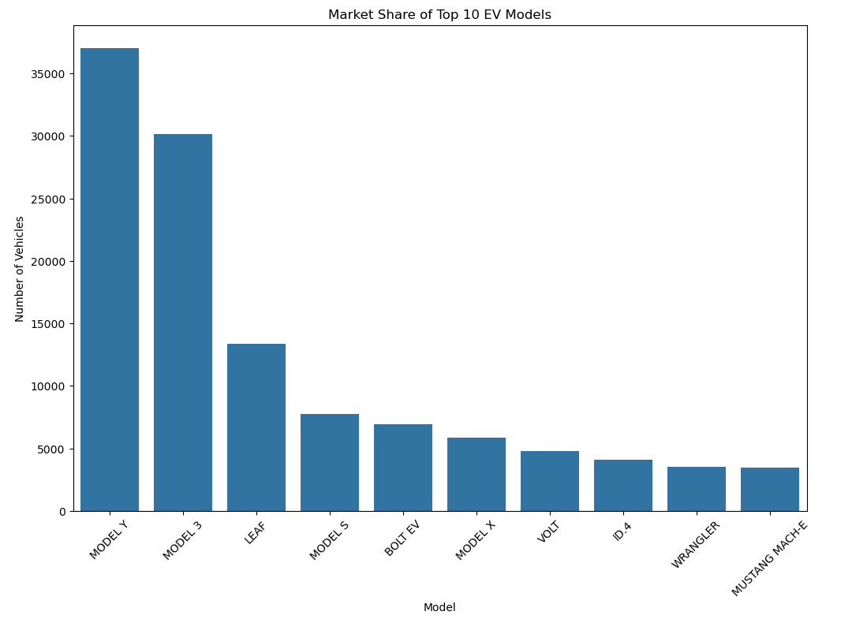
What is the market share between EV models?

Slide 12
What is the market share between EV models?
The market share of EV models shows that the Model Y leads with 37,007 units, followed by the Model 3 with 30,149 units, and the Leaf with 13,356 units. Other notable models include the Model S with 7,730 units and the Bolt EV with 6,935 units, highlighting the dominance of Tesla in the electric vehicle market.

Slide 13
Thank You !
© Templateswise.com

