Slide 1

Intro to Web Applications

Slide 2

Learning to build dynamic websites
Static websites: write it once and it stays that way
Dynamic websites: constantly change with new information
People connect and share content
Sellers create and list products
Artists craft and share music
Examples of a dynamic website, or web application include: Amazon, Facebook, Twitter, etc.

Slide 3
What are we building?
Lesson 1: Your personal web page.
It can be a resume or something more.
It’s a static page. You need to edit the code to update it.
Lesson 2: Personal web page service
Your friends can create an account and set their own pages
The pages are now dynamic. You edit via an interface.
Lesson 3: Connect the pages, a social network
Create a news feed and add relationships between pages

Slide 4
Course philosophy
Learning to code is not hard, just avoid the traps
Setting up your environment
Hitting bad bugs
No syntax, just concepts. Not means, just ends.
Always focus on making your idea.
Once you have a basic framework to work with, you can learn the rest by yourself.

Slide 5
Let’s set some expectations
This is (mostly) a one man show.
Please be respectful on capacity.
You need to try problem-solving by yourself first.
Stay focused in the class. Stay off Facebook.
Help those beside you.

Slide 6
That was crazy right?
Let’s recap…

Slide 7
Let’s set some expectations
This is (mostly) a one man show.
Please be respectful on capacity.
You need to try problem-solving by yourself first.
Stay focused in the class. Stay off Facebook.
Help those beside you.
Image credits to Codecademy (http://codecademy.com/

Slide 8
Next steps
Join the Facebook group:
https://www.facebook.com/groups/gutencode/
Introduce yourself:
Name
Major
Why did you join this class? Do you want to build something? Share it with us ☺
Use the group to ask questions, share ideas, discuss lessons

Slide 9
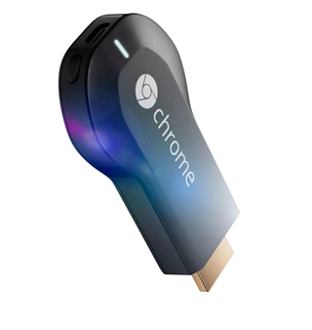
Use what you learned today to create your own page and win a ChromeCast!
Update the design to fit your needs.
Upload your page to http://neocities.org/. Share with us either the link or a screenshot.
The page with the most likes wins!

