Slide 1

Hackers Creed
Or how to keep your password safe?

Slide 2
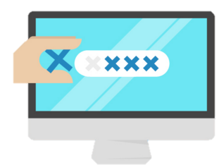
A bit about passwords
Average user uses about 500 password protected services
About 10 of the passwords are unique
More then 70% are 5 years old
90% can be hacked in 6 hours
Passwords are the most popular way to steal identity

Slide 3
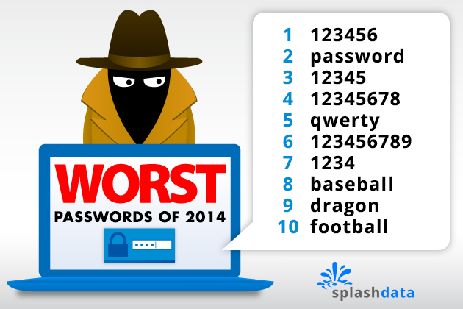

Slide 4
Dataset
2 million passwords from DAZZLEPOD
One of the most useful datasources for bruteforce
All of the password are on English

Slide 5

Problems and Opportunities
Content and Patterns
Variety
Lots of data about frequencies
Big, one dimentional data
Dirty
Out of Context

Slide 6
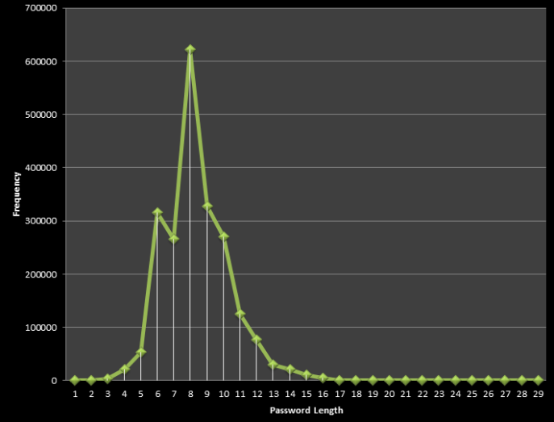
Data Cleanup
Removing empty / broken strings
Special Characters cleanup
Working only on typical pass length (4-12)
4
12

Slide 7
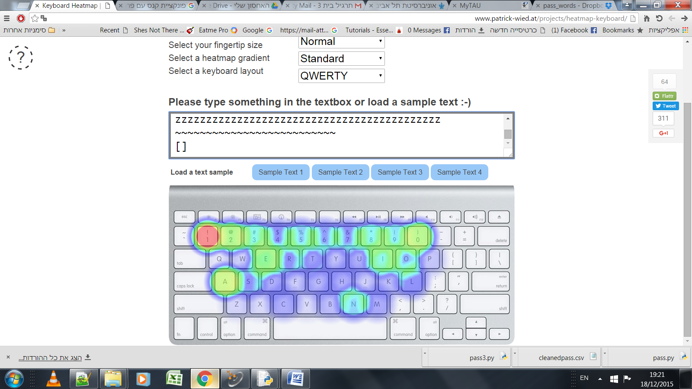
Passwords heatmap

Slide 8
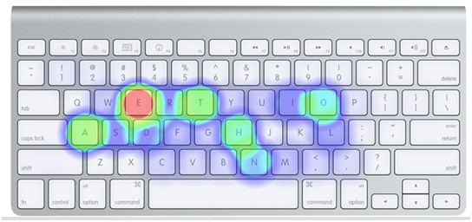
Genesis
Password DB

Slide 9
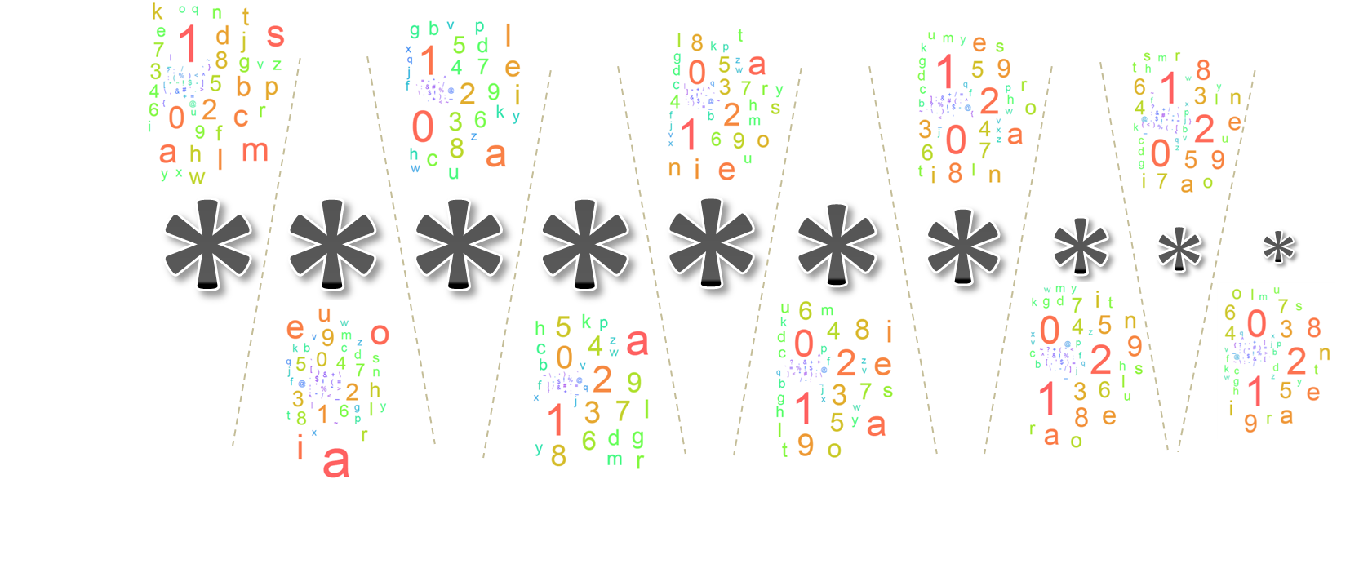
Chars / Location Density

Slide 10
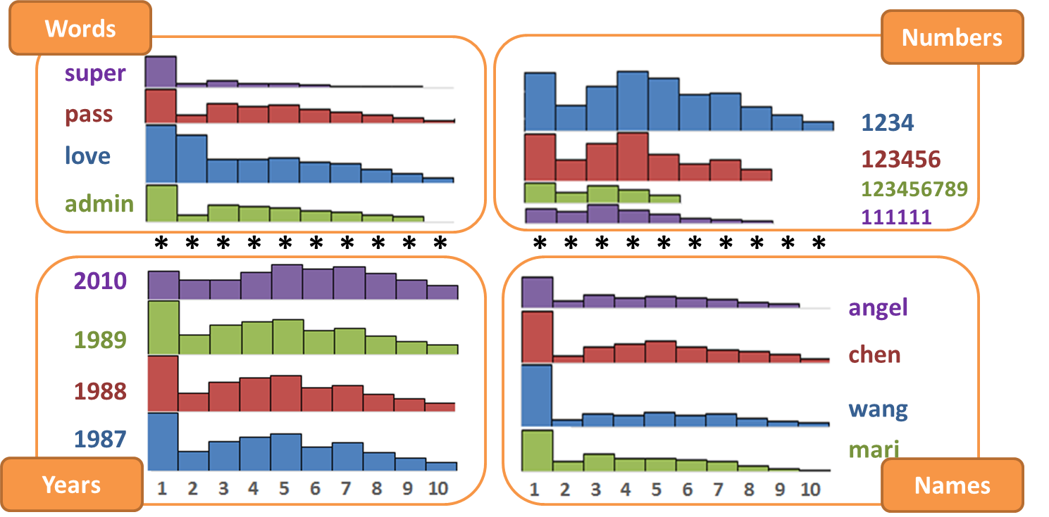
Location of common suquences

