Slide 1
Visual Echo
Spatialisation of an Echo States Network(ESN)
Can we give an ESN new properties by adding spatial constraints ?

Slide 2
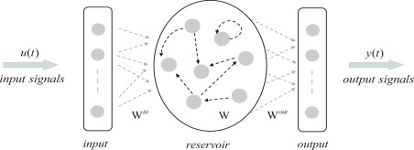
Echo States Networks
Based on a reservoir that keeps the information
Leaky neurons : retains part of their previous activity
Echo States property

Slide 3
Main ideas of Visual Echo
Spatialization of the reservoir.
Easier display
Physical properties
Fewer connections

Slide 4
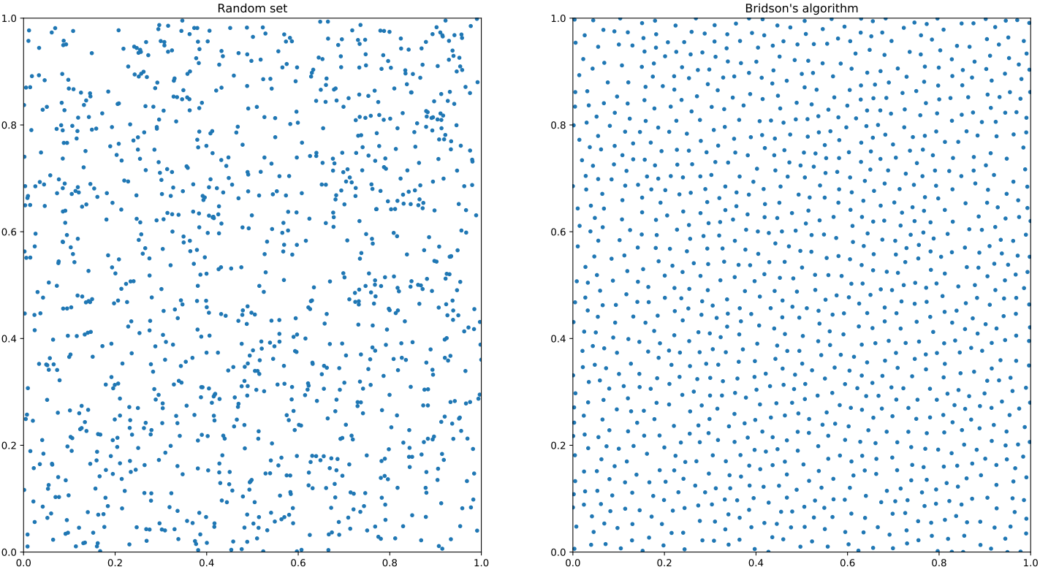
Blue Noise
More even spacing, avoids difficulties of connections.
1099 points.

Slide 5
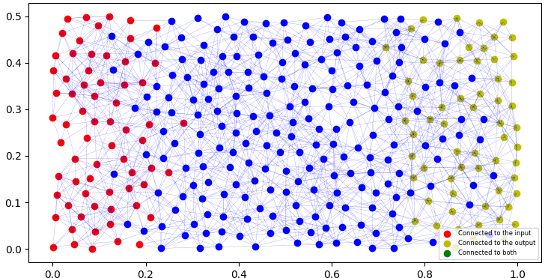
Connections in the reservoir
Forward connections
Distance based

Slide 6
Observation of the propagation

Slide 7
Results
Works in some cases
Lots of hyperparameters to adjust

Slide 8
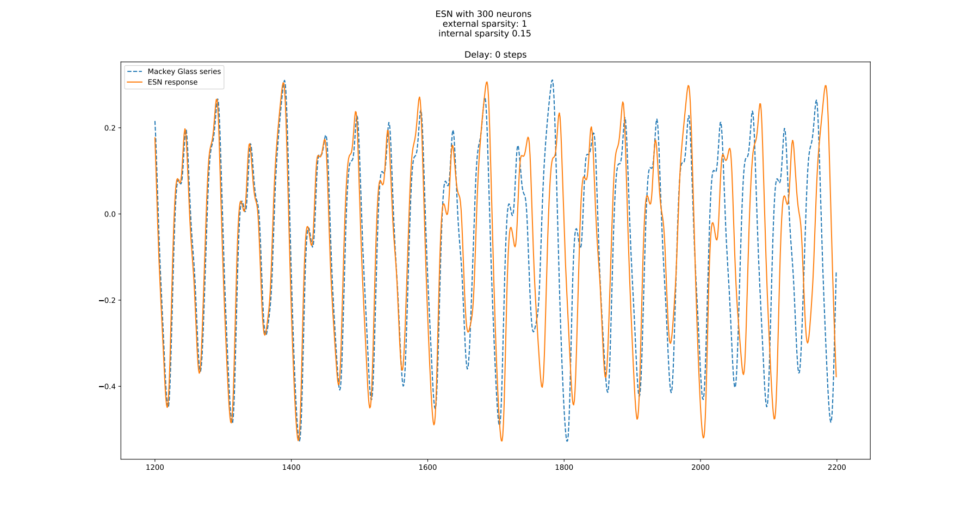
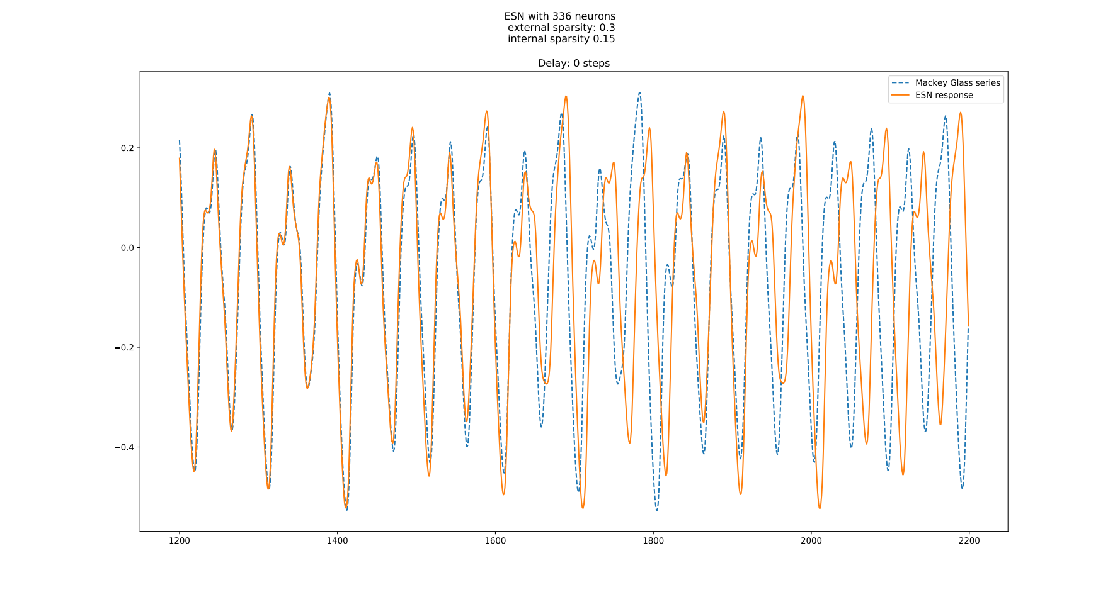
Properties of the network
-Classic ESN
-300 neurons
-13307 internal connections
-Spatial ESN
-336 neurons
-2061 internal connections

Slide 9
Delay in the training
Time needed for information to go throught the reservoir
Can expect a need in delay

Slide 10
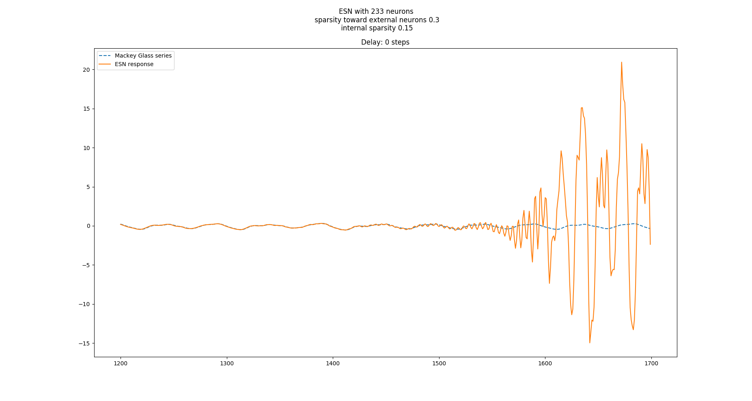
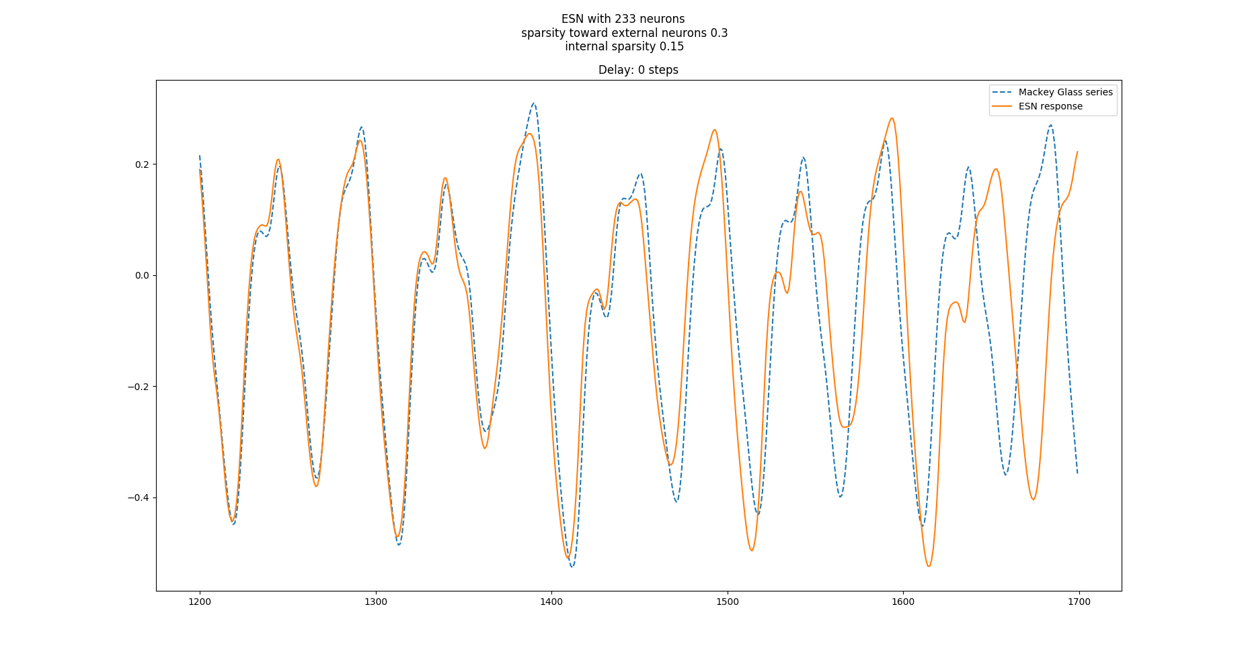
Importance of noise
No noise in the training
Random noise of 0.02 to the input during the training.

Slide 11
Other ideas
Find equivalent of Echo State property for stability.
Backward connections
Neurons modelisation
Need for a good metric (compromise stability/precision)
Try different limitation size for the position of the neurons
3-dimensions reservoir

