Slide 1
Projekat1:OpenStreetMap & PostGIS

Slide 2
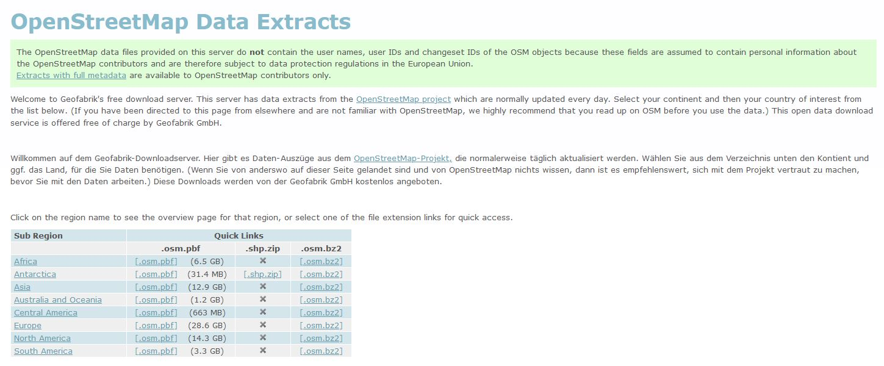
Geofabrik & OpenStreetMap

Slide 3

OSM2PGSQL

Slide 4
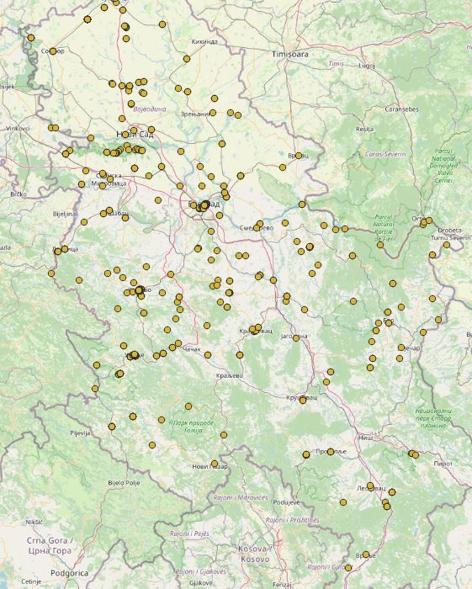
Historical sites close to road

Slide 5


With index 0.7 s; without index 20s

Slide 6
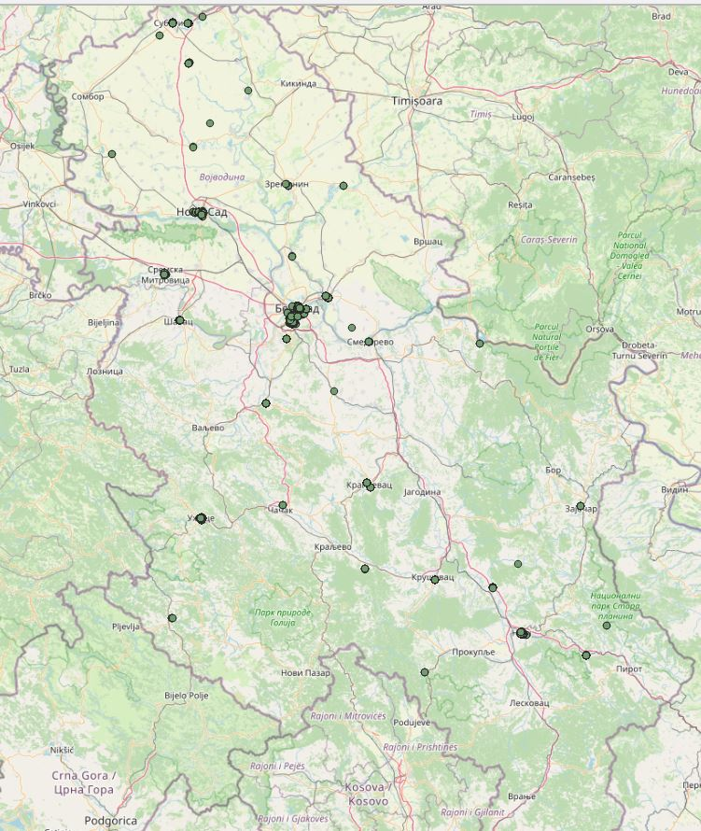
Benches in parks in Serbia

Slide 7
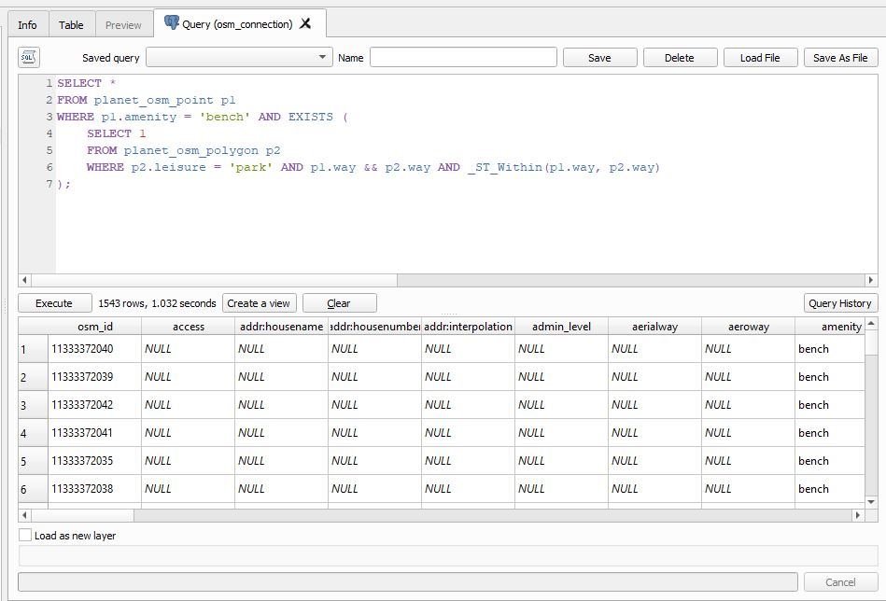
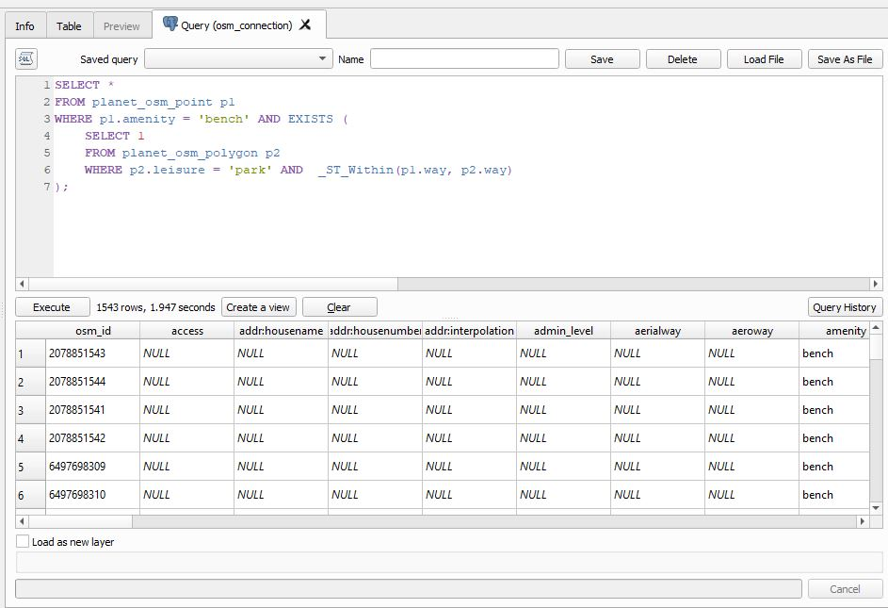

Slide 8
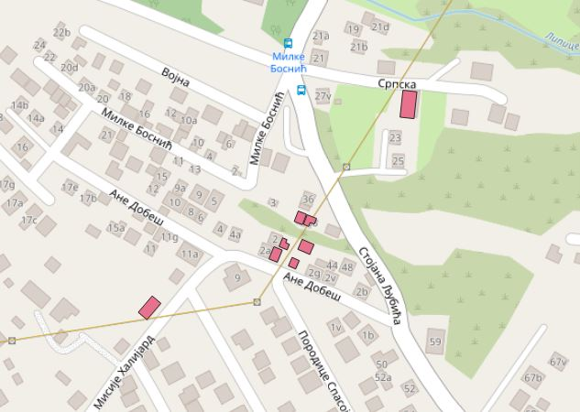
Buildings close to power lines

Slide 9
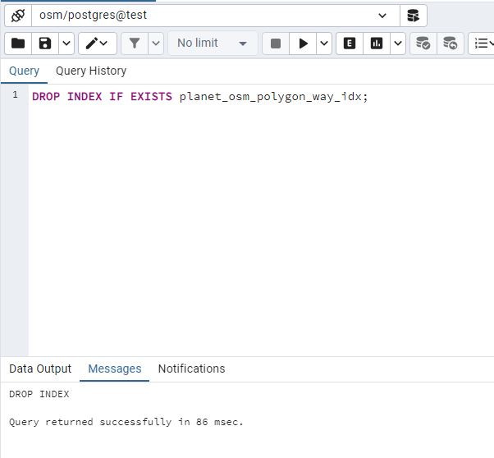
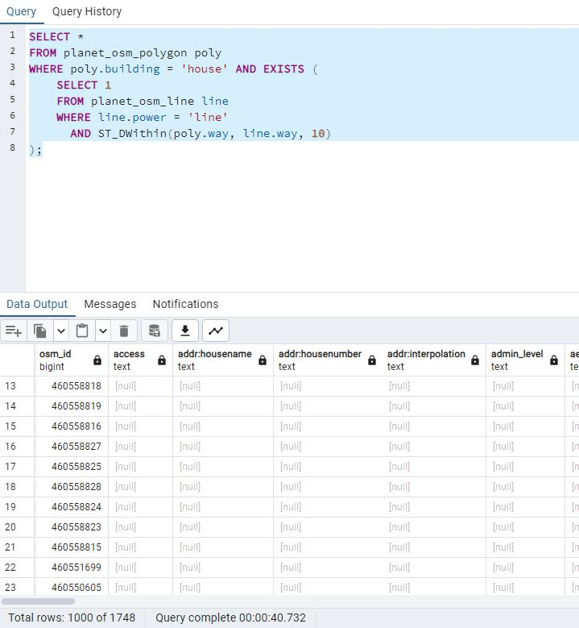
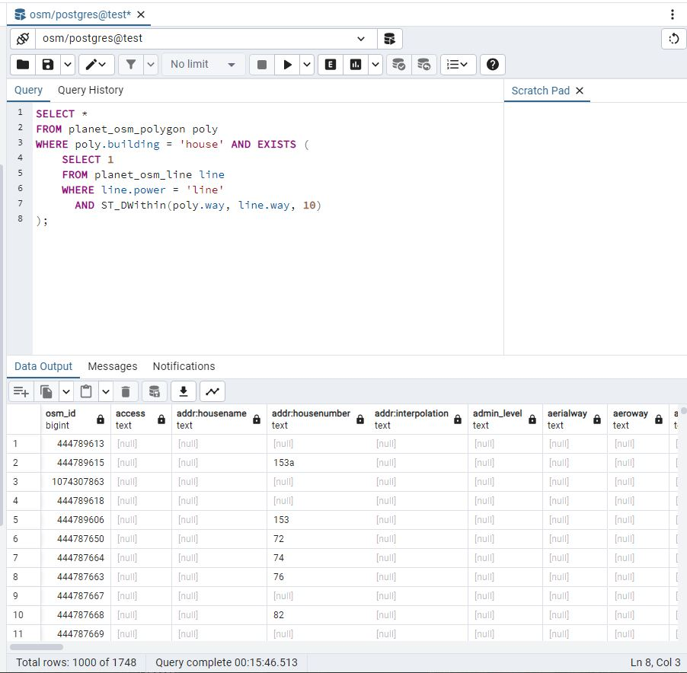
40s vs 15 min

