Slide 1
Napredni operativni sistemi

Slide 2
Zephyr OS
RTOS ecosystem
< 8KB Flash
< 5KB RAM
Open-Source
Scalable
Supported by major silicon vendors

Slide 3
Use cases
Industiral IoT
Asset Tracking
Healthcare
Automotive
Worker safety

Slide 4
600+ supported boards
ESP32
Arduino
Raspberry Pi
nRFx

Slide 5
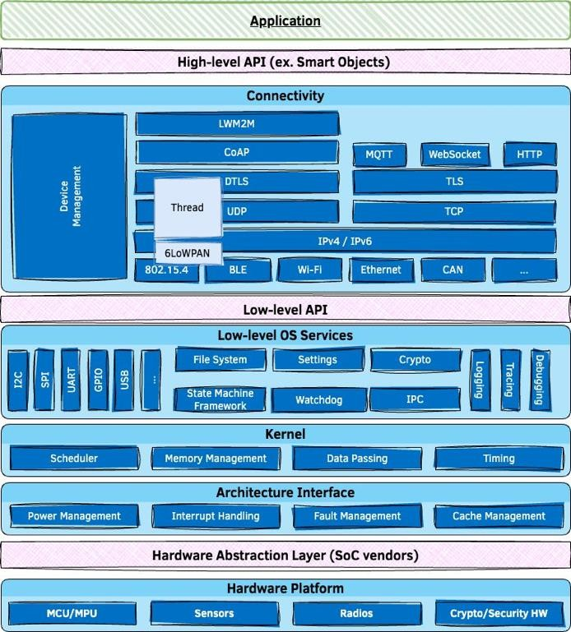
Architecture

Slide 6
Features overview
Comprehensive, lightweight, kernel & supporting services
Inherently portable & secure
Highly connected
Bluetooth 5.0 & BLE
Wi-Fi, Ethernet, CANbus, …
IoT protocols: CoAP, LwM2M, MQTT, OpenThread, …
USB & USB-C

Slide 7
Building on POSIX
Zephyr apps can run as native Linux applications
Re-use existing code & libraries by accessing Zephyr services through POSIX API

Slide 8
Performance
Benchmark on Arm Cortex-M4F running at 120 MHz:
Thread create 2.5 μs
Thread start 3.6 μs
Thread suspend 3.3 μs
Thread resume 3.8 μs
Context switch (yield) 2.2 μs
Get semaphore 0.6 μs
Put semaphore 1.1 μs

Slide 9
West (Zephyr’s meta-tool)
building applications, flashing and debugging
west build -b <BOARD>
west flash

Slide 10
Source Tree of Zephyr app:
• CMakeLists.txt
• Kconfig
• west.yml
• arch
• soc
• boards
• doc
• drivers
• dts
• include
• kernel
• lib
• misc
• samples
• scripts
• cmake
• subsys
• tests
• share

Slide 11
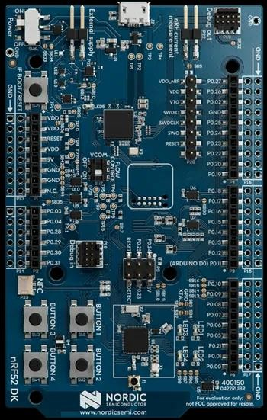
nRF52 DK
Bluetooth Low Energy
Bluetooth mesh
NFC
ANT
2.4 GHz

Slide 12
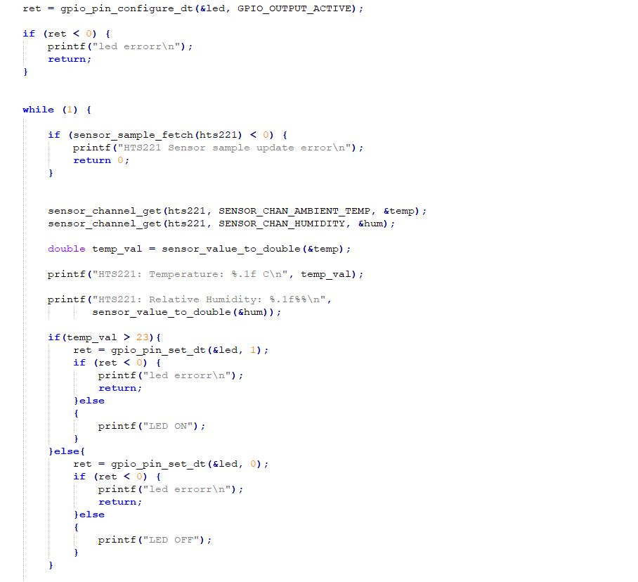

Slide 13
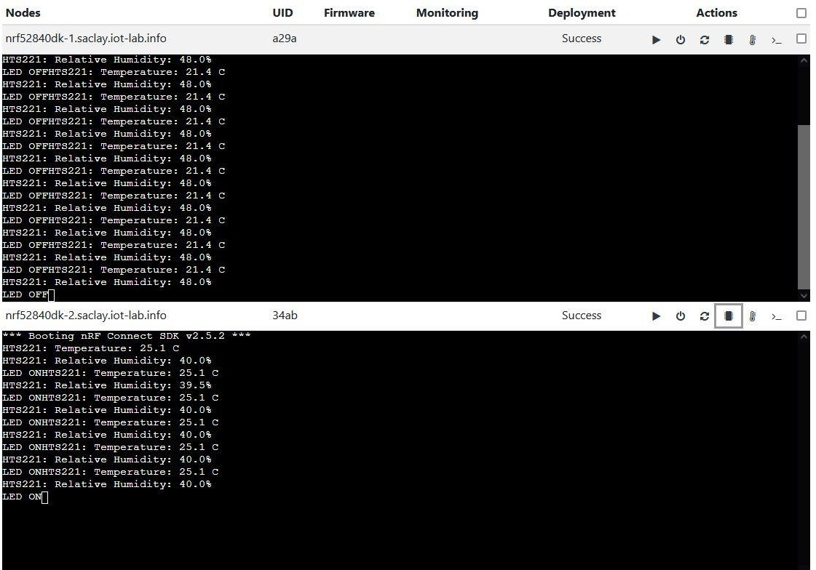
FIT IoT Lab

