Slide 1
Napredni operativni sistemi

Slide 2
Zephyr OS
RTOS ecosystem
< 8KB Flash
< 5KB RAM
Open-Source
Scalable
Supported by major silicon vendors

Slide 3
Use cases
Industiral IoT
Asset Tracking
Healthcare
Automotive
Worker safety

Slide 4
600+ supported boards
ESP32
Arduino
Raspberry Pi
nRFx

Slide 5
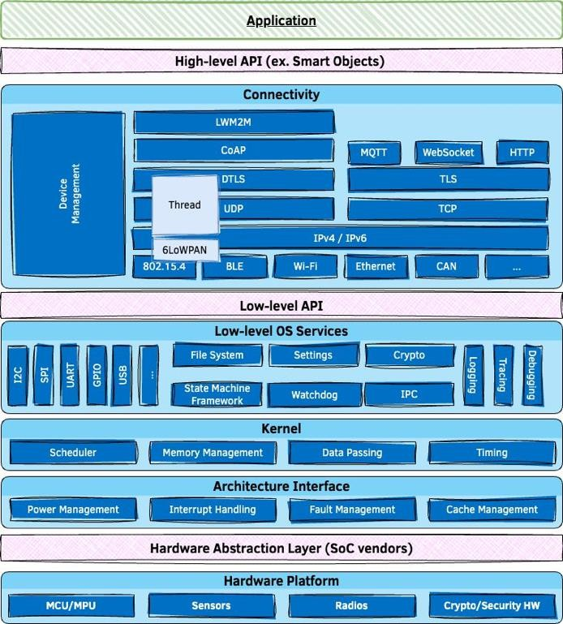
Architecture

Slide 6
Features overview
Comprehensive, lightweight, kernel & supporting services
Inherently portable & secure
Highly connected
Bluetooth 5.0 & BLE
Wi-Fi, Ethernet, CANbus, …
IoT protocols: CoAP, LwM2M, MQTT, OpenThread, …
USB & USB-C

Slide 7
Building on POSIX
Zephyr apps can run as native Linux applications
Re-use existing code & libraries by accessing Zephyr services through POSIX API

Slide 8
Performance
Benchmark on Arm Cortex-M4F running at 120 MHz:
Thread create 2.5 μs
Thread start 3.6 μs
Thread suspend 3.3 μs
Thread resume 3.8 μs
Context switch (yield) 2.2 μs
Get semaphore 0.6 μs
Put semaphore 1.1 μs

Slide 9
West (Zephyr’s meta-tool)
building applications, flashing and debugging
west build -b <BOARD>
west flash

Slide 10
Source Tree of Zephyr app:
• CMakeLists.txt
• Kconfig
• west.yml
• arch
• soc
• boards
• doc
• drivers
• dts
• include
• kernel
• lib
• misc
• samples
• scripts
• cmake
• subsys
• tests
• share

Slide 11
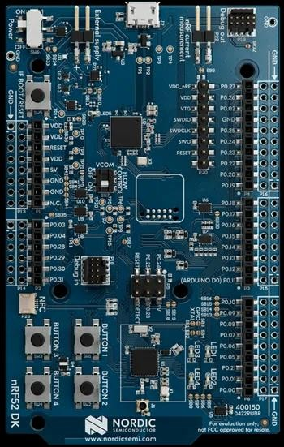
nRF52 DK
Bluetooth Low Energy
Bluetooth mesh
NFC
ANT
2.4 GHz

Slide 12
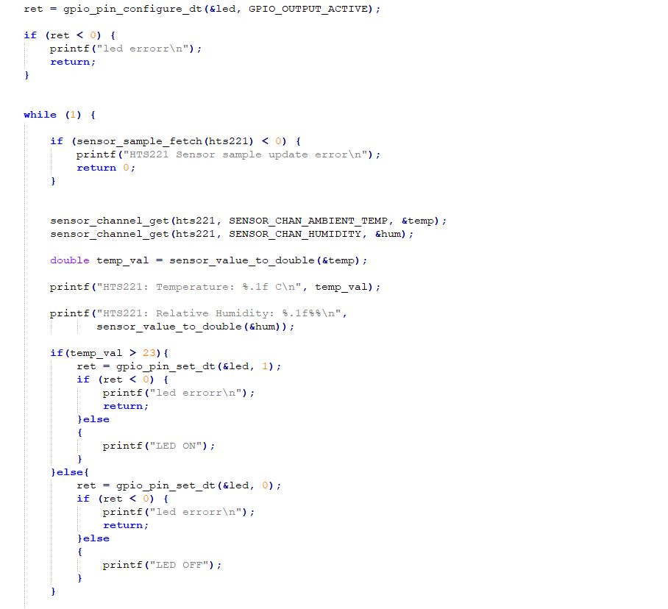

Slide 13
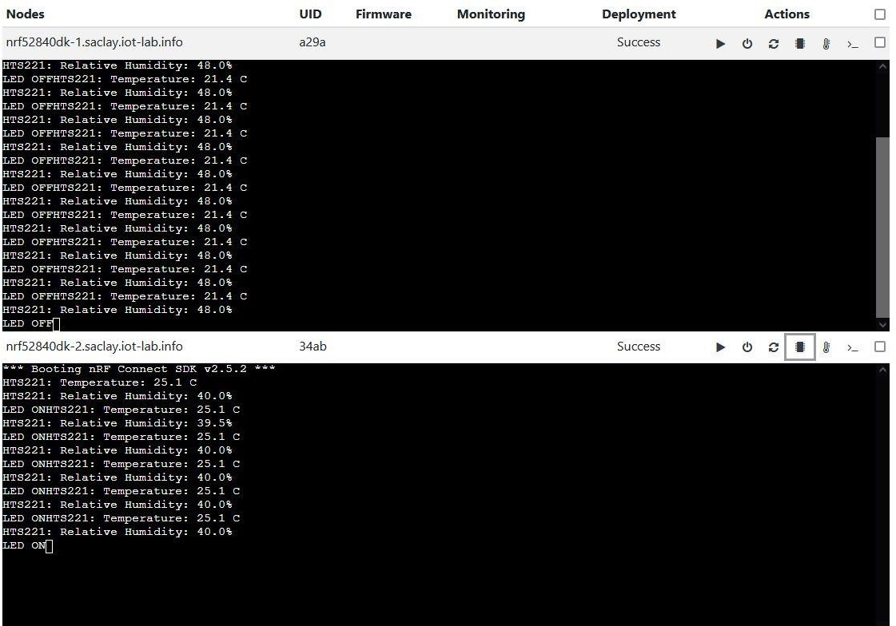
FIT IoT Lab

Slide 14
ROS - Robot Operating System
Open source software development kit for robotics applications.
https://github.com/ros
Multi-platform tested on Linux, Windows, and macOS +embedded platforms (via micro-ROS)
Industry support

Slide 15
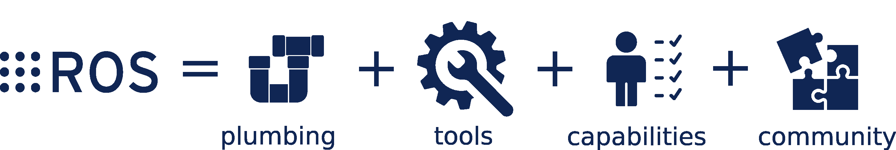
The ROS Ecosystem

Slide 16
Plumbing
At its core, ROS provides a message-passing system, often called “middleware” or “plumbing”. Communication is one of the first needs to arise when implementing a new robot application, or really any software system that will interact with hardware

Slide 17
Tools
To build applications efficiently, you need good developer tools. ROS has them, including: launch, introspection, debugging, visualization, plotting, logging, and playback. These tools accelerate the progress of your dev team, and they can be included with your product when you ship it.

Slide 18
Capabilities
The goal of the ROS project is to continually raise the bar on what is taken for granted, and thus to lower the barrier to entry to building robot applications. Anyone with a good idea for a useful (or fun, or interesting) robot should be able to make that idea real, without having to understand everything about the underlying hardware and software.

Slide 19
Community
The ROS community is large, diverse, and global. From students and hobbyists to multinational corporations and government agencies, people and organizations of all stripes keep the ROS project going.
The community hub and neutral steward for the project is Open Robotics, who hosts the shared online services (such as this website), create and manage distribution releases (including the binary packages that you install), and develop and maintain much of the core software within ROS. Open Robotics also offers engineering services related to ROS.

Slide 20
In support of this primary goal of sharing and collaboration, there are several other goals of the ROS framework:
Thin: ROS is designed to be as thin as possible -- we won't wrap your main() -- so that code written for ROS can be used with other robot software frameworks. A corollary to this is that ROS is easy to integrate with other robot software frameworks: ROS has already been integrated with OpenRAVE, Orocos, and Player.
ROS-agnostic libraries: the preferred development model is to write ROS-agnostic libraries with clean functional interfaces.
Language independence: the ROS framework is easy to implement in any modern programming language. We have already implemented it in Python, C++, and Lisp, and we have experimental libraries in Java and Lua.
Easy testing: ROS has a builtin unit/integration test framework called rostest that makes it easy to bring up and tear down test fixtures.
Scaling: ROS is appropriate for large runtime systems and for large development processes.

