Slide 1
Name Detection in
ASR Hypothesis
Minh Duong & Aasish Pappu

Slide 2
Outline
Motivation
Related work
Approach
Data
Preliminary experiment results

Slide 3
Motivation
Each OOV token contributes to ~1.5 ASR errors (Hetherington '95)
From TDT broadcast corpus news 97-98:
  45.2% of OOVs are in person name phrases
  9.4% of words are part of name phrase
  45.1% of utterances contain at least 1 name phrase
  word error rate 38.6% for words within name phrases, 29.4% for non-name words
  OOV rate < 1% for large vocab (48-64k) system
We need to improve ASR’s performance on names

Slide 4
Sources of OOV person names
“New” names of global importance
  World leaders, terrorists, corporate leaders…
News reporter
  “CNN’s John Zarrella has the story…”
  Readily available from news agencies
Spelling and morphological variants
Sports figures
…

Slide 5
How to deal with OOV?
Add all names to vocabulary?
  Too many to add
  Increasing vocab size beyond 64k yields negligible improvement (Rosenfeld ‘94)
Add some names to vocabulary?
  Which names?
  Names that are phonetically close to “name-like” words
  How do we know which words are “name-like”?
  Good question!

Slide 6
Example
REFERENCE: looking beyond its borders for newcomers. as abc's jim sciutto reports,
HYPOTHESIS A: LOOKING BEYOND ITS BORDERS FOR NEWCOMERS AS A B C 'S JIM PSEUDO REPORTS
HYPOTHESIS B: LOOKING BEYOND ITS BORDERS FOR NEWCOMERS AS A B C 'S JIM SHOOTOUT WITH PORTS

Slide 7
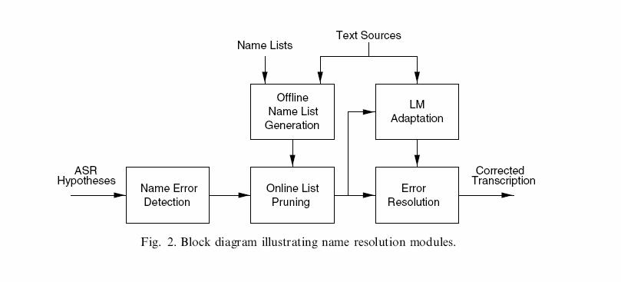
Big picture
(Palmer & Ostendorf ‘05)

Slide 8
Our project

Slide 9
Related Work
Miller et al. ’00
  Used IdentiFinder NER system on
    Human transcripts without case, punctuations
    Noisy ASR output
    Observed NER performance with varying WER, training set size, textual clues (punctuations, case)
Palmer & Ostendorf ’00, ’01
  HMM like model with state dependent bigrams
  Precision 59.0%, Recall 65.7%, F1 62.2%

Slide 10
Approach
Feature selection:
  Can’t rely on surface form because:
    ASR output is noisy
    No punctuations or case information
  Instead, explore phonetic features:
    “Bag of phones”
    Phone bigrams
    Phone class: vowels, consonants, nasal, aspirated
  Parse short phrases to look for NP
  Acoustic confidence
Use a linear-chain CRF

Slide 11
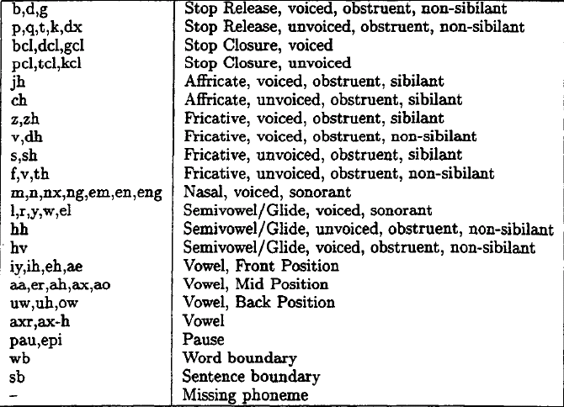
Phone Types

Slide 12
Data
Broadcast news, TDT4 2004
Only 2.5 hours of usable labeled data
 | Labeled | Unlabeled
Hours | 8 | 718
Tokens | 33,479 | 2,410,855
Named Entities | 3164 | ?

Slide 13
ASR systems
Our own
  Language Model: WSJ 30k broadcast news
  Dictionary: WSJ 30k broadcast news
  Acoustic Model: hub4 continuous (trained using 140 hours of ’96, ’97 hub4 data)
  Decoder: Sphinx 3.0.6
TDT4’s (less noisy output)
  Dictionary: 64k
  Decoder: Dragon System from Nuance Communications

Slide 14
Experimental Setup
Sphinx 3: ~3 hours to decode 1144 utterances of 3 sec long.
SCLITE: for reference-hypothesis alignment
MinorThird: About 45 minutes for a 10-fold cross validation experiment with CRF

Slide 15
Preliminary Results – less noisy output
Measurement | Token Prec | Token Recall | Token F1
VanillaFE (BoW) | 0.7846 | 0.3577 | 0.4914
V+PhoneUnigrams window size = 4 | 0.6071 | 0.3529 | 0.4347
V+PhoneBigrams, window size = 4 | 0.6085 | 0.2853 | 0.3884
V+PhoneUnigrams window size = 2 | 0.7096 | 0.3745 | 0.4903
V+PhoneBigrams, window size = 2 | 0.6934 | 0.3905 | 0.4996
V+PhoneUnigrams, window size = 2, context only | 0.7336 | 0.3527 | 0.4764

Slide 16
Preliminary Results – noisy output
Measurement | Token Prec | Token Recall | Token F1
VanillaFE (BoW) | 0.6723 | 0.2143 | 0.3250
V+PhoneUnigrams window size = 4 | 0.5113 | 0.2012 | 0.2887
V+PhoneBigrams, window size = 4 | 0.5582 | 0.1754 | 0.2669
V+PhoneUnigrams window size = 2 | 0.5474 | 0.2246 | 0.3185
V+PhoneBigrams, window size = 2 | 0.5276 | 0.2462 | 0.3358

Slide 17
Ongoing work
Implement more features
  Phone types, phone type pattern
  NP
  Acoustic confidence
  …
Work on improving recall
Experiment with semi-supervised approaches

Slide 18
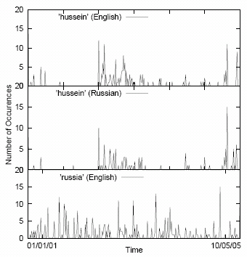
Future work

Slide 19
Conclusions
Name error detection is necessary for 2nd pass recognition
PhoneUnigrams or PhoneBigrams features alone don’t seem to help
Bigrams vs. Unigrams: lower prec, higher recall

