Slide 1


Slide 2
Introduction
  OOVs ~ Names
  Mountainous vocabulary ??
  John, Jean, Joana .... ?? okay, a multiple personality disorder !
  Each OOV token contributes on average 1.5 errors (Hetherington '95
  Major source of word errors in ASR hypothesis. why ?
    [from TDT broadcast corpus news]
    9.4% of the words are part of name phrases
    45.1% of the utterances contain at least one name phrase.
    WER: 38.6% for words within name phrases
    WER: 29.4% for non-name words
    OOV rate is less than 1% for large-vocab (48-64k) systems, but significantly higher for words in name phrases.
    [ ]

Slide 3
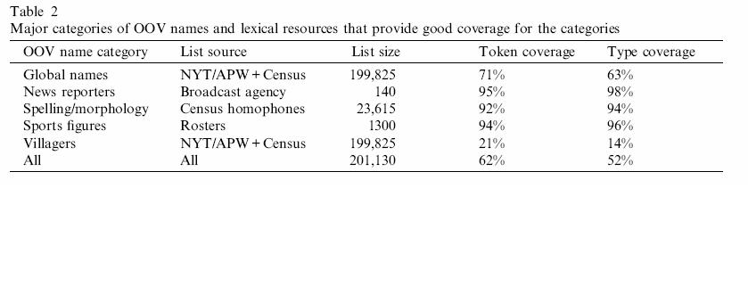
Primary sources of OOV person names
  "New" names of global importance
    News worthy: World leader, terrorists, criminals and corporate leaders
    Assuming entities of global importance appear both in broadcast and print during same period
  News Reporters
    "CNN's John Zarrella has the story..."
    readily available from news agency itself
  Spelling and Morphological variants
  Sports Figures
  Villagers and human interest personalities (Joe the plumber is an outlier ?)

Slide 4
Recap
  Detect OOV errors.
  Generate targeted name lists for candidate OOV
  Offline generation of a large name list and online pruning based on a phonetic distance.
  The resulting list can be used in a rescoring pass in automatic speech recognition.
  Wide variety of sources, including automatic name phrase tagging of temporally relevant news text can be used for NE correction.

Slide 5
Features
Phone level confusion
nasalized vowels or affricated stops, rather than full phone transformations.
TTS confusions as features to recognition ?

