Slide 1
OOV Detection from
ASR Hypothesis
Minh Duong & Aasish Pappu

Slide 2
Outline
Motivation
Related work
Approach
Data
Preliminary experiment results

Slide 3
Motivation
Each OOV token contributes to ~1.5 ASR errors (Hetherington '95)
From TDT broadcast corpus news 97-98:
  45.2% of OOVs are in person name phrases
  9.4% of words are part of name phrase
  45.1% of utterances contain at least 1 name phrase
  word error rate 38.6% for words within name phrases, 29.4% for non-name words
  OOV rate < 1% for large vocab (48-64k) system
We need to improve ASR’s performance on names

Slide 4
Primary sources of OOV person names
“New” names of global importance
  World leaders, terrorists, corporate leaders…
News reporter
  “CNN’s John Zarrella has the story…”
  Readily available from news agencies
Spelling and morphological variants
Sports figures
…

Slide 5
Solutions
Add all names to vocabulary?
  Too many to add
  Increasing vocab size beyond 64k yields negligible improvement (Rosenfeld ‘94)
Add some names to vocabulary?
  Which names?
  Names that are phonetically close to “name-like” words
  How do we know which words are “name-like”?
  We work on it in an IE project

Slide 6
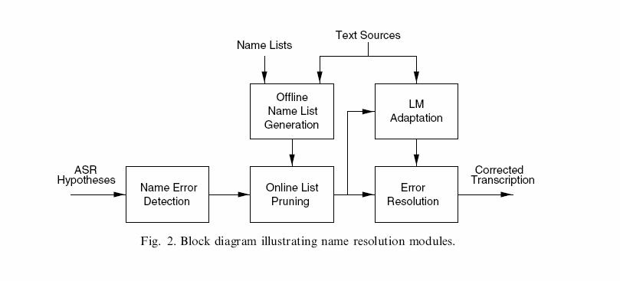
Improved system
(Palmer & Ostendorf ‘05)

Slide 7
Related Work
Miller et al. ’00
  Used IdentiFinder NER system on
    Human transcripts without case, punctuations
    Noisy ASR output
    Observed NER performance with varying WER, training set size, textual clues (punctuations, case)
Palmer & Ostendorf ’00, ’01
  HMM like model with state dependent bigrams
  Precision 59.0%, Recall 65.7%, F1 62.2%

Slide 8
Approach
Use a linear-chain CRF
Feature selection:
  Can’t rely on surface form because:
    ASR output is noisy
    No case or punctuations
  Instead, explore phonetic features:
    “Bag of phones”
    Phone bigrams
    Phone class: vowels, consonants, nasal, aspirated
  Parse short phrases to look for NP
  Acoustic confidence

