Slide 1
Department of Electrical and Computer Engineering
M.Sc. in Informatics Engineering
Proposal Thesis
Professor: G. Kornaros
Thesis Title: Kubernetes Based IoT online parking platform
Student: Dimitra Deka
A.M. mtp282

Slide 2
Agenda
Introduction
Kubernetes Platform IoT – Edge Computing
Hardware
Software
System Architecture
Test Cases
Related work
Conclusions

Slide 3
Introduction
Cyber Bullying based on Twitter’s Data
Plethora of Information on Social Media.
exports outcomes by utilizing probabilistic logic reasoning through the use of a Bayesian Network. The training data pertains to the domain of Cyber Bullying.
Text Analysis to determine whether a tweet is racist or not

Slide 4
Kubernetes IoT online platform
Main Description
An online platform where a is taking place on AMEA seat
Recognize a vehicle and see that it might park on that place
If it does then a notification is sent
Capture details and a notification is sent to the server
Server notification send to the police station
Vehicle is removed from the parking seat

Slide 5
Hardware
VM Ubunut 22.04 LTS
Raspberry Pi 4
4 GB RAM
32 GB micro sd
OS: Ubuntu 22.04 LTS with ssh configuration
Raspberry Pi Camera Module V3

Slide 6
Software
OS: Ubuntu 22.04 LTS
Kubernetes K3s on VM as a master node, control plane
K3s for worker node raspberry Pi 4
Real – series database server like Grafana to store objects data streaming
Application for Machine Learning algorithms like probabilistic logic reasoning using a Bayesian Network approach. This application is developed on Python
Web application for sending data to main server (VM) Technologies used are Java, Spring Boot, Maven, Grafana database, Restful services

Slide 7
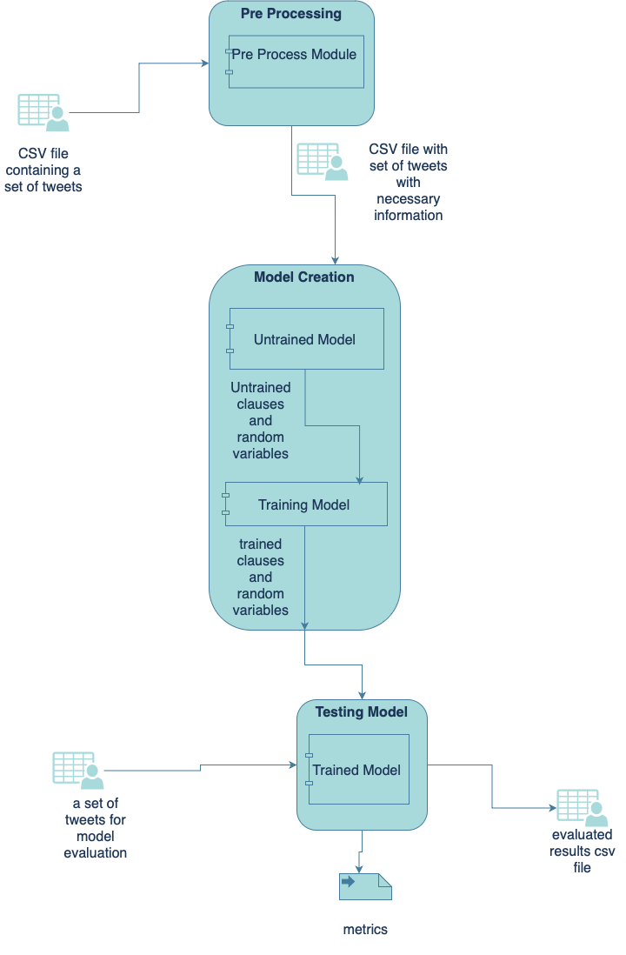
System Architecture

Slide 8
Pre-process, Create Model, Testing
Pre-process data
certain format
create mode
untrained model
t(_)::religion.
t(_)::sex.
t(_)::racist_phrase :- sex,religion.
t(_)::racist_phrase :- \+sex,religion.
t(_)::racist_phrase :- sex,\+religion.
t(_)::racist_phrase :- \+sex,\+religion.
evidence set
evidence(religion, true).
evidence(sex, false).
evidence(religion, false).
evidence(sex, false).
evidence(religion, true).
Trained Model
0.520487690832955::religion 0.483132505472743::sex. 0.583272613885992::racist_phrase :- sex, religion. 0.90305150416143::racist_phrase :- \+sex, religion. 0.556308244518812::racist_phrase :- sex, \+religion. 0.492849848333152::racist_phrase :- \+sex, \+religion

Slide 9
Model Components
main.py
create_model.py
testing_model.py
clear_data.py
clears data and creates certain format for further processing
call each component
create trained model
creates untrained model
creates evidence set based on data given from previous component clear_data
tests model based on testing data and trained model
calculates metrics Accuracy, Precision, Recall and F-Measure
outputs testing data labeled
get synonyms for each random variable

Slide 10
Test Cases / Scenario
Accuracy
Precision
Recall
F-Measure
0.65
0.89
0.58
0.71

Slide 11
Related Work
@youfoundthecard @ChrisWarcraft gross. netware.,none,none,0.0
RT @DTeambanning: UNREAL: Obama Refused to Give Jordan, Egypt Intel to Target ISIS (What More Proof Do You Need!?) http://t.co/t2lXtCLcCT,none,none,0.0
Please enjoy my deconstructed lemon tart. #MKR http://t.co/PhhcBgvp5L,none,none,0.0
@ConorPonting That's possibly the most laughably poorly executed thought I've read today.,none,none,0.0
Really just go read all of @IjeomaOluo 's feed today, she says all the things.,none,none,0.0
My kingdom for a subscription to Safari Books Online. I miss having one provided by my former employer. :(,none,racism,0.8468
@DiscordianKitty sigh.,none,none,0.0
#mkr not sure if anyone noticed but kat and andre aren't in any of the promos...I'd say they get the bootüë¢pretty eay!,none,none,0.0
@ChinaDailyUSA The most helpless words in politics these days are "UN calls for".,none,none,0.0
@ummayman90 @wood_brwood333 For example, in Medina Mohammed said, kindly cut off the heads of these 600 Jewish men and enslave their women.,racism,racism,0.8468
RT @tahliaandfamily: Ready to run playing as mkr background music üòçüëå #mkr,none,none,0.0
@PhoenixDK i think there's a really fine line beyond being vocal about your experiences and indirect bullying.,none,none,0.0
@ummahwitness The Muslim pedophiles do this all the time. It's so common and accepted that it's not even news.,racism,racism,0.8468

Slide 12
Conclusions
Bayesian Model based on Social media data
Metrics
Future work
Process data in a certain format
Able to extract data and label
Accuracy is good enough, though it needs further improvement
Precision is fair enough but needs more improvement
This is for Recall to have more valuable results.
Better data procession will return a better model with better metrics

Slide 13
Thank You
Dimitra Deka
AM: mtp282

