Slide 1
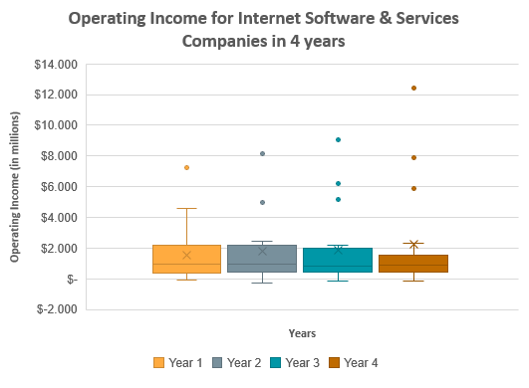
How does the Operating Income for the Internet Software & Services industry change in 4 years?
The box-plot graph on the left shows the changes in the Operating Income for the Internet Software & Services industry in 4 years.
We can see that all four box-plots are right or positively skewed distributions, i.e., distributions where the mean is greater than the median. Indeed, in all box-plots, we can see that the median line is below the “X” mark which represents the mean.
We can also notice that the Minimum in all cases is a negative number as one company (CRM) has a negative Operating Income for Years 1-3 and one (YHOO) for Year 4. On the other hand, the Maximum steadily increases every year and so does the Range. What is worth considering though is that the IQR is mostly decreasing as we can see by the length of the distance between the two whiskers, which is shortened during Years 1-3 and slightly increases in Year 4 but still under the value it had on Years 1 & 2.
As the Mean, Maximum & Range are increasing, while the IQR has a decreasing tendency and the Standard Deviation increases too, we would expect to see more outliers in Years 2-4 i.e. data points that are located outside the whiskers of the box plot. Indeed, this is the case as we notice 1 outlier in Year 1, 2 in Year 2, and 3 in Years 3 & 4.

