Slide 1
Κυψελιδωτά Αυτόματα – Τελική Εργασία
Κούτρας Δημήτριος – ΑΜ: 355

Slide 2
Περιληψη Εργασίας

Slide 3
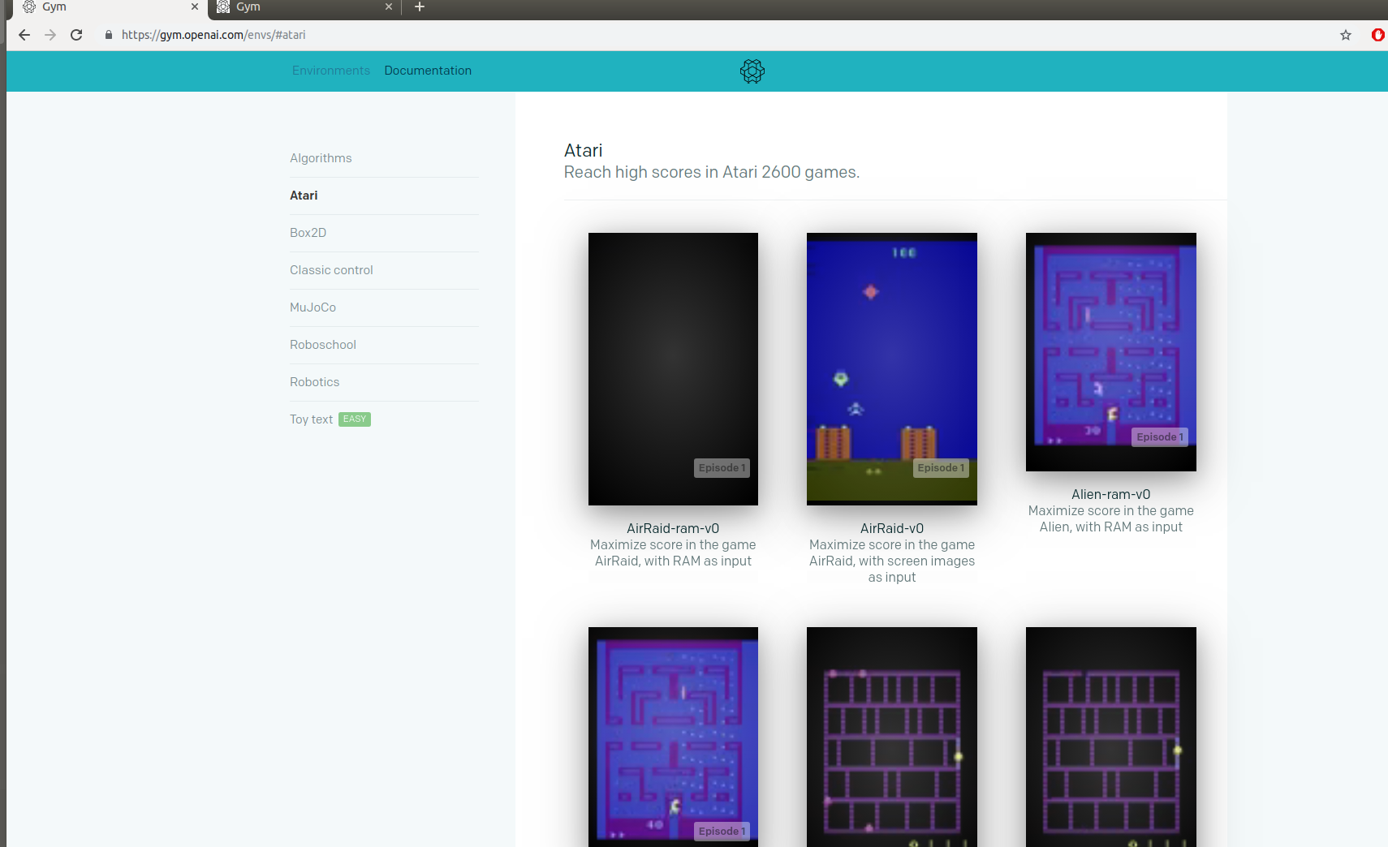
OpenAI Gym

Slide 4
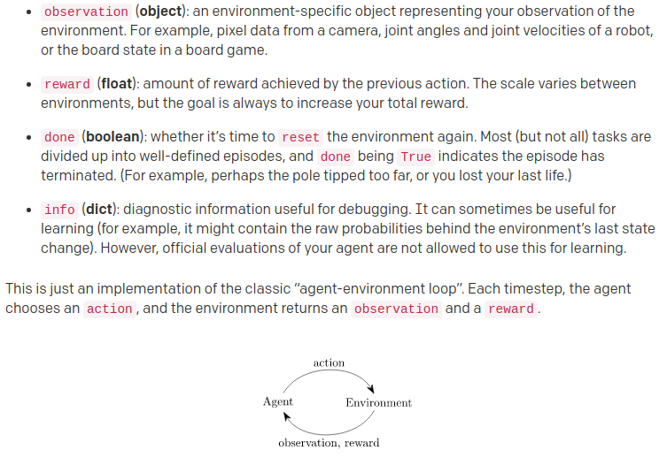
OpenAI Gym

Slide 5
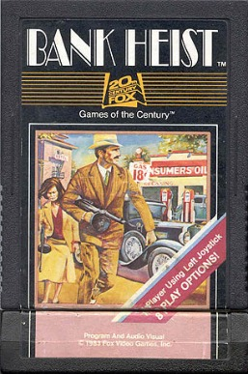
Bank Heist – Atari 2600
  1. Atari 2600
  2. 1983
  3. Maze-like city (Pac-man)

Slide 6
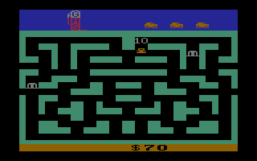
Bank Heist – Atari 2600

Slide 7
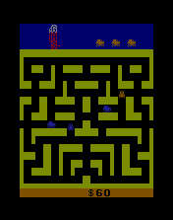
Bank Heist – Atari 2600

Slide 8
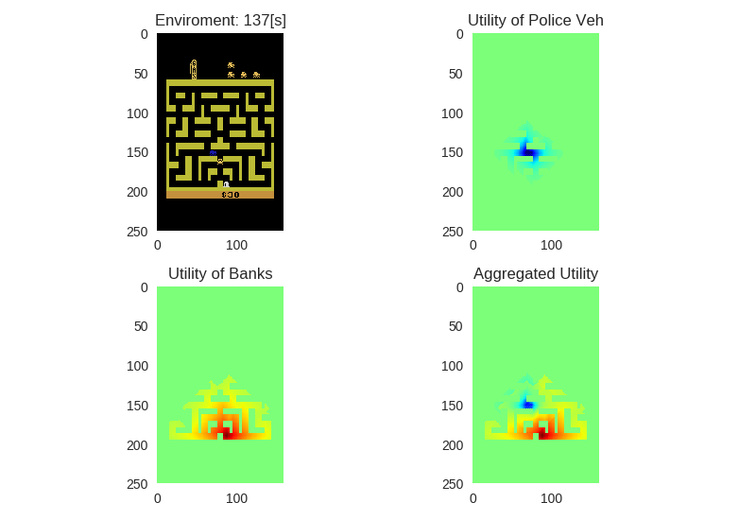
Κυψελιδωτά Αυτόματα

Slide 9
Detection
Ego veh (Getaway car )-> rgb(223, 183, 85)
Bank -> rgb(214, 214, 214)
Wall -> rgb(187,187,53)
Free Space -> rgb(0,0,0)
Police veh -> rgb(24,26,167)

Slide 10
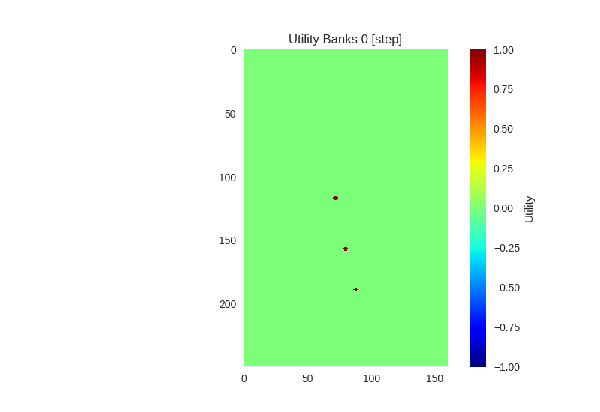
Baks Utility

Slide 11
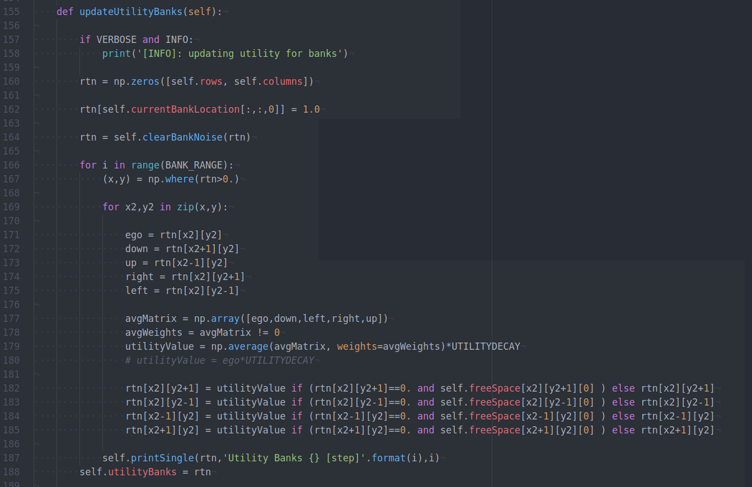
Baks Utility

Slide 12
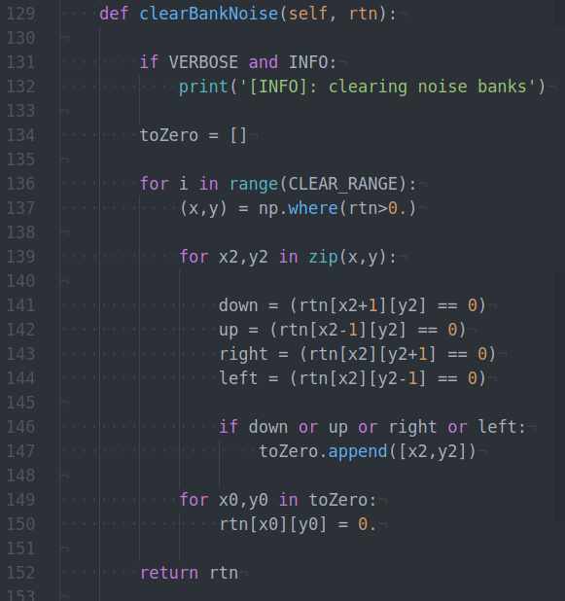
Banks Utility – Clear Noise

Slide 13

Banks Utility

Slide 14
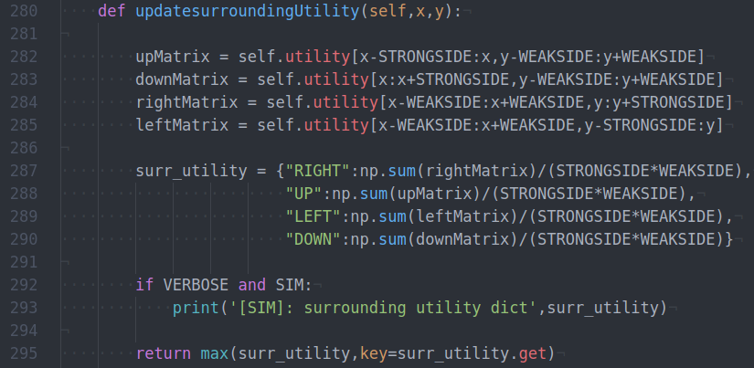
Agent Action

Slide 15
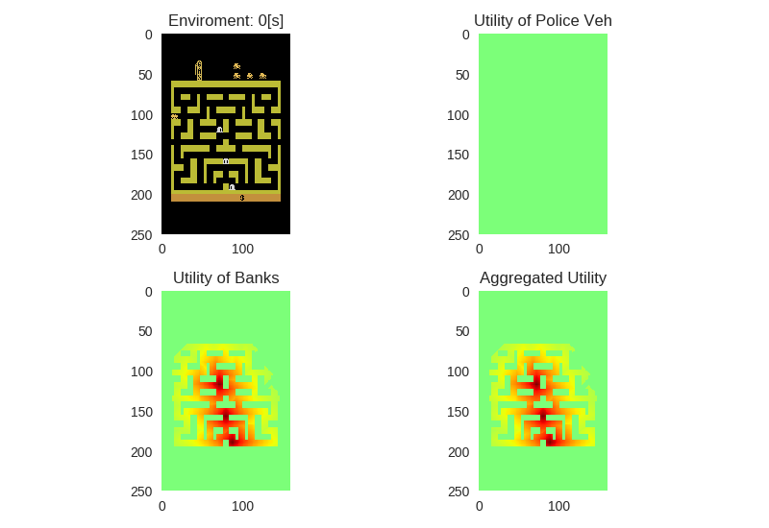
Bank Utility – Example

Slide 16

Bank Utility – Example

Slide 17
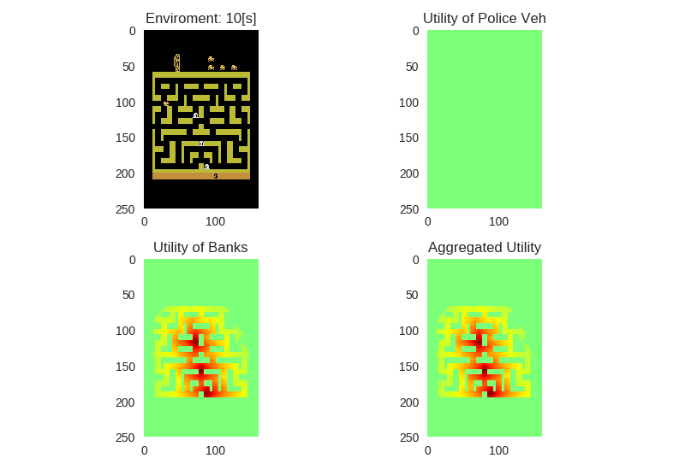
Bank Utility – Example

Slide 18

Bank Utility – Example

Slide 19

Bank Utility – Example

Slide 20

Bank Utility – Example

Slide 21

Bank Utility – Example

Slide 22

Bank Utility – Example

Slide 23

Bank Utility – Example

Slide 24
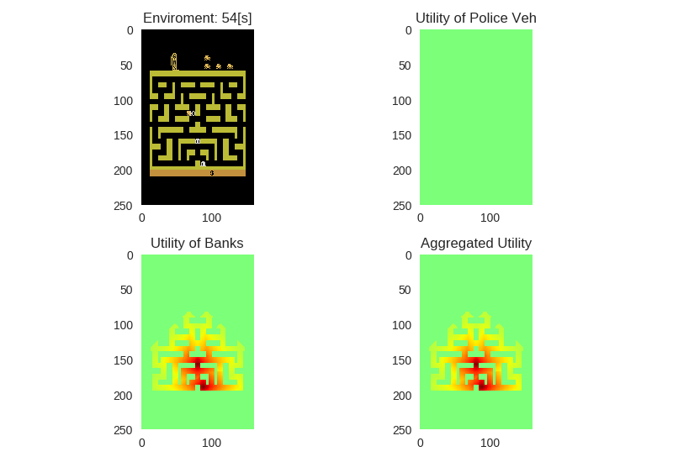
Bank Utility – Example

Slide 25
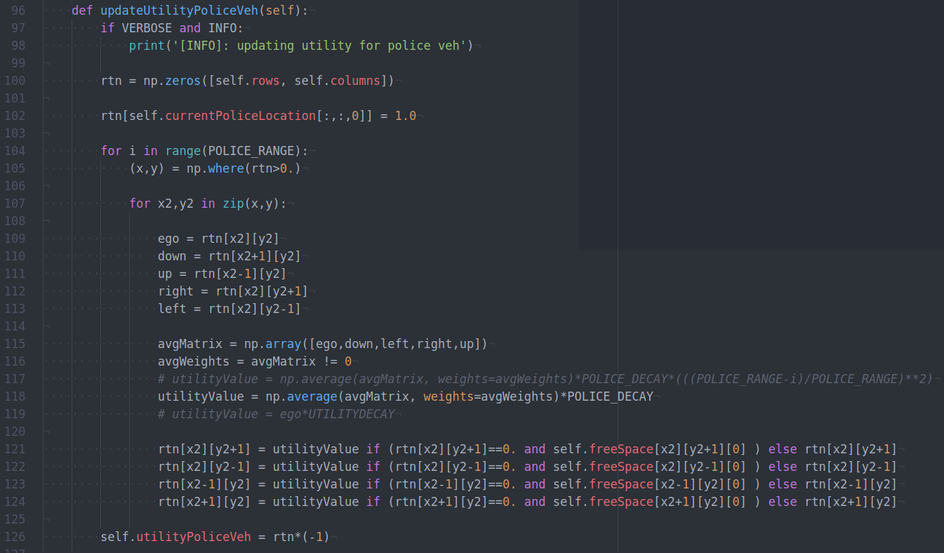
Police Vehicle Utility

Slide 26
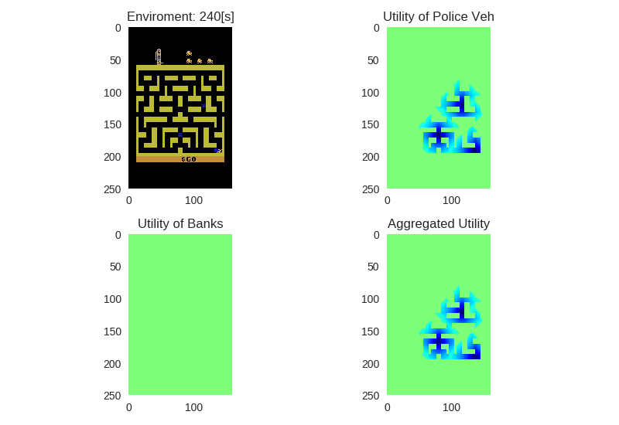
Police Vehicle Utility – Example

Slide 27
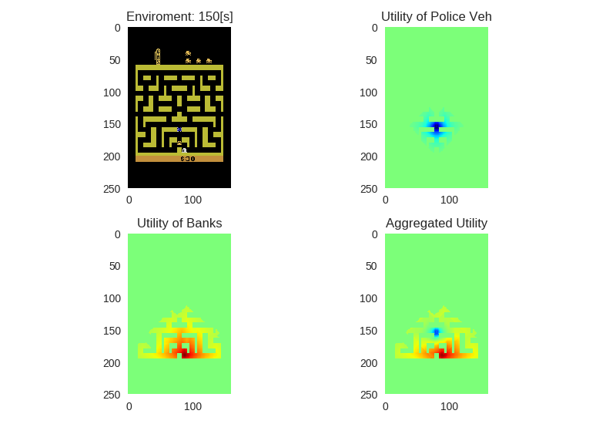
Police Vehicle Utility – Example

Slide 28
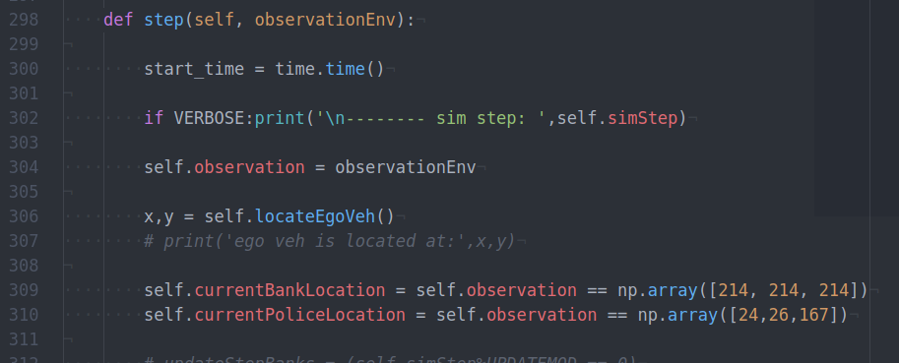
Decision Making

Slide 29
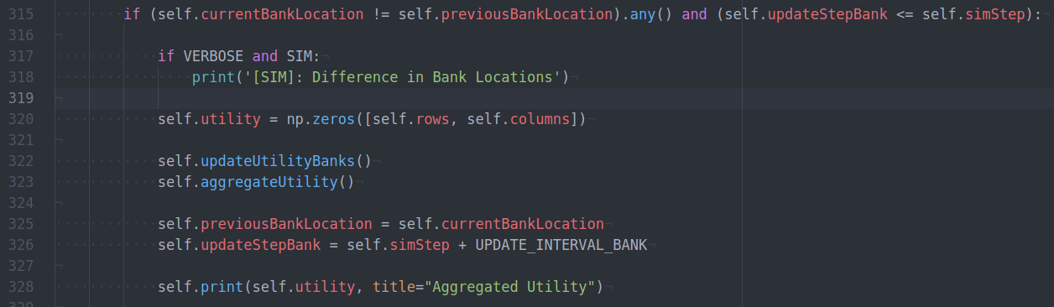
Decision Making – Bank Update

Slide 30
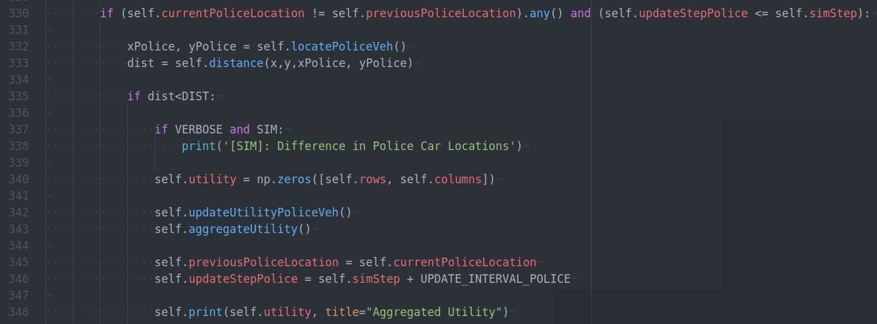
Decision Making – Police Update

Slide 31
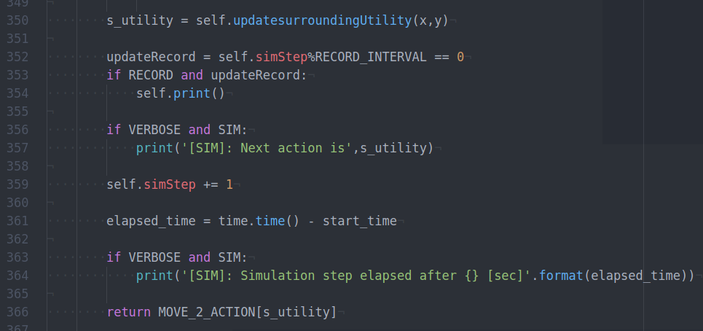
Decision Making

Slide 32
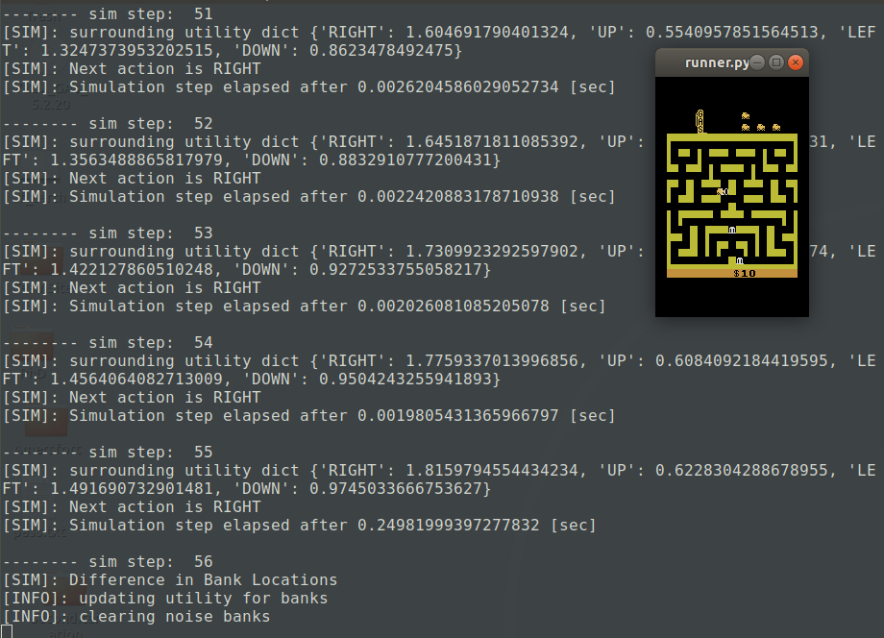
Output

Slide 33
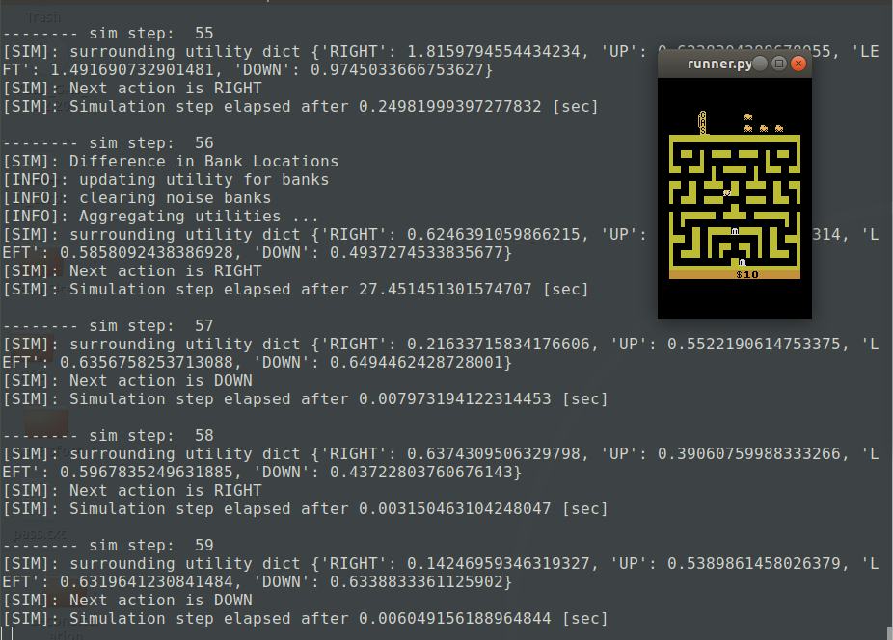
Output

Slide 34

Example

Slide 35
Example

