Slide 1


AcmeBirdSeed
Terms Extension Opportunity Assessment June 24

Slide 2
To create a comprehensive summary based on the images related to AcmeBirdSeed, please upload the images or provide more details about their content. This will help in generating an accurate and concise summary.
© 2023 Taulia LLC. Confidential information. Do not distribute.

Slide 3

Card Adoption
© 2023 Taulia LLC. Confidential information. Do not distribute.

Slide 4
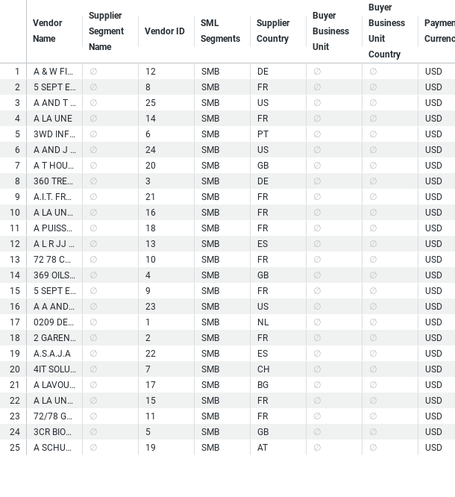
Buyer - Payables Planner Supplier List
© 2023 Taulia LLC. Confidential information. Do not distribute.

Slide 5
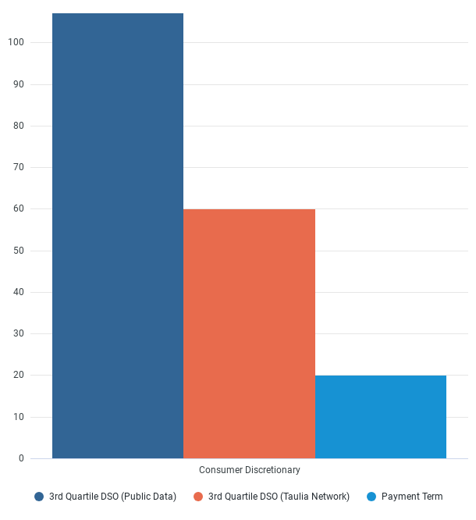
Supplier Payment Terms Comparison
© 2023 Taulia LLC. Confidential information. Do not distribute.

Slide 6
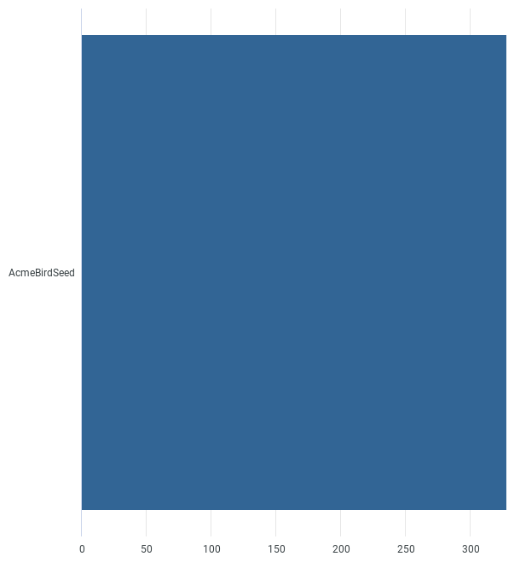
Peer DPO
© 2023 Taulia LLC. Confidential information. Do not distribute.

