Slide 1


AcmeBirdSeed
Terms Extension Opportunity Assessment June 24

Slide 2
We have analyzed various aspects of AcmeBirdSeed's financial operations, focusing on working capital management and potential efficiency improvements. Our findings include:
- **Out of Scope Spend**: Identifies categories of spend that are not addressed by the current working capital strategy.
- **AP Balance Impact**: Evaluates the impact of accounts payable balances on liquidity.
- **Net Impact to Suppliers**: Assesses how changes in payment terms affect suppliers.
- **Target Average Terms**: Proposes optimal payment terms to improve cash flow.
- **Discount Capture**: Analyzes potential savings from early payment discounts.
- **Payment Term Descriptions**: Provides detailed descriptions of current and proposed payment terms.
- **Strategic Scenarios**: Outlines different strategic approaches for optimizing working capital.
- **DPO Impact**: Measures the impact of Days Payable Outstanding (DPO) on cash flow.
- **Payables Concentrations**: Examines the concentration of payables among top suppliers.
- **Estimated Payables**: Estimates future payables based on current trends.
- **Early Payment Adoption by Sector**: Reviews sector-wise adoption rates of early payment programs.
- **Target Working Capital Impact**: Quantifies the potential impact of targeted working capital initiatives.
- **Cash from Other Funders**: Identifies alternative funding sources for liquidity.
- **Current Average Terms**: Analyzes the current average payment terms used.
- **Total Early Payment Adoption**: Summarizes overall adoption rates of early payment discounts.
- **Cash from Treasury**: Evaluates the role of treasury in providing liquidity.
- **Avg Return on Capital**: Measures the average return on capital for different strategies.
These analyses aim to help AcmeBirdSeed unlock working capital and drive efficiencies through targeted financial strategies.
© 2023 Taulia LLC. Confidential information. Do not distribute.

Slide 3
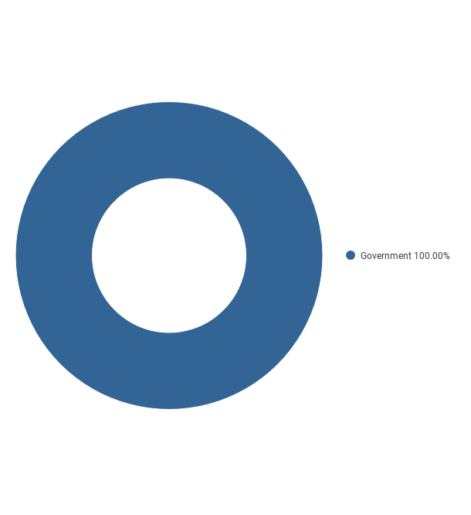
Out of Scope Spend
© 2023 Taulia LLC. Confidential information. Do not distribute.

Slide 4

AP Balance Impact
© 2023 Taulia LLC. Confidential information. Do not distribute.

Slide 5
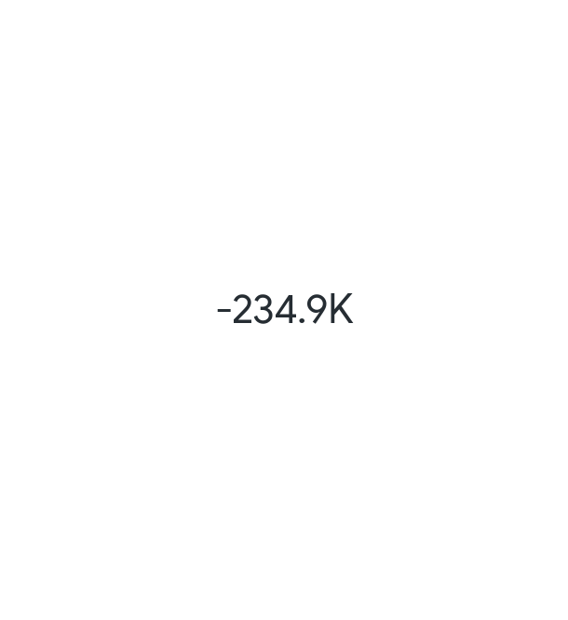
Net Impact to Suppliers
© 2023 Taulia LLC. Confidential information. Do not distribute.

Slide 6
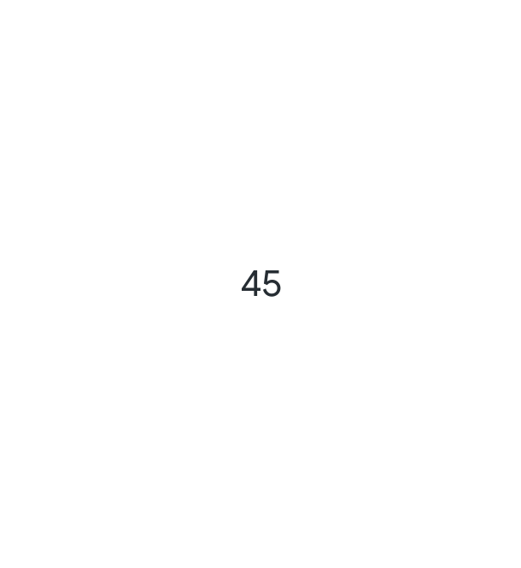
Target Average Terms
© 2023 Taulia LLC. Confidential information. Do not distribute.

Slide 7

Discount Capture
© 2023 Taulia LLC. Confidential information. Do not distribute.

Slide 8
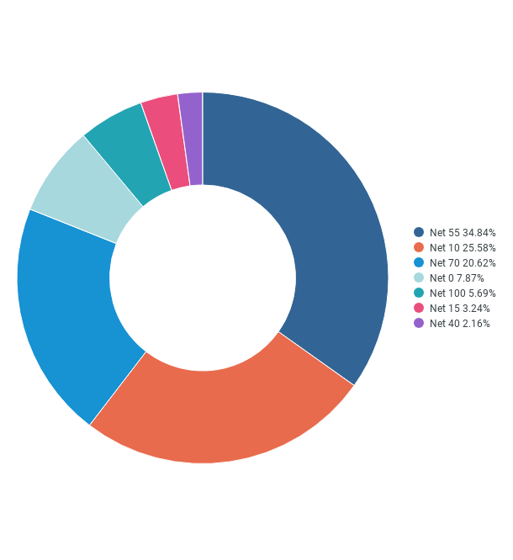
Payment Term Descriptions
© 2023 Taulia LLC. Confidential information. Do not distribute.

Slide 9
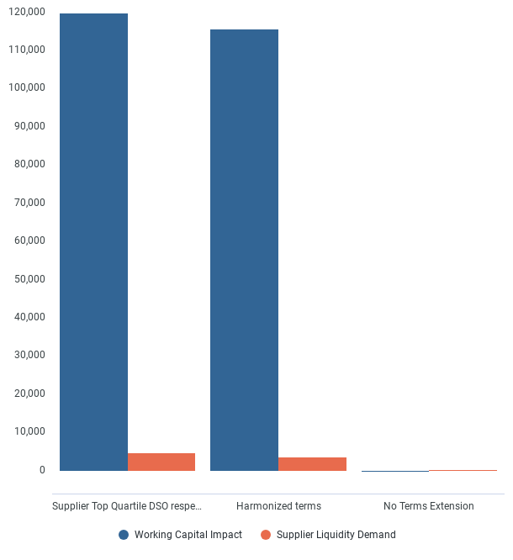
Strategic Scenarios
© 2023 Taulia LLC. Confidential information. Do not distribute.

Slide 10

DPO Impact
© 2023 Taulia LLC. Confidential information. Do not distribute.

Slide 11
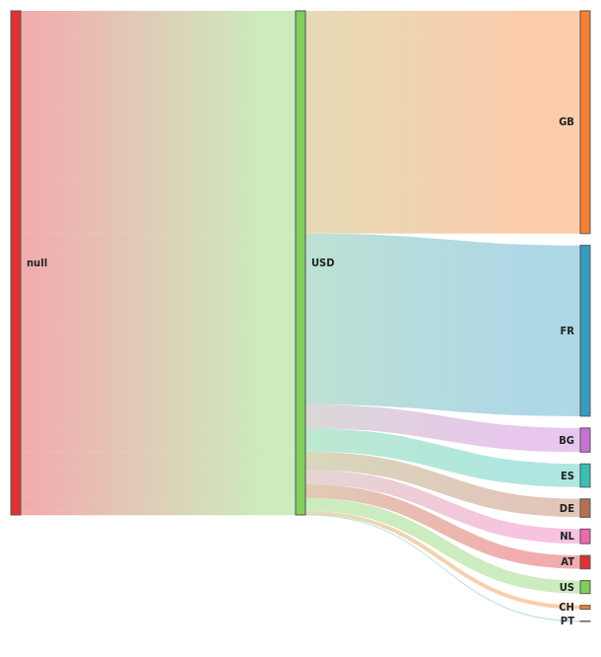
Payables Concentrations
© 2023 Taulia LLC. Confidential information. Do not distribute.

Slide 12
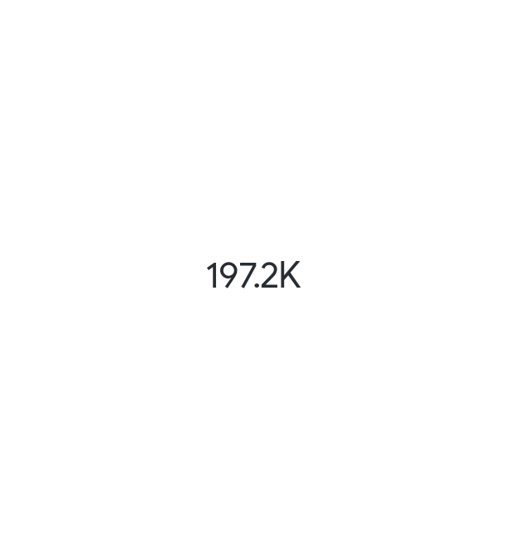
Estimated Payables
© 2023 Taulia LLC. Confidential information. Do not distribute.

Slide 13
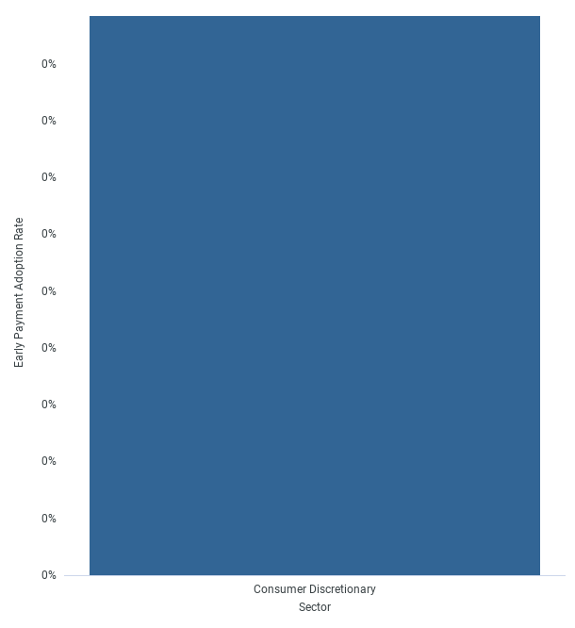
Early Payment Adoption by Sector
© 2023 Taulia LLC. Confidential information. Do not distribute.

Slide 14

Target Working Capital Impact
© 2023 Taulia LLC. Confidential information. Do not distribute.

Slide 15
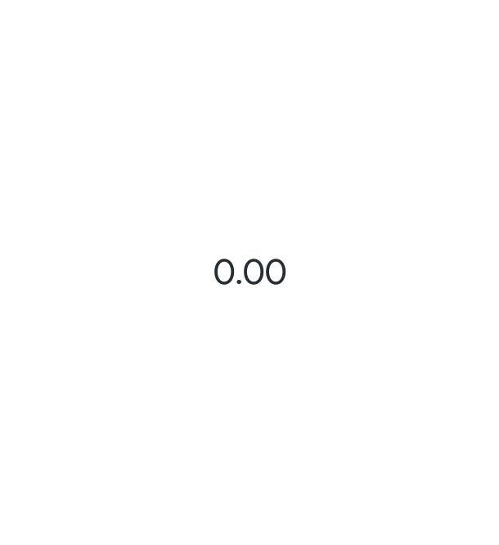
Cash from Other Funders
© 2023 Taulia LLC. Confidential information. Do not distribute.

Slide 16
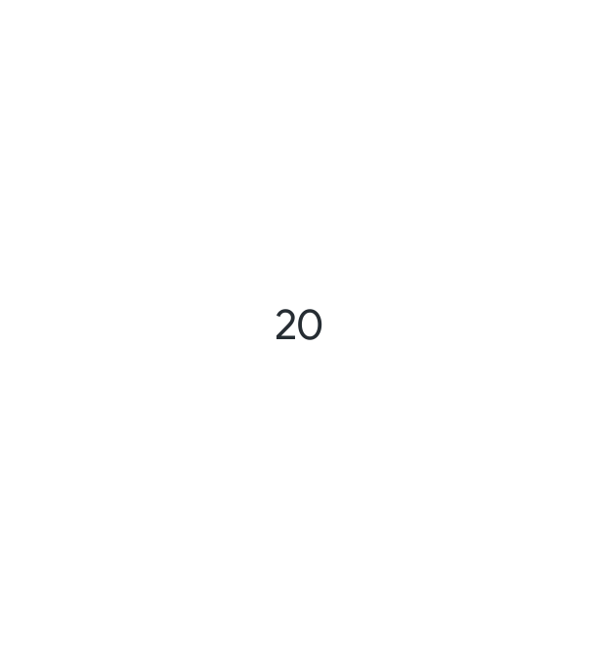
Current Average Terms
© 2023 Taulia LLC. Confidential information. Do not distribute.

Slide 17
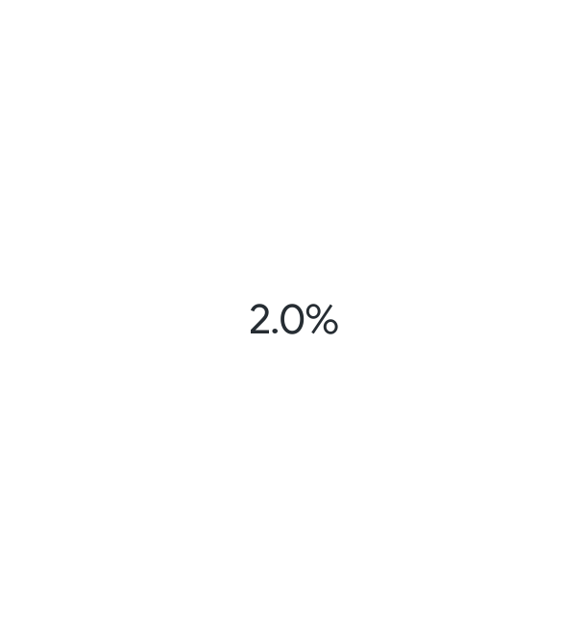
Total Early Payment Adoption
© 2023 Taulia LLC. Confidential information. Do not distribute.

Slide 18
Cash from Treasury
© 2023 Taulia LLC. Confidential information. Do not distribute.

Slide 19
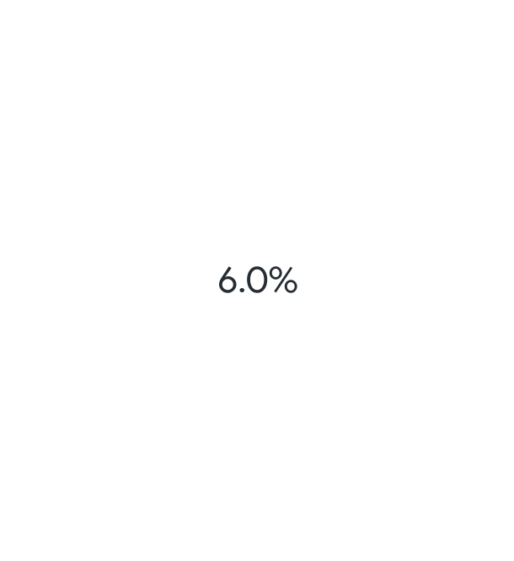
Avg Return on Capital
© 2023 Taulia LLC. Confidential information. Do not distribute.

