Slide 1





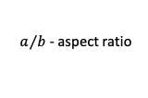

$$ε$$
$a/b$ - aspect ratio
$$b$$
Center of mass
$$B$$
$$M=\left(x_{M},y_{M}\right)$$
$$a$$
$$A$$

