Slide 1










known
neighborhood
$B_{ε}\left(p\right)$
known image
$$ε$$
boundary $δΩ$
$$p$$
$$N$$
$$∇I$$
$$q$$
$$p$$
region $Ω$ to be
inpainted
$$N$$
a)
b)

Slide 2








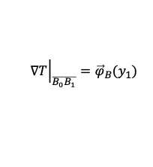
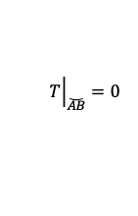

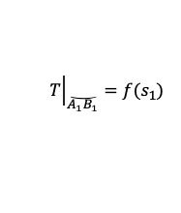

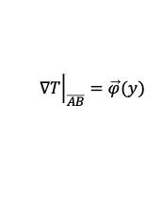



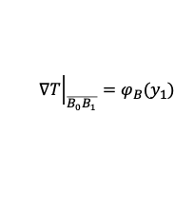
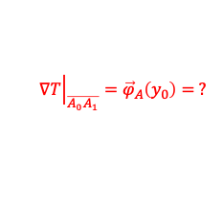




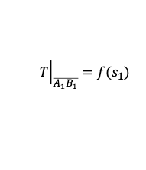

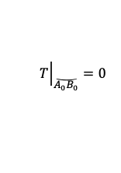



$${\left.T\right|}_{\overline{A_{1}B_{1}}}=f(s_{1})$$
$$Β$$
$${\left.T\right|}_{\breve{A_{1}B_{1}}}=f(s_{1})$$
$$β$$
$$β$$
$$Ω$$
$$Ω$$
$$Ω$$
$$s_{1}$$
$$B_{1}$$
$$B$$
$${\left.∇T\right|}_{\overline{B_{0}B_{1}}}=φ_{B}(y_{1})$$
$$A_{1}$$
$$T_{1}$$
$${\left.∇T\right|}_{\overline{B_{0}B_{1}}}={\vec{φ}}_{B}(y_{1})$$
$${\left.∇T\right|}_{\overline{A_{0}A_{1}}}={\vec{φ}}_{A}\left(y_{0}\right)= ?$$
$$T_{1}$$
$$y_{1}$$
$$T_{1}$$
$${\left.∇T\right|}_{\overline{AB}}=\vec{φ}(y)$$
$$y_{0}$$
$$A_{0}$$
$$B_{0}$$
$$s_{0}$$
$${\left.T\right|}_{\breve{A_{0}B_{0}}}=0$$
$${\left.T\right|}_{\breve{AB}}=0$$
$$A$$
$$y$$
$$s$$

Slide 3

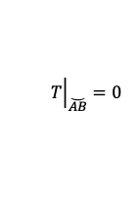








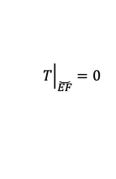



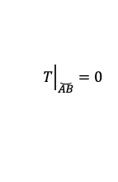
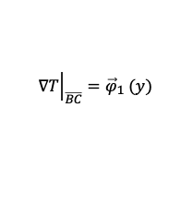


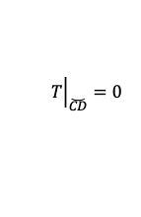

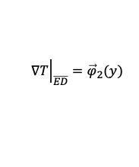
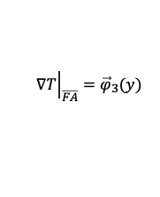


$${\left.T\right|}_{\breve{AB}}=0$$
$$β$$
$${\left.T\right|}_{\breve{CD}}=0$$
$$C$$
$${\left.∇T\right|}_{\overline{BC}}={\vec{φ}}_{1} (y)$$
$$D$$
$${\left.T\right|}_{\breve{AB}}=0$$
$$B$$
$$y_{1}$$
$${\left.∇T\right|}_{\overline{ED}}={\vec{φ}}_{2}(y)$$
$$s_{2}$$
$$T_{1}$$
$$Ω$$
$$T_{1}$$
$$β$$
$$E$$
$$s_{3}$$
$$Ω$$
$$y_{2}$$
$$T_{1}$$
$$s_{1}$$
$$A$$
$${\left.T\right|}_{\breve{EF}}=0$$
$$y_{3}$$
$${\left.∇T\right|}_{\overline{FA}}={\vec{φ}}_{3}(y)$$
$$F$$
river
islet
lake

