Slide 1



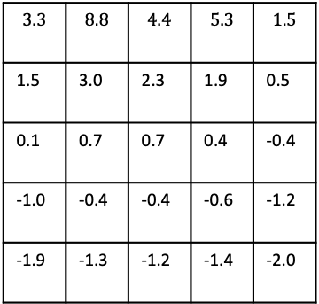




$$A$$
$$B$$
$$3.3$$ | $$8.8$$ | $$4.4$$ | $$5.3$$ | $$1.5$$
1.5 | 3.0 | 2.3 | 1.9 | 0.5
0.1 | 0.7 | 0.7 | 0.4 | -0.4
-1.0 | -0.4 | -0.4 | -0.6 | -1.2
-1.9 | -1.3 | -1.2 | -1.4 | -2.0
$$+5$$
$$+10$$
$$B^{′}$$
$$A^{′}$$
 | 1 | 2 | 3
4 | 5 | 6 | 7
8 | 9 | 10 | 11
12 | 13 | 14
$$R_{t}=−1$$
on all transitions
actions

Slide 2



























$$s$$
$$s,a$$
$$π$$
$$p$$
$$a$$
$$r,s′$$
$$p$$
$$π$$
$${r, s}^{′}$$
$$s′,a$$
$$q_{π}\left(s,a\right)$$
$$r,s$$
$$v_{π}\left(s\right)$$
$$s,a$$
$$r_{0},s$$
$$π\left(a|s\right)$$
$$π$$
$$r_{1},s_{1}^{′}$$
$$r_{2},s_{2}^{′}$$
$$r_{3},s_{3}^{′}$$
$$v_{π}\left(s′\right)$$
$$s,a_{1}$$
$$s,a_{2}$$
$$s,a_{3}$$
$$q_{π}\left(s,a\right)$$
$$s,a$$
$$p$$
$$r,s′$$

Slide 3









$$max$$
$$r_{0},s$$
$$max$$
$$s,a$$
$$max$$
$$p$$
$$a$$
$$p$$
$$r,s′$$
$$max$$
$$max$$
$$max$$
$$max$$
$${r, s}^{′}$$
$$s′,a′$$

