Slide 1

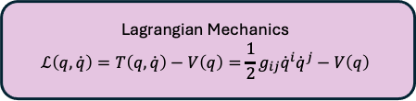
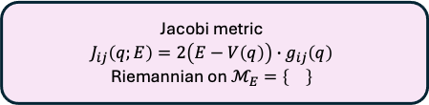
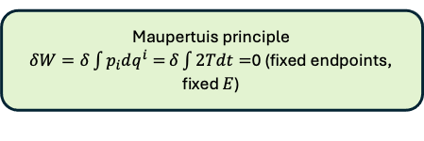
Lagrangian Mechanics
$$ℒ\left(q,\dot{q}\right)=T\left(q,\dot{q}\right)−V\left(q\right)=\frac{1}{2}g_{ij}{\dot{q}}^{i}{\dot{q}}^{j}−V\left(q\right)$$
Energy Conservation
$$T\left(q,\dot{q}\right)+V\left(q\right)=E$$
Accessible region: $V\left(q\right)<E$
Maupertuis principle
$δW=δ\int{p_{i}dq^{i}=}δ\int{2Tdt=}$0 (fixed endpoints, fixed $E$)
Jacobi metric
$$J_{ij}\left(q;E\right)=2\left(E−V\left(q\right)\right)∙g_{ij}\left(q\right)$$
Riemannian on $ℳ_{E}=\left\{\right\}$

