Slide 1
Ludo game
Dimitar Vikentiev
Monica Stoica
Rosen Danev

Slide 2
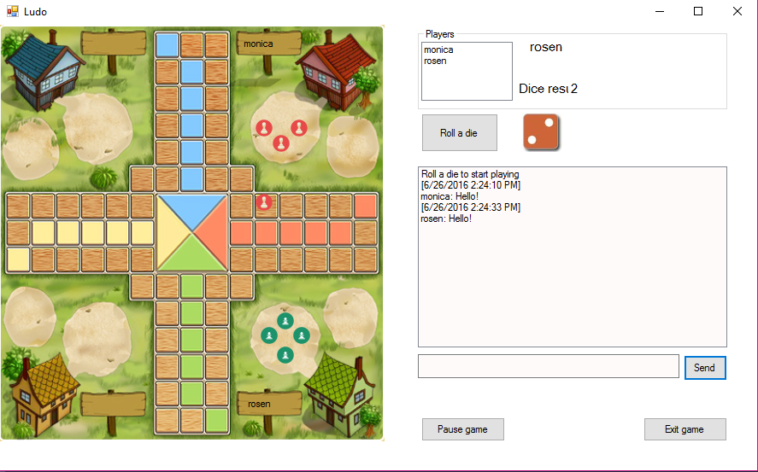
Ludo
Gameplay
Players
Dice
Winner

Slide 3
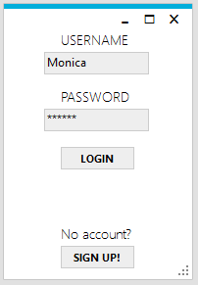
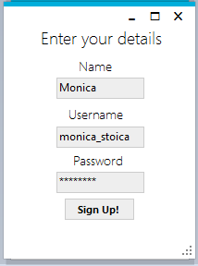
Features
Sign up
Log in
Start game
Chat

Slide 4
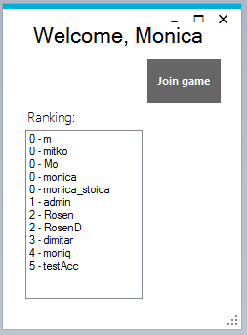
Not implemented features
Finish positions
Lobby
Invite players

Slide 5
Demo

