Slide 1



An IR System based on Economic News using Bert Embeddings
Search Engines and Web Mining
ITC-6008 Fall 2021
Instructor: Dr. Lazaros Polymenakos
Presented by:
Iris Kleopa | Michael Koinakis | Dimitra Kouvara
Notes:
With so much text outputted on digital platforms, the ability to automatically understand key topic trends can reveal tremendous insight.

Slide 2






Scenario
An application utilizing various NLP techniques
Economic and financial news
Classify a text based on its content
Web scraper
A database of retrieved documents
IR system was developed to provide quick access to the news through a GUI
Notes:
With so much text outputted on digital platforms, the ability to automatically understand key topic trends can reveal tremendous insight.

Slide 3
Main Phases
Future implementation
Evaluation
IR system
Text preprocessing
Storing to Database
Web scraping

Slide 4

IR System
Stores the information into a database
SQL
Websites
Queries
IR System
Web Scraping
User
BERT
EMBEDINGS

Slide 5
Part 1
WEB SCRAPING

Slide 6
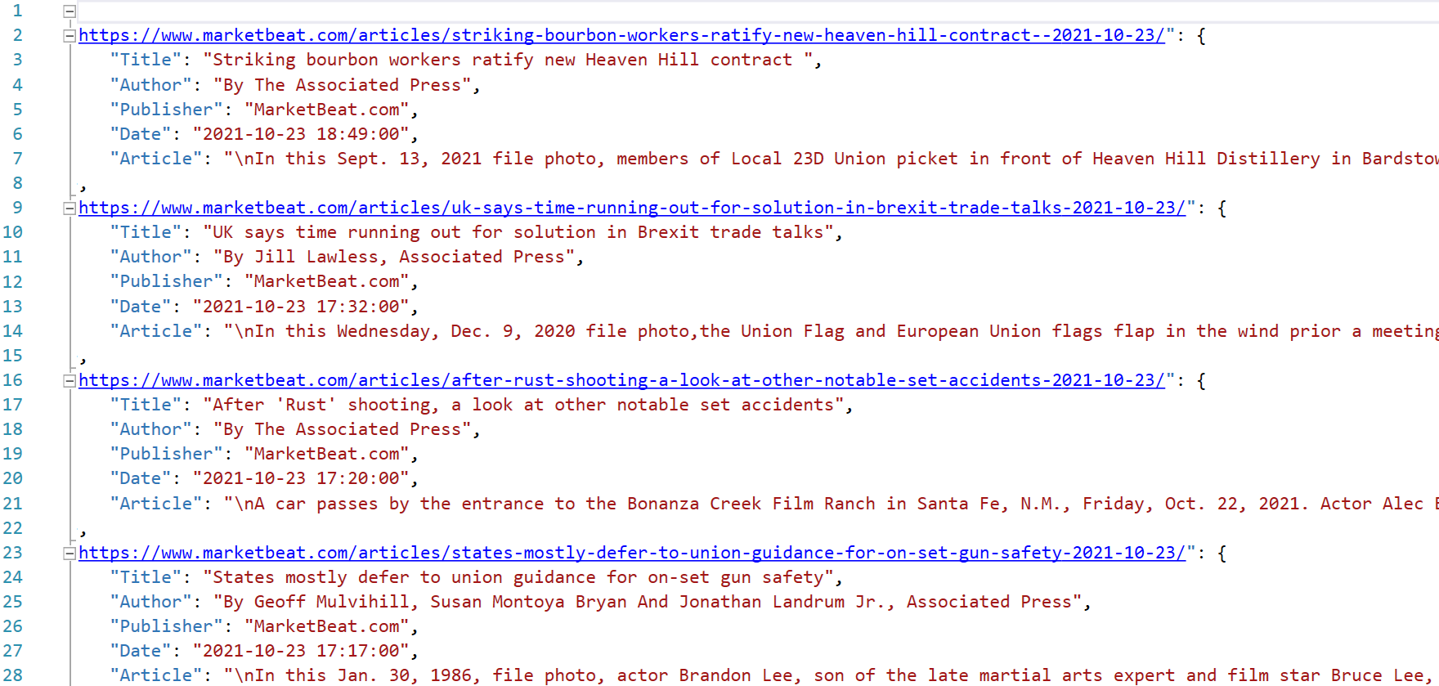
Web Scraping
Extract the content from two different websites of economic/finance news:
Market Beat & Economic Times
Inspect the website using developer tools
Retrieved document links with Beautiful Soup
Parse the links to get the Article, Title, Author, Date and Publisher
Difficulties
Websites block an IP when getting many requests
Infinite to drop down lists
Changing elements blocks in HTML structure

Slide 7

Data Preparation
Word embeddings
-> Transform articles to Bert embeddings
Create articles summary

Slide 8
Challenges
Limitations
Selecting the proper sources (paywalls/subscriptions)
Free accessing websites
Dealing with legal limitations
Infinite scroll down sites
A web driver API, from selenium module was used, to navigate the site to the moving refreshing point
Adding Proxies
Proxies being refreshed regularly
Spoofing user agents
Code delaying
Limiting the number of requests per some time
Articles remain online for a limited time (2-4 days)
User can view older posts only from the IR System

Slide 9
Part 2
Database Management

Slide 10
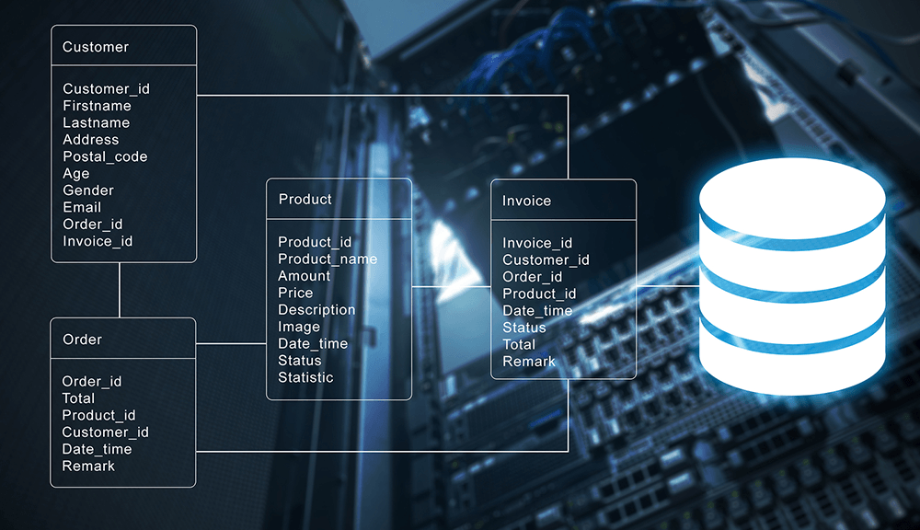
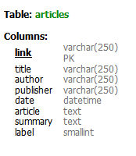
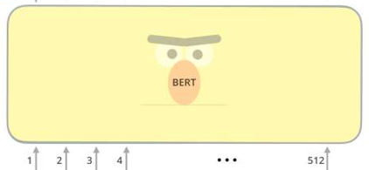
Database Management
SQL
Data
Embeddings
_________
JSON File
Retrieved Documents

Slide 11
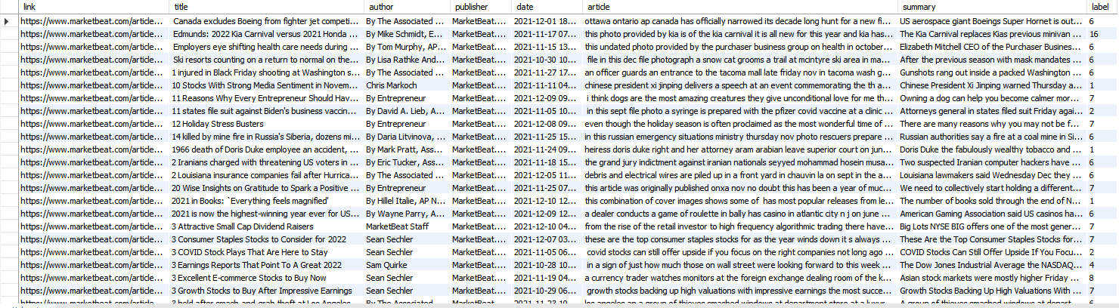
Storing the data
SQL

Slide 12

Database Maintenance
SQL
Rejecting duplicated documents
– setting the link’s article as Primary key
Removing near-duplicated documents
– applying/searching for similar documents
comparing Bert embeddings with cosine similarity
– applying threshold on documents’ similarity

Slide 13
Part 3
Model & Documents Cleaning

Slide 14
Choosing the language model
Bert ✓
Pre-trained on an absurd amount of data
Open source
Explicitly takes as input the position (index) of each word in the sentence before calculating its embedding
Accounts for a word’s context considering the semantics of words, returning different vectors for the same word depending on the words around it
Generates a vector representation for any arbitrary word and is not limited to the vocabulary space. (infinite vocabulary / provides support for out-of-vocabulary (OOV) words) (Gupta,2021)
Boolean Model X
Vector Space Model X
word2vec X

Slide 15







Choosing the language model
Boolean
Vector Space
Word2Vec
BERT
Open source
Ranking
Word Ordering
Context - dependency
OOV words
Pre-trained models

Slide 16

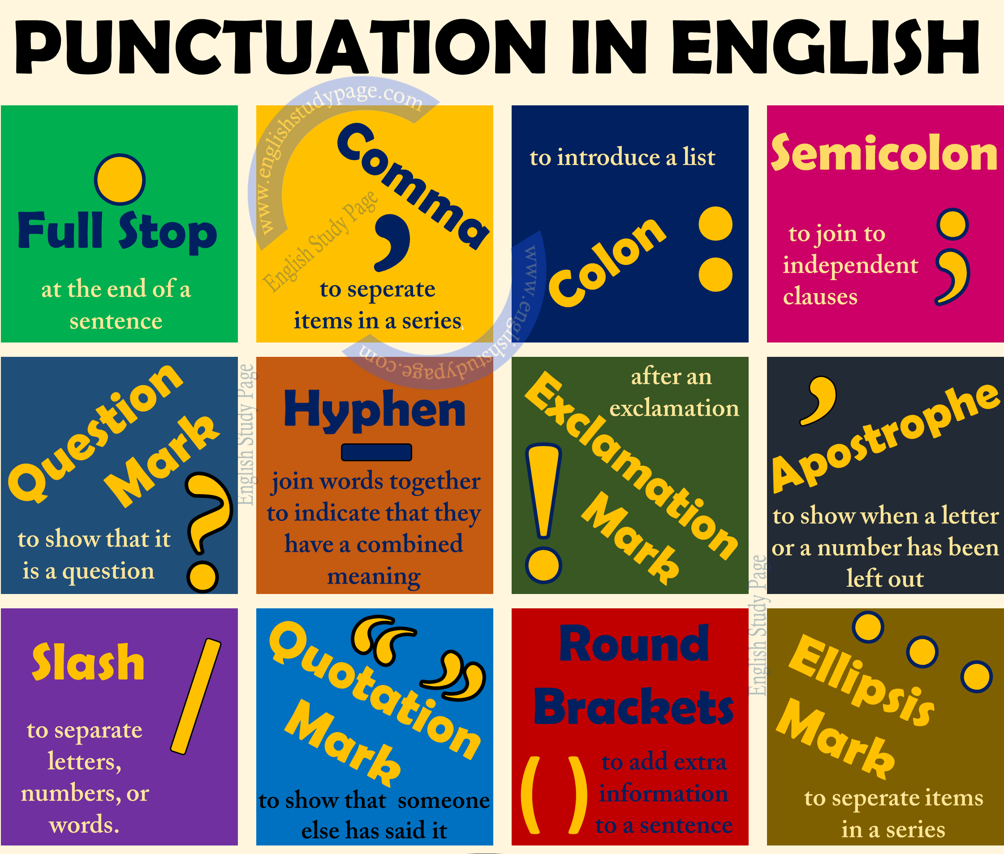
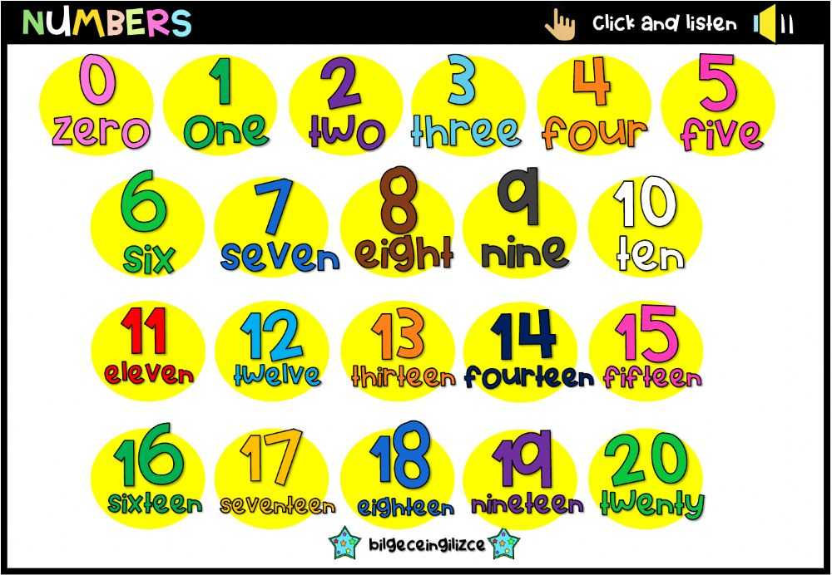
Text Preprocessing
Removing HTML tags
Removing punctuation
Expanding contractions
Lowercase
Removing numbers
Bert tokenizer

Slide 17
Part 4
Information Retrieval System

Slide 18
IR System Deployment
User Query
Transform
Retrieve embeddings from JSON file
Sent requests to database
Compare query
with articles
Return results sorted by cosine
User Results

Slide 19

Optimization
Context creation with clustering technique
Train article classifier
Predict the query context with the classifier
Find similar groups include them in the search

Slide 20
Evaluation
User’s observation
Samples of 1.000 random text from the database
Predicting query context: 7.8%
Predicting query context with similar retrieved groups: 55.1%
Precision: 0.549
Recall 0.0653
F1-score 0.093
Full article prediction:
100% accuracy

Slide 21

Creating the GUI
Python’s Library: Streamlit
Create the title
Render a logo
Create the search bar
Search Output
the link of the most similar articles along with a brief summary
Execute through Terminal
streamlit run gui.py

Slide 22
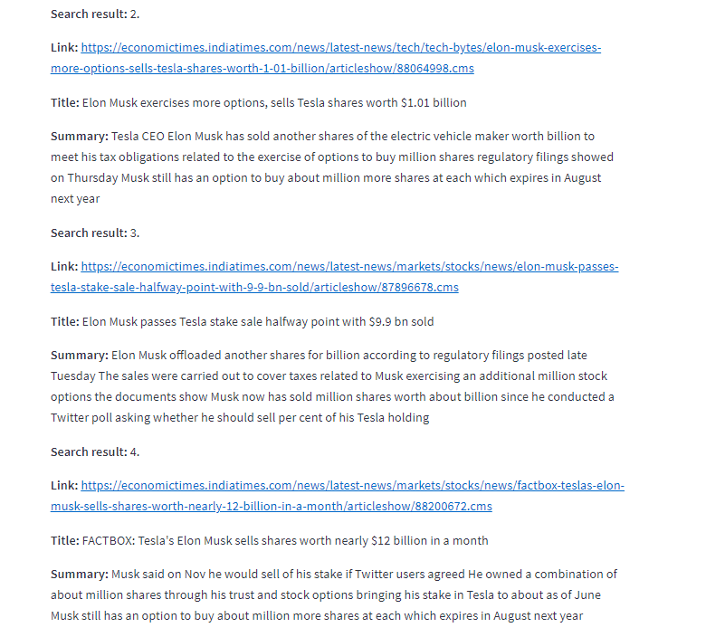
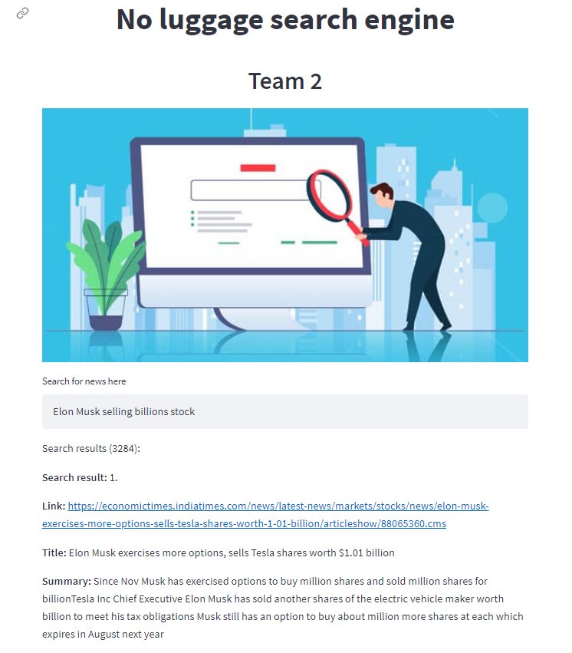
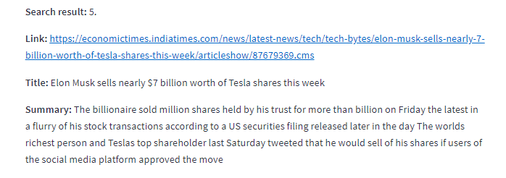
GUI Results

Slide 23
Future Implementation
4
3
Adding quotes
2
Improving search engine’s efficiency
1
Scraping more documents
Page Rank algorithm, App in iOS and Android
Running the IR system on server (automated)
5

Slide 24
Conclusions
Bert can be used in many NLP tasks but needs fine tunning
Need to consider trade off between precision and speed
Continuous updates to the database
Continuous updates to the models
Consider keeping repository of popular queries with results computing on the full extent of the database

Slide 25
References
Gupta, Lavanya. “Differences between word2vec and Bert.” Medium, The Startup, 7 Jan. 2021, https://medium.com/swlh/differences-between-word2vec-and-bert-c08a3326b5d1.
Scraped Websites:
ET. “Business News Today: Read Latest Business News, India Business News Live, Share Market & Economy News.” The Economic Times, 2021, https://economictimes.indiatimes.com/.
My Market Beat , “Stock Market News and Research Tools.” MarketBeat, 2021, https://www.marketbeat.com/.
Images References:
Buonocore, Tommaso. “Embeddings, Embeddings Everywhere!” Medium, Towards Data Science, 16 Dec. 2020, https://towardsdatascience.com/embeddings-embeddings-everywhere-5c1d292d73e3.
Day Trade The World, “Top Free Sources to Find Quality Financial News - DTTW™.” Day Trade The World™, 30 Mar. 2021, https://www.daytradetheworld.com/trading-blog/top-free-sources-to-find-quality-financial-news/.
“Futurama Fry - I Want Them All.” Memegenerator.net, https://memegenerator.net/instance/31211006/futurama-fry-i-want-them-all.

Slide 26
Thank you for your attention!

