Slide 1




Project Assignment: Melodica Business Intelligence Pipeline
Developed by:
Iliana Zacharopoulou
(Electrical & Computer Engineer, TUC)
Dimitra Stroubakou
(Informatics & Telecommunication, NKUA)
Anastasia Ntogramatzidou
(Tech Consultant @ EY)
Georgia Giannaki
(BSc Mathematics, NKUA)
Asimina Tzana
(MSc Data Science, UNIWA)

Slide 2
PRESENTATION OVERVIEW
Introduction
Implementation
OLTP to Data Warehouse
Integration Services
SSIS
Analysis Services
SSAS
Power Bi
Conclusion & Future Work

Slide 3
PRESENTATION OVERVIEW
Introduction
Implementation
OLTP to Data Warehouse
Integration Services
SSIS
Analysis Services
SSAS
Power Bi
Conclusion & Future Work

Slide 4

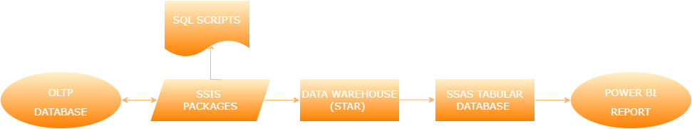
Melodica Media Corporation
Melodica Media Corp. is a multinational company headquartered in California
…operates the namesake Melodica online music store.
Project Scope
Creation of a business intelligence pipeline to analyze track sales
Support the company’s decision-making process.

Slide 5
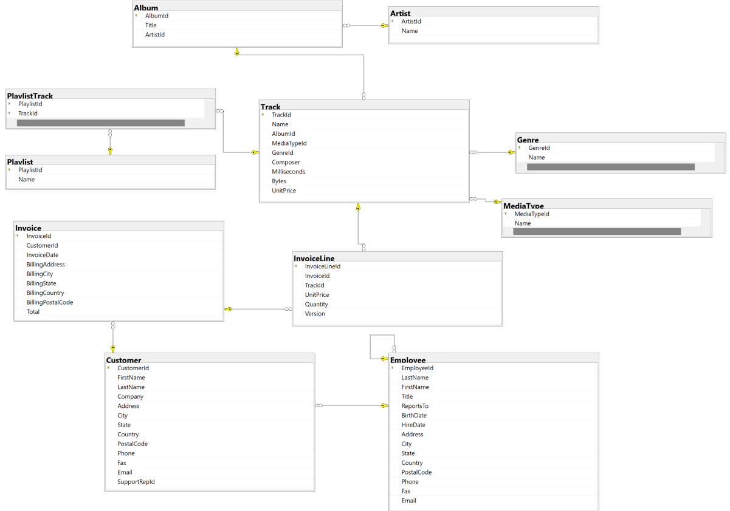
Chinook Database Schema
The database contains data about the songs sold by the Melodica company.
Each song (Track) has an Album and each album has an Artist
A sale is represented by an Invoice and each invoice can include multiples of the same/different track purchased.
Each Invoice is produced for a Customer, who is also assigned an Employee as a support representative.

Slide 6
PRESENTATION OVERVIEW
Introduction
Implementation
OLTP to Data Warehouse
Integration Services
SSIS
Analysis Services
SSAS
Power Bi
Conclusion & Future Work

Slide 7
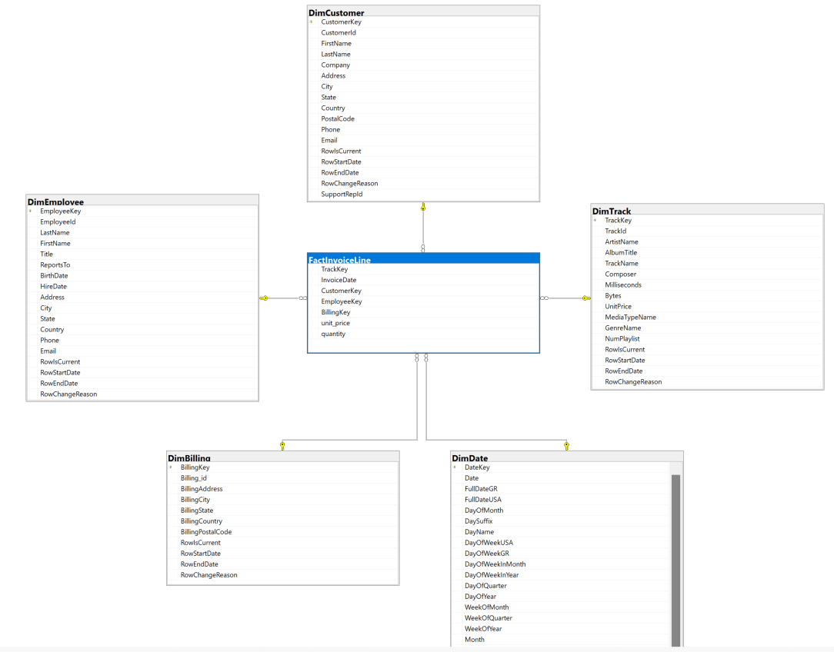
Data Warehouse (Star) Schema
Implemented ETL Tasks:
Retention of historical values for Customer’s table, using SCD type 2.
Incremental loading of new rows for the fact table.

Slide 8
PRESENTATION OVERVIEW
Introduction
Implementation
OLTP to Data Warehouse
Integration Services
SSIS
Analysis Services
SSAS
Power Bi
Conclusion & Future Work

Slide 9
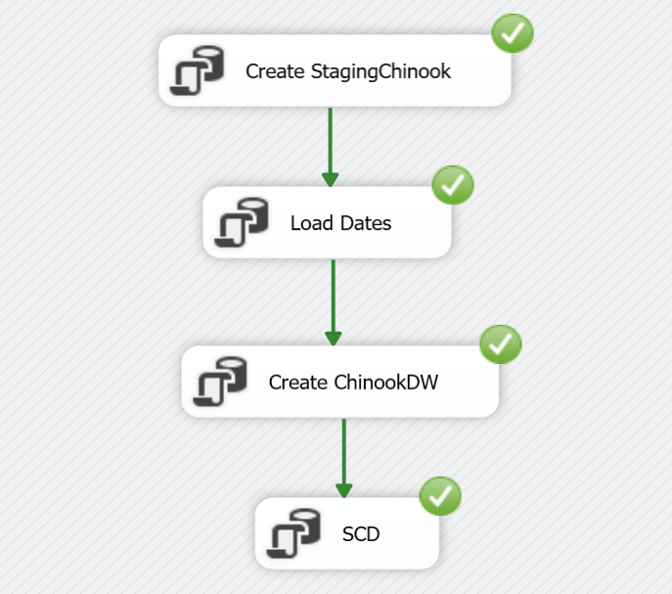
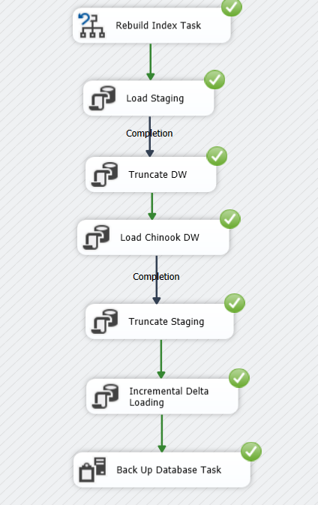
Integration Services (SSIS)
Concepts:
Implementation of Extract, Transform and Load (ETL) solution made on SQL Server
Creation of an automated package running monthly and loading new data

Slide 10
PRESENTATION OVERVIEW
Introduction
Implementation
OLTP to Data Warehouse
Integration Services
SSIS
Analysis Services
SSAS
Power Bi
Conclusion & Future Work

Slide 11
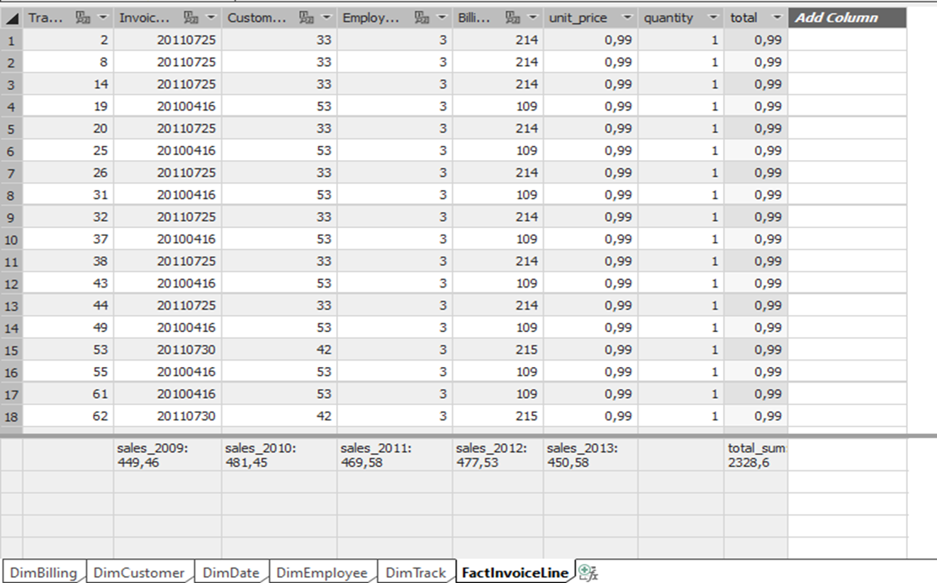
Analysis Services (SSAS)
Calculated Columns:
Total(quantity* unit_price)
Current ages of Employees
Age groups of Employees
Measures:
Sales per year (2009-2013)
Sum of bytes
Sum of milliseconds(converted to hours)
Sum of Tracks
Sum of Artists
Sum of Albums

Slide 12
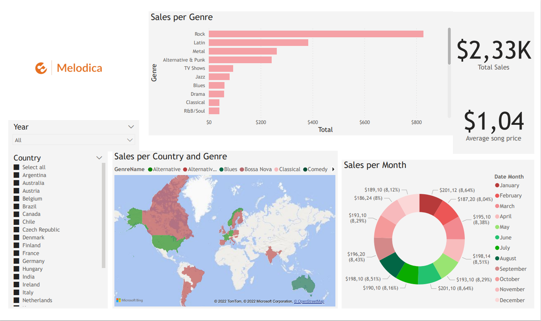
Power BI (I)

Slide 13
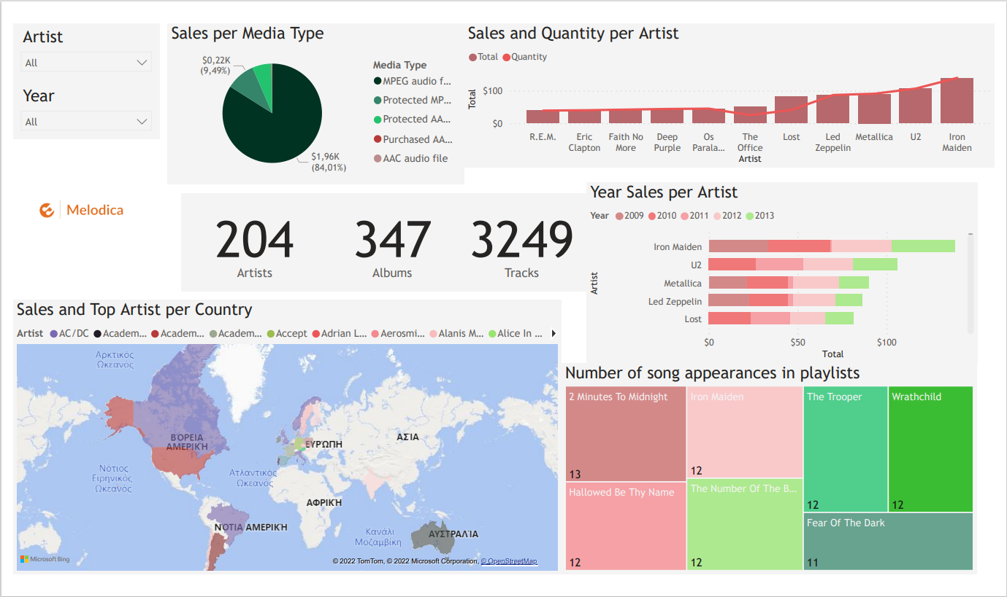
Power BI (II)

Slide 14
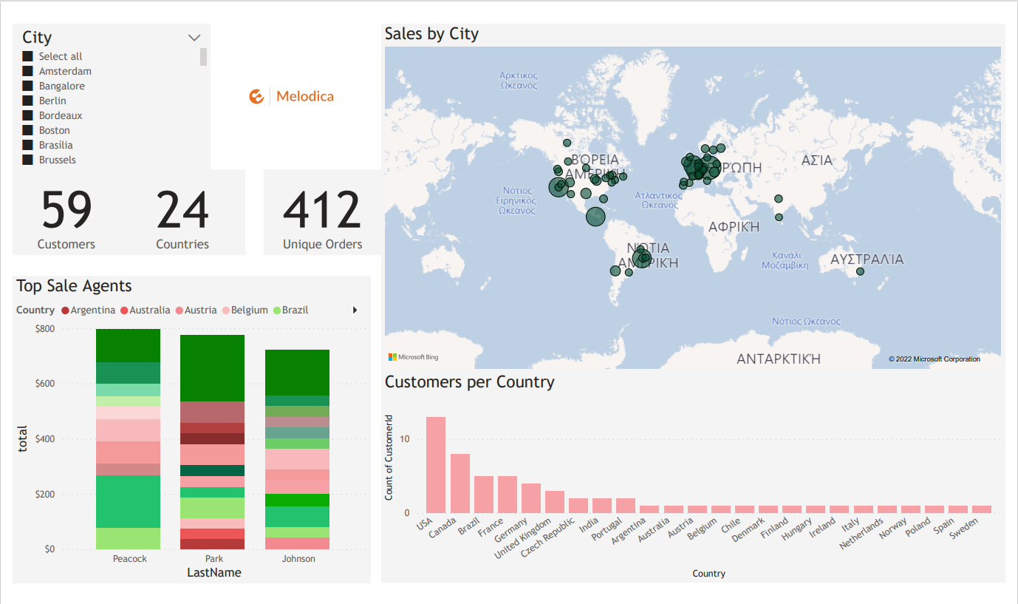
Power BI (III)

Slide 15
PRESENTATION OVERVIEW
Introduction
Implementation
OLTP to Data Warehouse
Integration Services
SSIS
Analysis Services
SSAS
Power Bi
Conclusion & Future Work

Slide 16
Conclusion & Future Work
Melodica Media corporation is capable of data driven decision making
Extra features such as Customers age group, gender and VAT.
More entries in the database.
Predictions based on our data using machine learning algorithms.

Slide 17
Thank you for your attention!

