Slide 1
Bounds on the Performance of P2P Networks Using Tit-for-Tat Strategies
Dimitri DeFigueiredo Balaji Venkatachalam
S. Felix Wu

Slide 2

Motivation
Content Distribution
A user wants to download a movie as
quickly as possible.
DVD New Releases:
Many users at the same time
Akamai? Can P2P help?

Slide 3
Outline
Motivation
Analysis Framework
Strategies
Comparison
Seed Capacity
Summary

Slide 4
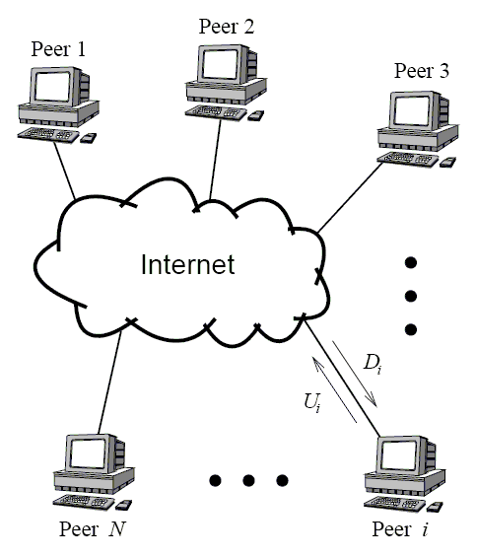
Topological Model
Real Network vs. Ideal Network
Upload capacity = willingness to contribute

Slide 5
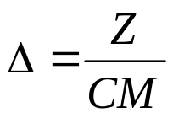
Analysis Framework
All peers want file at time t=0 (Flash Crowd)
N peers
M pieces
File of size Z bytes.
All peers have the same upload capacity U
For now:
seed capacity C = peer capacity U
upload capacity = download capacity
It takes seconds to upload a piece

Slide 6

Client/Server Model
Server connects to all clients.
How fast is it?
Workload: W = NZ

Slide 7
Analysis in 3 Axes
Efficiency, E[t]
Scalability, N
Workload, W (and C )
Fairness, I_{Abs}

Slide 8
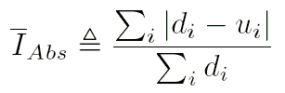
Fairness
Motivation:
  Absolute value needed to prevent cancellation
  Max instead of sum does not detect all unfairness
  (Always exclude seed from the sums)

Slide 9

Client/Server Fairness
Other notable points 0 and 2.

Slide 10
Fully Cooperative Strategy
Setting:
Previously agreed upon
All peers cooperate
N = 2^{k} peers
(Proposed by Yang and de Veciana ’04)

Slide 11
FC Strategy
Example…

Slide 12
2⁴ = 16 peers
5 pieces

Slide 13
t = 0⁺
t = Δ⁺

Slide 14
t = 2Δ⁺
t = Δ⁺

Slide 15
t = 3Δ⁺
t = 2Δ⁺

Slide 16
t = 4Δ⁺
t = 3Δ⁺

Slide 17
t = 5Δ⁺
t = 4Δ⁺

Slide 18
t = 6Δ⁺
t = 5Δ⁺

Slide 19
t = 7Δ⁺
t = 6Δ⁺

Slide 20
t = 7Δ⁺
t = 8Δ

Slide 21
FC Properties
All peers finish at the same time
Each peer connects to (log N) others.
Download = Upload
Pieces are completed in order
Very Fast!

Slide 22

FC Strategy
How fast is it?
Workload:
Fairness (see full version):
I_{Abs} → 0 as N → ∞

Slide 23
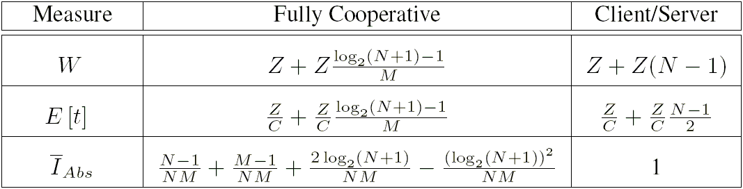
FC vs. Client/Server
Client/server Tit-for-Tat FC
Increasing cooperation

Slide 24
Tit-for-Tat Strategies
Direct Reciprocity (DR):
A uploads to B only if B uploads to A
Indirect Reciprocity (IR):
    A uploads to B only if somebody uploads to A
A
B
A
B
C

Slide 25

Tit-for-Tat Strategies
From previous definitions:
Peer stops uploading as soon as it is done
W ≥ max( N, M ) pieces
Fairness:

Slide 26
IR Strategy
Example…

Slide 27
IR Strategy
1
2
3
4
5
t = 0⁺
t = Δ⁺
Peers

Slide 28
IR Strategy
1
2
3
4
5
t = Δ⁺
t = 2Δ⁺
Peers

Slide 29
IR Strategy
1
2
3
4
5
t = 3Δ⁺
t = 2Δ⁺
Peers

Slide 30
IR Strategy
1
2
3
4
5
t = 4Δ⁺
t = 3Δ⁺
Peers

Slide 31
IR Strategy
1
2
3
4
5
t = 5Δ⁺
t = 4Δ⁺
Peers

Slide 32
IR Strategy
1
2
3
4
5
t = 6Δ⁺
t = 5Δ⁺
Peers

Slide 33
IR Strategy
1
2
3
4
5
t = 7Δ⁺
t = 6Δ⁺
Peers

Slide 34
IR Strategy
1
2
3
4
5
t = 7Δ⁺
t = 8Δ⁺
Peers

Slide 35
IR Strategy
1
2
3
4
5
t = 9Δ
t = 8Δ⁺
Peers

Slide 36

IR Strategy
How fast?
Fastest among TFT when:
N = infinite; or,
download capacity = upload capacity

Slide 37
Outline
Motivation
Analysis Framework
Strategies
Comparison
Seed Capacity
Summary

Slide 38
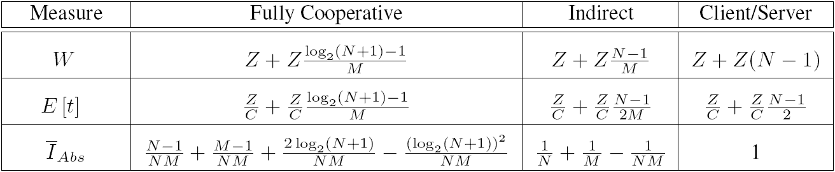
Strategy Comparison
In TFT, peers cooperate with ≤ M-1 others
In TFT, M is important!
    Increase in number of cooperating peers
    Gain of IR strategy over client/server
It does not hurt to increase M
O( log N )
O(N/M)
O(N)
O( log N )
O(N/M)
O(N)
→0
→0

Slide 39
Outline
Motivation
Analysis Framework
Strategies
Comparison
Seed Capacity
Summary

Slide 40
Seed Capacity
2 views: Throughput or Replication
s =
Previous TFT results hold for s = 1
Let us assume N > M
seed capacity
peer capacity

Slide 41
Increasing Seed Capacity
If s=1, use IR
If s=N/M ,use IR with Parallel Grouping
If s=N, we can obtain optimal strategy
Increasing s

Slide 42
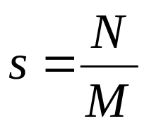
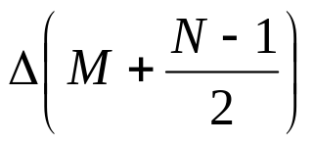
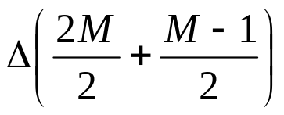
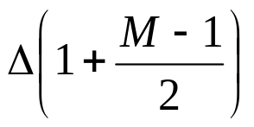
Seed Capacity Threshold
Strategy | IR | IR+Parallel Grouping | Optimal
Seed Capacity | s = 1 |  | s = N
E[t]
×N/M
×M
÷N/M
÷3
Rule of Thumb:

Slide 43
Summary
Analysis criteria: N, E[t], W, I_{Abs}
Client/Server: slow, high workload
Log increase in E[t] with N is best possible
M is important:
  Determines cooperation in TFT
  The larger M, the better for cooperation
Rule of thumb for seed in TFT: s=N/M

Slide 44
Questions ?
Thank You!
defigueiredo@ucdavis.edu
www.cs.ucdavis.edu/~defigued
(looking for a job!)

