Slide 1
TrustDavis: A Non-Exploitable Online Reputation System
Dimitri DeFigueiredo and Earl T. Barr
Dept. of Computer Science, University of California at Davis

Slide 2
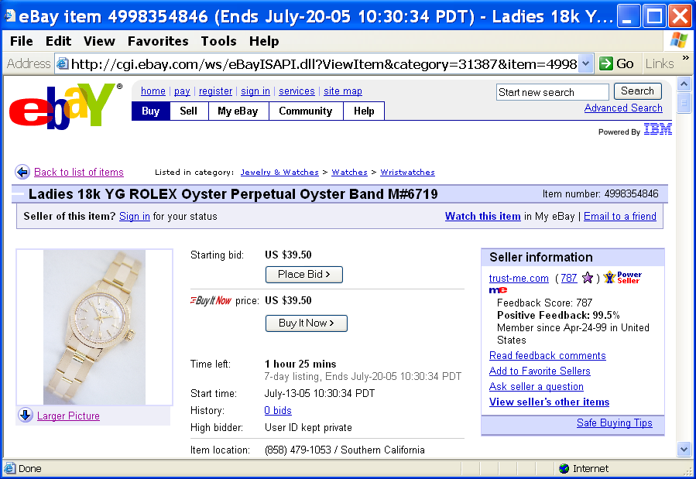
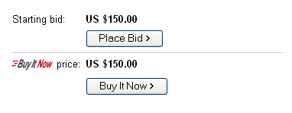

Motivation

Slide 3

Motivation
Should we buy?
How do we decide?

Slide 4
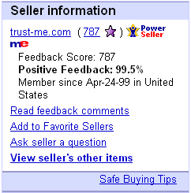
Motivation

Slide 5
Motivation
Should we buy?
How do we decide?
What we want:
  accurately estimate risk of default
  minimize the risk of default
  minimize losses due to pseudonym change
  avoid trusting a centralized authority
How do we achieve these goals?

Slide 6
Motivation
TrustDavis is a reputation system that realizes these goals.
It recasts these goals as the following properties:

Slide 7
Motivation
Agents can accurately estimate risk
  Third parties provide accurate ratings
Honest buyer/seller avoids risk (if possible)
  Insure transactions
No advantage in obtaining multiple identities
  Agents can cope with pseudonym change
No need to trust a centralized authority
  No centralized services needed

Slide 8
Motivation
Incentive Compatibility:
Each player should have incentives to perform the actions that enable the system to achieve a desired global outcome.

Slide 9
Motivation
Agents can accurately estimate risk
  Third parties provide accurate ratings
Honest buyer/seller avoids risk (if possible)
  Insure transactions
No advantage in obtaining multiple identities
  Agents can cope with pseudonym change
No need to trust a centralized authority
  No centralized services needed
Incentive Compatibility!

Slide 10
Motivation
A Reference is:
Acceptance of Limited Liability.
$100
C
A
B

Slide 11
Motivation
Agents can accurately estimate risk
  Third parties provide accurate ratings
  Parties are liable for the references they provide
Honest buyer/seller avoids risk (if possible)
  Insure transactions
  Buyers/sellers pay for references to insure their transactions
No advantage in obtaining multiple identities
  Agents can cope with pseudonym change
  References are issued only to trusted identities
No need to trust a centralized authority
  No centralized services needed
  Anyone can issue a reference
Use References!

Slide 12
Motivation
Related Work:
Z. Abrams et al. – Workshop P2P Econ 2004
S. Buchegger et al. – Workshop P2P Econ 2004
C. Dellarocas – Ideabook 2004
S. Lee et al. – IEEE Infocom 2003
S. Kamvar et al. – “EigenTrust” 2003
J. Golbeck et al. – Sematic Web 2003
T. Riggs et al. – ACM/IEEE-CS CDL 2001

Slide 13
Outline
Motivation
The Model
  Buying references
  Selling references
A Non-Exploitable Strategy
Future Work
Conclusion
  Key ideas

Slide 14
Outline
TrustDavis leverages social networks
For now, examples assume No False Claims (NFC)
The use of TrustDavis does NOT preclude trade outside the system.

Slide 15
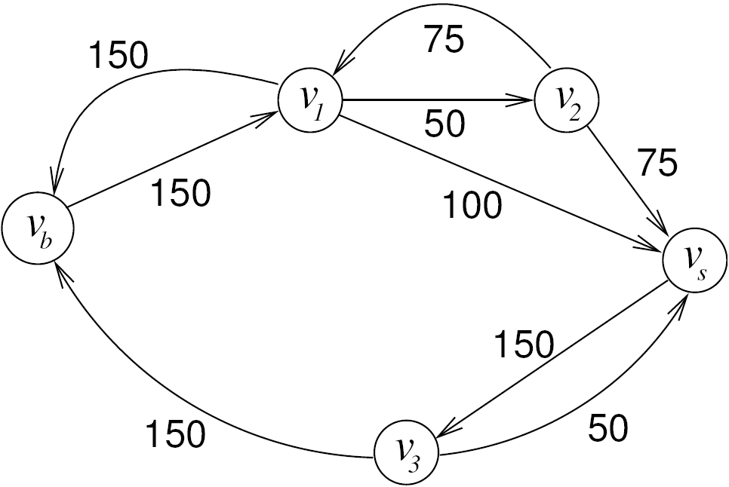

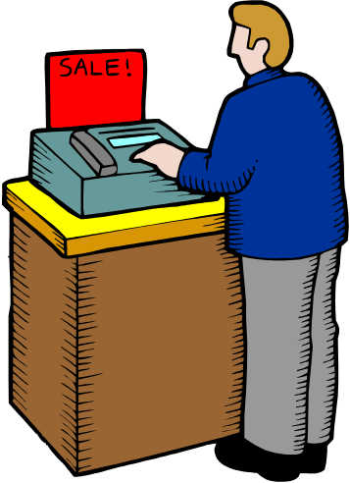
Paying for References
50
150
100
50
150

Slide 16
Outline
Motivation
The Model
  Buying references
  Selling references
A Non-Exploitable Strategy
Future Work
Conclusion
  Key ideas

Slide 17



Paying for References
How much is v_{b} willing to pay to insure the transaction?
(No riskless profitable arbitrage criterion)
Example:
v_{b} wants to buy three shirts.
Shirts cost $100 each from a trustworthy seller
Unknown seller offers shirts for $50 each (but maybe they are only worth $25).
v_{b} would risk 3 x $50 = $150 in the transaction
v_{b} can borrow and lend money at rate r=1.25 through the period of the transaction
For $30, v_{b} can insure herself!
$100 each
Trust-me.com
Blowout SALE!
$150!
$50 each!

Slide 18
Paying for References
To insure herself v_{b} buys the shirts and a hedging portfolio as follows:
  Instead of buying 3 shirts for $50 each
  she buys only 2, saving $50.
  The buyer, v_{b} , adds $30 of her own money and lends the resulting $80 at rate r = 1.25.

Slide 19
Paying for References
On Success:
  v_{b} obtains $100 from the loan and buys
  the 3rd shirt
On failure:
  v_{b} sells the two shirts for $25 each
  gets $100 from the loan.
  She obtains a total of $150
  Thus, v_{b} can insure herself for $30.

Slide 20
Outline
Motivation
The Model
  Buying references
  Selling references
A Non-Exploitable Strategy
Future Work
Conclusion
  Key ideas

Slide 21
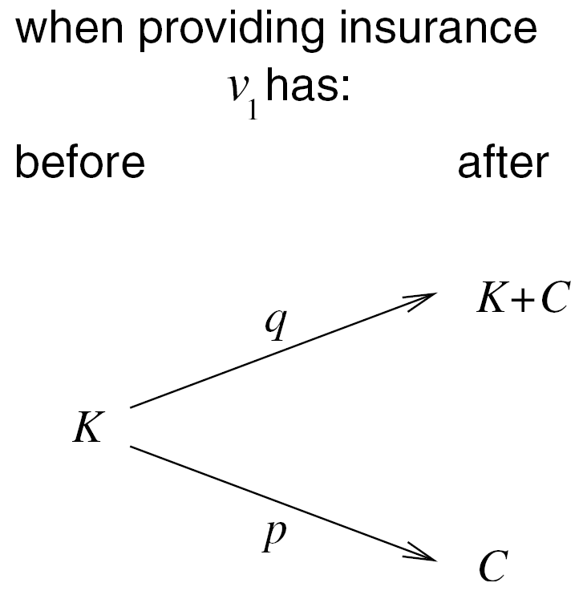
Selling References

Slide 22
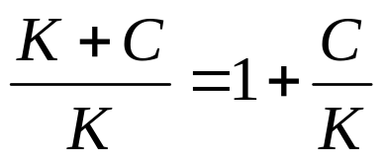

Selling References
Seen as an investment…
On Success the ROI is:
On failure the ROI is:
If repeated many times the insurer may go bankrupt. Assume the insurer has W dollars available to insure this transaction.

Slide 23
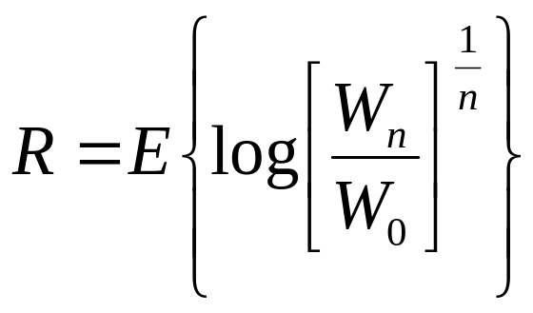
Selling References
Insurer maximizes the expected value of the growth rate of capital (Kelly Criterion).
For given:
  probability of failure p,
  a desired growth rate of capital R; and,
  fraction of the total funds W being risked in a transaction.
The insurer can obtain a lower bound on the premium C.

Slide 24
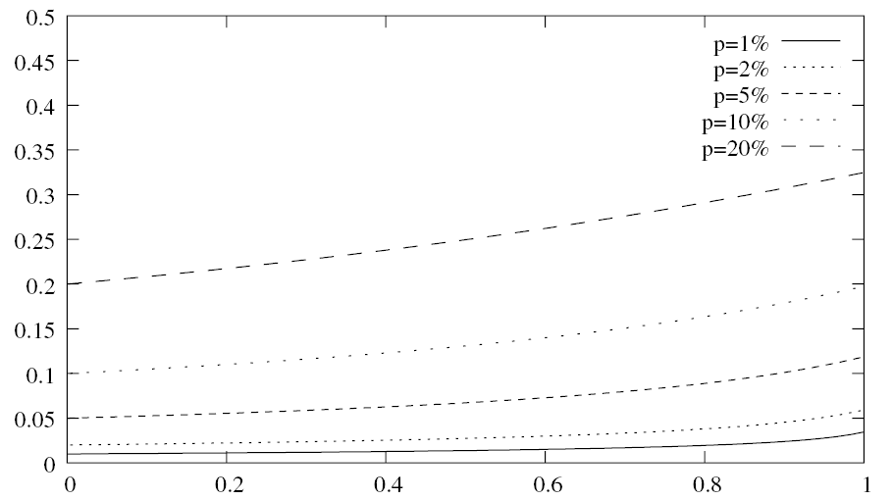
Selling References
Minimum Return/Risk Ration for Different Failure Probabilities
Cost/Insured Value – C/K
Insured Value as a fraction of total funds – f

Slide 25
Outline
Motivation
The Model
  Buying references
  Selling references
A Non-Exploitable Strategy
Future Work
Conclusion
  Key ideas

Slide 26
A Non-Exploitable Strategy
Two Scenarios:
No False Claims - NFC
With False Claims - FC
False claims only change the probability p.
We can incorporate the cost of verification.
Key Idea:
Save part of the money obtained in successful transactions in excess of the opportunity cost.

Slide 27
A Non-Exploitable Strategy
Example.
The buyer, v_{b}, has $190 to spend on 1 of 3 options:
Buying 3 shirts from an unknown seller for $50 each and insuring the transaction for $40. She values each shirt at $100.
Buying 2 pairs of shoes from a reliable retailer for $70 each. She thinks each pair is worth $90.
Buying 1 game console for $150, from a reliable online shop. She values the console at $240.

Slide 28
A Non-Exploitable Strategy
v_{b}’s valuation for each of the 3 options is:
Shirts: 100 x 3 + 0 (no cash leftover) = $300
Pairs of Shoes: 90 x 2 + 50 (cash) = $230
Console: 240 x 1 + 40 (cash) = $280
    Gains in excess of the opportunity cost are:
    300-280=$20.
    Part of these $20 should be saved to insure
    future transactions.

Slide 29
A Non-Exploitable Strategy
The Strategy:
Initially only provide references to known agents or those that leave a security deposit.
Insure all trade through references provided by trusted agents.
Do not provide more insurance than you can recover. Charge at least the lower bound for providing a reference.
Save part of the money received “in excess of the opportunity cost”.

Slide 30
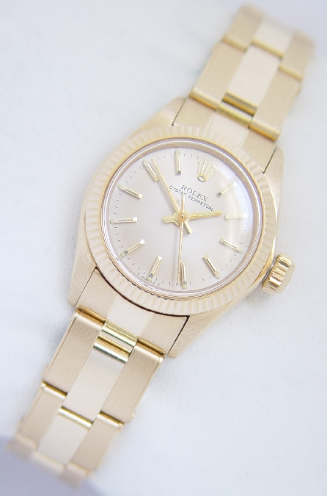
A Non-Exploitable Strategy
50
50
150
100
50
OK!
$10 saved to
provide future
insurance
Failed!
Payment made automatically by v₁
150
10

Slide 31
Outline
Motivation
The Model
  Buying references
  Selling references
A Non-Exploitable Strategy
Future Work
Conclusion
  Key ideas

Slide 32
Future Work
Simulation
  sensitivity to estimates of p
  growth rate of capital
  dynamic behavior
Price Negotiation
  should avoid “double spending” problem
  fair distribution among insurers of the premium paid

Slide 33
Outline
Motivation
The Model
  Buying references
  Selling references
A Non-Exploitable Strategy
Future Work
Conclusion
  Key ideas

Slide 34
Conclusion
TrustDavis provides:
Accurate Ratings
Non-exploitable strategy for honest agents
Pseudonym change tolerance
Decentralized infrastructure
Through the use of References.

Slide 35
Conclusion
Key Ideas:
Incentive Compatibility
  Incentive to accurately rate
  Incentive to insure
  No incentive to change pseudonym
Saving gains in excess of the opportunity cost to insure future transactions.

Slide 36
The End
Questions?
Thank you!
{defigueiredo,etbarr}@ucdavis.edu

