Slide 1
Beauty Is in the Eye of the Beholder
Dimitri DeFigueiredo Earl Barr S. (Felix) Wu
Adobe Systems Inc. UC Davis UC Davis

Slide 2
Overview
Motivation
Conceptual Properties
Formal Model
Theorems
Key Point

Slide 3
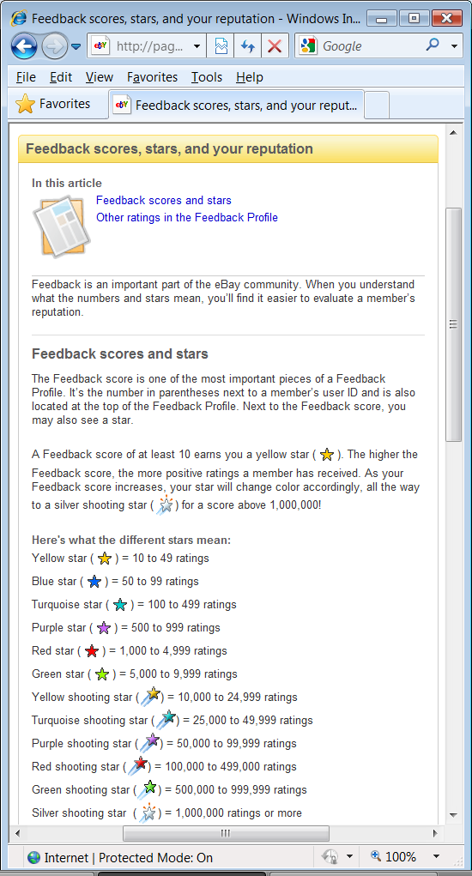
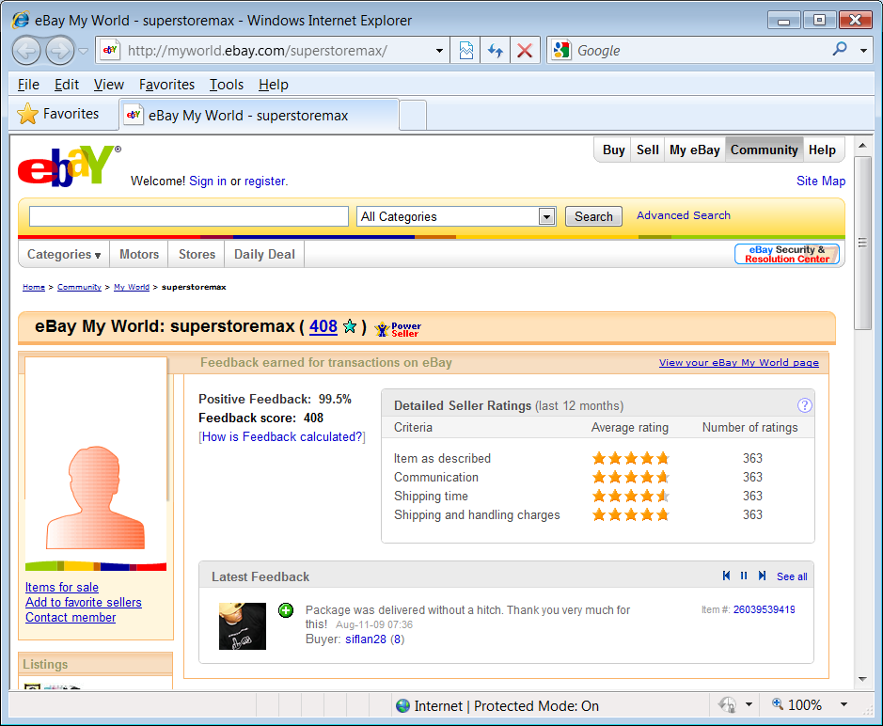
Can I trust him?
What is it?
What is it used for?

Slide 4
Trust
Trust is useful.
What is it?
What is it used for?
Ratings are not the same as trust. Why not?

Slide 5
How do we use Trust?
Trust helps us avoid risks that depend on others
We don’t take risks with people we do not trust
We are vulnerable to the actions of people we trust
Trust is under each person’s complete control
I trust you as much as I want
Notes:
Used car salesmen example, and “we are vulnerable to the people we trust” example.

Slide 6
Basic Properties
Two-role rule
Domain specific
Complete ordering
Higher is better

Slide 7
Trust Values
Definition: Trust values are real numbers.
Think in dollar$
“How much would you bet C will be on time for dinner?”

Slide 8
Reputation Graph
$100
From your experience, how much would you bet C is a good seller?
A
B
$50
$10
E
$30
$20
$60
D
$10
C
$100
Notes:
Used to determine trust – hook: how about second hand opinions?

Slide 9
World
G₀ G₁ G_{k}
A World is a sequence of reputation graphs
…
Notes:
Introduce domain of being a good cook.

Slide 10
Reputation Function
World Trust Graph
f
…

Slide 11
Trust Graph
A
B
50
10
20
D
C
Notes:
Make the point we are labeling each edge not each vertex

Slide 12
Trust Graph
A
?
B
50
10
?
20
?
?
?
?
?
?
D
?
C
Notes:
eBay scenario where user may at any point visit another seller motivates need for Trust graph to be complete

Slide 13
Trust Threshold
Trusted
or
Untrusted?
h_{A}=30
h_{C}=9
A
B
50
10
20
D
C

Slide 14
How can we make Trust transitive?
A
B
50
10
20
D
C
Notes:
If B knows A’s utility for $20, B STILL doesn’t know how much to trust C. He needs to convert A’s utility into his own utility.

Slide 15
Trust - Definition
Trust is the personal threshold determined by the trusting party that describes the maximum utility the trusting party is willing to risk when dealing with the trusted party.
Notes:
Point out that: trust != trust threshold. In fact, trust = max(trust threshold)

Slide 16
Normalized Reputation Function
For any world W
For any permutation of vertices π
World Trust Graph
…
f

Slide 17
Why normalize?
A
N.Y.T.
20
F
trusted
Why?
B
D
2000
E
C

Slide 18
Why normalize?
A
N.Y.T.
20
F
trusted
B
D
2000
E
C
Notes:
Find a way to explain the chicken and egg problem

Slide 19
Types of Reputation Function
Trivial
A
B
A
B
A
B
D
C
D
C
D
C

Slide 20
Types of Reputation Function
Trivial
Consensus-based
A
30
B
= 30
A
B
30
30
D
C
D
C

Slide 21
Types of Reputation Function
Trivial
Consensus-based
Personalized
A
50
B
A
B
30
40
D
C
D
C

Slide 22
A Collusion
A
B
50
10
20
D
C

Slide 23
An Untrusted Collusion
h_{A}=30
50
A
B
50
10
20
10
D
C

Slide 24
A Manipulated World
A
B
50
f
10
W
20
h_{A}=30
W
W
10
Manipulated W
D
C
A
B
A
B
f
?
?
?
D
C
D
C

Slide 25
Non-exploitability
For any trust threshold h a vertex chooses, no untrusted collusion can fool it.
Manipulated W
A
B
A
B
f
?
?
?
D
C
D
C

Slide 26
Theorems
Impossibility
All non-exploitable consensus-based reputation functions are trivial
Possibility
There are non-trivial non-exploitable personalized reputation functions

Slide 27
Impossibility Proof Sketch
h_{A} = 100
B=50
A
50
10
20
What if h_{C} = 30 ?!
10
D=10
C=20

Slide 28
Possibility Proof Sketch
Constructive proof
For a reputation threshold λ=0.5
Define:
λ=0.5
B
0.7
0.6
1
1
A
1
C

Slide 29
Possibility Proof Sketch
Non-trivial
λ=0.5
B
0
0.7
0.6
1
1
A
1
C

Slide 30
Possibility Proof Sketch
Non-exploitable
For any trust threshold h set by any trusting party:
untrusted node is not reachable
unreachable node node cannot make other nodes reachable or unreachable
B
1
1
A
1
C

Slide 31
Key Point
Trust is a personal value.
Rating systems should allow different people to have different points of view

Slide 32
Questions? Thank you!
Full version
http://www.cs.ucdavis.edu/~defigued/

