Slide 1

Electronic Structure of Mn Ions in GaAs and (Ga,MnAs)
V.F. Sapega^{1,2}
1
2

Slide 2
Outline
Motivation
Introduction
Electronic structure of Mn acceptor in GaAs
Raman study of Mn acceptor states in bulk GaAs
Strain effect on Mn acceptor state in bulk GaAs
Confinement effect on Mn acceptor state in GaAs:Mn/AlAs QW
States of Mn double donor in LT-GaAs
Conclusions

Slide 3
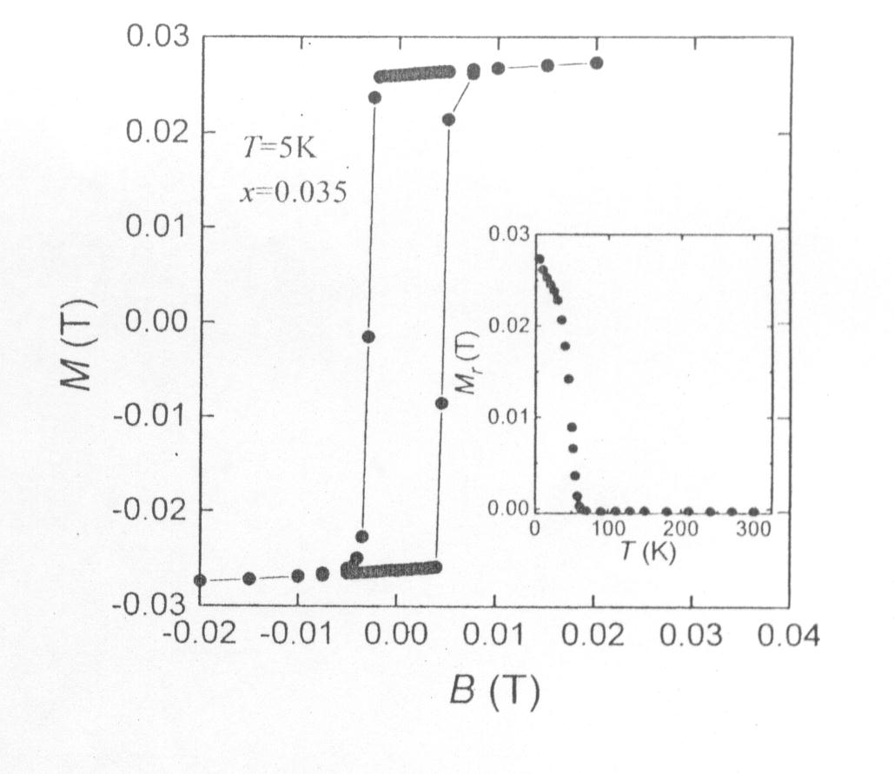
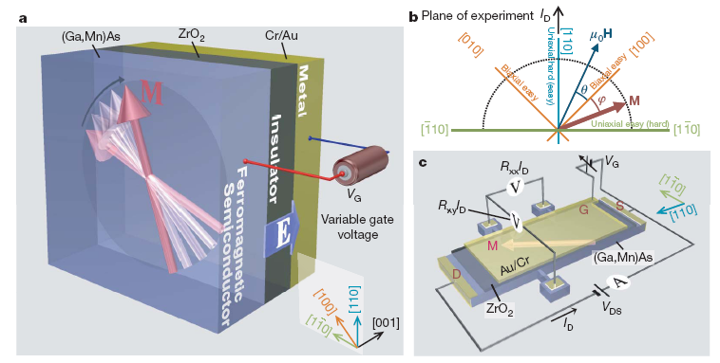
Ferromagnetism in (Ga,Mn)As and its applications
Ferromagnetism in
(Ga,Mn)As DMS
Magnetization vector manipulation
by electric fields
D. Chiba et al., Nature Lett. (2008)
H. Ohno et al., APL, 69, 363 (1996)

Slide 4
Models of the Mn acceptor in GaAs
GaAs:Mn_{Ga}
Mn 3d⁵4s²
E_{A}=113 meV
i. hole enters the 3d⁵ shell, resulting in 3d⁴ configuration
magnetic susceptibility (1983)
Faraday-rotation (1985)
ii. 3d⁵ shell + weakly bound hole
Hot PL (1982)
EPR (1987)
Piezo-spectroscopy (1978, 1984)
Infrared Spectroscopy (1997)
Raman scattering (2000)

Slide 5
Antiferromagnetic exchange in 3d⁵ +h Mn acceptor
ρ_{c}(B) →0.5, B→∞
I.Ya. Karlik, et al., Sov. Phys. Solid State, 1982

Slide 6
Mn acceptor electronic structure
N.S. Averkiev et al., Sov. Phys. Semicond. 1987
N.S. Averkiev et al., Sov. Phys. Solid State 1988
2Δ_{dh} = 10 meV
δ<1meV
g₁*=7/4g_{e}-3/4g_{h}=2.74
g₂*=11/12g_{e}+1/12g_{h}=1.94
ρ_{c}(∞) =0.504
2Δ_{dh}= 3 meV - K. Lassmann and Hp. Schad, Solid State Comm. 1976
2Δ_{dh} = 2.5 meV - Th.Frey et al, J.Phys.C: Solid State Phys. 1988
2Δ_{dh} = 9-12 meV - M. Linnarsson et al Phys. Rev. B 1997
g=2.77 – J.Schneider, et al., PRL 1987

Slide 7
Electronic Raman study of Mn acceptor state
V.F. Sapega, T. Ruf, M. Cardona, SSC 2000, and PSS(b) 2001.

Slide 8
Spin flip Raman study of Mn acceptor state
V.F. Sapega, T. Ruf, M. Cardona, SSC 2000, and PSS(b) 2001.

Slide 9

Strain effect on Mn acceptor state
P||[111]
N.S. Averkiev, et al, Soviet Phys. Semiconductors, 1987

Slide 10
Strain effect on Mn acceptor state
P||[111]

Slide 11
Strain effect on Mn acceptor polarization
P
B
Compressive strain applied perpendicular to magnetic field reduces
Mn acceptor polarization in a magnetic field.
V.F. Sapega, et al., SSC 2013
Notes:
cheam

Slide 12
The effect of confinement on Mn acceptor state
R1 MBE bulk GaAs:Mn
D1 MBE GaAs:Mn/AlAs (10/3)nm
D2 MBE GaAs:Mn/AlAs (12.5/3)nm
V.F. Sapega, et al., PRB 2007.

Slide 13
The effect of QW confinement on Mn acceptor state
QW confinement effect:
Random fields effect:

Slide 14
Mn acceptor states in GaMnAs DMS
x~5x10⁻⁵
LT-(Ga,Mn)As
Single Mn acceptors exist even in heavily
doped (x<1-2%) (Ga,Mn)As DMS.
V.F. Sapega, et al., PRB 2002

Slide 15
Double Mn donor in LT GaAs:Mn

Slide 16
Double Mn donor in LT GaAs:Mn

Slide 17
Double Mn donor in LT GaAs:Mn

Slide 18
Double Mn donor polarization in a magnetic field
Faraday geometry
T=4K
positively doubly charged Mn interstitials in GaAs act as double donors:
For He like atom:
Mn double donor:
N.S. Averkiev, A.V. Rodina, Sov. Phys. Solid State 1993

Slide 19
Conclusions
Electronic structure of Mn acceptor in GaAs is studied by means of hot PL, electronic and spin-flip Raman scattering
The effect of confinement and uniaxial stress and magnetic field on Mn acceptor state is studied.
The exchange, deformationail energy and g factor of the Mn acceptor state are detemined
The states of Mn double donnor are observed in PL and their binding energies are measured.

Slide 20
Acknowledgements:
N.S. Averkiev, Ioffe Inst., SPb
M. Cardona, MPI, Stuttgart
T. Ruf, MPI, Stuttgart
K.H. Ploog, PDI, Berlin
I.V. Kraynov, Ioffe Inst., SPb
G.V. Dimitriev, Ioffe Inst., SPb
N.I. Sablinas, Ioffe Inst., SPb
I.E. Panaiotti, Ioffe Inst., SPb

Slide 21
Thank you for your attention

Slide 22
Strain and magnetic field effect on Mn acceptor state
P
B

