Slide 1






Star Pizzas
Save the Galaxy with Pizzas!

Slide 2


Yet Another Collision Game…
…with a Fresh Take from the Oven!
Capitan Slice’s Mission
get:
avoid:
move:
fire: f

Slide 3
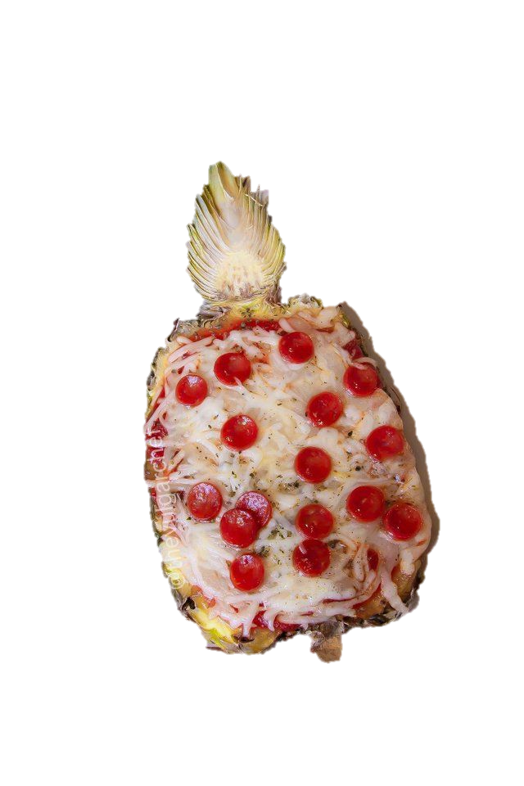
If you LOSE
Don’t get desperate.
Try Again.
YOU can Make It!

Slide 4
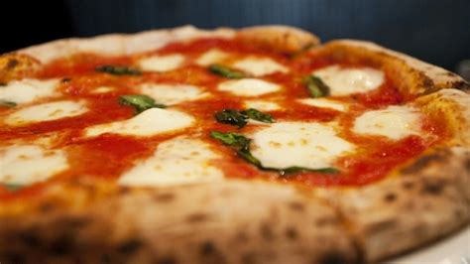
If you WIN
YOU Made It!

