Slide 1
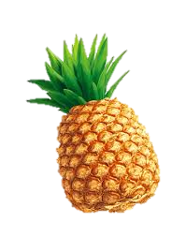





Star Pizzas
Save the Galaxy with Pizzas!

Slide 2
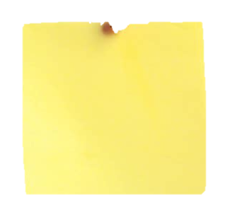

Yet Another Collision Game…
…with a Fresh Take from the Oven!
Capitan Slice’s Mission
get:
avoid:
move:
fire: f

Slide 3
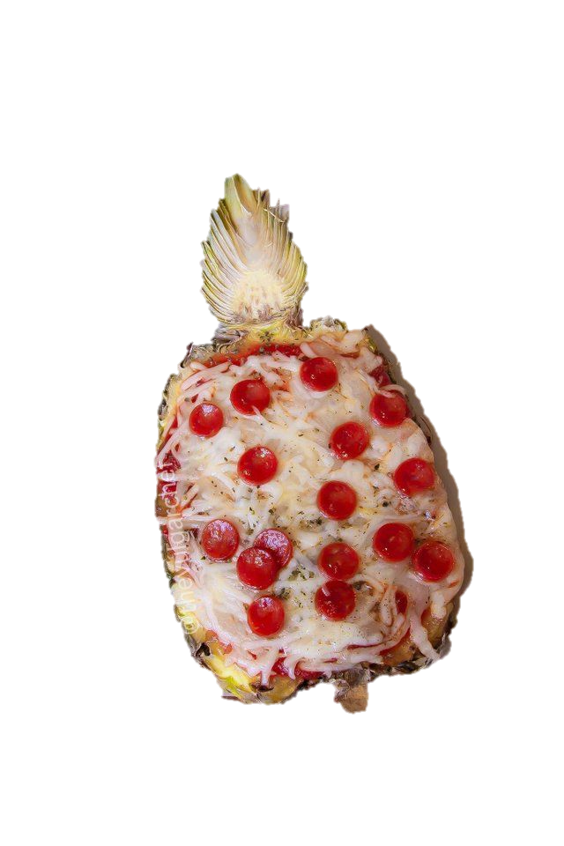
If you LOSE
Don’t get desperate.
Try Again.
YOU can Make It!

Slide 4
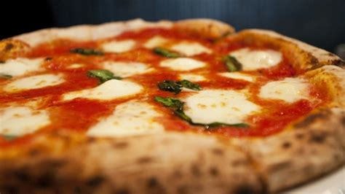
If you WIN
YOU Made It!

Slide 5
Features
Player can move in a 2D environment
Toy-physics with acceleration and inertia
Player can shoot
Gain points by hitting a class of “goodies”
Lose lives by hitting the “baddies”, aka pineapples

Slide 6
Code
5 classes: Game, Player, Goodies, Baddies & Bullets
Game class manages:
1 – collision check (player, NPC, bullets)
2 – objects life cycle (creation, deletion)
2 – user events
3 – game loop
4 – game over status

Slide 7
Future Features
Add more recipes / themes
Add animations
Add PizzaBase with tricky landing mini-game
Complete game refactoring

Slide 8
Starting From Scratch
More time spent
on designing the classes / OOP
More time spent on understanding how to acquire,
modify and manage the AV assets

